Slide 1


Digital Electoral Rolls
Supervisor: Prof. Subodh Sharma
Presented by:
Anjali Sharma Hardeep Kaur
2019CS50422 2019CS10354

Slide 2
Contents
Introduction
Transaction Flow
Design
Thoughts on Improvement

Slide 3
Introduction
Electoral roll of a region/constituency is a list released by the election commission which includes the names of all the registered voters who have the right to vote for specific elections of a region.
Electoral Roll is essentially a public document
Electronic electoral rolls are increasingly being adopted

Slide 4
Transaction Flow
Main transactions - Access, Insert , Delete, Update, Object.
Each request by user is sent to Regulator to verify and is recorded in metadata
All valid requests are forwarded to AOs having respective access.
ECI rules – consent and notify for deletion to respective voter and political parties
Regulator is assumed to be trusted authority(ECI).

Slide 5

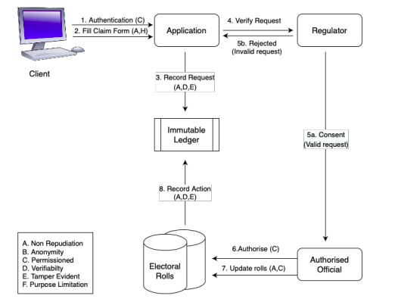

Transaction Flow [Insert/Update]
User fills the request forms to be validated by Regulator.
Each request by user is stored in metadata and forwarded to AO for update in ER DB

Slide 6
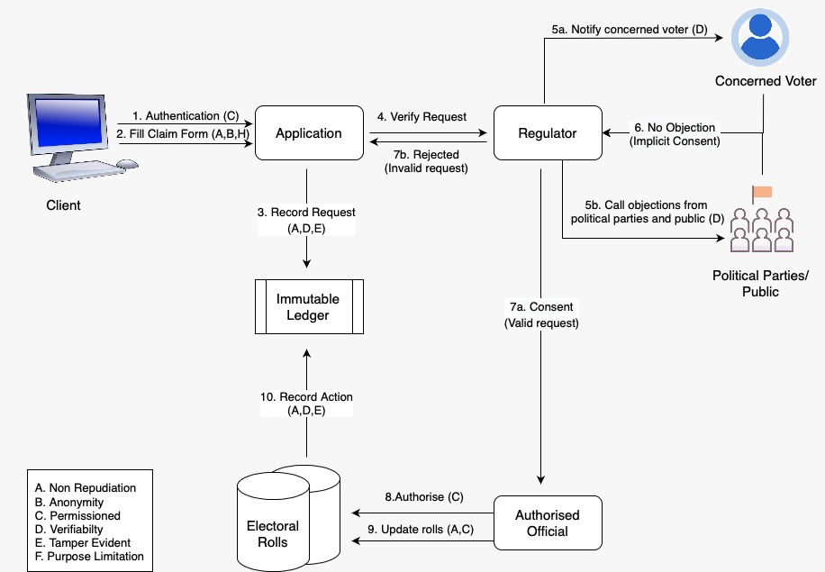

Slide 7
Design
Append only database
Hash Pointers
Merkle Trees
Access Control
Digital Signatures
Immutable Digital Ledger

Slide 8
Append only database
Implemented using a linked list of blocks for each voter
Head of the list contains the current data about the elector
Rest of the chain constitutes the history of that voter
Any existing block of data can't be modified or deleted
Updates/ deletions are made by inserting a new block to chain

Slide 9
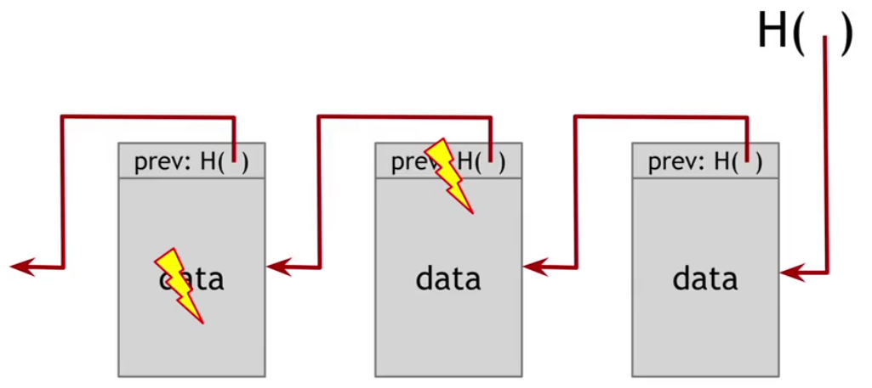
Tamper Evidence using Hash Pointers
Hash of data is stored in each block
Hash of previous block is also stored
Tamper trial could be detected by re-computing hashes

Slide 10
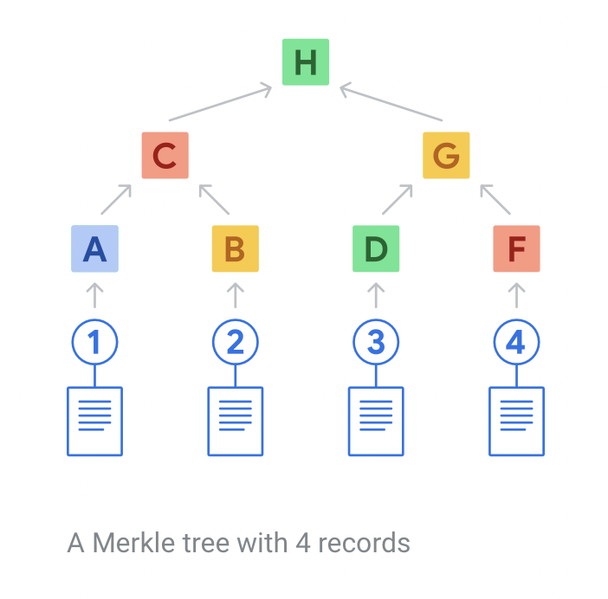
Merkle Trees
Complete binary tree of hash values
Leaves contain hashes of data records
Non leaf nodes contain hash of concatenation
Query membership and consistency
Search: O(1)
Inclusion and Consistency Proof: O(log(n))

Slide 11
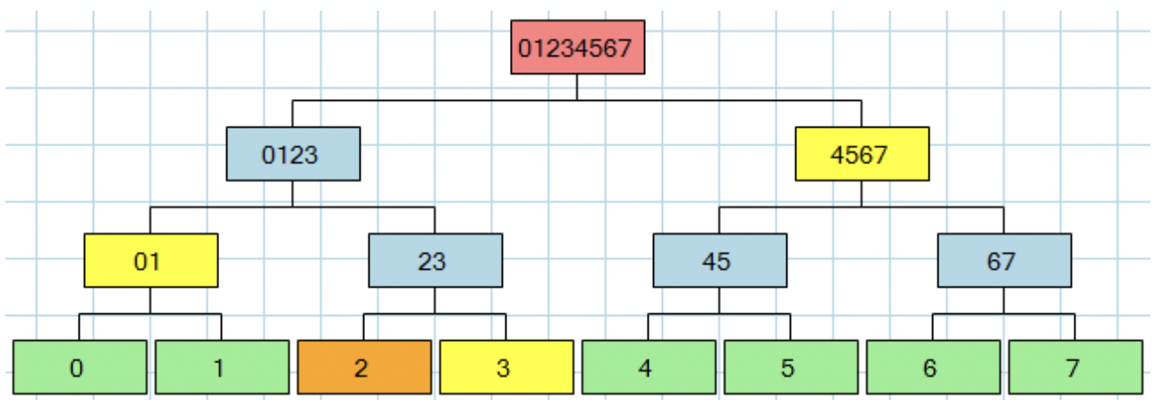
Merkle Trees: Inclusion Proof

Slide 12
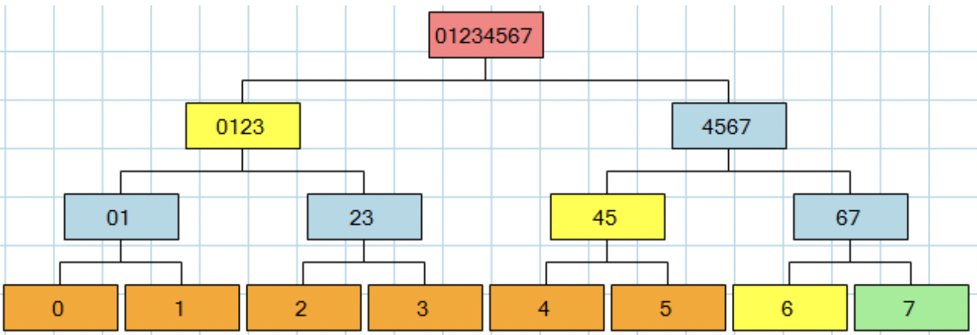
Merkle Trees: Consistency Proof

Slide 13
Access Control
Information provided on a need-to-know basis
Provide minimal personal data for inspection
Only Authorised Officials can insert/update/delete data
Only for voters assigned to them

Slide 14
Digital Signatures
Used RSA public key algorithm to generate keys
AO encrypts hash of data using his private key
Signed hash is stored in block
Decrypt the hash using public key
Decrypted value same as hash of data =>
integrity + authentication

Slide 15
Thoughts on Improvement
The proposed design doesn't guarantee safety from insider attacks (i.e. by regulating authorities ), which we have assumed to be trusted
Electors Registration Rules should be amended to aim at restricting the unfettered access to the electoral database
Incorporating ways to include 3rd party researchers

Slide 16


Thank You !

Slide 17
Structure Of Data Block
EPIC ID
Voter Data Personal Details (name, age, gender) Constituency Details
Hash of previous block Hash of all the data listed above Pointer to previous block Block Status Metadata Digital Signature of Writer

