Slide 1
SmartFleet AI
Supply Chain Disruption Assistant & Fleet Utilisation Optimizer
IBM BoB AI Innovation Hackathon 2026

Slide 2
Problem
Supply-chain disruptions can cause delivery delays.
Vehicle breakdowns and route problems require fast decisions.
Some vehicles can remain underutilised while urgent deliveries wait.
Manual fleet allocation can be slow and difficult to monitor.

Slide 3
Proposed Solution
SmartFleet AI is a logistics decision-support prototype.
Monitors fleet utilisation and vehicle availability.
Identifies deliveries on disrupted routes.
Recommends suitable vehicle reassignment.
Provides a natural-language AI assistant for logistics questions.

Slide 4
How It Works
Fleet Data + Delivery Data + Disruption Data
↓ Analyse utilisation, capacity and disruption context
↓ Identify affected deliveries
↓ Find suitable available vehicles
↓ Generate an explainable recommendation

Slide 5
AI Features
Vehicle utilisation analysis
Disruption impact analysis
Vehicle reassignment recommendation
Explainable recommendation reasons
Natural-language logistics assistant

Slide 6
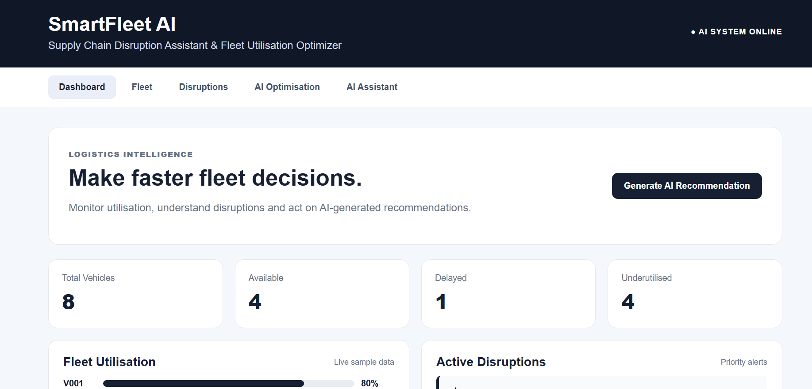
Application — Dashboard

Slide 7
Example Scenario
Ahmedabad-Surat route has a high-severity road disruption.
The system identifies deliveries that may be affected.
It checks available vehicles, remaining capacity and utilisation.
It recommends a suitable vehicle and explains the reason.
The manager can review the recommendation before taking action.

Slide 8
Benefits
Faster disruption response
Better fleet visibility
Improved vehicle utilisation
Reduced manual analysis
Clear and explainable decision support

Slide 9
Future Scope
Live GPS integration
Real-time traffic and weather data
Demand forecasting
Predictive maintenance
Advanced route and cost optimisation
Enterprise transport-system integration

Slide 10
Thank You
SmartFleet AI
Questions?

