Slide 1
Torque Script Array Implementation
By: Hardik Bhatt
Mentor: George Grevera, Ph.D.

Slide 2
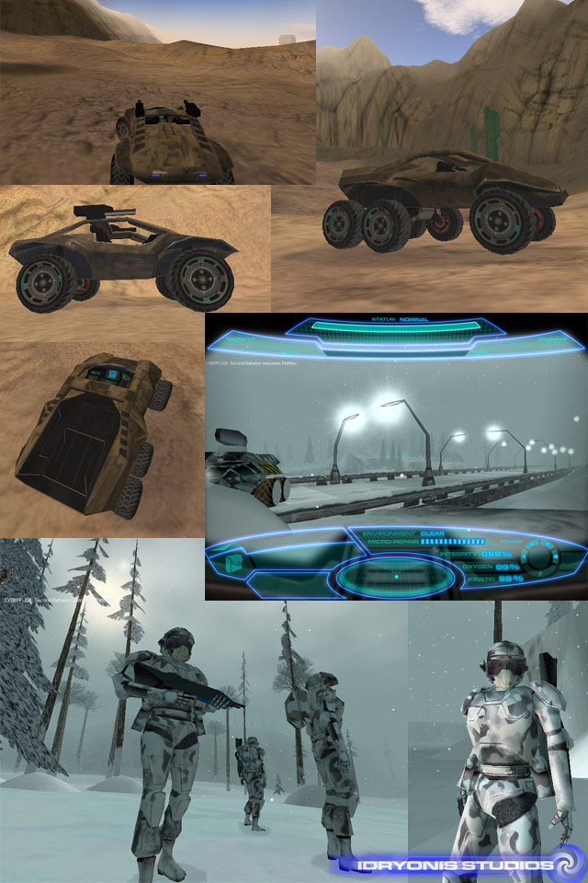
Introduction
Torque is a freely available, 3D game engine from garagegames.com.
Torque Script is a scripting language for the game engine

Slide 3
Problem
Torque Script does not fully support arrays.
My project is to add array support to Torque Script.

Slide 4
Overview
Torque Script in general
  Comments, literals, variables
  Operators, keywords
  While, for, if, switch
  Functions
  Arrays*
  Assignment

Slide 5
Features of Torque Script
Typeless
  Declarations not needed
Case-insensitive identifiers
  The function runHelloWorld is the same as RuNhElLoWoRlD.
Statement termination (via ;)
Full complement of constructs
Functions
Provides inheritance and polymorphism
Provides namespaces
Provides on-demand loading and unloading
Compiles and executes PCODE
Full complement of operators

Slide 6
Variables in Torque Script
Variables
  Not declared
  Not case-sensitive for identifiers
  Global vars begin with $ (scope prefix)
    Accessible in all blocks
  Local vars begin with % (scope prefix)
    Only accessible within defining block
  Naming:
    [$,%][a-z,A-Z,_][a-z,A-Z,0-9,_]*

Slide 7
Arrays in Torque Script
$aFoo[n] (1d)
$aBar[n,m] (2d or more)
$aBar[n,m,o,p] (also 2d or more)
Note: $a and $a[0] are separate and distinct variables!
Note: $aMyarray0 and $aMyarray[0] are the same!
Note: arrays are not (easily) passed to functions!

Slide 8
Passing arrays in Torque Script
How can we pass arrays to functions?
  Use global variables.
    But we still aren’t really passing them to functions.
Introducing the ScriptObject
  It may contain anything. It’s like the garbage can or kitchen sink of objects!
  %wrapper = new ScriptObject();
  %wrapper.fred = 12;
  %wrapper.ethel = “hello”;
  So how can we use this for an array?

Slide 9
The magic of ScriptObjects
function h ( ) {
%wrapper = new ScriptObject();
for (%i=0; %i<10; %i++) {
%wrapper.contents[%i] = 2 * %i;
}
%wrapper.count = %i;
return %wrapper;
}
Bounds checking is nonexistent.

Slide 10
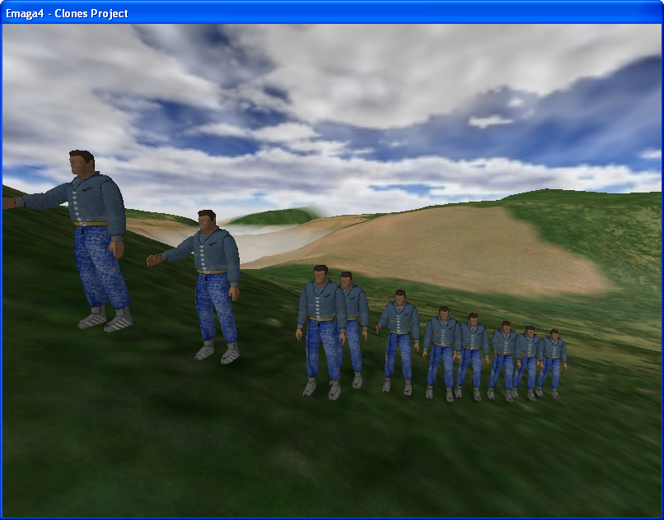
Using Globule's

Slide 11
The strain of using Globules
%count = 5;
for(%i = 10; %i > 0; %i--)
{
$clones[%i] = %this.createClone( (%i - %count) SPC (%i + %count) SPC "220 1 0 0 0" );
}
How it looks on a symbol table.

Slide 12
Our solution
Add new classes for:
  1D int array and float array
  2D int array and float array
  3D int array and float array
  Easily extended to other types and higher dimensions.

Slide 13
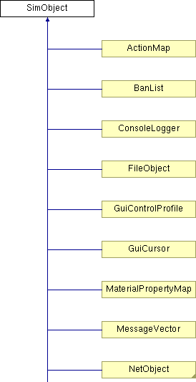
Torque Script C++ SDK
Everything inherits from SimObject.
Public Member Functions
  bool save (string fileName[, bool selectedOnly])
  void setName (string newName)
  string getName ()
  string getClassName ()
  int getId ()
  int getGroup ()
  void delete ()
  int schedule (int time, string command[, mixed args...])
  void dump ()
  int getType ()

Slide 14
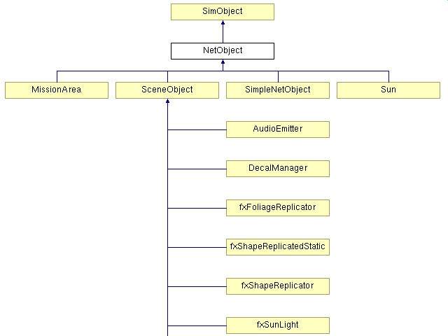
Using NetObject as a model
IntArray
Int2DArray…

Slide 15
The Solution
NetObject was used because it was the easiest to understand due to the fact that it had the least amount of coding out of all the other C++ classes, which inherit from SimObject. Roughly around 700 lines of code including both the .cc and the .h classes.
There was not a lot of reused involved in that class so we basically had to start everything from scratch but it included the right imports and the fact that it directly inherited from SimObject was the only reason it was used as a model.

Slide 16
Results
The result was an efficient IntArray class. Which does its own array bounds checking and does its own garbage collection.
Public Member Functions
  void setSize (int newSize)
  int getSize ()
  void setValue (int newValue)
  int getValue ()

Slide 17
1D Array Implementation
Test results for an integer array size of 125,000
  1 set and get per array element
  Elapsed time
    1.5s for the Torque Script symbol table version
    6.3s for the Torque Script script object version
    1.6s for the array implemented version

Slide 18
1D Array Implementation
Test results for an float array size of 125,000
  1 set and get per array element
  Elapsed time
    1.5s for the Torque Script symbol table version
    6.1s for the Torque Script script object version
    1.6s for the array implemented version

Slide 19
2D Array Implementation
Test results for a 2D integer array size of 500x500 equivalent to 250,000 array size of a 1D array
  1 set and get per array element
  Elapsed time
    4.5s for the Torque Script symbol table version
    42.5s for the Torque Script script object version
    4.7s for the array implemented version

Slide 20
2D Array Implementation
Test results for a 2D float array size of 500x500 equivalent to 250,000 array size of a 1D array
  1 set and get per array element
  Elapsed time
    4.4s for the Torque Script symbol table version
    51.9s for the Torque Script script object version
    5.4s for the array implemented version

Slide 21
3D Array Implementation
Test results for a 3D integer array size of 50x50x50 equivalent to 125,000 array size of a 1D array
  1 set and get per array element
  Elapsed time
    2.9s for the Torque Script symbol table version
    11.0s for the Torque Script script object version
    2.9s for the array implemented version

Slide 22
3D Array Implementation
Test results for a 3D float array size of 50x50x50 equivalent to 125,000 array size of a 1D array
  1 set and get per array element
  Elapsed time
    2.9s for the Torque Script symbol table version
    9.8s for the Torque Script script object version
    3.3s for the array implemented version

Slide 23
Summary
Added 1D to 3D array support to Torque Script by modifying the C++ game engine SDK.
  Defined new array classes
    Implemented array bounds checking (similar to Java).
    Determine the array length (similar to Java).
  Tested performance
    Comparable to symbol table.
    Order of magnitude faster than ScriptObject.

Slide 24
Thank you
Dr. Grevera for all your guidance on this project. We went from no knowing what to do for my senior project to developing something that can be actually integrated into Torque Script.

Slide 25
Question’s

