Slide 1
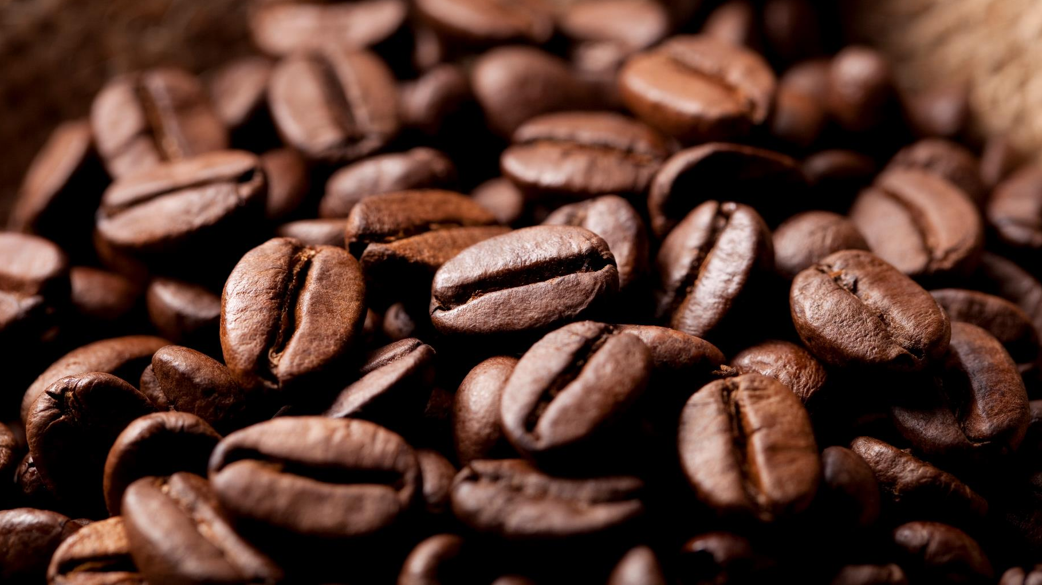
Coffee Chain Performance Analysis
Presented by
Hardi Raval

Slide 2
Coffee - Statistics
73% - 3 in 4 Americans drink coffee every day
3 to 5 cups of coffee a day
51% Weekly - people purchase coffee from a coffee shop at least once a week
48% of people agree that drinking coffee benefits their health
48% of people report Starbucks coffee is their favorite brand, while 45% prefer Dunkin' coffee
Average Cups
Daily Drinkers
Coffee Shop Purchase
Health Benefits
Coffee Chain

Slide 3
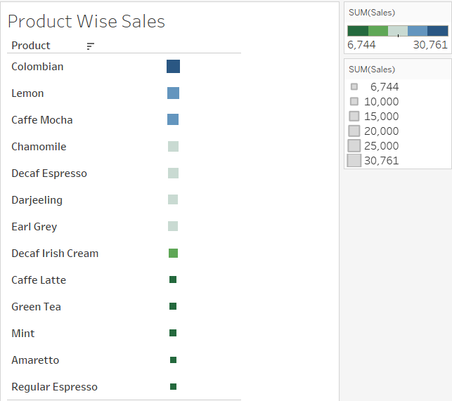
Coffee – Product Wise Sales
This bar chart displays our product sales in descending order, offering a clear view of each item's performance.
Colombian coffee leads with the highest sales.
Regular espresso has the lowest sales.

Slide 4
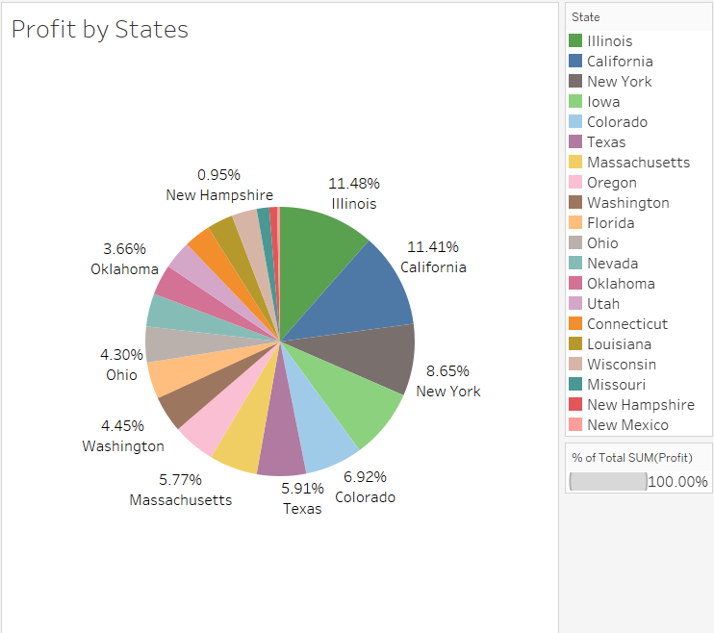
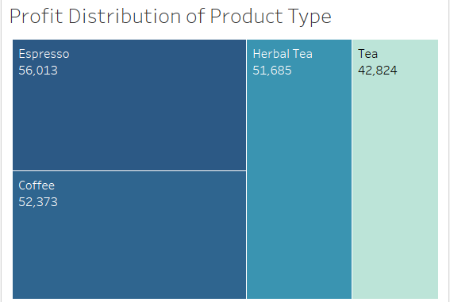
Profit
Espresso and coffee products are our most profitable, while tea products generate the least profit.
As shown in the tree map, espresso has approximately $56,000 in profit, while tea has around $43,000.

Slide 5
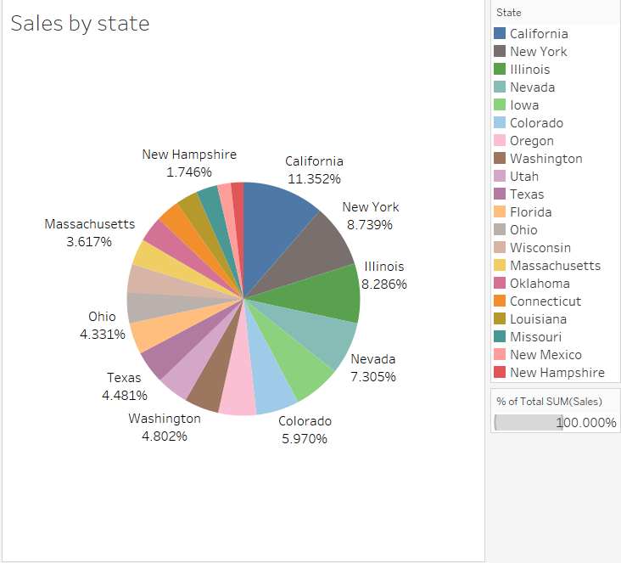
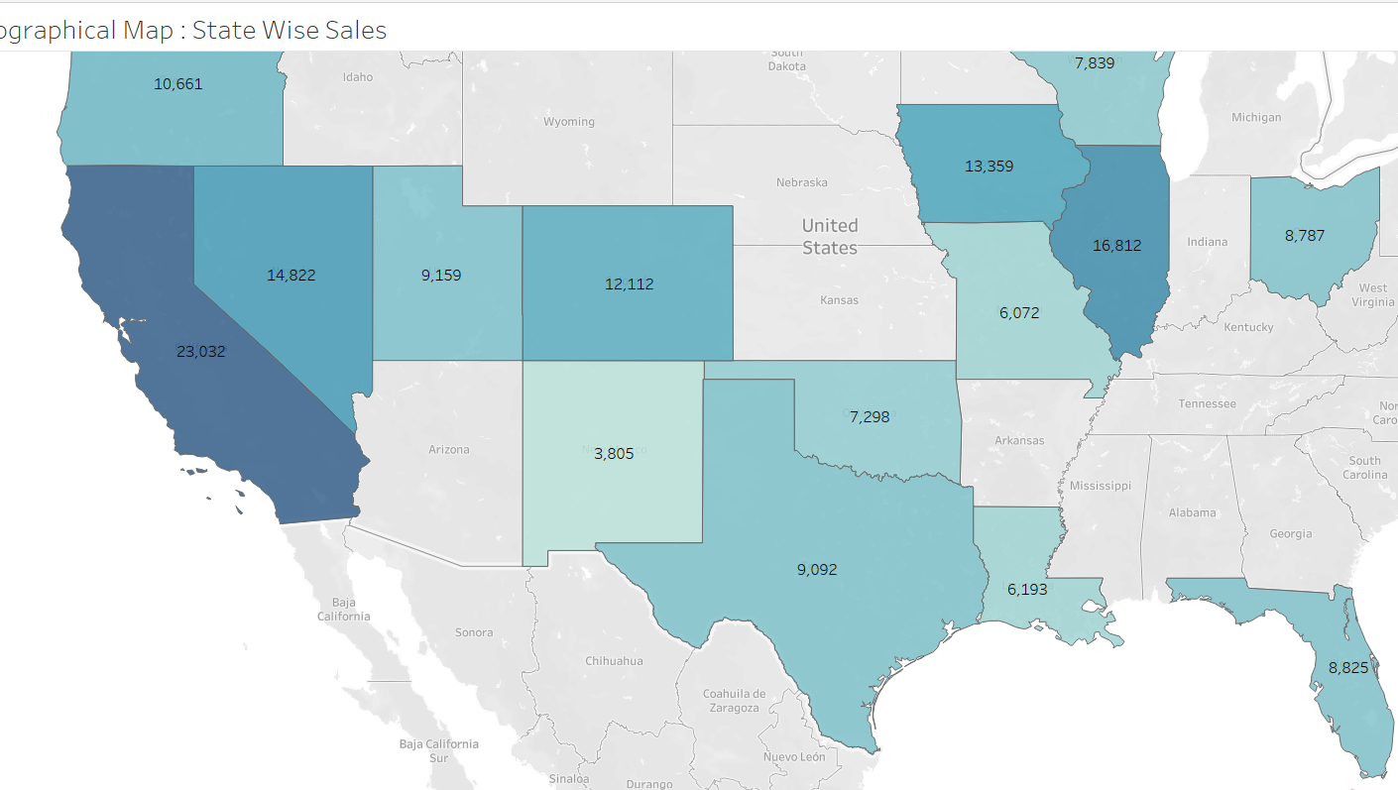
Geographical Sales by State
The map displays state-level sales, with California obviously leading as the top-selling region.
The related pie chart offers a more detailed analysis, showcasing California's 11.35% percentage of total sales. In contrast, New Hampshire has the smallest market share, at 1.7%.

Slide 6
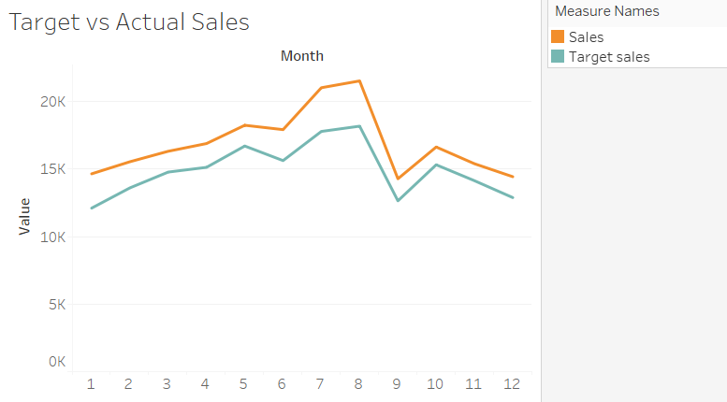
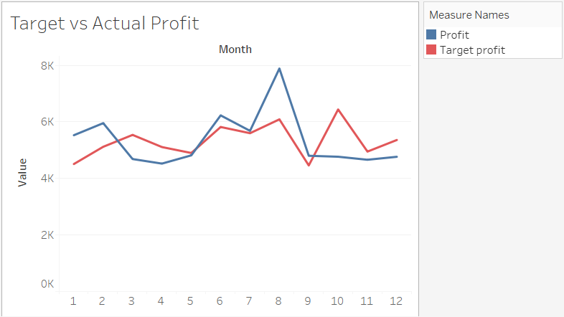
Profit & Sales (Monthly Performance)
Sales: The company seems to struggle to meet its sales target early on, but from month 5 onwards, it achieves and exceeds the target.
Profit: The company's actual profit greatly fluctuates after the middle of the year, indicating potentially variable expenses or external factors affecting profitability.

Slide 7

SUmmary
In summary, while the chain performs well overall, particularly in its coffee products and top regions, there’s room to optimize profitability and explore new growth opportunities in smaller markets.

