Slide 1
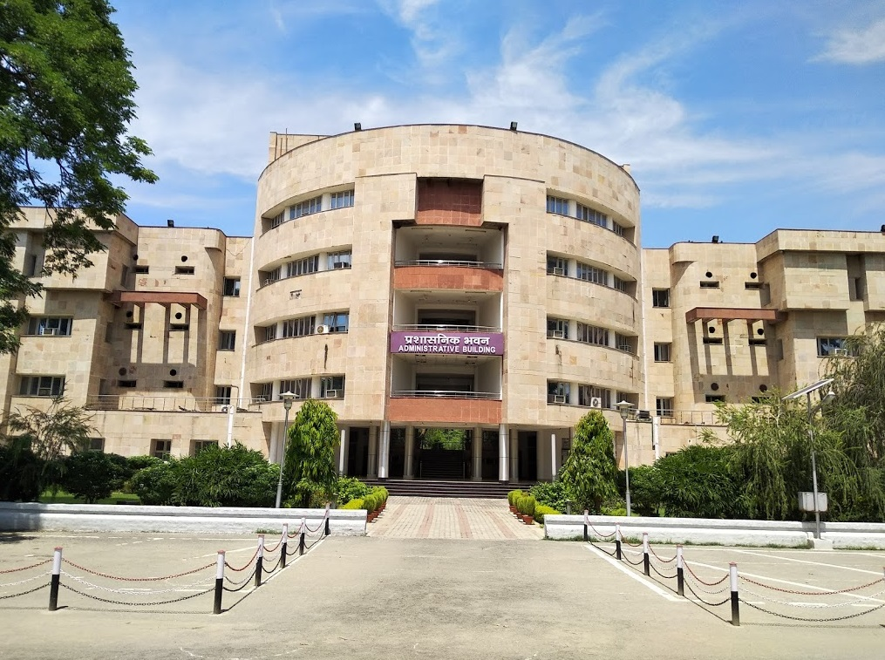

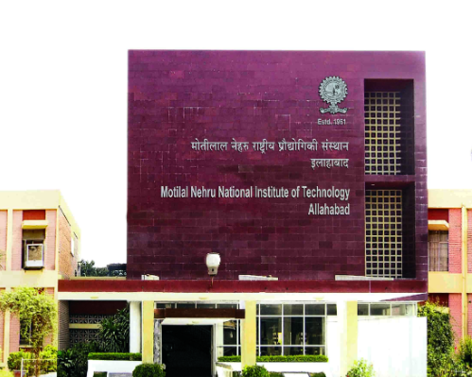
HABIT-2025
Organizing committee
https:// mnnit.ac.in/habit2025/
Patron: Prof. Rama Shanker Verma
Director, MNNIT Allahabad
Chairperson: Dr. Manisha Sachan
Head, Department of Biotechnology
Convener: Dr. Ashutosh Mani
Treasurer: Dr Joyabrata Mal
An
International Conference
On
Health and Agricultural Biotechnology: Interdisciplinary Trends
February 28- March 2, 2025
Organizing Secretary | Advisory Committee
Dr. Radha Rani | Dr. Giovanna Chiorino, Italy
Dr. Joyabrata Mal | Dr. Rattan Yadav , UK
Dr. Rupika Sinha | Dr. Maria Scatolini, Italy
Dr. Harinder Singh (CHED) | Dr. Jennifer Ann Harikrishna, Malaysia
Dr. Dushyant Kumar (CSED) | Dr. Panlada Tittabutr, Thailand
 | Dr. Luciana Scotti, Brazil
 | Dr. Ashutosh Sharma, Mexico
 | Dr. S. Ramachandran, India
Registration Procedure
All participants are requested to register online at https://shorturl.at/PW4YN Participants should submit the print out filled registration form along with DD (offline mode) or electronic receipt (online mode).
Accommodation will be provided in the Institute on paid basis, as per availability. Please contact organizers for more details.
Organized by:
Department of Biotechnology
Motilal Nehru National Institute of Technology Allahabad
PRAYAGRAJ, 211004, India
Accommodation
Contact details:
Dr. Ashutosh Mani
Convener
HABIT-2025
Department of Biotechnology
Motilal Nehru National Institute of Technology Allahabad
Prayagraj-211004 (UP) India
Phone: +91-532-2271239(O)
Mob.: +91 9455354251
Fax: +91-532-2545341
Sponsorship details
The HABIT 2025 organizing committee is actively seeking generous sponsorship from our valuable partners to sponsor its various activities and events. The conference will definitely provide and ideal platform for exhibitors of books, equipments, chemicals, software’s, and pharmaceutical companies etc. to showcase their latest products. All enquiries and request regarding sponsorship may be addressed to the correspondence notified.
Registration link: https://shorturl.at/PW4YN
Email: 2025habit@gmail.com
Notes:
To change this brochure, replace our sample content with your own. Or, if you'd rather start from a clean slate, press the New Slide button on the Home tab to insert a new page. Now enter your text and pictures in the empty placeholders. If you need more placeholders for titles, subtitles or body text, copy any of the existing placeholders, then drag the new one into place.
And did you notice we made fold marks for you? They are really light, but if you don’t like them showing on your brochure, select and delete them before you print.

Slide 2
About the Conference
About the Institute
Payment Details for Registration:
It gives us immense pleasure to invite you to join HABIT 2025, “International Conference on Health and Agricultural Biotechnology: Interdisciplinary Trends”, to be held at one of the most ancient and culturally rich cities of India “Kumbh Nagari”, Prayagraj from February, 28 to March 2, 2025. The conference is being organized by Department of Biotechnology, Motilal Nehru National Institute of Technology (MNNIT) Allahabad with an aim to promote excellence in scientific knowledge and innovation in biotechnology and related disciplines to motivate young researchers. The conference also envisages providing a forum to researchers around the globe to explore and discuss on various aspects on recent advances in field of health, agriculture and allied disciplines. It will provide deep insights into innovations, challenges and growth opportunities in diversified domains of Biotechnology. Each session in the conference will be addressed by renowned experts in their respective fields. The event will also offer young scientist an opportunity to present their work in front of eminent experts of their field and compete for various awards like HABIT Young Scientist Award-2025.
Thrust Areas of the conference
Health and Medical Biotechnology
Bioinformatics, Computational Biology & Chemistry
Agricultural Biotechnology
Molecular Biology, Nanotechnology and Material Science
Environmental and Industrial Biotechnology
Interdisciplinary approaches in Health, Food, Agriculture and
Environment
Important dates :
Abstract Submission: December 30, 2024
Acceptance and Notification : January 15, 2025
Early Bird Registration:: January 20, 2025
Scope of HABIT-2025
The event will draw assemblage of scholars from different parts of the globe and diverse fields. HABIT-2025 will also act as a single platform for sharing state-of-the art updates from diverse fields of the biotechnology. The scope of this conference is multidisciplinary and invites original work to be presented in various categories viz., young scientist, oral and poster presentation.
Paper Submission:
Please submit the abstract (not exceeding 250 words) online at https://forms.gle/nupHfwqcnciCd7U8A
Candidates should register at https://shorturl.at/PW4YN and then login to submit the abstract. The notification regarding nature of the presentation (oral/poster) will be communicated well in advance. The size of poster will be 90*90cm for all poster presentation. It should state title, name and address of the authors, short introduction, methods and materials, results and conclusions.
Bank Account Name:: SNFCE MNNIT Allahabad
Bank Account number: 10424975574
Bank Name and Branch: SBI, MNNIT Allahabad
IFSC Code: SBIN0002580
Motilal Nehru National Institute of Technology (MNNIT) Allahabad, is an institute with total commitment to quality and excellence in academic pursuits. It was established as one of the seventeen Regional Engineering Colleges of India in the year 1961 as a joint enterprise of Government of India and Government of Uttar Pradesh. With more than 50 years of experience and achievements in the field of technical education, having traversed a long way, on June 26, 2002 MNREC was transformed into National Institute of Technology fully funded by Government of India. With the enactment of national Institutes of Technology Act-2007, the Institute has been granted the status of institution of national importance w.e.f. 15.08.2007.
Fee Structure
Category | Early Bird (20/01/2025) | Late (10/02/2025) | On Spot
From India (INR)
Students(UG/PG) | 2500 | 3000 | 3500
PhD/Post doctoral fellow/ Research Scholar | 3500 | 4000 | 5000
Faculty/Scientist | 5000 | 6000 | 7000
Industries | 6000 | 7000 | 8000
Accompanying person | 2500 | 3000 | 3500
Foreign Delegates (USD)
Students (UG/PG) | 200 | 250 | 300
PhD/Post Doctoral fellow/Research Scholar | 250 | 300 | 350
Faculty/Scientist | 300 | 400 | 500
Industries | 400 | 500 | 600
Accompanying person | 200 | 250 | 300
About the Department
Biotechnology at MNNIT Allahabad was established as a new academic unit under Applied Mechanics in 2006, with the objective of integrating life sciences with engineering and to develop cutting-edge technology through research, training and technological innovation. An independent Department of Biotechnology was established in the April, 2012. Since its inception, the department has witnessed a consistent rise in the students demand for the subject. Keeping a beat to the global demands for researchers in this field, B.Tech, M.Tech and PhD programmes are being run by the department. The department has a team of young enthusiastic and well qualified faculty actively involved in research and training.
Publication of Conference Papers:
Selected papers from the HABIT 2025, after approval of EIC, will be invited to contribute to special issues in journals including:
Current Topics In Medicinal Chemistry (Bentham)
Plant Gene (Elsevier)
Conference Proceedings:
Structured abstracts from the conference will be included in Proceedings of HABIT 2025. The ISSN/ISBN indexed Proceedings will be published in online / offline mode by reputed publisher. The corresponding author will be contacted for further processing including copyright and publication charges, if any.
Registration Fee includes registration charges, refreshments served during the conference, conference kit and entry to cultural events. All payment details shall be mentioned by participant in the online registration form.
HABIT-2025 awards
To promote the budding young scientist, participants are encouraged to apply for various awards like young scientists award, Best poster award, Best oral presentation award. HABIT 2025 young scientist award will include a cash prize along with the certificate.
Register at: https://shorturl.at/PW4YN
Submit form at: https://forms.gle/nupHfwqcnciCd7U8A
https:// mnnit.ac.in/habit2025/
Notes:
To change this brochure, replace our sample content with your own. Or, if you'd rather start from a clean slate, press the New Slide button on the Home tab to insert a new page. Now enter your text and pictures in the empty placeholders. If you need more placeholders for titles, subtitles or body text, copy any of the existing placeholders, then drag the new one into place.
And did you notice we made fold marks for you? They are really light, but if you don’t like them showing on your brochure, select and delete them before you print.

