Slide 1

Project Title Faculty Leave Management System
Problem Statement: | The problems are inefficient leave request processing and difficulty in tracking leave records of faculties.
Project Group No.: | SISTec/Btech/CS/2023/Minor_project_||12
Group Member Details:
Guide Details: | Dr. Meena Malik
0187CS201063 | Hardik Kushwaha
0187CS201066 | Harshit Dongre
0187CS201068 | Him Shrivas
0187CS201094 | Mohit Malviya

Slide 2



Idea/Approach Details
Idea/Solution:
The idea of the faculty leave management system project is to create a web-based application that will applying the process of requesting, approving, and managing leave requests for faculty members. The system will provide a user-friendly interface for both faculty members and administrators to manage leave requests and balances.
Abstract:
The leave management application will allow the users to apply for the leaves through the online mode by specifying a valid reason for the leave. It is leave requests, approvals, and tracking of leave balances, aiming to solve the problems of an inefficient leave request processing and difficulty in leave management for faculties.

Slide 3



Idea/Approach Details
Tools & technology | Version
Node.js | 18.14.0
Express | 4.16.1
MongoDB | 4.0
HTML | 5
CSS | 3
JavaScript | ES6
VS Code | 1.76.1
Bootstrap | 5

Slide 4
Project Requirements
Functional requirements
Non-Functional requirements
User Authentication
Apply Leave
Leave Tracking
Approve Leave
Edit/View Profile
Security
Usability
Reliability

Slide 5
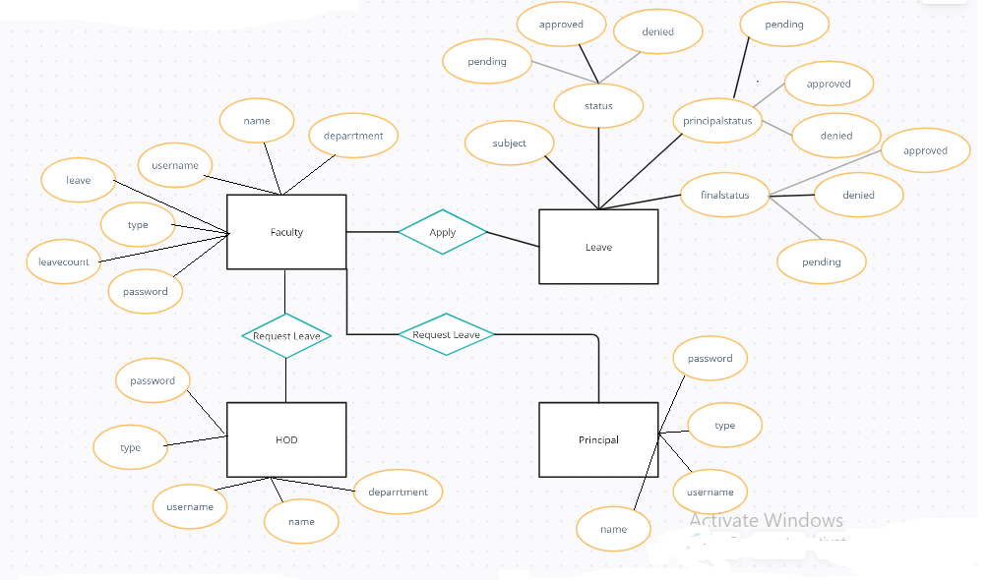
Design
ER Diagram

Slide 6
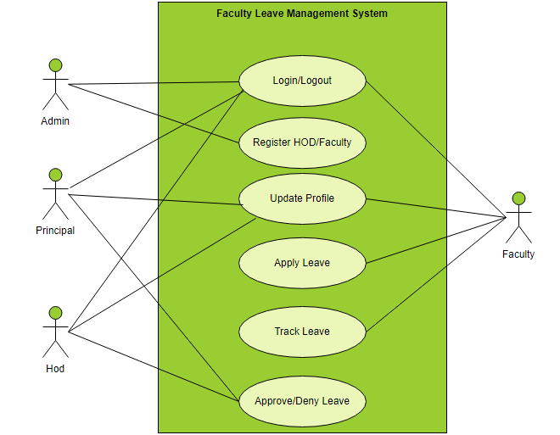
Design
Use Case Diagram

Slide 7
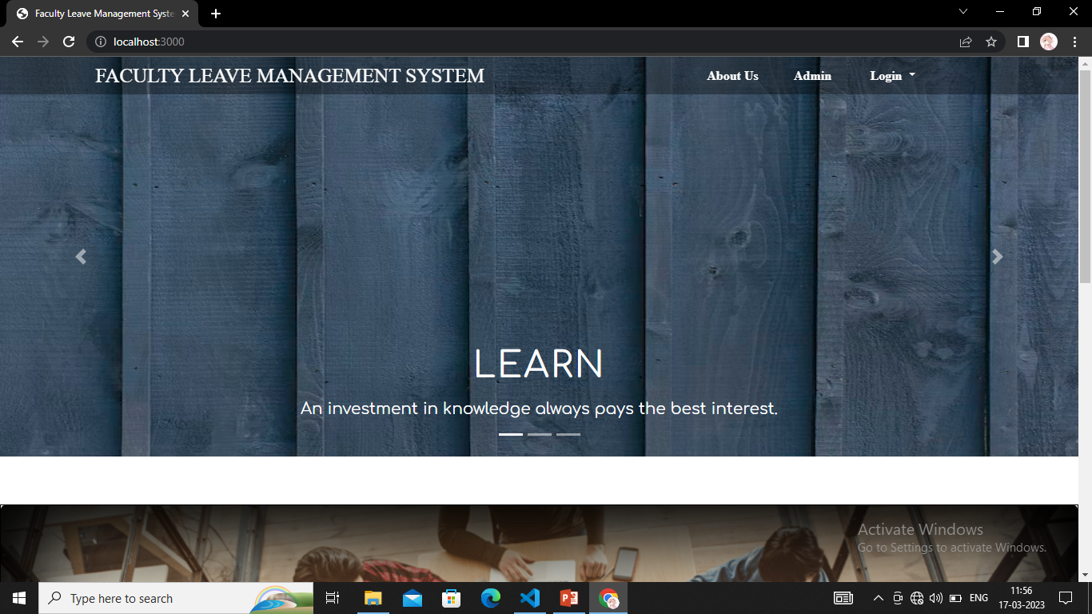
Project Snapshots

Slide 8

GitHub Repository
GitHub Repository Link

Slide 9


