Slide 1
MCPShield
A multi-agent runtime firewall for MCP-connected AI agents

Slide 2
Problem
Enterprises connect AI agents to tools via MCP servers.
The agent trusts tool metadata and tool outputs as context.
A malicious/compromised MCP server can hijack the agent:
poisoning, shadowing, rug pulls, indirect injection, split payloads, exfiltration.

Slide 3
Existing challenge
Today: manual tool review and static allowlists.
Misses hidden instructions and split payloads.
Cannot see rug pulls (trusted tool changes later).
Misses runtime attacks (injection in outputs, tainted arguments).
No audit trail for compliance.

Slide 4
Proposed solution
A transparent proxy between the host agent and MCP servers.
Every MCP event flows through a LangGraph multi-agent pipeline.
Decides ALLOW / SANITIZE / BLOCK / ESCALATE with an explanation.
Hash-pins tools, scans with RAG over a threat KB, enforces policy, tracks taint.

Slide 5
Agent roles
Orchestrator - Planner, utility-based (fast vs deep path).
Registry Auditor - Research, model-based (hash pinning, rug-pull, RAG).
Intent Verifier - goal-based (policy, sensitive data, taint).
Output Sanitizer - reflex + LLM (injection in outputs).
Critic - utility-based (risk aggregation, self-consistency, guardrail).
Auditor - monitoring (audit log, explainability).

Slide 6
Orchestration workflow
Perception: proxy turns MCP traffic into events.
Reasoning: plan -> rule detectors -> (grey-zone) LLM judge -> Critic.
Fast path for clear cases; deep path only in the grey zone (latency/risk trade-off).
Action: proxy applies the decision; Auditor records it.

Slide 7
Architecture
System diagram (see docs/architecture.md for the Mermaid source).
(figure architecture_system.png not found; run make eval && make figures)

Slide 8
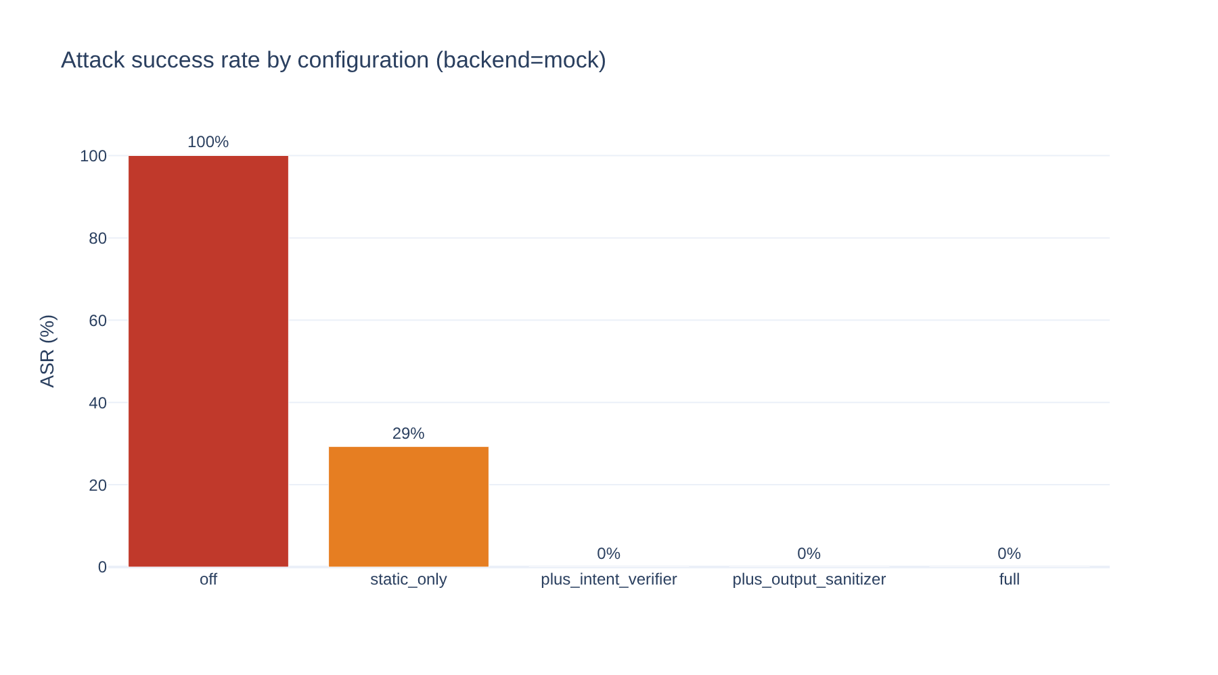
Results: attack success rate
ASR drops from the shield-OFF baseline to near zero.

Slide 9
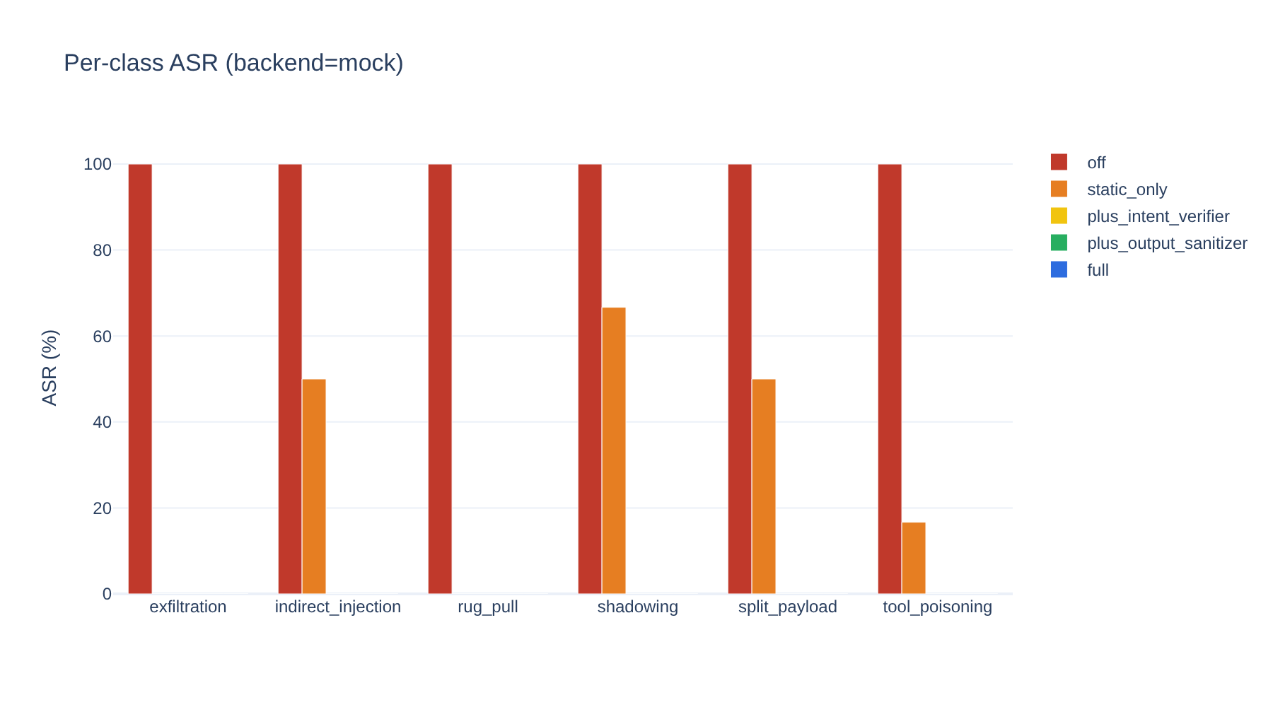
Results: per-class ASR
Per attack class, across ablations.

Slide 10
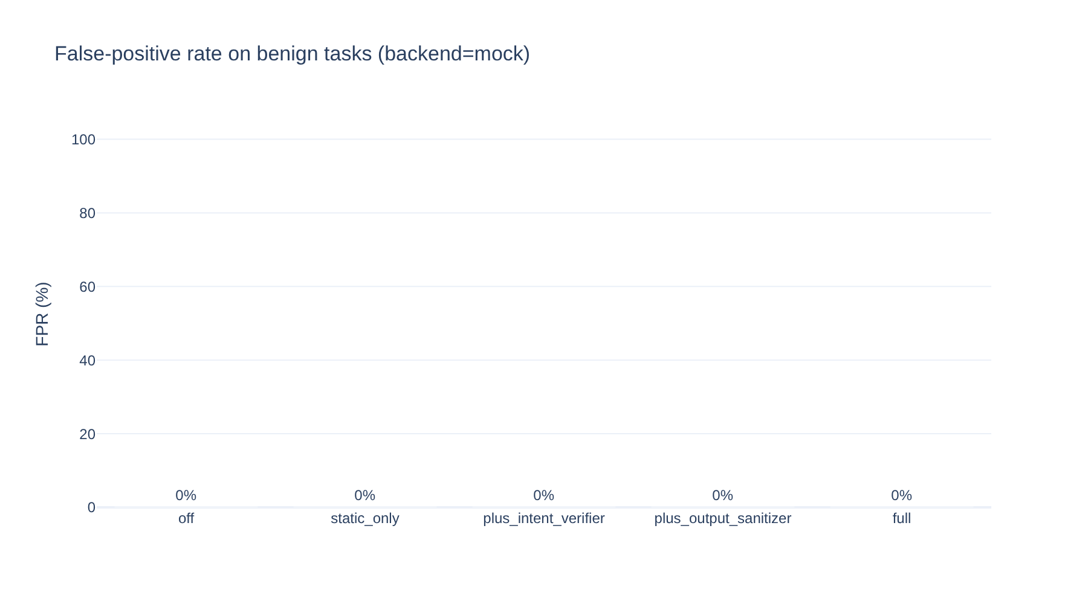
Results: false positives
FPR on benign tasks stays low.

Slide 11
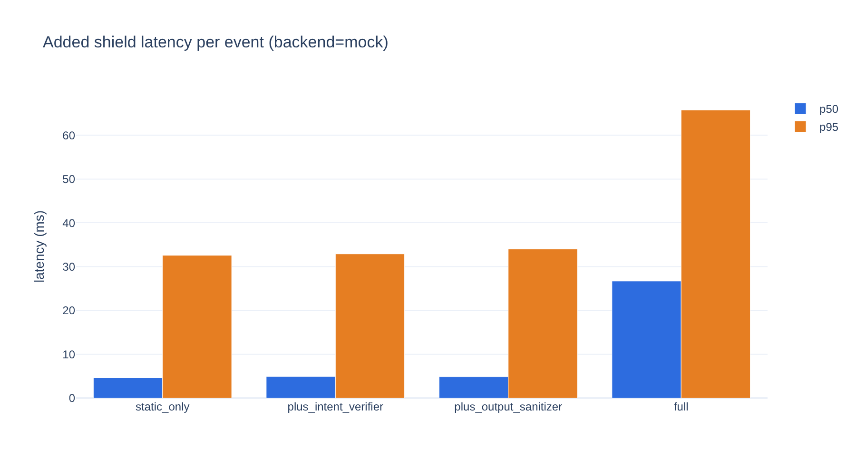
Results: added latency
Deep path adds latency only in the grey zone.

Slide 12
Validation
Deterministic mock backend: reproducible, offline, worst-case obedient agent.
Shield-OFF ASR is 100% by construction; the result is the drop with the shield on.
Ground truth from side effects (ledger, outbox, exfil sink); results are order-independent.
Every decision has a human-readable explanation in the audit log and UI.

Slide 13
Limitations and future scope
Limitations: LLM judge is injectable; small models misclassify; attacks are synthetic;
deep path adds latency; taint tracking is coarse; offline embeddings are weaker.
Future: full taint tracking, signed manifests, fine-tuned classifier, A2A protection,
adaptive red-teaming, sidecar deployment with monitoring.

Slide 14
Conclusion
MCPShield lets enterprises adopt untrusted MCP tools safely.
It blocks runtime attacks that static review misses, at a low false-positive cost.
It leaves a full, explainable audit trail for compliance.

