Slide 1
TIC TAC TOE Game
Submitted in the partial fulfillment for the award of the degree of
BACHELOR OF ENGINEERING
IN
Computer Science
Submitted by :
Hardik Sharma
20BCS6355
Jatin
20BCS6424
Under the Supervision of :
Neeshu Sharma Mam
Department of AIT-CSE
DISCOVER . LEARN . EMPOWER

Slide 2
Outline
Introduction to Project
Problem Formulation
Objectives of the work
Key features
Methodology used
Results and Outputs
Conclusion
Future Scope
References

Slide 3
Introduction to Project
Our project name is tic-tac-toe game.
This game is very popular and is fairly simple by itself.
It is actually a two player game. In this game there is a board with n x n squares . In this game , there is 3x3 squares
The goal of tic-tac-toe is to be one of the players to get three same symbols in a row.
Horizontally, vertically or diagonally on a 3 x 3 grid.

Slide 4
This game uses board to control players. In each turn players enter a number and choose a move before selecting the player symbol i.e. X or 0.
Simplify programming assumes that player one always movers first and uses his symbols and then player two uses his symbol and places his mark

Slide 5
Problem Formulation
A simple game like tic-tac-toe can be a mirror of how people move through obstacles and handle decisions in life. It also shows you that the pluses outweigh the minuses and that you learn how to develop strategies to help you pull through
Because of the simplicity of tic-tac-toe, it is often used as a pedagogical tool for teaching the concepts of good sportsmanship
If played optimally by both players, the game always ends in a draw, making tic-tac-toe a futile game.

Slide 6
Objectives
The goal of the game is for players to position their marks so that they make a continuous line of three cells vertically, horizontally, or diagonally. An opponent can prevent a win by blocking the completion of the opponent’s line.
In this project user,
• Can Keep track of scores.
• Can not win by unfair means

Slide 7
KEY FEATURES
The game is built to make a good sportsmanship between players.
This game can be played by anyone.
It helps us in develop coordination, fine motor skills and visual skills.
It helps children learn how to follow rules and take turns.

Slide 8
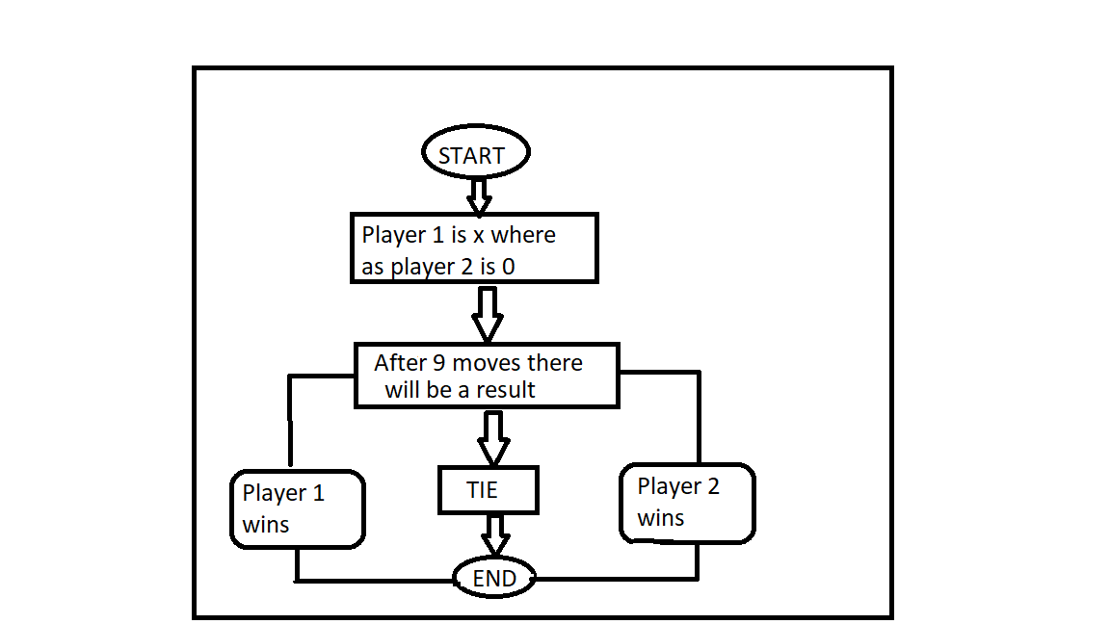
Flowchart

Slide 9
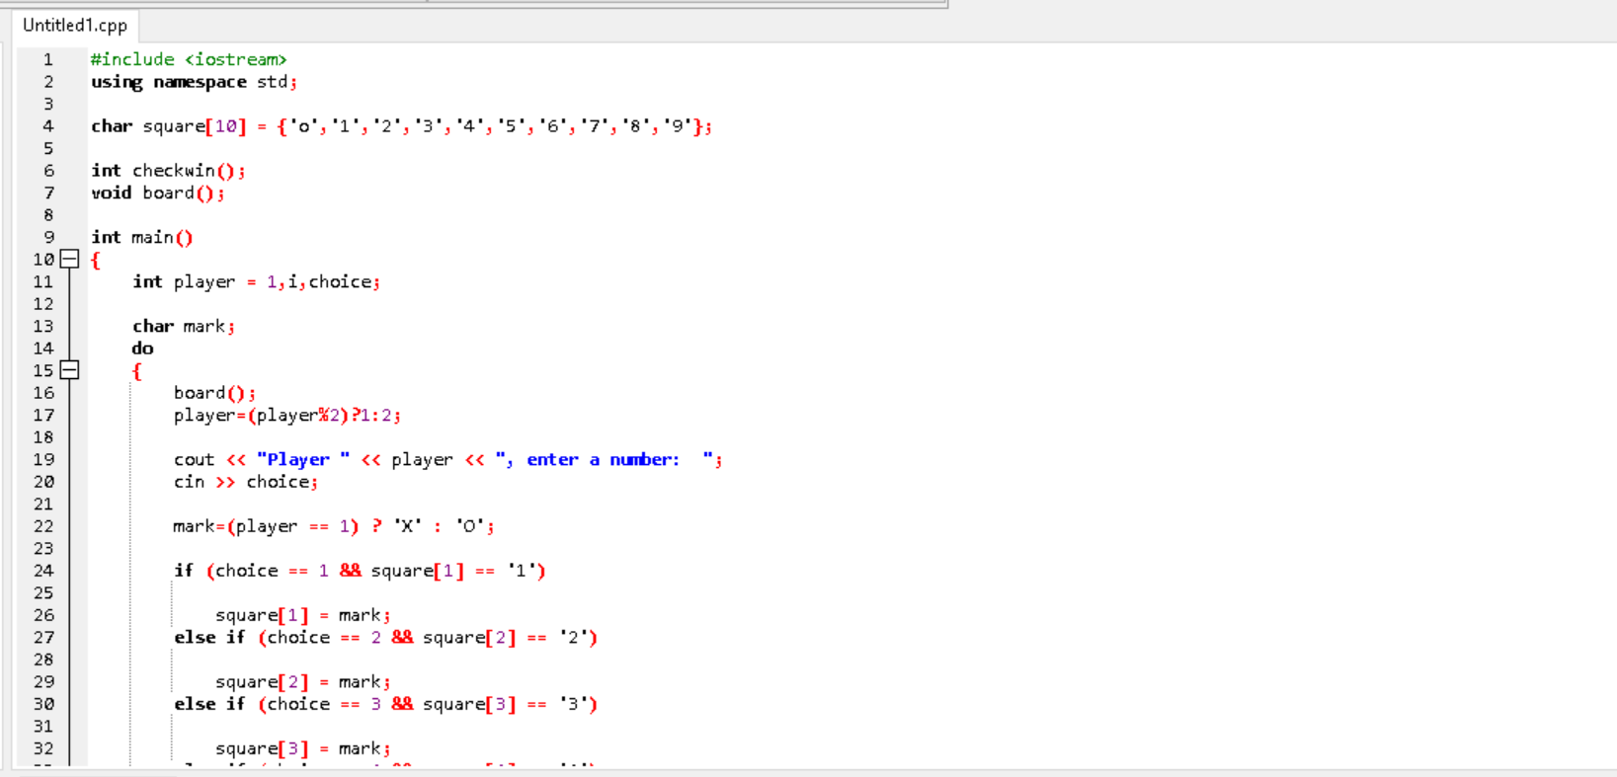
Methodology used

Slide 10
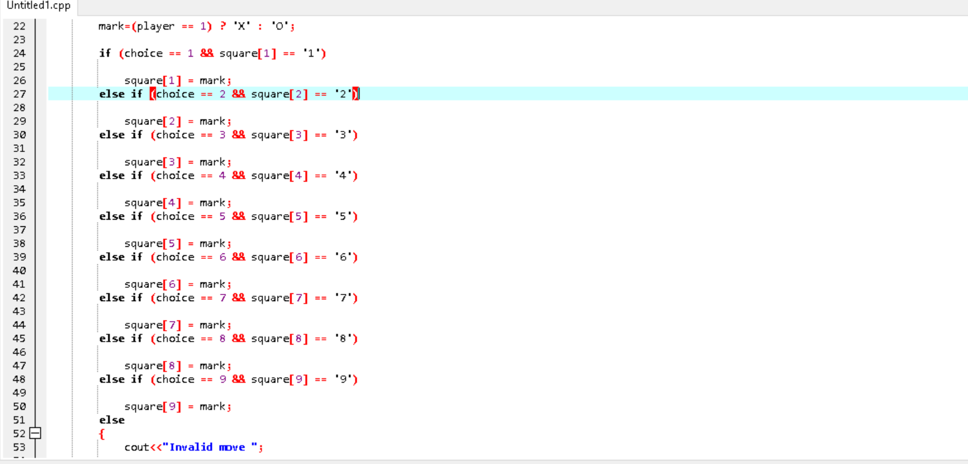
Here we have coded the condition for win. Horizontally, vertically and diagonally. Also I have coded the swap the player condition after every player input.

Slide 11
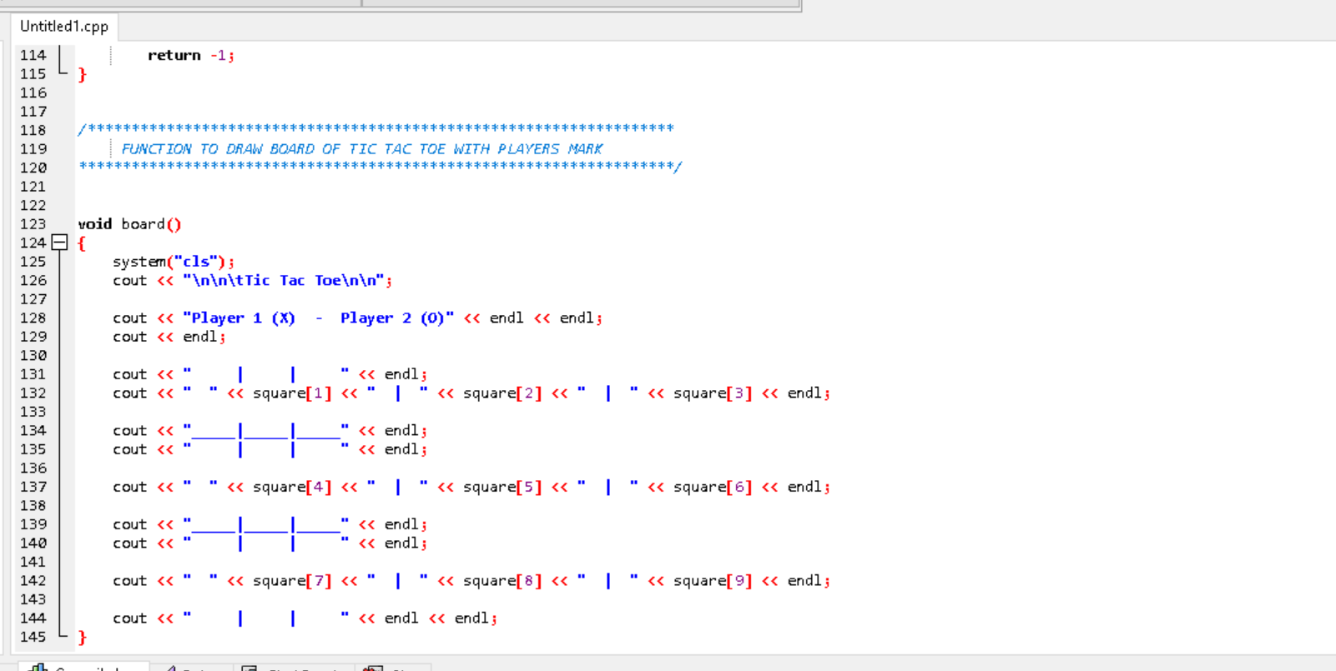
In this part of the code we coded the final tic tac toe game output

Slide 12
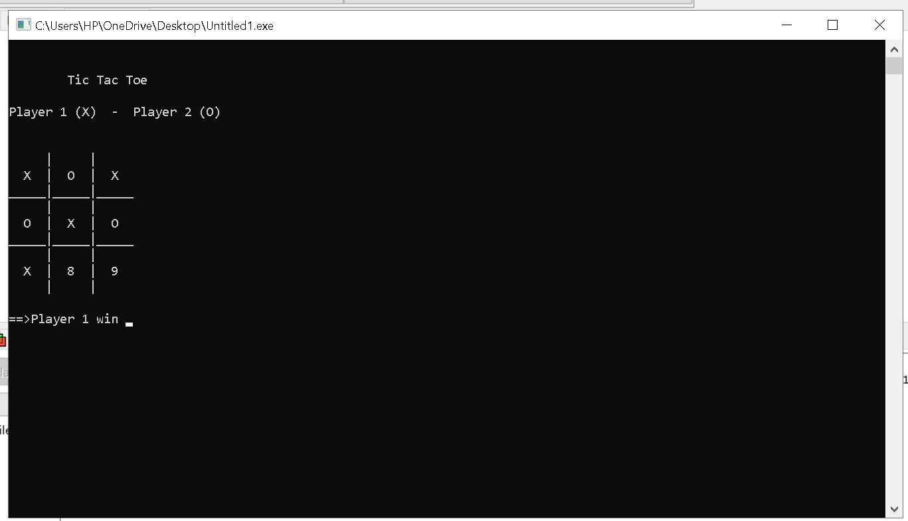
Results and Outputs

Slide 13
Conclusion
Tic-tac-toe is a game for two players, X and O, who take turns marking the spaces in a 3x3 grid. The player who succeeds in placing three of their marks in a horizontal, vertical, or diagonal row wins the game. Tic-tac-toe is a game which can be played by people of all ages, any time, anywhere. The game is usually used in enhancing the players thinking by teaching concepts of good sportsmanship.

Slide 14
Future Scope
We have upgrade our project by making player play with machine itself.
We can upgrade our AI made tic tac toe game by leveling up the AI to make game difficult to win .
Making levels in the game with increase in difficulty level at each step.

Slide 15
References
https://www.slideshare.net/PriontoAbdullah/tic-tac-toe-game-with-graphics-presentation
https://www.youtube.com/watch?v=KrH1qNVYKO0&t=893s
https://www.slideshare.net/saadsymbianpk/tic-tac-toe-c-project-presentation?next_slideshow=1

Slide 16



