Slide 1
Final Presentation of the B.Tech. Project (CSN-400B) 2022-2023
on
Predicting Rainfall-Induced Landslides and Gender-Based Twitter Analysis of Joshimath Crisis
by
Hardik Thami (19114035, 9646050577), Purushottam (19114065, 9334818825), Devanshu Chaudhari (19114027, 9167595004)
Supervisor: Prof. Sudip Roy
Department of Computer Science and Engineering
Date: May 12, 2023

Slide 2
Outline
Introduction
Problem Statements and Objectives
Rainfall-Induced Landslide Prediction
Gender-Based Twitter Analysis of Joshimath Crisis
Landslide Prediction
Methodology
Dataset Preparation
Applying Machine Learning Techniques
Results
Comparing Accuracy of Applied Machine Learning Techniques
Landslide Visualization using OpenStreetMap

Slide 3
Outline (contd…)
Gender-Based Twitter Analysis of Joshimath Crisis
Methodology and Results
Extracting Joshimath Crisis Tweets
Gender Estimation of user from Tweets
Sentiment Analysis of Tweets
Conclusions and Future Work

Slide 4
Introduction
India is prone to many natural disasters like floods, landslides, cyclones, forest fires, earthquakes, drought, etc.
Satellites provide observations of the natural disasters at regular intervals that helps in better planning and management of disasters.
Pre-processing / Post-processing of satellite imagery is time consuming, leading to delay in rescue efforts by disaster management teams.
Possible Solution:
Machine learning based techniques to predict a landslide caused by rainfall over a long/short period of time.

Slide 5
Introduction (contd…)
This study also takes into account the recent Joshimath, Uttarakhand Incident of Land subsidence.
According to images released by the National Remote Sensing Centre of the Indian Space Research Organisation,
Joshimath has witnessed a rapid subsidence of nearly 5.4 cm from Dec 27, 2022 to Jan 8, 2023 and the report stated that a subsidence of nearly 9 cm was recorded between April-November 2022
We present a case study in which we have done sentiment analysis on tweets related to Joshimath Incident, to get an insight into how a large audience reacts to such incidents.

Slide 6
Problem Statements and Objectives
Rainfall-Induced Landslide Prediction
Build a rainfall-induced landslide prediction model using various machine learning classification algorithms such as:
Logistic Regression
Decision Tree
Support Vector Machine
Gaussian Naive Bayes
The problem statement can be further divided into many objectives such as:
Data Preparation (Data Collection, Cleaning, Reduction, Integration)
Apply Machine Learning Classification Algorithms

Slide 7
Problem Statements and Objectives (contd…)
2. Gender-Based Twitter Analysis of Joshimath Crisis
Analyse Tweets related to Joshimath Land Subsidence Crisis to understand the commonality and differences in views and sentiments of a large audience which includes individuals and organisations.
The problem statement can be further divided into many objectives such as:
Tweet Extraction and Translation
Gender Estimation of Twitter User
Sentiment Analysis of Tweets

Slide 8
Landslide Prediction: Methodology

Slide 9
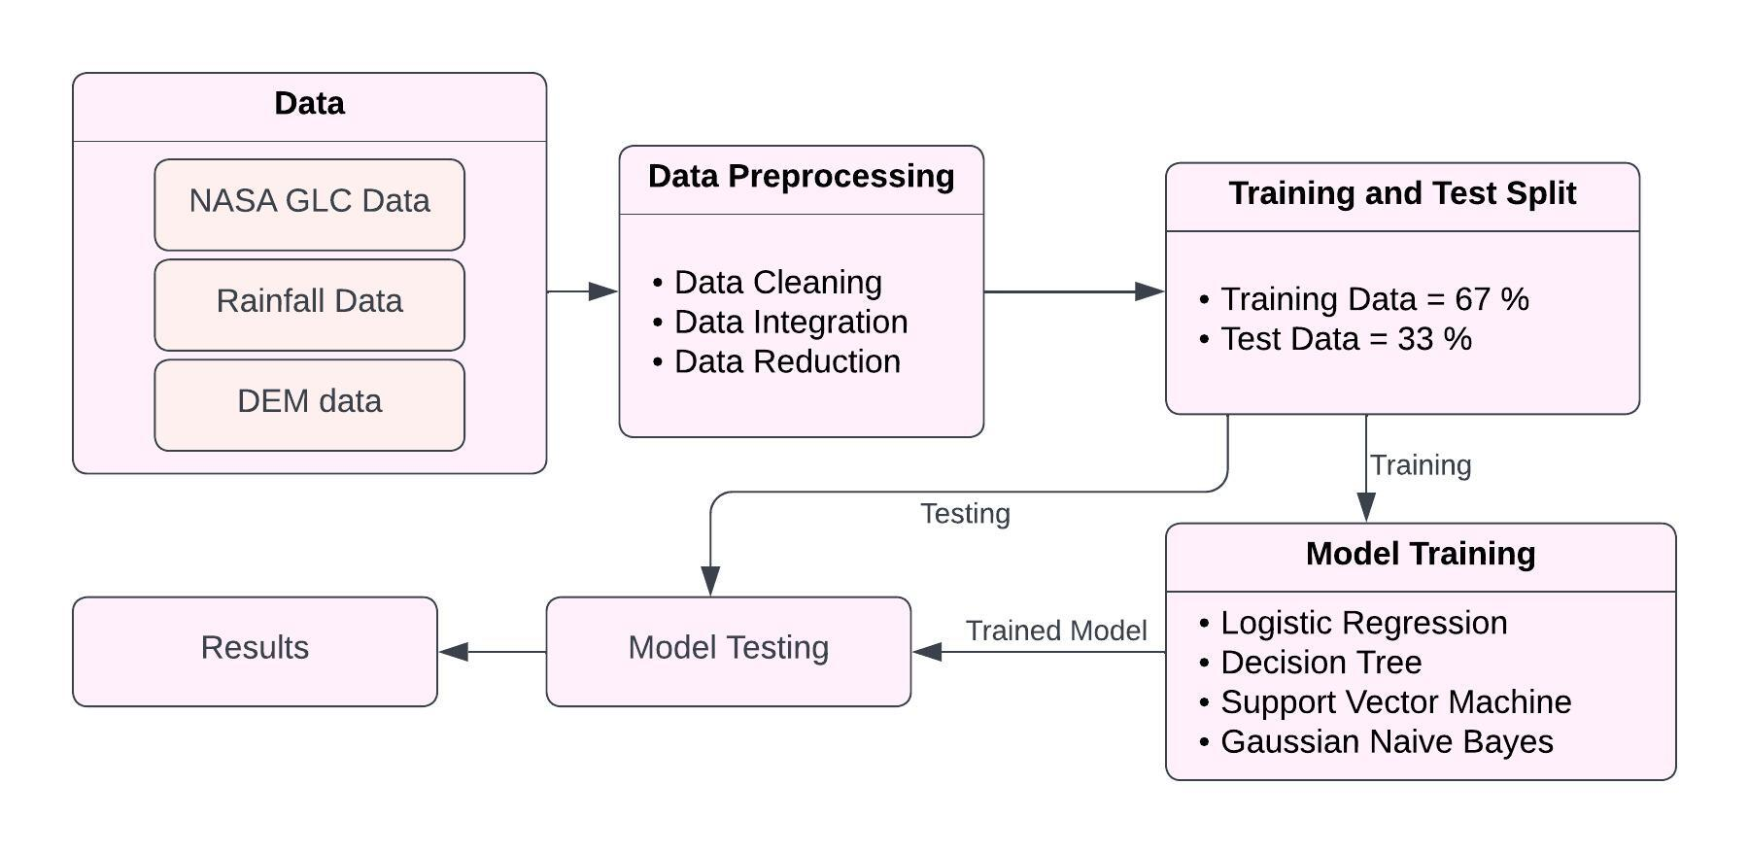
Flowchart
Figure: Flowchart For Predicting Rainfall-Induced Landslides

Slide 10
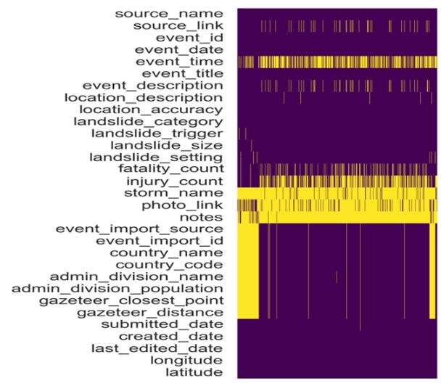
Dataset Preparation
Landslide Dataset:
NASA Global Landslide Catalogue (GLC)
Contains landslide events that have occurred worldwide from the year 2007 to 2021.
The dataset is based on media reports, government reports, and scientific publications.
The figure on right shows data present in GLC.
Landslide Features Present in NASA GLC Dataset

Slide 11
Dataset Preparation (contd…)
Landslide Dataset:
NASA Global Landslide Catalogue (GLC)
It consists of 1742 landslides that occurred in India.
After applying data cleaning, we were left with 781 rainfall-induced landslides and 52 landslides were caused due to other factors.
Landslide Features Present in NASA GLC Dataset

Slide 12
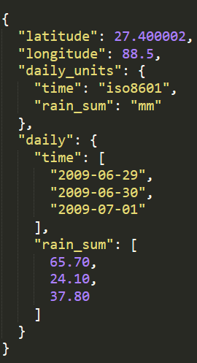
Dataset Preparation (contd…)
Rainfall Data:
Open-Meteo Historical Weather API
Open source API for fetching daily rainfall data for a location.
This API was considered as Open-Meteo boasts weather data dating back to 1940!
The figure on right shows sample trimmed response from API for a given latitude and longitude.

Slide 13
Dataset Preparation (contd…)
Rainfall Data:
Open-Meteo Historical Weather API
Short-term rainfall (mm): Accumulated rainfall on the day of landslide and a day before landslide occurred.
Long-term rainfall (mm): Accumulated rainfall from the day of landslide occurrence to 10 days prior to landslide occurrence.

Slide 14
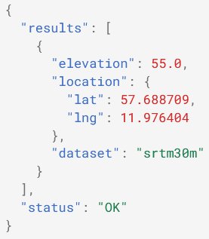
Dataset Preparation (contd…)
Elevation Data:
NASA SRTM 1 Digital Elevation Model
It provides global coverage at a spatial resolution of approximately 30 meters.
There exist several open-source services that provide elevation data while internally using this DEM.
We have used Open Topo Data open source API to extract elevation data of a location.

Slide 15
Dataset Preparation (contd…)
Elevation Data:
NASA SRTM 1 Digital Elevation Model
Elevation Relief (m): Difference between highest elevation and lowest elevation in an area.
An estimate of Elevation Relief was calculated after sufficient (~39,400) points were considered in the region affected by the landslide.
Elevation was fetched for each of these points and highest, lowest elevation were considered for Elevation Relief.

Slide 16
Applying Machine Learning Techniques
Dataset includes:
781 rainfall-induced landslides
52 landslides caused due to other factors
Dataset is currently imbalanced !!
Solution: Synthetic Minority Over-sampling Technique (SMOTE) to increase the instances of minority class in the dataset.
Once the dataset in balanced, the data was split into training (67%) and test (33%) sets for training and assessing our models.
Machine Learning Algorithms used:
Logistic Regression
Decision Tree (We used 3 Cutoff Criteria: max_depth, min_samples_leaf, and min_samples_split and their values were kept as 3, 1, 2 respectively)
Support Vector Machine
Gaussian Naive Bayes

Slide 17
Landslide Prediction: Results

Slide 18
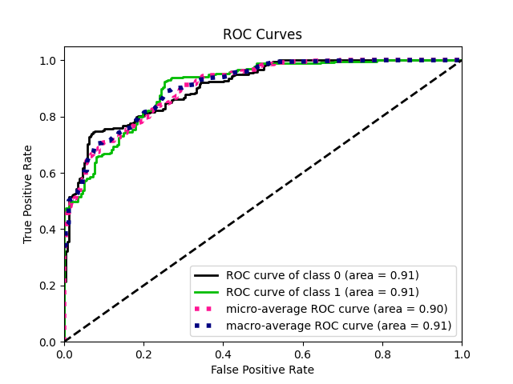
Logistic Regression
Figure on the right shows the ROC Curve for Logistic Regression Model.
From this curve, we can obtain AUC (Area under ROC Curve), which is a commonly used metric to evaluate the performance of a model. Its value is 0.91
Macro-Average ROC and Micro-Average ROC are generally used in multi-class or imbalanced datasets, hence they are similar to the roc curve of individual classes.

Slide 19
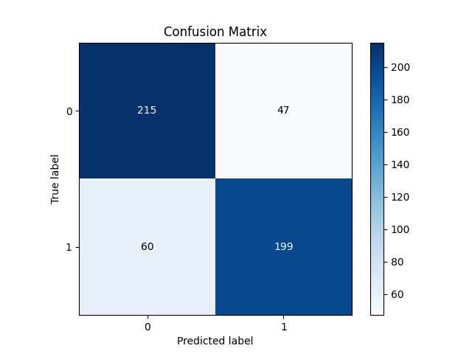
Logistic Regression
Figure on the right shows the Confusion Matrix for Logistic Regression Model.
From this curve, we can obtain Accuracy Score, which is the ratio of correct predictions to the total predictions made. Its value is 0.79462
True Negatives (TN) = 215
False Positives (FP) = 47
False Negatives (FN) = 60
True Positives (TP) = 199

Slide 20
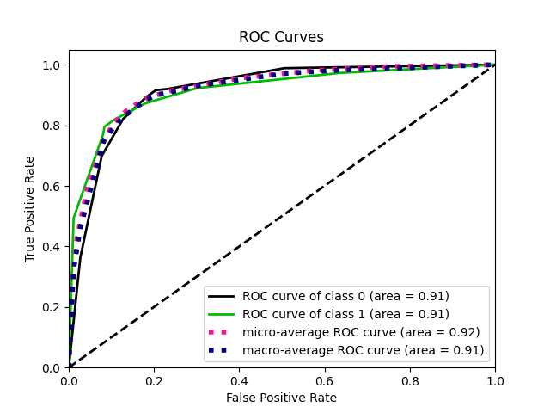
Decision Tree
Figure on the right shows the ROC Curve for Decision Tree Classifier.
From this curve, we can obtain AUC (Area under ROC Curve), which is a commonly used metric to evaluate the performance of a model. Its value is 0.91
Macro-Average ROC and Micro-Average ROC are generally used in multi-class or imbalanced datasets, hence they are similar to the roc curve of individual classes.

Slide 21
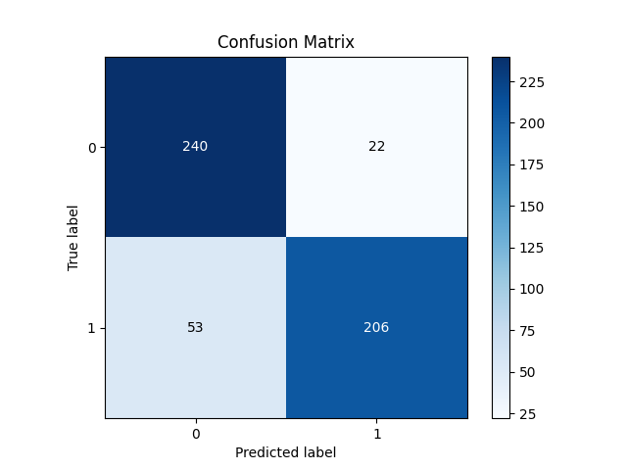
Decision Tree
Figure on the right shows the Confusion Matrix for Decision Tree Classifier.
From this curve, we can obtain Accuracy Score, which is the ratio of correct predictions to the total predictions made. Its value is 0.85604
True Negatives (TN) = 240
False Positives (FP) = 22
False Negatives (FN) = 53
True Positives (TP) = 206

Slide 22
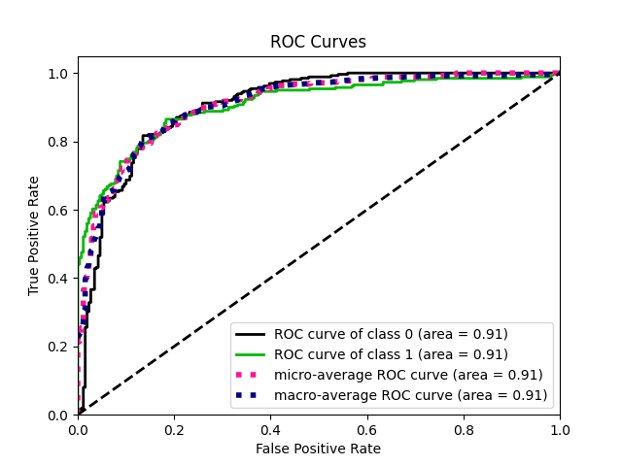
Support Vector Machine (SVM)
Figure on the right shows the ROC Curve for Support Vector Machine Model.
From this curve, we can obtain AUC (Area under ROC Curve), which is a commonly used metric to evaluate the performance of a model. Its value is 0.91
Macro-Average ROC and Micro-Average ROC are generally used in multi-class or imbalanced datasets, hence they are similar to the roc curve of individual classes.

Slide 23
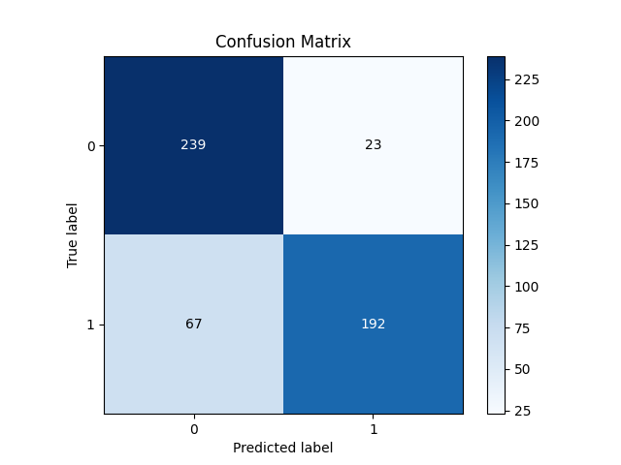
Support Vector Machine (SVM)
Figure on the right shows the Confusion Matrix for Support Vector Machine Model.
From this curve, we can obtain Accuracy Score, which is the ratio of correct predictions to the total predictions made. Its value is 0.82725
True Negatives (TN) = 239
False Positives (FP) = 23
False Negatives (FN) = 67
True Positives (TP) = 192

Slide 24
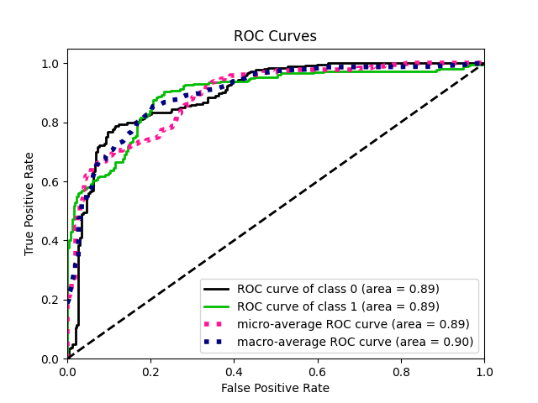
Gaussian Naive Bayes
Figure on the right shows the ROC Curve for Gaussian Naive Bayes Model.
From this curve, we can obtain AUC (Area under ROC Curve), which is a commonly used metric to evaluate the performance of a model. Its value is 0.89
Macro-Average ROC and Micro-Average ROC are generally used in multi-class or imbalanced datasets, hence they are similar to the roc curve of individual classes.

Slide 25
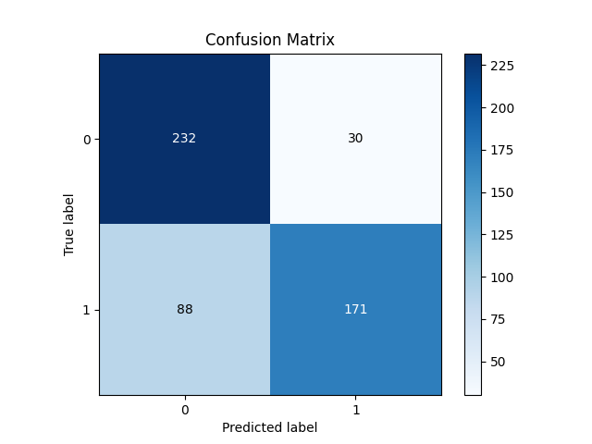
Gaussian Naive Bayes
Figure on the right shows the Confusion Matrix for Gaussian Naive Bayes Model.
From this curve, we can obtain Accuracy Score, which is the ratio of correct predictions to the total predictions made. Its value is 0.77351
True Negatives (TN) = 232
False Positives (FP) = 30
False Negatives (FN) = 80
True Positives (TP) = 171

Slide 26
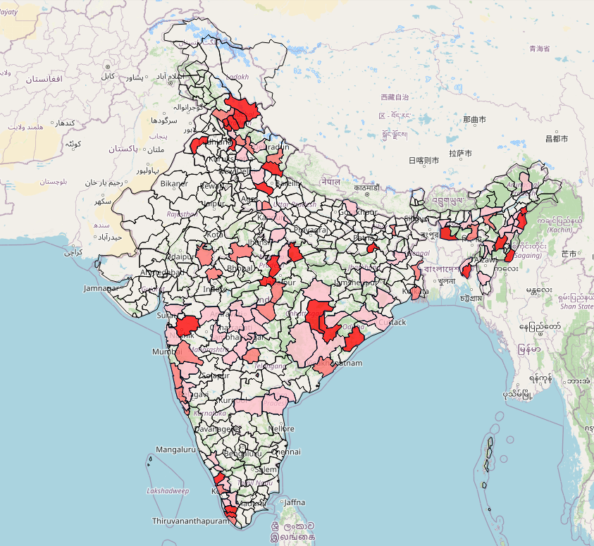
Landslide Visualization
OpenStreetMap (OSM), a free and open-source mapping platform, was used for data visualization
To create interactive maps and add features like hovering dialogue, shapefile shading, we have used the Folium library in python.
Folium is a Python library that allows users to create customized, interactive maps.
Figure: Shaded Regions Affected By Landslides

Slide 27
Landslide Visualization (contd…)
The map displays the predicted probability of landslides in various districts of India based on a machine learning model.
The severity of the landslide in each district is indicated by the darkness of the color, with darker shades representing higher severity.
Figure: Shaded Regions Affected By Landslides

Slide 28
Gender-Based Twitter Analysis

Slide 29
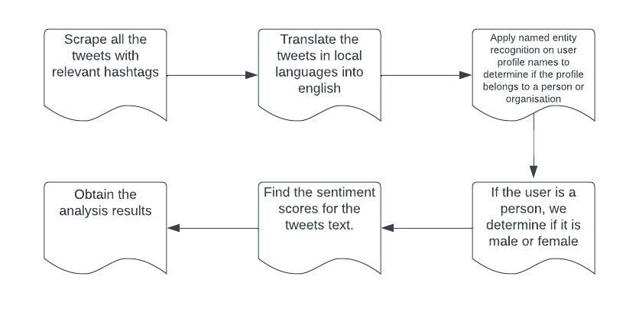
Flowchart
Figure: Flowchart For Gender-Based Twitter Analysis

Slide 30
Extracting Joshimath Crisis Tweets
We decided to use the Scweet library for tweet extraction which uses web scraping internally.
We have considered the following hashtags for extracting information from 1st December, 2022 to 8th February, 2023:
#Joshimath
#SaveJoshimath
#JoshimathIsSinking
#Joshimathcrisis
#joshimathsinking
We use Google Translate API for translating tweets to English as some tweets were in local languages.
Ultimately, we were able to extract total 5856 tweets.

Slide 31
Gender Estimation of user from Tweets
The process of estimating a user’s gender can be divided into two steps:
Person Identification: Identify whether a tweet is created by a person or an entity like news channels, govt bodies etc.
To accomplish this, we perform Named Entity Recognition (NER) on user’s name on twitter using spacy open-source library. The spacy model used is called en_core_web_trf and it does NER with an accuracy of 89.8%. From NER results, we can classify a user into PERSON or Non-PERSON.
Gender Estimation: If we find that a tweet is created by a PERSON, we use the name-based gender classification API provided by genderize.io to determine their gender.

Slide 32
Gender Estimation Statistics
Total Number of Tweets: 5856
Total Number of Male Tweets and Female Tweets are 1965 and 464 respectively
Total Number of Male Users and Female Users are 1154 and 259 respectively
Total Number of Persons: 1732 (1154 + 259 + people whose gender is unidentifiable)
Among male and female users, their gender has been determined with:
minimum probability of 50%
maximum probability of 100%
average probability of 98% (weighted average)

Slide 33
Gender Estimation Statistics (contd…)
Probability Range (%) | 50-59 | 60-69 | 70-79 | 80-89 | 90-99 | 100
No. of users | 9 | 11 | 16 | 52 | 260 | 1065
*Probability values were rounded to the nearest integer
Gender Prediction Probability Distribution the nearest integer

Slide 34
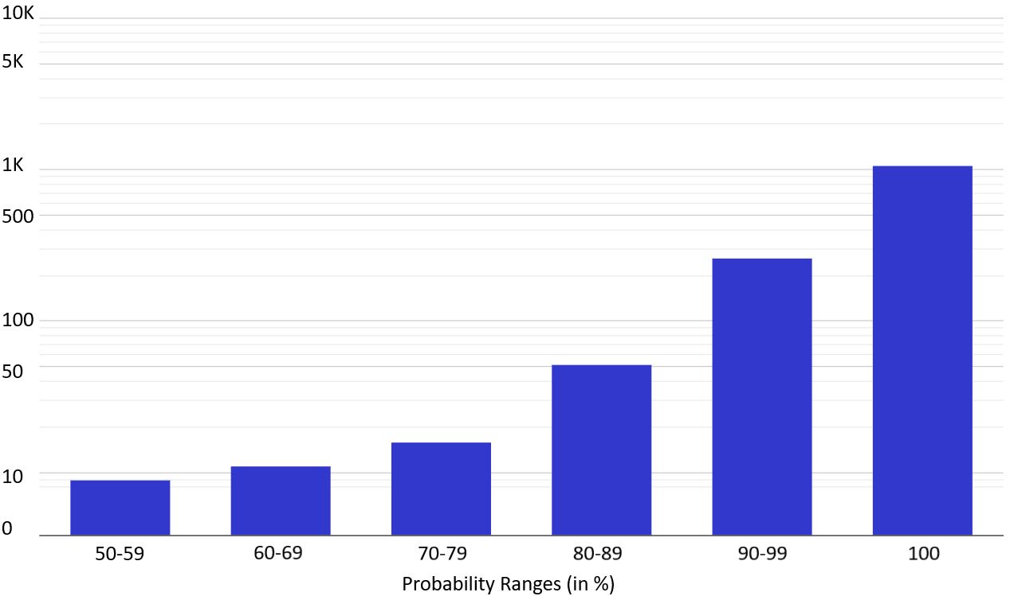
Gender Estimation Statistics (contd…)
Figure: Gender Probability Spread of 1413 Twitter Users

Slide 35
N-grams extraction from tweets’ text
n-grams are continuous sequence of words or tokens in a document. One token is called unigram and two tokens sequence is called bigram.
The text content of the tweets need to be pre-processed before we proceed with extraction of n-grams.
This includes converting to lowercase, removing punctuations and unwanted characters, tokenizing and lemmatizing.
We have extracted unigrams and bigrams along with the frequency of their occurrence for all the tweets and also male, female and non-persons separately.

Slide 36
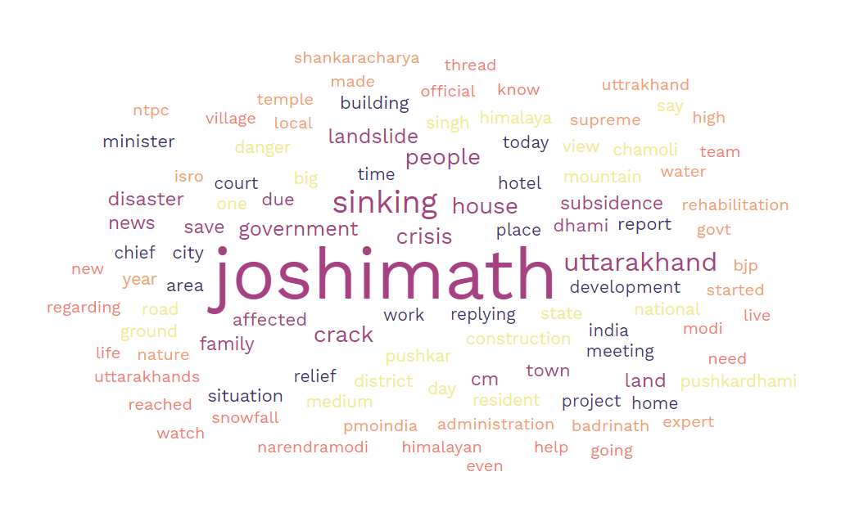
Figure: word cloud of top 100 words from all tweets

Slide 37
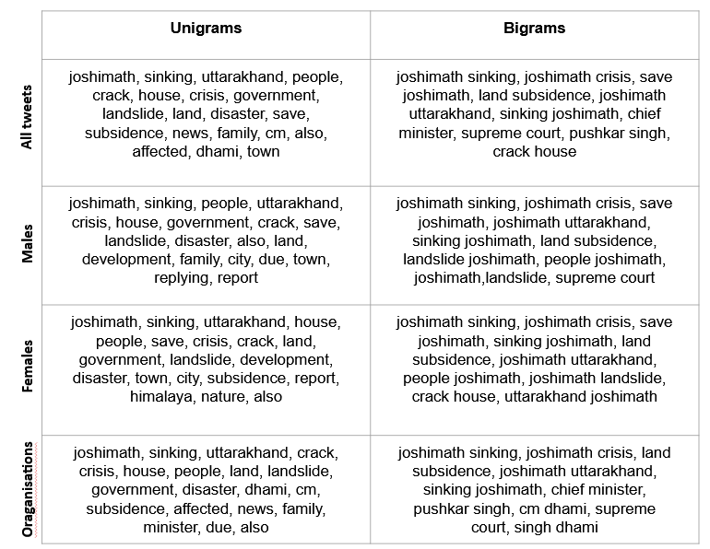
Figure: Top-20 Unigrams and Top-10 Bigrams from all entity types.

Slide 38
Observation from Unigrams and Bigrams
Analysis of the most common unigrams and bigrams used by different groups shows:
Top unigrams and bigrams are mostly similar.
Males may be more concerned on the economic and infrastructural impact of the disaster, use of words such as “development”, “report”, “town”.
Females may be more concerned on the environmental impact of the disaster, use of words such as “nature”, “Himalaya”.
Organisations may be more concerned on the political response to the disaster, use of words such as “Dhami”, “chief minister”.

Slide 39
Sentiment Analysis of Tweets
Through sentiment analysis, we aim to classify user’s tweets on basis of sentiments and opinions presented in their content.
Sentiment analysis was done for the text of the tweets through the VADER library (https://pypi.org/project/vaderSentiment/).
We can deduce gender-wise sentiments for people and also see how organizations are perceiving this incident.
This can help us get a better understanding of the commonality and differences in views and sentiments of different stakeholders.

Slide 40
Sentiment Analysis of Tweets (contd…)
Tweets can be classified according to the positive, negative or neutral sentiment they reflect.
Positive, negative, and neutral aspects of the tweets are measured on a scale of 0 to 1.
Example Tweet text: “Although this was posted just 10 days ago on Dec 27, it feels like a long time. It seems unbelievable that the situation has deteriorated so rapidly in #Joshimath in #Uttarakhand. In our own ways, let us express solidarity & hope for the best for the people of the battered town.”
Sentiment analysis result: {'neg': 0.0, 'neu': 0.757, 'pos': 0.243, 'compound': 0.967}
The sentiment of the text is highly positive.
Sentiment analysis results are compared groupwise.

Slide 41
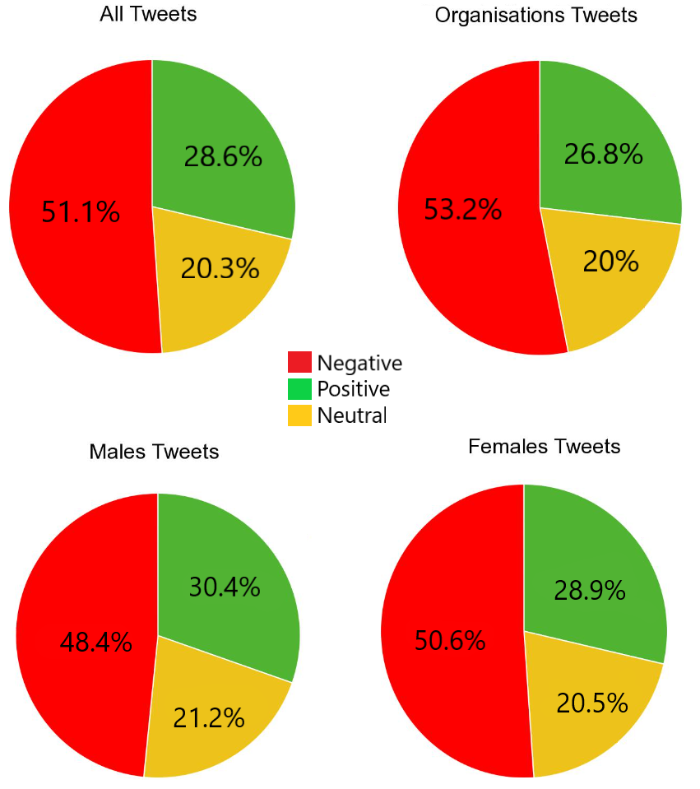
Figure: Percentage representations of sentiments of all, male, female and organisations tweets

Slide 42
Observation from Sentiment Analysis
Combining gender estimation with the sentiment analysis results we observe the following:
More than half of the tweets of all the groups are negative.
All groups have a predominantly negative response to the disaster.
The fact that organizations, which are typically perceived as more stoic and less emotional than individuals, have a similar sentiment distribution to individuals suggests that the crisis elicited a strong emotional response from all stakeholders.

Slide 43
Conclusions and Future Work

Slide 44
Conclusions and Future Work
Future Work:
Examining the impact of other factors such as vegetation, soil and bedrock on occurrence of landslides. Enhancing the datasets like accommodating more landslides cases from different sources in current dataset. Investigating the performance/accuracy of deep learning algorithms.
Gender estimation can be improved by graphical analysis of user's profile image. Performing Social Network Analysis can provide an understanding of the network structure, information diffusion, and gender-specific dynamics
Even then, our results prove that with better datasets, these systems can find great use in early warning systems for forecasting rainfall-induced landslides.

Slide 45
References
[1] F. Tehrani, G. Santinelli, and M. Herrera, “A framework for predicting rainfall-induced landslides
using machine learning methods un cadre pour predire les glissements de terrain induits par les ´
precipitations ´ a l’aide d’un apprentissage automatique,” 09 2019. `
[2] M. J. Froude and D. N. Petley, “Global fatal landslide occurrence from 2004 to 2016,” Nat. Hazards
Earth Syst. Sci, vol. 18, p. 2161–2181, 2018.
[3] I. S. R. Institute, “Disaster management: National and international,” accessed: Nov 27, 2022.
[Online]. Available: https://www.isro.gov.in/DisaterManagementNationalInternational.html
[4] D. Kumar, M. Thakur, C. Dubey, and D. Shukla, “Landslide susceptibility mapping and prediction
using support vector machine for mandakini river basin, garhwal himalaya, india,” Geomorphology,
vol. 295, 06 2017.
[5] Y. R M and B. Dolui, “Statistical and machine intelligence based model for landslide susceptibility
mapping of nilgiri district in india,” Environmental Challenges, vol. 5, p. 100211, 07 2021.
[6] S. Meena, O. Ghorbanzadeh, C. Westen, T. Gudiyangada, T. Blaschke, R. Singh, and R. Sarkar,
“Rapid mapping of landslides in the western ghats (india) triggered by 2018 extreme monsoon
rainfall using a deep learning approach,” Landslides, 01 2021.
[7] D. Kirschbaum, R. Adler, Y. Hong, S. Hill, and A. Lerner-Lam, “A global landslide catalog for
hazard applications: Method, results, and limitations,” Natural Hazards, vol. 52, pp. 561–575, 03
2009.
[8] Open-Meteo, Historical Weather API, accessed: Apr 10, 2023. [Online]. Available:
https://open-meteo.com/en/docs/historical-weather-api

Slide 46
References (contd…)
[9] H. Hersbach, B. Bell, P. Berrisford, S. Hirahara, A. Horanyi, J. Mu ´ noz Sabater, J. Nicolas, ˜
C. Peubey, R. Radu, D. Schepers, A. Simmons, C. Soci, S. Abdalla, X. Abellan, G. Balsamo,
P. Bechtold, G. Biavati, J. Bidlot, M. Bonavita, and J.-N. Thepaut, “The era5 global reanalysis,” ´
Quarterly Journal of the Royal Meteorological Society, 05 2020.
[10] T. Farr, P. Rosen, E. Caro, R. Crippen, R. Duren, S. Hensley, M. Kobrick, M. Paller, E. Rodriguez,
L. Roth, D. Seal, S. Shaffer, J. Shimada, J. Umland, M. Werner, M. Oskin, D. Burbank, and D. Alsdorf,
“The shuttle radar topography mission,” Rev. Geophys., vol. 45, 06 2007.
[11] S. He, J. Wang, and S. Liu, “Rainfall event–duration thresholds for landslide occurrences in china,”
Water, vol. 12, no. 2, 2020. [Online]. Available: https://www.mdpi.com/2073-4441/12/2/494
[12] T. Hindu, “Joshimath sank by 5.4 cm in 12 days, says isro report,” accessed: Feb
25, 2023. [Online]. Available: https://www.thehindu.com/sci-tech/energy-and-environment/
isro-releases-satellite-images-showing-rise-in-joshimath-land-subsidence/article66373138.ece
[13] Y. A. Jeddi, A simple and unlimited twitter scraper, accessed: Feb 25, 2023. [Online]. Available:
https://github.com/Altimis/Scweet
[14] Explosion, Industrial-strength Natural Language Processing (NLP) in Python, accessed: Nov 27,
2022. [Online]. Available: https://pypi.org/project/spacy/
[15] ——, Facts and Figures, The hard numbers for spaCy and how it compares to other tools, accessed:
May 12, 2023. [Online]. Available: https://spacy.io/usage/facts-figures

Slide 47
References (contd…)
[16] C. Strømgren, genderize.io: A simple API to predict the gender of a person given their name,
accessed: Feb 25, 2023. [Online]. Available: https://genderize.io
[17] C. Hutto, VADER (Valence Aware Dictionary and sentiment Reasoner), accessed: Feb 25, 2023.
[Online]. Available: https://pypi.org/project/vaderSentiment/
[18] H. Thami, Purushottam, and D. Chaudhari, “Twitter dataset,” accessed: Feb 25, 2023. [Online]. Available: https://docs.google.com/spreadsheets/d/1kg6jav48zBSfbBxroRskB3rFiOWSvnG-TyQyipQj-0Q/edit?usp=sharing

Slide 48

Thank You

