Slide 1
Introduction to Machine Learning
Section 1.1

Slide 2
1.1 Introduction to Machine Learning
Issues in Machine Learning
Application of Machine Learning
Steps of developing a Machine Learning Application.

Slide 3
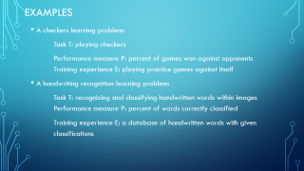
What is machine learning?
Machine learning is an area I computer science which involves teaching computers to do things naturally by learning through experience.
This means that the computer systems is turning data into information.
Machine learning algorithms derive information from data without the help of any model.
Definition: A computer program is said to learn from experience E with respect to some class of tasks T and performance measure P, if its performance at tasks in T, as measured by P, improves with experience E
In general, for a well defined problem three features should be identified: the class of tasks, the measure of performance to be improved and the source of information.

Slide 4
Examples
A checkers learning problem:
Task T: playing checkers
Performance measure P: percent of games won against opponents Training experience E: playing practice games against itself
A handwriting recognition learning problem:
Task T: recognizing and classifying handwritten words within images Performance measure P: percent of words correctly classified
Training experience E: a database of handwritten words with given classifications

Slide 5
A robot driving learning problem:
Task T: driving on public four-lane highways using vision sensors Performance measure P: average distance traveled before an error (as judged by human overseer)
Training experience E: a sequence of images and steering commands recorded while observing a human driver

Slide 6
Applications of Machine learning
Learning to recognize spoken words.
All of the most successful speech recognition systems employ machine learning in some form. For example, the SPHINX system learns speaker-specific strategies for recognizing the primitive sounds (phonemes) and words from the observed speech signal. Neural network learning methods and methods for learning hidden Markov models are effective for automatically customizing to, individual speakers, vocabularies, microphone characteristics, background noise, etc. Similar techniques have potential applications in many signal-interpretation problems.

Slide 7
Learning to drive an autonomous vehicle:
Machine learning methods have been used to train computer-controlled vehicles to steer correctly when driving on a variety of road types
Learning to classify new astronomical structures
Machine learning methods have been applied to a variety of large databases to learn general regularities implicit in the data. For example, decision tree learning algorithms have been used by NASA to learn how to classify celestial objects from the second Palomar Observatory Sky Survey (Fayyad et al. 1995). This system is now used to automatically classify all objects in the Sky Survey, which consists of three terrabytes of image data.

Slide 8
Learning to play world-class backgammon.
The most successful computer programs for playing games such as backgammon are based on machiie learning algorithms

Slide 9
Types of learning
Supervised
Unsupervised
Reinforcement

Slide 13
DESIGNING A LEARNING SYSTEM
To get a successful learning system , it could be designed.
For a proper design several steps (for perfect and efficient system)should be followd
Choosing the Training Experience
Choosing the Target Function
Choosing a Representation for the Target Function
Choosing a Function Approximation Algorithm
Final design is obtained

Slide 14
DESIGNING A LEARNING SYSTEM
Choosing the Training Experience
The first design choice we face is to choose the type of training experience from which our system will learn.
The type of training experience available can have a significant impact on success or failure of the learner.
In choosing a training experience three attributes are taken
Type of feedback – direct/ indirect
Degree
Distribution of examples
One key attribute is whether the training experience provides direct or indirect feedback regarding the choices made by the performance system.
A second important attribute of the training experience is the degree to which the learner controls the sequence of training examples.
A third important attribute of the training experience is how well it represents the distribution of examples over which the final system performance P must be measured. In general, learning is most reliable when the training examples follow a distribution similar to that of future test examples

Slide 15
Type of feedback – direct/ indirect
One key attribute is whether the training experience provides direct or indirect feedback regarding the choices made by the performance system
E.g. In checkers game , we will be making moves. After every move computer will tell whether we made correct move or wrong move
In learning driving example, consider you are driving car and trainer is sitting beside you. While driving, everything will be told by the trainer about accelerator, gear, clutch , steering wheel . On which road which gear to use , everything will be told by trainer even when we are driving . That is for each and every step , trainer will be giving instructions.
The above two example are of direct feedback where spontaneous and continuous instructions are given.

Slide 16
In Indirect feedback, the trainer will not be physically beside you, some recorded instructions are given. No simultaneous and continuous instructions that are pre recorded will be given irrespective of the step you take. So whether you are driving good or bad doesn’t matter, it will simply give recorded instructions.
In checkers game also , in case of indirect feedback , whether the move is correct or wrong will not be told instead hints will be given

Slide 17
Degree
the degree to which the learner controls the sequence of training examples.
E.g. learning driving
With trainers help
Completely on your own
With trainers partial help

Slide 18
Distribution of examples
how well it represents the distribution of examples over which the final system performance P must be measured.
learning is most reliable when the training examples follow a distribution similar to that of future test example
More possible combinations
More situations, more examples
Learning over distributed range of examples
E.g. software testing, learning driving- 2 lane/4 lane/ highway/ hilly area

Slide 19
E.g.
A checkers learning problem:
Task T: playing checkers
Performance measure P: percent of games won in the world tournament Training experience E: games played against itself
In order to complete the design of the learning system, we must now choose
the exact type of knowledge to be learned
a representation for this target knowledge
a learning mechanism

Slide 20
2. Choosing the Target Function :
The next design choice is to determine exactly what type of knowledge will be learned and how this will be used by the performance program
E.g. checkers game
In checkers game , we are allowed to travel only in one direction, can make only one move per chance, only in diagonal direction, jump over opponent.
In this game, when we are moving diagonally , set of all possible moves(left diagonal or right diagonal) is called legal moves . Out of possible moves you can take one move and that move is called target move. Target moves can be represented by a target function V(b)
Board state – b(i.e. initial state, final state etc.)
Set of legal moves- B

Slide 21
The notation V : B ->ℛ to denote that V maps any legal board state from the set B to some real value (we use ℛ to denote the set of real numbers).
We intend for this target function V to assign higher scores to better board states. If the system can successfully learn such a target function V, then it can easily use it to select the best move from any current board position.
What exactly should be the value of the target function V for any given board state?
Of course any evaluation function that assigns higher scores to better board states will do. we will find it useful to define one particular target function V among the many that produce optimal play.
Let us define the target value V(b) for an arbitrary board state b in B, as follows:
if b is a final board state that is won, then V(b) = 100
if b is a final board state that is lost, then V(b) = -100
if b is a final board state that is drawn, then V(b) = 0
4. if b is a not a final state in the game, then V(b) = V(b’), where b' is the best final board state that can be achieved starting from b and playing optimally until the end of the game

Slide 22
The goal of learning in this case is to discover an operational description of V; that is, a description that can be used by the checkers-playing program to evaluate states and select moves within realistic time bounds.
It may be very difficult in general to learn such an operational form of V perfectly. In fact, we often expect learning algorithms to acquire only some approximation to the target function, and for this reason the process of learning the target function is often called function approximation

Slide 23
3. Choosing a Representation for the Target Function
we must choose a representation that the learning program will use to describe the function V that it will learn.
We could, for example, allow the program to represent using a large table with a distinct entry specifying the value for each distinct board state.
Or we could allow it to represent using a collection of rules that match against features of the board state, or a quadratic polynomial function of predefined board features, or an artificial neural network.
In general, this choice of representation involves a crucial tradeoff. On one hand, we wish to pick a very expressive representation to allow representing as close an approximation as possible to the ideal target function V. On the other hand, the more expressive the representation, the more training data the program will require in order to choose among the alternative hypotheses it can represent

Slide 24
E.g. in checkers game
the function V will be calculated as a linear combination of the following board features:
x1: the number of black pieces on the board
x2: the number of red pieces on the board
x3: the number of black kings on the board
x4: the number of red kings on the board
x5: the number of black pieces threatened by red (i.e., which can be captured on red's next turn)
X6: the number of red pieces threatened by black
Thus, our learning program will represent V(b) as a linear function of the form where wo through W6 are numerical coefficients, or weights, to be chosen by the learning algorithm.

Slide 25

4. Choosing a Function Approximation Algorithm
Steps to follow:
derives such training examples from the indirect training experience available to the learner
adjusts the weights wi to best fit these training examples.

Slide 26
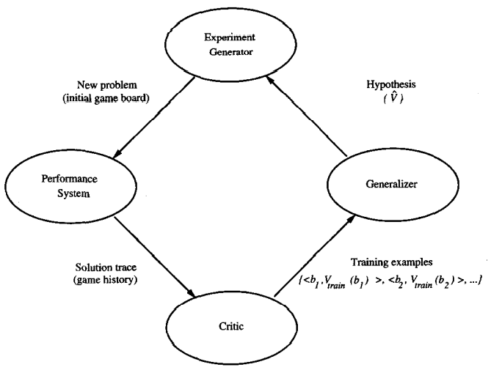
The Final Design

Slide 27
The Performance System :
is the module that must solve the given performance task, in this case playing checkers, by using the learned target function(s).
It takes an instance of a new problem (new game) as input and produces a trace of its solution (game history) as output.
In our case, the strategy used by the Performance System to select its next move at each step is determined by the learned p evaluation function.
Therefore, we expect its performance to improve as this evaluation function becomes increasingly accurate

Slide 28
The Critic:
takes as input the history or trace of the game and produces as output a set of training examples of the target function.
As shown in the diagram, each training example in this case corresponds to some game state in the trace, along with an estimate Vtrain, of the target function value for this example
The Generalizer :
takes as input the training examples and produces an output hypothesis that is its estimate of the target function. It generalizes from the specific training examples, hypothesizing a general function that covers these examples and other cases beyond the training examples. I

Slide 29
The Experiment Generator :
takes as input the current hypothesis (currently learned function) and outputs a new problem (i.e., initial board state) for the Performance System to explore. Its role is to pick new practice problems that will maximize the learning rate of the overall system.

Slide 30
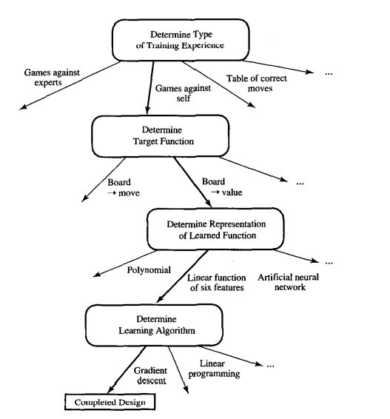

Slide 31
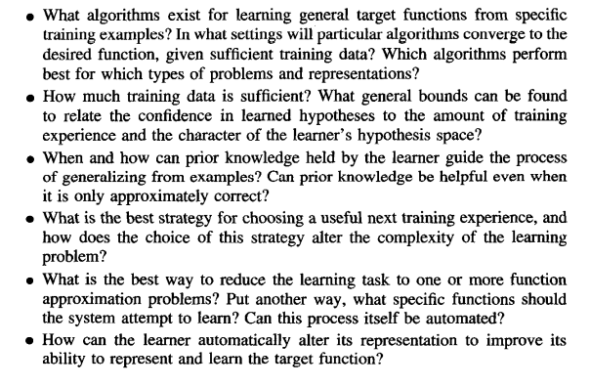
Issues in Machine Learning

Slide 32
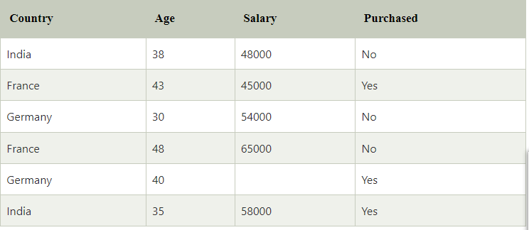
What is a dataset?
A dataset is a collection of data in which data is arranged in some order. A dataset can contain any data from a series of an array to a database table. Below table shows an example of the dataset:
A tabular dataset can be understood as a database table or matrix, where each column corresponds to a particular variable, and each row corresponds to the fields of the dataset. The most supported file type for a tabular dataset is "Comma Separated File," or CSV. But to store a "tree-like data," we can use the JSON file more efficiently.

Slide 33
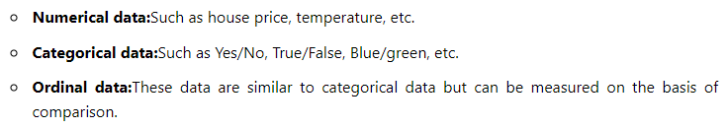
Types of data in datasets

Slide 34
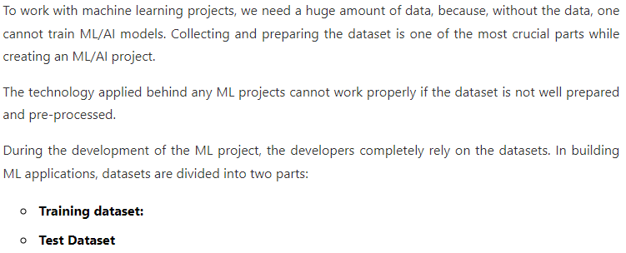
Need of Dataset

Slide 35
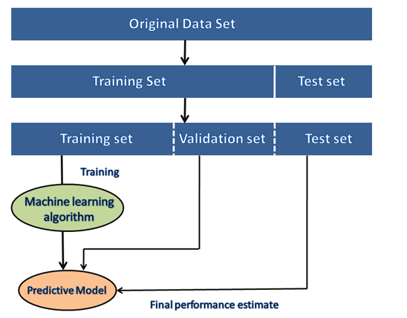

Slide 36
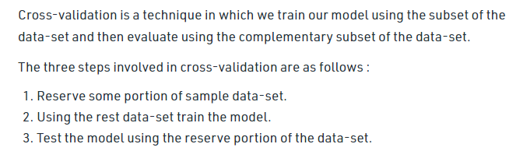
cross validation

Slide 37
overfitting and under fitting of model
A model is said to be a good machine learning model if it generalizes any new input data from the problem domain in a proper way. This helps us to make predictions in the future data, that the data model has never seen. Now, suppose we want to check how well our machine learning model learns and generalizes to the new data. For that, we have overfitting and underfitting, which are majorly responsible for the poor performances of the machine learning algorithms.
Before diving further let’s understand two important terms:
Bias: Assumptions made by a model to make a function easier to learn.
Variance: If you train your data on training data and obtain a very low error, upon changing the data and then training the same previous model you experience a high error, this is variance.

Slide 38
Underfitting:
A statistical model or a machine learning algorithm is said to have underfitting when it cannot capture the underlying trend of the data.
Underfitting destroys the accuracy of our machine learning model. Its occurrence simply means that our model or the algorithm does not fit the data well enough.
It usually happens when we have fewer data to build an accurate model and also when we try to build a linear model with fewer non-linear data.
In such cases, the rules of the machine learning model are too easy and flexible to be applied on such minimal data and therefore the model will probably make a lot of wrong predictions.
Underfitting can be avoided by using more data and also reducing the features by feature selection.
In a nutshell, Underfitting – High bias and low variance

Slide 39
Techniques to reduce underfitting:
Increase model complexity
Increase the number of features, performing feature engineering
Remove noise from the data.
Increase the number of epochs or increase the duration of training to get better results.

Slide 40
Overfitting:
A statistical model is said to be overfitted when we train it with a lot of data
When a model gets trained with so much data, it starts learning from the noise and inaccurate data entries in our data set. Then the model does not categorize the data correctly, because of too many details and noise.
A solution to avoid overfitting is using a linear algorithm if we have linear data or using the parameters like the maximal depth if we are using decision trees.
In a nutshell, Overfitting – High variance and low bias

Slide 41
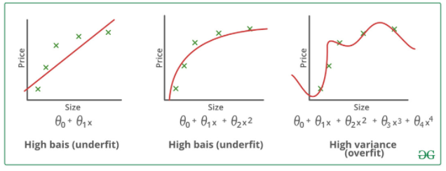
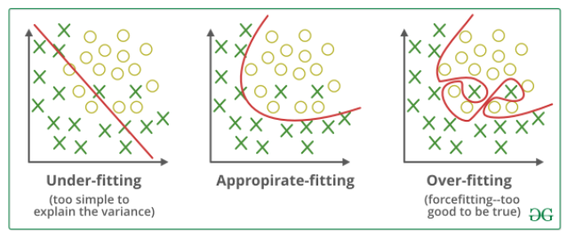

Slide 42
Techniques to reduce overfitting:
Increase training data.
Reduce model complexity.
Early stopping during the training phase (have an eye over the loss over the training period as soon as loss begins to increase stop training).
Ridge Regularization and Lasso Regularization
Use dropout for neural networks to tackle overfitting.

Slide 43
Performance Measures
There are various metrics which we can use to evaluate the performance of ML algorithms.
We must carefully choose the metrics for evaluating ML performance because
How the performance of ML algorithms is measured and compared will be dependent entirely on the metric you choose.
How you weight the importance of various characteristics in the result will be influenced completely by the metric you choose.

Slide 44
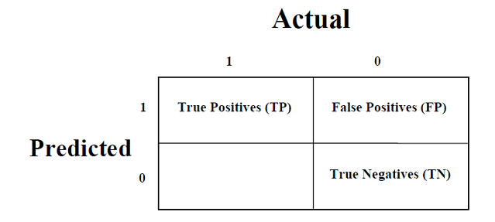
1. Confusion Matrix
It is the easiest way to measure the performance of a classification problem where the output can be of two or more type of classes.
A confusion matrix is nothing but a table with two dimensions viz. “Actual” and “Predicted” and furthermore, both the dimensions have “True Positives (TP)”, “True Negatives (TN)”, “False Positives (FP)”, “False Negatives (FN)” as shown below −

Slide 45
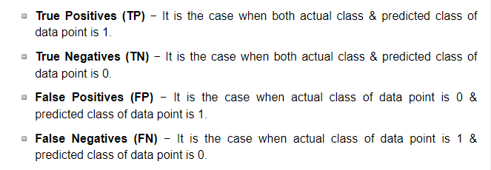

Slide 46
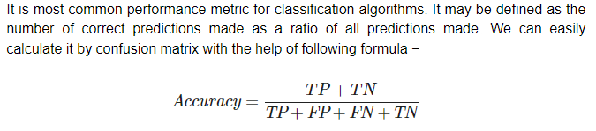
Classification Accuracy

Slide 47
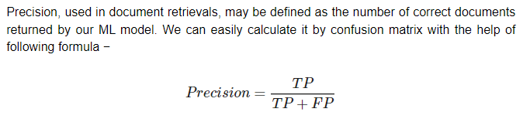
Precision

Slide 48
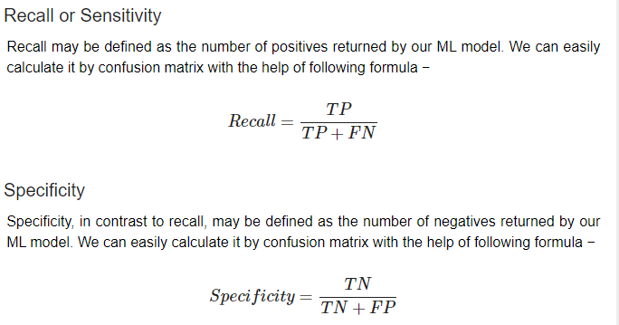

Slide 49
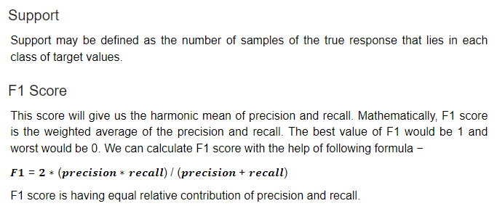

Slide 50
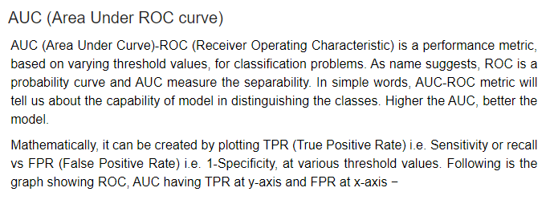
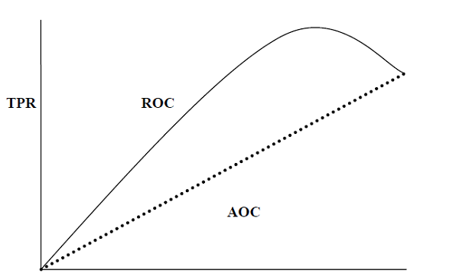

Slide 51
LOGLOSS (Logarithmic Loss)
It is also called Logistic regression loss or cross-entropy loss.
It basically defined on probability estimates and measures the performance of a classification model where the input is a probability value between 0 and 1
accuracy is the count of predictions (predicted value = actual value) in our model whereas Log Loss is the amount of uncertainty of our prediction based on how much it varies from the actual label.

Slide 52
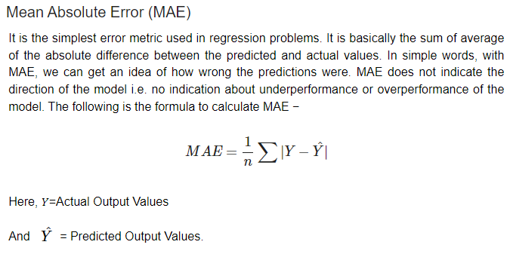

Slide 53
