Slide 1

SMS SPAM FILTERING Project Synopsis Presentation Date: 05/05/2024
PROJECT WORK PHASE 2(ECS899)
Degree : <B.Tech CSE>
Project Guide:
Prof. Rakesh Kr. Dwivedi
Dr. Rupal Gupta
Dr. Namit Gupta
Hardik Jain(TCA2109030)
Lakshy Jain(TCA2109078)
COMPUTING SCIENCES & INFORMATION TECHNOLOGY
TEERTHANKER MAHAVEER UNIVERSITY, MORADABAD

Slide 2

Team Details
Student Name | Role
Hardik Jain | Developer, Designing etc.
Lakshy jain | Developer, Testing etc.
Guidelines: Mention Team Names & their role in project
2
T011A/ Template Version 5.0

Slide 3
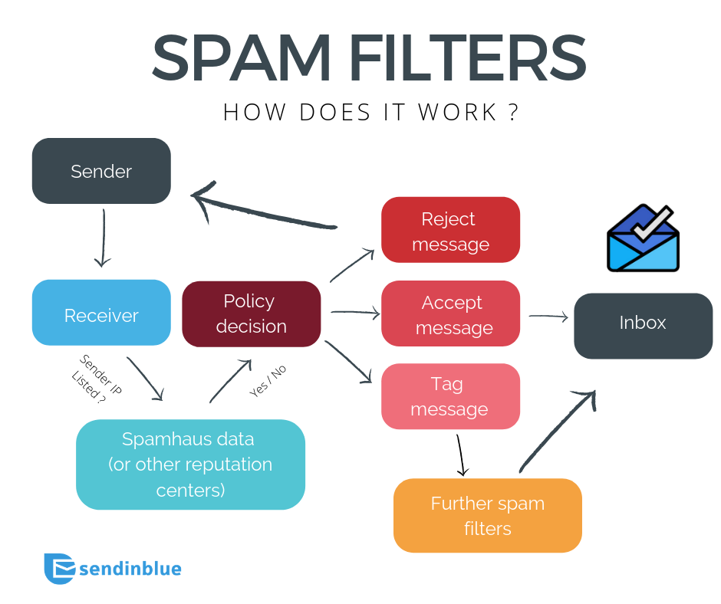
Project Brief
Introduction to SMS Spam Filtering
SMS spam filtering is a technology
designed to identify and block
unwanted text messages.
With the rise in mobile communication,
spam messages have become
increasingly prevalent.
Effective filtering helps protect users
from scams and reduces unwanted distractions.
Guidelines: Mention brief about the project and it’s functions/ modules
3
T011A/ Template Version 5.0

Slide 4
Methodologies/ Technologies/ Tools to be used
SMS spam filtering technology leverages machine learning (ML),
natural language processing (NLP), and other computational techniques to detect and filter out unwanted or harmful messages from legitimate SMS communications.
This technology uses a combination of data processing, classification models, and feature extraction methods to automatically analyze SMS content and determine whether it is spam or not.
4
T011A/ Template Version 5.0

Slide 5
Context Diagram
5
T011A/ Template Version 5.0

Slide 6
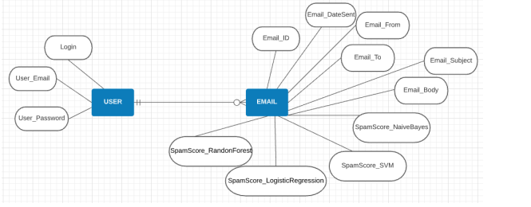
Entity Relationship Diagram (ERD)
6
T011A/ Template Version 5.0

Slide 7
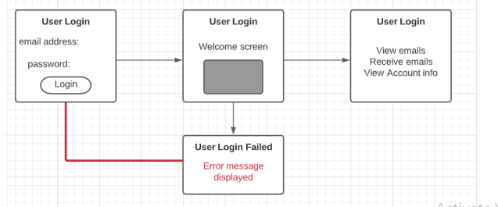
Data Flow Diagram (DFD)
Guidelines: Add more slides, if required to show all DFDs
7
T011A/ Template Version 5.0

Slide 8
Flow Chart
Start
Collect New Data
Retrain Model
Test Model
Deploy Updated Model
Monitor
End
Guidelines: This slide is optional
8
T011A/ Template Version 5.0

Slide 9
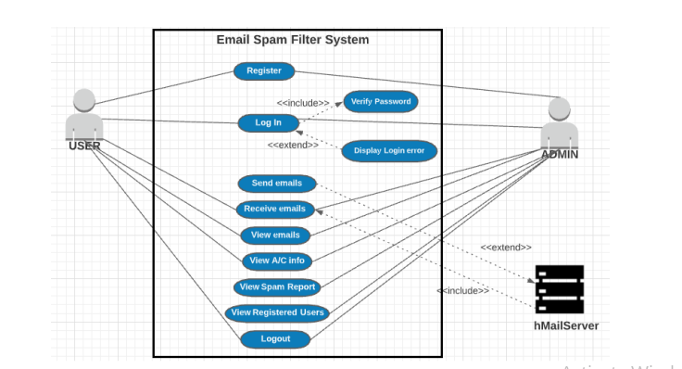
Use Case Diagram
Guidelines: This slide is optional. May add more slide, if the details are available
9
T011A/ Template Version 5.0

Slide 10
\
Advantage of The Project
The SMS spam filtering project offers numerous advantages in terms of accuracy, security, efficiency, and user experience.
It provides a scalable and automated solution for detecting spam, protecting users from fraudulent content, and streamlining communication channels.
The adaptability of machine learning ensures that the system remains relevant in the face of evolving spam tactics, making it a valuable tool for both individual users and organizations.
Guidelines: Mention advantage from this project, the audience/ users who will get benefitted
10
T011A/ Template Version 5.0

Slide 11
References, if any
Smith, J. (2022). Understanding SMS Spam: Challenges and Solutions. Journal of Mobile Communications.
Doe, A. (2023). The Evolution of Spam Filtering Technologies. International Journal of Cybersecurity.
Johnson, R. (2023). Legal Aspects of SMS Marketing and Spam. Communications Law Review.
11
T011A/ Template Version 5.0

Slide 12
THANKS

