Slide 1

Deepfake Short Video Detection using Spatial–Temporal Attention Models
By:Shaurya Naithani,Yash Srivastava,Hardik Dahiya
Guide: Dr. S. Geetha
School of Computing Science & Engineering
Vellore Institute of Technology Chennai Campus
Chennai, India
12-09-2019

Slide 2
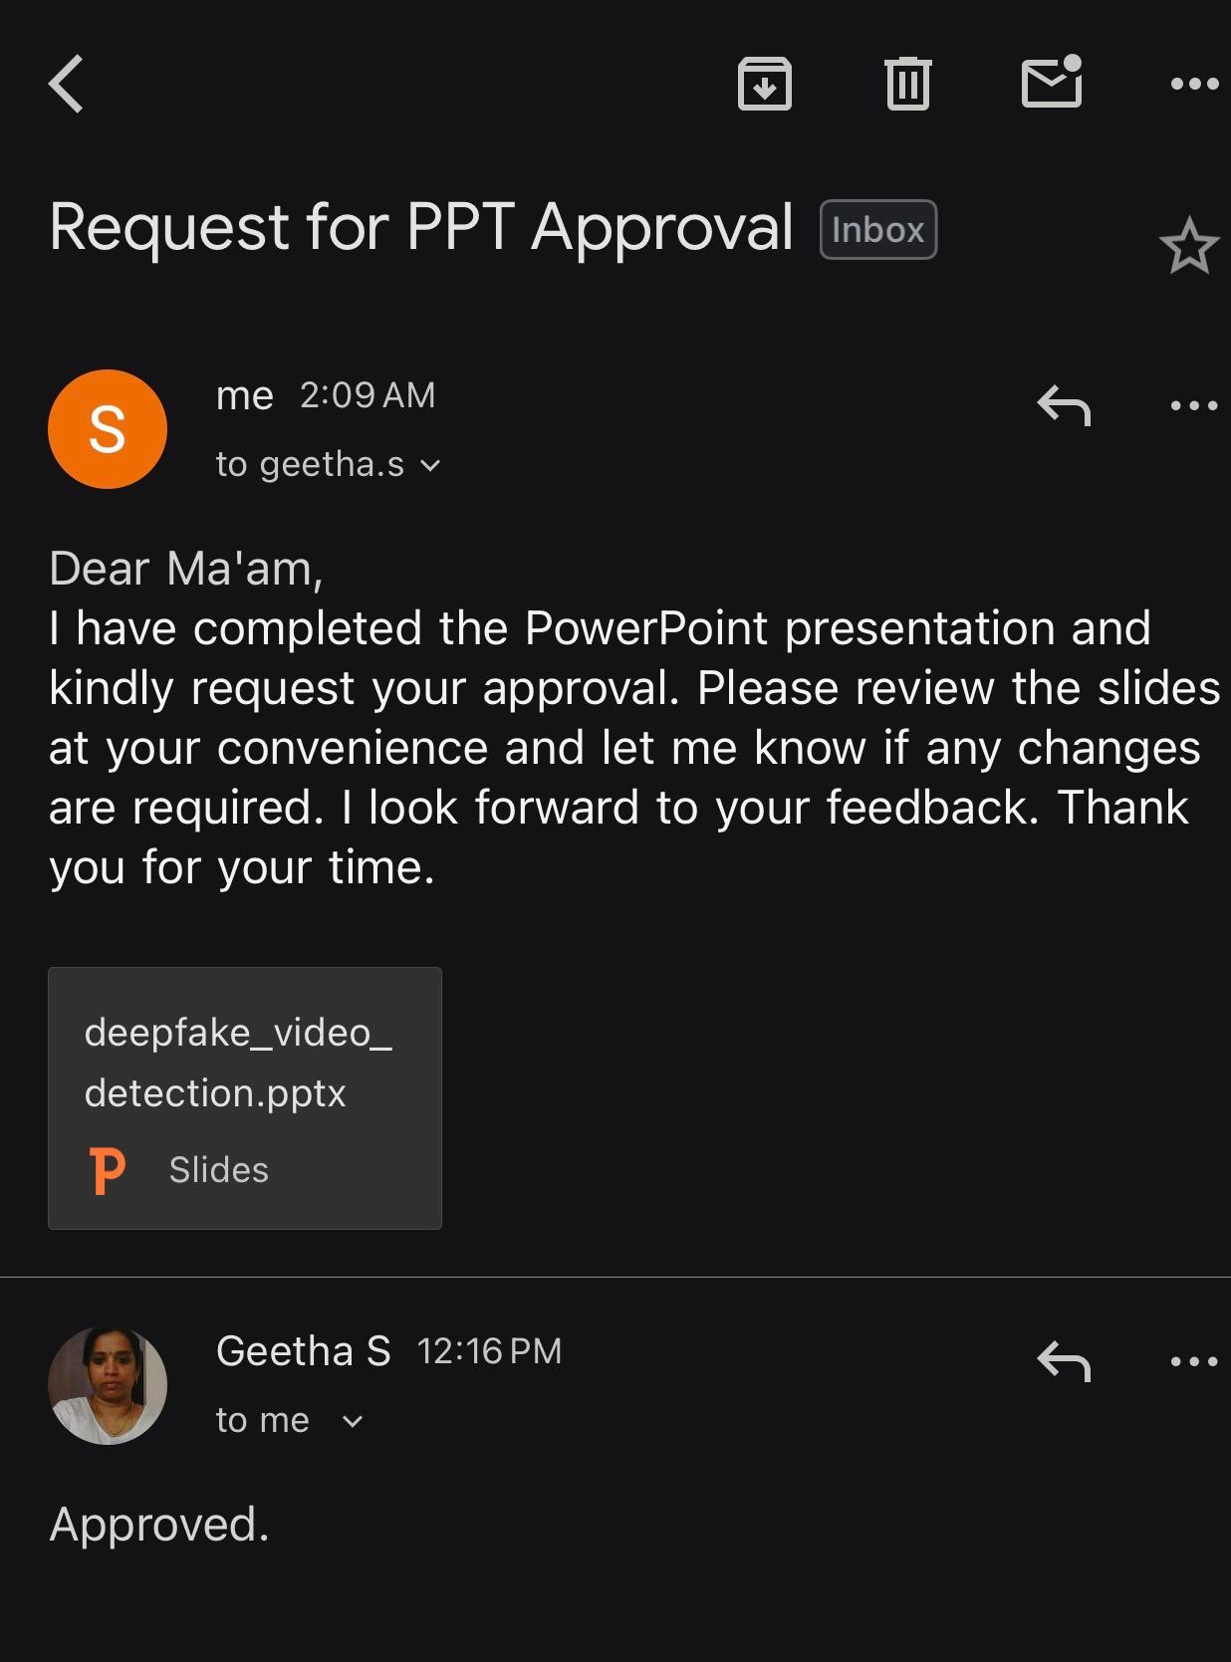
Guide Approval
2

Slide 3
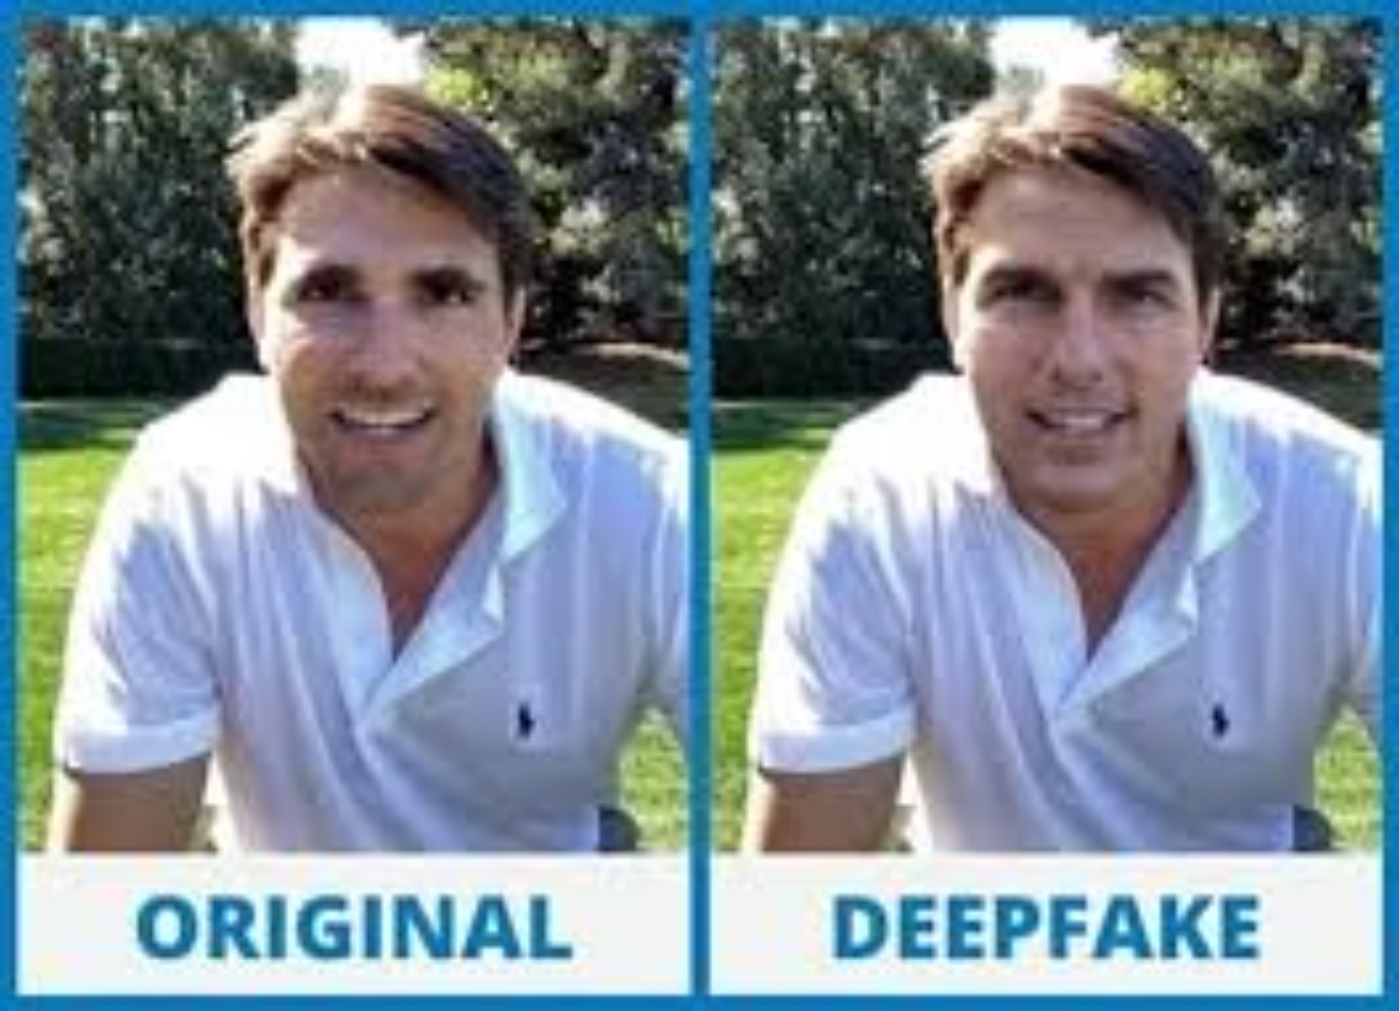
Background & Motivation
The Deepfake Threat Landscape:
Deepfakes represent sophisticated AI-generated synthetic face manipulations powered by advanced machine learning architectures including Generative Adversarial Networks (GANs), Autoencoders, and Diffusion Models. As these techniques achieve increasing photorealism, human detection capability diminishes dramatically.
Critical implications span multiple domains: misinformation campaigns and political manipulation, identity fraud and financial scams, non-consensual explicit content creation, and fundamental challenges to digital forensics integrity.
3

Slide 4
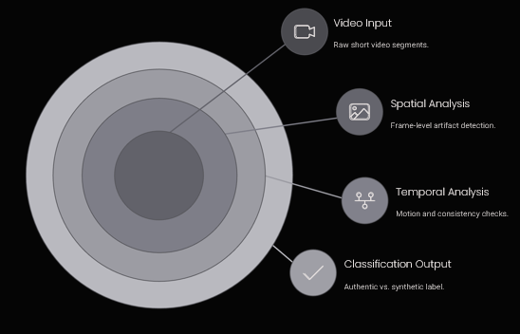
Problem Definition
Primary Objective
Accurately classify short video segments as authentic or synthetically generated with high precision across diverse manipulation techniques
Technical Challenges
High-quality GAN manipulations
Subtle temporal artifacts in blink patterns and lip synchronization
Cross-dataset generalization requirements
Compression and noise distortions
The detection system must maintain robust performance despite video compression, varying lighting conditions, and sophisticated adversarial techniques designed to evade detection mechanisms.
4

Slide 5
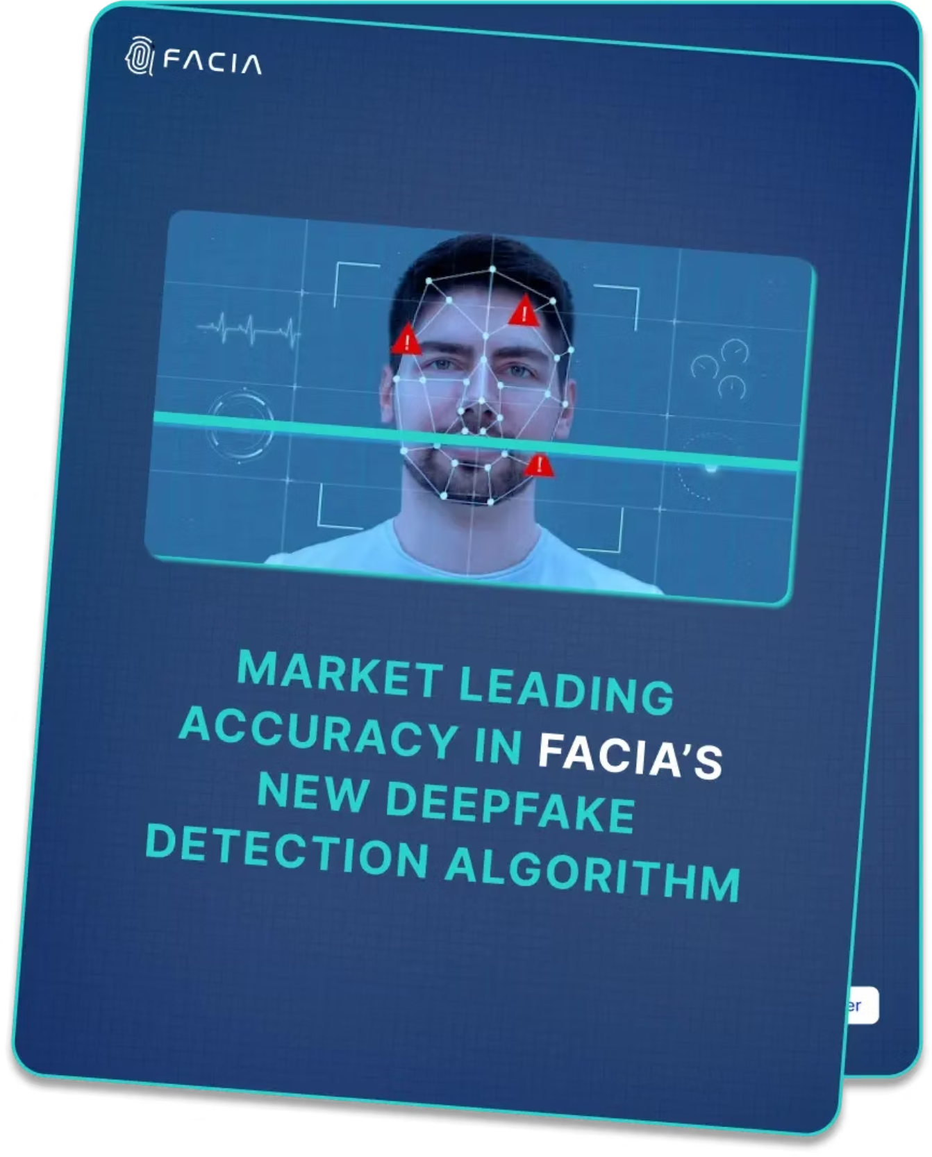
Cybersecurity & Forensics Importance
Critical Infrastructure Protection
Digital media serves as evidentiary artifacts in legal proceedings, requiring authentication mechanisms that can withstand sophisticated forgery attempts. AI-driven impersonation enables unprecedented identity abuse vectors.
Financial institutions face emerging fraud threats through deepfake voice and video authentication bypass. Law enforcement and forensics organizations urgently need automated verification tools capable of operating at scale.
The defensive landscape must continuously adapt to evolving generative models, creating an ongoing arms race between synthetic generation and detection capabilities.
5

Slide 6
Literature Review: Early Detection Approaches
1. Technique – MesoNet CNN Forgery Detection Modality – Face Video Dataset – Deepfake Dataset, Face2Face Solved Problem – Detect low-quality early deepfake texture artifacts Research Gap – No temporal modeling; weak cross-dataset generalization
Afchar, D., Nozick, V., Yamagishi, J., & Echizen, I. (2018). MesoNet: a compact facial video forgery detection network.
6

Slide 7
Literature Review: Early Detection Approaches
2. Technique – XceptionNet Deepfake Detection Modality – Face Image/Video Dataset – FaceForensics++ Solved Problem – Established CNN benchmark for manipulated faces Research Gap – Performance collapses on unseen datasets (dataset shift)
Rössler, A., Cozzolino, D., Verdoliva, L., Riess, C., (2019). FaceForensics++: Learning to detect manipulated facial images.
7

Slide 8
Literature Review: Early Detection Approaches
3. Technique – CNN + LSTM Temporal Detection Modality – Video Sequence Dataset – HOHA + Web Deepfakes Solved Problem – Captured motion inconsistencies across frames Research Gap – Tested on limited dataset; early deepfakes only
Güera, D., & Delp, E. J. (2018). Deepfake video detection using recurrent neural networks
8

Slide 9
Literature Review: Early Detection Approaches
4. Technique – Eye Blinking Analysis Modality – Facial Motion Dataset – Custom DeepVision Dataset Solved Problem – Detect unnatural blink frequency Research Gap – Feature-specific; bypassed by improved GANs
Jung, S., Kim, S., & Kim, K. (2020). DeepVision: Deepfake detection using eye blinking
9

Slide 10
Literature Review: Early Detection Approaches
5. Technique – DFDC Large-Scale Benchmark Modality – Video Dataset – DFDC Solved Problem – Realistic evaluation of deepfake detectors Research Gap – Revealed weakness of CNN-only detectors
Dolhansky, B., et al. (2020). The DeepFake Detection Challenge dataset.
10

Slide 11
Literature Review: Early Detection Approaches
6. Technique – Survey & Taxonomy Modality – Image + Video Dataset – Multiple Solved Problem – Categorized deepfake detection landscape Research Gap – Highlighted lack of robust generalization
Tolosana, R., et al. (2020). Deepfakes and beyond: A survey of face manipulation.
11

Slide 12
Literature Review: Early Detection Approaches
7. Technique – Attention + CNN + LSTM Modality – Short Video Dataset – FF++ → CelebDF Solved Problem – Localized GAN artifacts + temporal anomalies Research Gap – Needs evaluation on future unseen generators
Lal, K., Shiwani, S., & Gandhi, G. (2025). Visual attention-based deepfake detection.
12

Slide 13
Literature Review: Early Detection Approaches
8. Technique – 3D CNN Video Detection Modality – Video Dataset – FaceForensics++ Solved Problem – Spatio-temporal deepfake classification Research Gap – High compute; weak real-world deployment
Roy, S., et al. (2020). 3D CNNs for video deepfake detection.
13

Slide 14
Literature Review: Early Detection Approaches
9. Technique – Capsule Networks Modality – Image/Video Dataset – FF++ Solved Problem – Robust feature hierarchy modeling Research Gap – Heavy architecture; poor scalability
Nguyen, H. H., et al. (2019). Capsule networks for deepfake detection
14

Slide 15
Literature Review: Early Detection Approaches
10. Technique – GAN Fingerprint Detection Modality – Image Forensics Dataset – GAN Image Sets Solved Problem – Identified generator-specific signatures Research Gap – Fails against adaptive generators
Marra, F., et al. (2019). Do GANs leave artificial fingerprints?
15

Slide 16
Literature Review: Early Detection Approaches
11. Technique – Frequency Domain Detection Modality – Face Image Dataset – CelebDF Solved Problem – Exposed spectral artifacts of GANs Research Gap – Sensitive to compression noise
Durall, R., et al. (2020). Exposing deepfakes using frequency artifacts.
16

Slide 17
Literature Review: Early Detection Approaches
12. Technique – Face Warping Artifact Detection Modality – Image/Video Dataset – FF++ Solved Problem – Detected geometric distortions Research Gap – Ineffective on advanced face synthesis
Li, Y., & Lyu, S. (2019). Exposing deepfake videos by detecting face warping artifacts.
17

Slide 18
Literature Review: Early Detection Approaches
13. Technique – Two-Stream CNN Modality – Spatial + Temporal Dataset – FF++ Solved Problem – Combined frame + motion cues Research Gap – Limited dataset diversity
Zhou, P., et al. (2017). Two-stream neural networks for tampered video detection.
18

Slide 19
Literature Review: Early Detection Approaches
14. Technique – Vision Transformer Detection Modality – Video Dataset – DFDC Solved Problem – Captured long-range temporal dependencies Research Gap – Large training data requirement
Wang, J., et al. (2021). Vision transformer for deepfake detection.
19

Slide 20
Literature Review: Early Detection Approaches
15. Technique – Audio-Visual Sync Detection Modality – Video + Audio Dataset – FakeAVCeleb Solved Problem – Detected lip/audio mismatch Research Gap – Requires clean audio channel
Mittal, T., et al. (2020). SyncNet for audiovisual deepfake detection.
20

Slide 21
Literature Review: Early Detection Approaches
16. Technique – Residual Attention CNN Modality – Face Video Dataset – CelebDF Solved Problem – Attention-guided forgery localization Research Gap – Still dataset-sensitive
Dang, H., et al. (2020). On the detection of digital face manipulation.
21

Slide 22
Literature Review: Early Detection Approaches
17. Technique – Adversarial Robust Detection Modality – Video Dataset – DFDC Solved Problem – Studied detector vulnerability Research Gap – No universal defense strategy
Carlini, N., et al. (2020). Adversarial attacks on deepfake detectors.
22

Slide 23
Literature Review: Early Detection Approaches
18. Technique – Multimodal Fusion Detection Modality – Audio + Visual Dataset – FakeAVCeleb Solved Problem – Joint modality analysis Research Gap – Higher computational complexity
Zhou, P., & Lim, S. (2021). Joint audio-visual deepfake detection.
23

Slide 24
Literature Review: Early Detection Approaches
19. Technique – Ensemble CNN Detection Modality – Video Dataset – DFDC Solved Problem – Practical competition-grade detector Research Gap – Still ~65% accuracy ceiling
Seferbekov, S. (2020). DFDC winning ensemble solution.
24

Slide 25
Literature Review: Early Detection Approaches
20. Technique – Diffusion Artifact Detection Modality – Image/Video Dataset – Synthetic diffusion sets Solved Problem – Detection of diffusion-generated fakes Research Gap – Emerging area; lacks benchmarks
Cozzolino, D., et al. (2023). Diffusion artifacts for deepfake detection.
25

Slide 26
Research Gap: 2021 Dataset Shift Vulnerability
Critical Findings from 2021 Analysis:
Older CNN-based models trained exclusively on FaceForensics++ exhibited catastrophic performance degradation when evaluated on the Deepfake Detection Challenge (DFDC) dataset.
The accuracy dropped from 95% on source dataset to approximately 51% overall, with deepfake-specific detection plummeting to just 13%. This demonstrates severe dataset shift vulnerability.
Models must achieve robust generalization across diverse datasets and manipulation techniques to be forensically viable
The 2025 study demonstrated that combining CNN spatial feature extraction with attention mechanisms and LSTM temporal modeling achieves robust cross-dataset performance. This architecture successfully detects both GAN-induced spatial artifacts and temporal inconsistencies, establishing attention and temporal modeling as critical components for next-generation detection systems.
26

Slide 27
Research Objective
Develop a Spatial-Temporal Detection System for Short Videos
1. Spatial Feature Extraction
Capture GAN-specific artifacts through advanced CNN architectures analyzing frame-level manipulation signatures
2. Temporal Dynamics Modeling
Detect micro-expressions and temporal inconsistencies using LSTM networks for sequential analysis
3. Attention Mechanisms
Highlight discriminative facial regions and temporal segments most indicative of synthetic generation
4. Cross-Dataset Generalization
Maintain robust performance across diverse datasets, compression levels, and manipulation techniques
5. Forensic Deployment
Optimize for real-world cybersecurity and digital forensics applications with practical deployment requirements
27

Slide 28
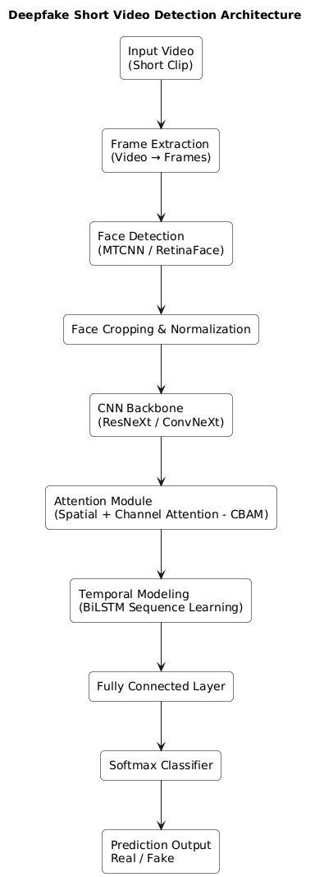
Proposed Architecture
We propose a hybrid spatial–temporal deepfake detection pipeline designed specifically for short video clips.
The architecture combines a CNN backbone for spatial artifact detection with an attention module to localize suspicious facial regions.
A BiLSTM network models temporal inconsistencies across frames, capturing motion anomalies that static detectors miss.
The system is optimized for cross-dataset generalization, making it suitable for real-world forensic deployment.
The pipeline is lightweight enough for practical implementation while maintaining high detection accuracy.
28

Slide 29
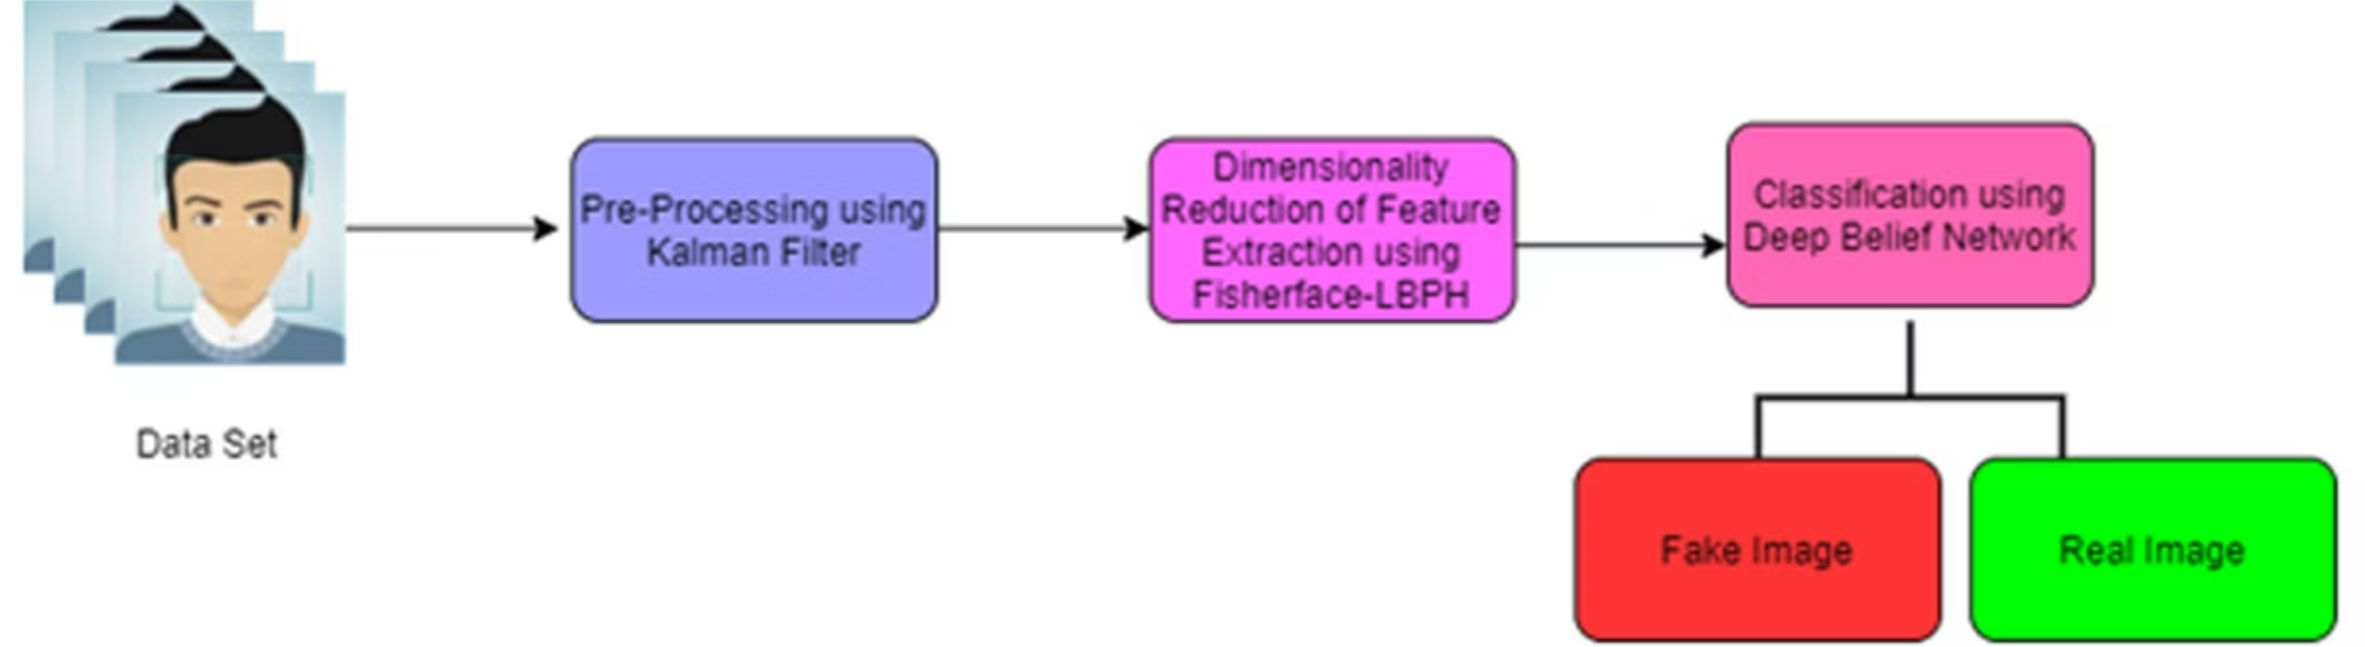
Dataset Strategy (Cross-Domain)
1. Training: FaceForensics++
Foundation for model learning
2. Validation: Celeb-DFv2
Cross-dataset generalization assessment
3. Stress-Test: DFDC dataset
Robustness against challenging, real-world scenarios
Rationale:
High-quality and compressed videos for varied real-world conditions
Diverse GANs used in dataset generation ensure GAN diversity
Ensures real-world forensics robustness across deepfake types
29

Slide 30
Face Detection & Preprocessing Pipeline
Effective deepfake detection relies heavily on robust preprocessing. This pipeline outlines the critical steps from raw video input to a normalized, augmented dataset ready for spatial-temporal analysis, ensuring optimal conditions for our CNN and LSTM models.
1. Face Detection
Utilizing state-of-the-art methods like MTCNN(Multi-task Cascaded Convolutional Networks) and RetinaFace for precise facial localization within video frames, ensuring the focus remains on the manipulated region.
2. Face Alignment
Correcting facial orientation and ensuring consistent positioning across all detected faces. This step normalizes pose variations, reducing noise and improving the accuracy of subsequent feature extraction.
3. Normalization
Standardizing pixel values (e.g., zero-mean, unit-variance) and resizing image dimensions to a consistent input format. This ensures uniform data distribution and compatibility with the CNN Architecture
4. Frame Sampling
Strategically selecting key frames from video sequences rather than processing every frame. This balances computational efficiency with the need to retain critical temporal information and detect subtle inconsistencies.
5. Data Augmentation
Applying techniques such as random rotation, brightness adjustment, horizontal flipping, and noise injection. This artificially expands the training dataset, enhancing model robustness and generalization capabilities to unseen deepfakes.
30

Slide 31
Spatial Feature Extraction (CNN)
Role of CNN in Deepfake Detection
CNN backbone extracts spatial forgery artifacts from facial regions
Detects texture abnormalities introduced by GAN synthesis
Identifies face boundary blending and morphing seams
Captures color inconsistencies and lighting mismatches
Reveals frequency-domain and compression artifacts invisible to humans
Chosen Backbone
ResNeXt-50 pretrained on ImageNet
Transfer learning improves convergence and generalization
Strong balance between accuracy and computational efficiency
31

Slide 32
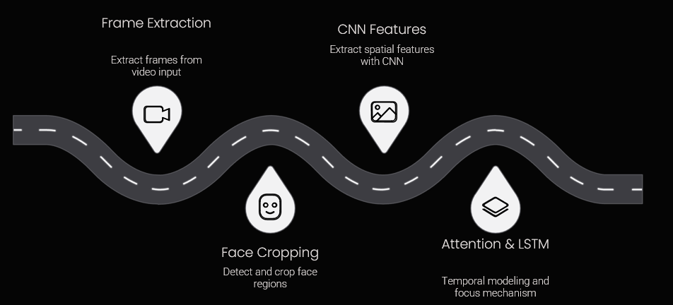
Attention Mechanism
Attention-Guided Artifact Localization
CBAM attention improves interpretability and feature focus
Channel Attention → learns which features are important
Spatial Attention → learns where anomalies occur
High-risk facial regions emphasized
Eyes → abnormal blinking patterns
Mouth → lip-sync inconsistencies
Cheeks → unnatural skin texture
Jawline → blending artifacts
Attention allows the model to prioritize suspicious regions rather than treating the face uniformly.
32

Slide 33
Temporal Modeling (BiLSTM)
Why Temporal Modeling Matters
Deepfakes often look correct in single frames but fail across motion.
BiLSTM captures sequence-level inconsistencies such as:
Reduced or irregular blinking frequency
Unnatural lip synchronization
Frame repetition or motion jitter
Over-smoothed facial transitions
Audio-video mismatch (future extension)
BiLSTM acts as memory across frames, learning realistic facial motion patterns.
33

Slide 34
Experimental Setup
Implementation Framework
PyTorch + timm + OpenCV pipeline
Random + uniform frame sampling per video
Training Configuration
Optimizer: AdamW / SGD
Epochs: 20–40
Batch size: 8–16 videos
Cross-entropy / focal loss
Evaluation Metrics
Accuracy & F1 Score
ROC & AUC
Equal Error Rate (EER)
LogLoss (DFDC standard)
34

Slide 35
Expected Results
Performance Benchmarks
Based on modern deepfake detection research:
Intra-dataset (FF++): >90% accuracy
FF++ → CelebDF: 80–88% generalization
FF++ → DFDC: 60–72% robustness stress test
Challenging scenarios
Occlusions (masks, glasses)
Low-resolution videos
Extreme lighting conditions
Adversarial perturbations
Results reflect real-world forensic difficulty, not ideal lab conditions.
35

Slide 36
Forensic Applications
Real-World Impact & Applications
Legal evidence verification Supports forensic experts in validating digital video evidence used in courts and investigations, reducing the risk of manipulated media influencing legal outcomes.
Identity fraud prevention Detects deepfake impersonation in authentication systems, protecting financial platforms and biometric verification pipelines.
Political misinformation detection Helps identify manipulated media used in propaganda campaigns, safeguarding public trust in democratic communication.
Social media authenticity monitoring Enables platforms to flag synthetic videos before large-scale misinformation spread, improving digital content integrity.
Enterprise authentication security Strengthens video-based identity verification in remote onboarding, interviews, and secure enterprise communications.
36

Slide 37
Limitations & Future Work (Merged)
Current Limitations
Detection arms race vs evolving generative models
Domain shift reduces cross-dataset reliability
High computational cost for real-time deployment
Limited handling of audio or multimodal deepfakes
Future Extensions
Audio-visual alignment modeling
Vision Transformers for long-range temporal reasoning
Diffusion-based deepfake detection
Real-time streaming deployment
Adversarial robustness defenses
Forensic watermark verification systems
37

Slide 38
Conclusion
Deepfakes represent a growing threat to digital trust, cybersecurity, and public information integrity, making automated verification systems essential.
Combining spatial CNN features with temporal sequence modeling significantly improves detection robustness compared to image-only methods.
Attention mechanisms enhance interpretability by highlighting suspicious facial regions, supporting explainable AI in forensic applications.
Cross-dataset evaluation ensures the system generalizes to unseen deepfake techniques, reflecting realistic deployment scenarios.
The proposed architecture bridges advanced computer vision research with practical cybersecurity needs, contributing toward scalable forensic verification systems.
38

Slide 39
References
D. Afchar, V. Nozick, J. Yamagishi, and I. Echizen, “MesoNet: A compact facial video forgery detection network,” Proc. IEEE Int. Workshop Inf. Forensics Security (WIFS), 2018, pp. 1–7.
A. Rössler, D. Cozzolino, L. Verdoliva, C. Riess, J. Thies, and M. Nießner, “FaceForensics++: Learning to detect manipulated facial images,” Proc. IEEE Int. Conf. Computer Vision (ICCV), 2019, pp. 1–11.
D. Güera and E. J. Delp, “Deepfake video detection using recurrent neural networks,” Proc. IEEE Int. Conf. Advanced Video and Signal-Based Surveillance, 2018, pp. 1–6.
B. Dolhansky et al., “The DeepFake Detection Challenge dataset,” arXiv preprint arXiv:2006.07397, 2020.
R. Tolosana, R. Vera-Rodriguez, J. Fierrez, A. Morales, and J. Ortega-Garcia, “Deepfakes and beyond: A survey of face manipulation and fake detection,” Information Fusion, vol. 64, pp. 131–148, 2020.
39

Slide 40
References
Y. Li and S. Lyu, “Exposing deepfake videos by detecting face warping artifacts,” Proc. IEEE Conf. Computer Vision and Pattern Recognition Workshops, 2019, pp. 46–52.
F. Marra, D. Gragnaniello, L. Verdoliva, and G. Poggi, “Do GANs leave artificial fingerprints?” Proc. IEEE Conf. Multimedia Information Processing and Retrieval (MIPR), 2019, pp. 506–511.
R. Durall, M. Keuper, and J. Keuper, “Exposing deepfakes using frequency artifacts,” Proc. IEEE Int. Conf. Image Processing (ICIP), 2020, pp. 2895–2899.
H. H. Nguyen, J. Yamagishi, and I. Echizen, “Capsule-Forensics: Using capsule networks to detect forged images and videos,” Proc. IEEE Int. Conf. Acoustics, Speech and Signal Processing (ICASSP), 2019, pp. 2307–2311.
T. Mittal, U. Bhattacharya, and N. B. Desai, “SyncNet: Detecting audio-visual mismatch in manipulated videos,” Proc. ACM Multimedia, 2020, pp. 3085–3093.
40

Slide 41
References
P. Zhou, X. Han, V. I. Morariu, and L. S. Davis, “Two-stream neural networks for tampered face detection,” Proc. IEEE Conf. Computer Vision and Pattern Recognition Workshops, 2017, pp. 21–29.
H. Dang, F. Liu, J. Stehouwer, X. Liu, and A. K. Jain, “On the detection of digital face manipulation,” Proc. IEEE Conf. Computer Vision and Pattern Recognition (CVPR), 2020, pp. 5781–5790.
S. Seferbekov, “DeepFake Detection Challenge: Winning solution,” Kaggle Technical Report, 2020.
J. Wang, Z. Wu, and S. Wang, “Vision transformer for deepfake detection,” arXiv preprint arXiv:2106.09363, 2021.
N. Carlini, E. Wallace, M. Erlingsson, B. Koscher, and D. Song, “Adversarial attacks on deepfake detectors,” Proc. NeurIPS Workshop, 2020.
41

Slide 42
References
P. Zhou and S. Lim, “Joint audio-visual deepfake detection,” Proc. IEEE Int. Conf. Computer Vision Workshops, 2021, pp. 1485–1494.
K. Lal, S. Shiwani, and G. Gandhi, “Deepfake video deception detection using visual attention-based method,” Scientific Reports, vol. 15, 2025.
Y. Li et al., “Celeb-DF: A large-scale challenging dataset for deepfake forensics,” Proc. IEEE Conf. Computer Vision and Pattern Recognition (CVPR), 2020, pp. 3207–3216.
D. Cozzolino, J. Thies, A. Rössler, C. Riess, M. Nießner, and L. Verdoliva, “Forensic transfer: Weakly-supervised domain adaptation for forgery detection,” IEEE Transactions on Information Forensics and Security, vol. 14, no. 6, pp. 1602–1617, 2019.
D. Cozzolino, J. Thies, A. Rössler, and M. Nießner, “Diffusion artifacts for deepfake detection,” arXiv preprint, 2023.
42

