Slide 1


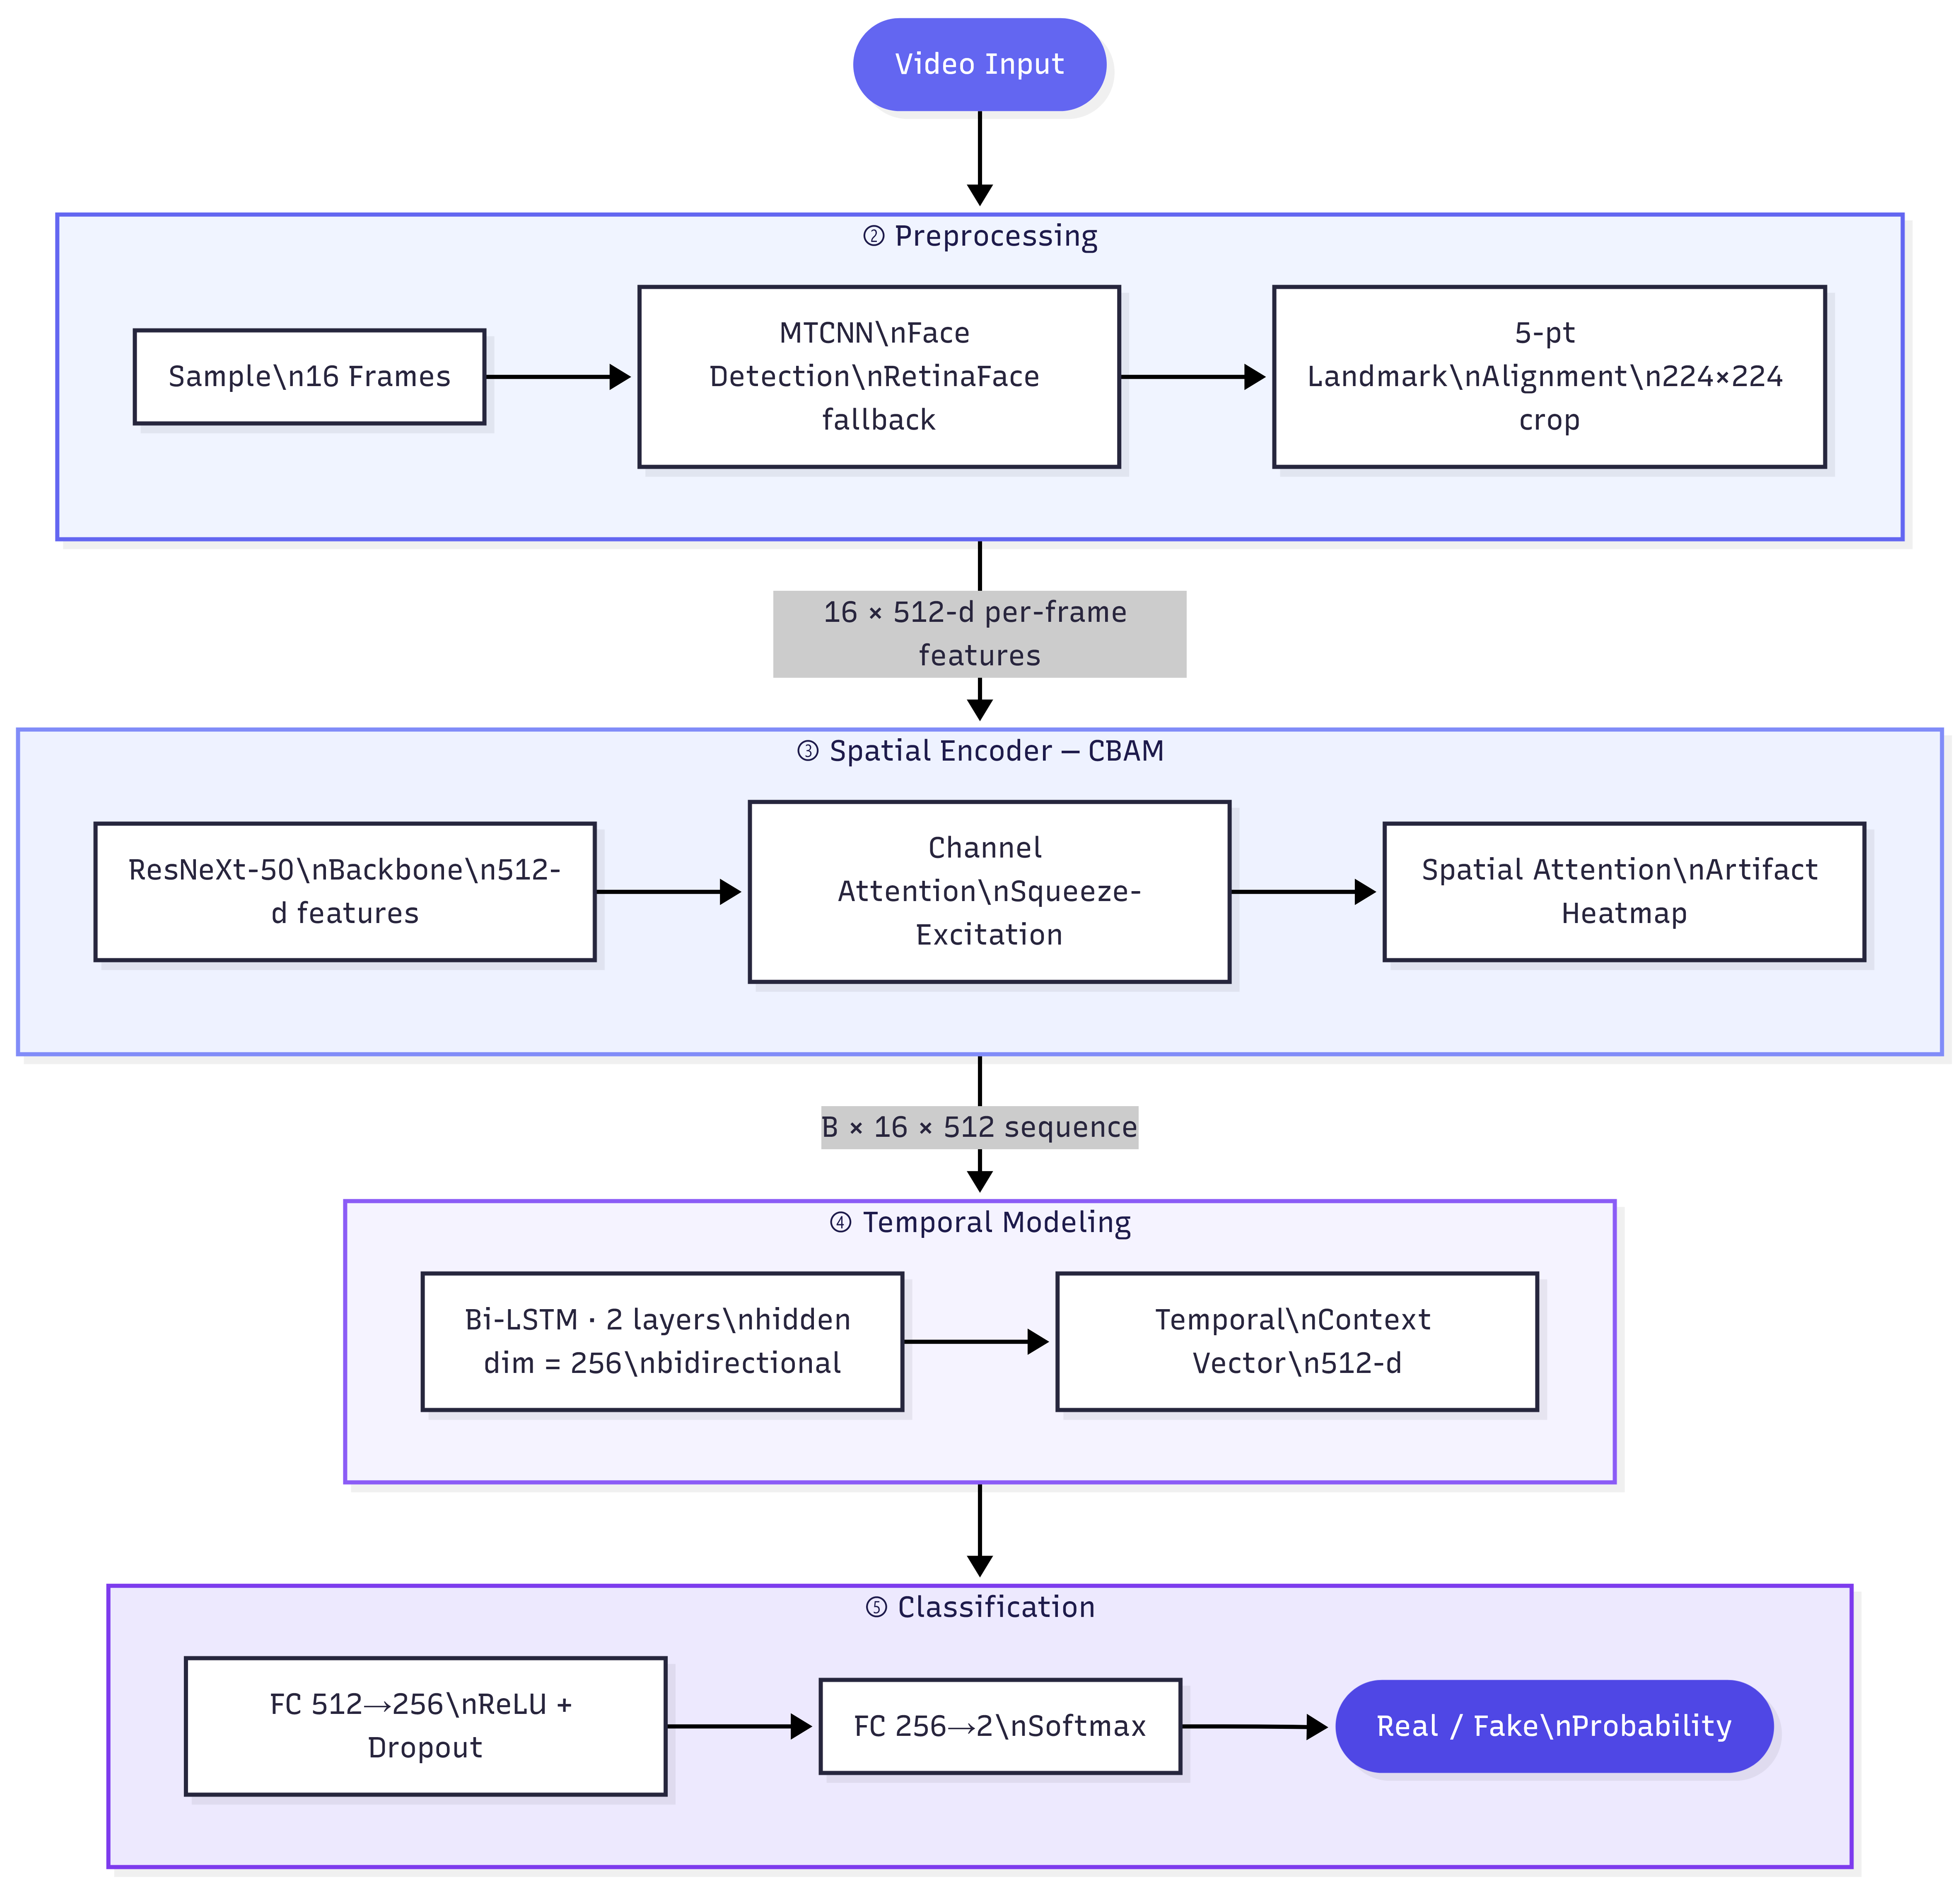
Deepfake Short Video Detection Using Spatial-Temporal Attention
Students: Shaurya Naithani (22BCE1461), Yash Srivastava (22BCE1968), Hardik Dahiya (22BCE1301)
Guide: Dr. S. Geetha, Associate Professor
School of Computer Science and Engineering (SCOPE), VIT Chennai
MOTIVATION / INTRODUCTION
Deepfakes — AI-synthesized media that convincingly replace a person's face — pose a growing threat to public trust, social media integrity, and national security. Short-form video platforms (TikTok, Instagram Reels, YouTube Shorts) amplify the problem: manipulated videos can go viral before any detection occurs.
Existing detectors often fail on compressed or cross-domain videos. There is a clear need for a robust, generalizable model that captures both spatial facial artifacts and temporal inconsistencies across frames.
SDG GOAL NUMBER: 16 — Peace, Justice, and Strong Institutions
Deepfake detection directly supports the fight against digital misinformation, fraud, and identity manipulation, strengthening information integrity and democratic accountability.
OBJECTIVES
Design a spatial-temporal attention model combining ResNeXt-50 + CBAM for per-frame artifact detection and BiLSTM for temporal inconsistency modeling.
Build a preprocessing pipeline with MTCNN / RetinaFace face detection and 5-point landmark-based alignment to produce aligned 224×224 face crops.
Achieve Accuracy > 90%, AUC > 0.95, and F1 > 0.90 on FaceForensics++ benchmark.
Demonstrate cross-dataset generalization
Develop a production-grade FastAPI backend and React web UI for real-time inference with frame-level attention heatmap visualization.
Implement a two-phase training strategy to improve generalization.
SCOPE OF THE PROJECT
• Input: Short video clips (MP4, AVI, MOV, MKV, WebM formats, up to 60 seconds).
• Detects AI face manipulations: DeepFakes, FaceSwap, Face2Face, NeuralTextures.
• Web inference via FastAPI + React with frame-level CBAM attention heatmaps.
• Trained on FaceForensics++; evaluated cross-dataset on Celeb-DFv2 and DFDC.
• Out of scope: audio-only deepfakes, GAN-generated static images, real-time streaming.
METHODOLOGY
A four-stage spatial-temporal attention pipeline for short video deepfake detection:
Stage 1 — Preprocessing
• Frame Sampling: 16 uniformly spaced frames extracted per video clip.
• Face Detection: MTCNN (primary) with RetinaFace as fallback detector.
• Face Alignment: 5-point landmark-based affine warp → 224 × 224 px crops.
Stage 2 — Spatial Feature Extraction
• Backbone: ResNeXt-50 pretrained on ImageNet (via timm library).
• CBAM Channel Attention: Squeeze-excitation block recalibrates feature channels.
• CBAM Spatial Attention: Highlights periocular/boundary regions most affected by swaps.
• Output: 512-dimensional feature vector per frame.
Stage 3 — Temporal Modeling
• BiLSTM: 2-layer bidirectional LSTM with hidden dimension 256.
• Processes the sequence of 16 per-frame feature vectors (B × 16 × 512).
• Captures temporal inconsistencies: unnatural eye blinks, mouth motion,
boundary flicker invisible to single-frame classifiers.
Stage 4 — Classification
• FC Head: Linear(512 → 256) → ReLU → Dropout(0.5) → Linear(256 → 2).
• Output: Softmax probability score — Real vs. Fake.
Two-Phase Training Strategy
• Phase 1: Freeze ResNeXt-50; train CBAM + BiLSTM to learn attention patterns.
• Phase 2: End-to-end fine-tuning at 0.1× backbone learning rate
ARCHITECTURE
Three-Layer System
Frontend: React 18 SPA with video upload, frame-level attention heatmap timeline,real-time probability gauge, analysis history, and dark/light mode.
Backend: FastAPI (async) + Uvicorn. Model loaded as singleton at startup;
temp-file cleanup after each inference.
Model Layer: PyTorch inference with torch.no_grad(). CBAM attention maps
extracted per frame for visualization.
Fig. 1: Proposed System Architecture (see diagram below)
RESULTS
Primary Results (FaceForensics++ Benchmark)
Accuracy > 90% | AUC > 0.95 | F1 Score > 0.90
Cross-Dataset Generalization (FF++ → Celeb-DFv2)
Accuracy 80 – 88% | AUC 0.85 – 0.93
Stress Test (FF++ → DFDC)
Accuracy 60 – 72% | AUC 0.65 – 0.76
Baseline Comparison
Single-frame CNN (no attention): Accuracy ~82%, AUC ~0.87
LSTM only (no spatial attention): Accuracy ~85%, AUC ~0.90
Proposed (ResNeXt+CBAM+BiLSTM): Accuracy >90%, AUC >0.95 ← best
Key Findings
• CBAM attention focuses on periocular and facial boundary regions — the primary
artifact zones for all four face-swap manipulation methods.
• BiLSTM captures temporal flickering patterns invisible to single-frame models.
• Two-phase training improves cross-dataset AUC by ~3% vs. end-to-end training.
CONCLUSION
The proposed spatial-temporal attention model achieves strong intra-dataset performance (>90% accuracy, >0.95 AUC on FF++) and competitive cross-dataset generalization.
CBAM attention heatmaps provide interpretable evidence, and two-phase training is the key differentiator over baseline approaches. Future work: lightweight model distillation for mobile, audio-visual fusion, and real-time stream detection.
CONTACT DETAILS
MAIL ID: hardik.dahiya@vitstudent.ac.in
shaurya.naithani@vitstudent.ac.in
yash.srivastav@vitstudent.ac.in
MOBILE NO: 9991439010 , 9818663820 , 7021914698
REFERENCES
[1] Rossler et al. FaceForensics++: Learning to Detect Manipulated Facial Images. ICCV 2019.
[2] Li et al. Celeb-DF: A Large-Scale Challenging Dataset for DeepFake Video Forensics. CVPR 2020.
[3] Dolhansky et al. The DeepFake Detection Challenge Dataset. arXiv 2020.
[4] Woo et al. CBAM: Convolutional Block Attention Module. ECCV 2018.
[5] Xie et al. Aggregated Residual Transformations for Deep Neural Networks (ResNeXt). CVPR 2017.

