Slide 1


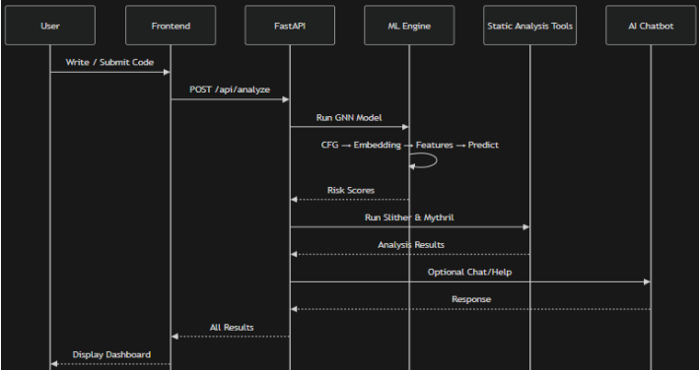
Smart Contract Vulnerability Detection Using Hybrid GNN and GraphCodeBERT
Students: Akshat Thakur (22BCE1108), Anantabh Sahu (22BCE1357), Prashant Singh (22BCE1116)
Guide: Dr. Shree Prakash, Assistant Professor
School Of Computer Science And Engineering
MOTIVATION / INTRODUCTION
Over $3.8 billion was lost to smart contract exploits in 2022 alone. The DAO hack (2016), Parity wallet freeze ($150M), and Wormhole bridge attack ($320M) exposed how immutable code means bugs are permanent.
Existing tools fail developers: Slither triggers 30-50% false positives, Mythril times out on complex contracts, and ML tools give a yes/no verdict with no explanation of where or why.
SDG GOAL NUMBER: 9 (Industry, Innovation and Infrastructure)
OBJECTIVES
Design HybridGNN combining 768-dim GraphCodeBERT embeddings with a 2-layer 4-head GAT for multi-label vulnerability classification across 5 SWC classes.
Build CFG extraction pipeline parsing Solidity into function-level nodes with 12-dimensional handcrafted feature vectors per node.Achieve F1-score ≥ 0.90 across five vulnerability classes on SolidiFI benchmark.
Integrate Slither, custom Mythril reimplementation, and Gemini 2.0 Flash into a unified tri-tool consensus pipeline with <10% FPR.
Develop production-grade FastAPI backend with React 18 dashboard featuring 7 tabs, real-time CFG visualisation, and line-level attention heatmaps.
Evaluate against standalone Slither and Mythril to demonstrate measurable improvement in precision, recall, and FPR.
Demonstrate analysis time <30 seconds for CI/CD integration on contracts up to 500 lines.
SCOPE OF THE PROJECT
Supports Solidity smart contracts on EVM-compatible chains (Ethereum, Polygon, BSC), versions 0.4.x-0.8.x.
Full analysis for contracts up to 2,000 LOC; GNN+Slither continue for larger contracts where Mythril may time out.
Covers 5 target SWC classes: Reentrancy (107), Integer Arithmetic (101), Access Control (115), Unchecked Calls (104), Timestamp Dependence (116).
Out of scope: non-EVM chains (Solana, Tezos), bytecode-only analysis, real-time on-chain monitoring, and cross-contract vulnerability detection.
METHODOLOGY
Phase 1 — CFG Extraction
Parses Solidity source into AST+CFG+DFG graph G=(V,E). Each function node gets a 12-dimensional handcrafted feature vector (has_call, tx.origin, unchecked_return, arithmetic density, etc.).
Phase 2 — GraphCodeBERT Embedding
Each function is tokenised (≤512 tokens) through microsoft/graphcodebert-base. The 768-dim CLS token is concatenated with the 12 features and projected to 268 dimensions: x_i = W_proj × [h_i || f_i].
Phase 3 — Graph Attention Network (GAT)
Two-layer GAT: Layer 1 uses 4 attention heads (output 1024-dim), Layer 2 uses 1 head (256-dim). Attention weights α_ij are extracted as explainability signals for the line-level risk heatmap.
Phase 4 — Tri-Tool Consensus
Score k_c = I_GNN + I_Slither + I_Mythril ∈ {0,1,2,3}. k=3→CRITICAL, k=2→HIGH, k=1→MEDIUM, k=0→SECURE. Critical/High findings trigger Gemini 2.0 Flash patch generation.
Training
SolidiFI dataset (4,804 contracts), 80/10/10 split. Optimizer: AdamW (lr=2e-4, λ=0.01). Loss: multi-label binary cross-entropy + L2. Trained 100 epochs on RTX 4090 (≈14 hrs). GraphCodeBERT frozen for first 10 epochs.
ARCHITECTURE
Three-Layer System
Frontend: React 18 + TypeScript, 7-tab dashboard, Monaco editor, @xyflow CFG visualiser, attention heatmap, Gemini AI chat
Backend: FastAPI (async) + Uvicorn + pydantic-settings. GNN inference as singleton. Slither + Mythril dispatched in parallel via thread pool.
Data Layer: PostgreSQL (protobuf storage) + Celery/Redis for large-contract backgroundjobs.
System Design and Architecture
RESULTS
Primary Results (SolidiFI Benchmark)
Reentrancy (SWC-107): F1=0.977, Precision=0.981, Recall=0.974, FPR=4.2%
Integer Arithmetic (SWC-101): F1=0.971, Precision=0.973, FPR=5.1%
Access Control (SWC-115): F1=0.982, Precision=0.985 — best in class
Weighted Average F1 = 0.977, FPR = 4.6%
Baseline Comparison
Slither alone: F1=0.68, FPR∼32% | Mythril alone: F1=0.71, FPR∼29%
GNN alone (no consensus): F1=0.93, FPR=8%
SmartAudit AI (full): F1=0.977, FPR=4.6% — best across all metrics
CI/CD Feasibility
Small (<100 LOC): 6.4s total | Medium (100-500 LOC): 18.2s
Attention weights correctly identified vulnerable code 94% of the time in true-positive cases.
CONCLUSION
SmartAudit AI achieves weighted F1 = 0.977 on SolidiFI — outperforming Slither (0.68) and Mythril (0.71) while cutting FPR from ∼30% to just 4.6%.
Tri-tool consensus is the key differentiator: GNN + Slither + Mythril independently agreeing makes false positives extremely unlikely since each uses a completely different detection approach.
Developer trust was harder to earn than accuracy. Line-level attention heatmaps and Gemini natural-language explanations were essential — not optional — for user adoption.
Future work: cross-contract CFG for flash-loan detection, Vyper language support, VS Code extension for real-time inline annotations, and Docker containerisation for zero-setup deployment.
CONTACT DETAILS
MAILID: Anantabh.sahu2022@vitstudent.ac.in, akshat.thakkur2022@vitstudent.ac.in,
prashant.singh@vitstudent.ac.in
MOBILE NO: 9580453129, 9810770296
REFERENCES
[1] Feist, J. et al. (2019). Slither: A static analysis framework for smart contracts. WETSEB, IEEE/ACM.
[2] Guo, D. et al. (2021). GraphCodeBERT: Pre-training code representations with data flow. ICLR 2021.
[3] Velickovic, P. et al. (2018). Graph Attention Networks. ICLR 2018.
[4] Zhuang, Y. et al. (2021). Smart contract vulnerability detection using GNNs. IJCAI 2021.
[5] Chainalysis. (2023). 2023 Crypto Crime Report. Chainalysis Inc

