Slide 1


Major Project - 2
SafeSpot – A Smart Tracking Device
Presented by:
Hardik Gupta – 500089339 – R252221023
Namra Tyagi – 500091016 – R252221044
Mentored By:
Prof. Sandip Chaurasiya
Associate Professor

Slide 2
Content
Introduction
Problem Statement
Objectives
Methodology
Flow Chart
PERT Chart
References

Slide 3
Introduction
Safespot, aiming to revolutionize tracking devices.
Problem: Existing trackers lack emergency response & user-friendliness.
Solution: Safespot offers:
SOS Alerts: Send instant danger messages with live location to contacts.
Simple Usage: No complex apps, location retrieval via messages.
Beyond the Technical: Addresses limitations, provides a secure future.
Impact: Feature-rich, user-friendly, and cost-effective alternative.

Slide 4
Problem Statement
Challenges: Existing tracking devices lack integrated emergency response, feature complex interfaces, and suffer from bulky designs with limited customization.
Solution: Introducing Safespot, a smart tracking device emphasizing safety and simplicity.
Key Features: Intuitive SOS alert system for immediate response, paired with a user-friendly message-based communication.
Differentiator: Safespot addresses these limitations, providing a feature-rich, user-friendly, and cost-effective alternative.
Versatility: Enhances personal safety, asset security, and peace of mind for various scenarios.
Safespot: Your trusted companion for seamless real-time location awareness and rapid emergency response.

Slide 5
Main Objectives
Develop a compact and portable tracking device: Enable easy attachment to personal belongings, pets, or assets for diverse use cases.
Integrate an intuitive SOS alert system: Trigger immediate emergency response upon button press, sending pre-configured danger messages with live location to designated contacts.
Offer user-friendly message-based location access: Simplify location retrieval through SMS communication, eliminating the need for dedicated applications.
Optimize for low power consumption: Implement hardware and software optimizations to maximize battery life for extended operation.

Slide 6
Additional Objectives
Provide customization options: Empower users to configure alert recipients, message content, operational settings, and notification preferences for personalized functionality.
Ensure data security and privacy: Implement robust security measures to protect user data and location information.
Maintain affordability: Develop a cost-effective solution accessible to a wide range of users.
Explore potential for integration with existing platforms: Investigate seamless integration with relevant platforms for enhanced functionality and user experience.
Conduct thorough testing and validation: Ensure device reliability, performance, and user-friendliness through rigorous testing procedures.

Slide 7
Methodology
Process Flow:
When you press the SOS button on Safespot, several processes occur in sync. The Neo-6M GPS module instantly grabs your location, and the Arduino Nano, the device's brain, processes it. The GSM module, your cellular connection, then transmits a pre-configured message containing your live location to your designated emergency contacts.
Simultaneously, the device acknowledges your action through a simple message-based system, ensuring you know help is on the way. This intuitive design prioritizes both your safety and ease of use, offering peace of mind with every press.
Components used in the Project:
Arduino Nano
SIM 800L GSM Module
NEO-6M GPS Module
Push Button
LED
3.7v 2600mAH Li-Po Battery

Slide 8
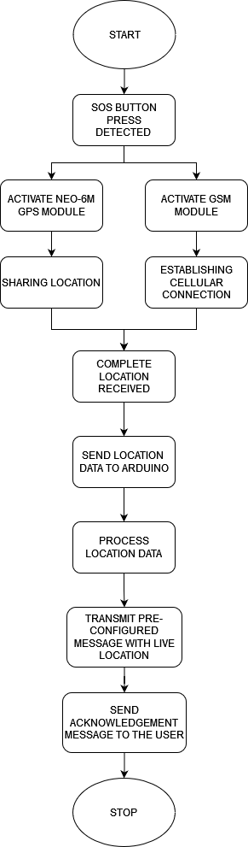
Flowchart

Slide 9
Flowchart

Slide 10
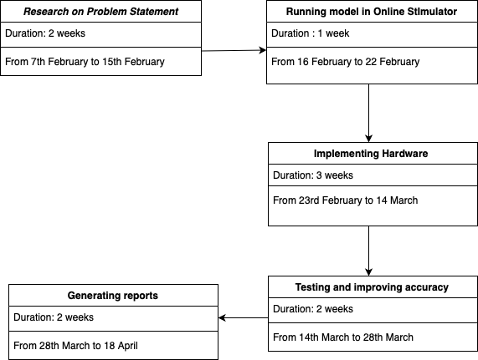
PERT Chart

Slide 11
Thank You

