Slide 1
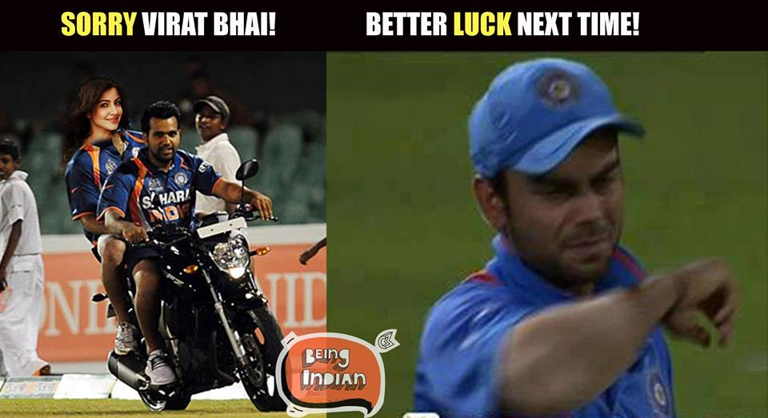
OOPs What is happening here

Slide 2
