Slide 1

Front-End Development
A development of user interface.

Slide 2
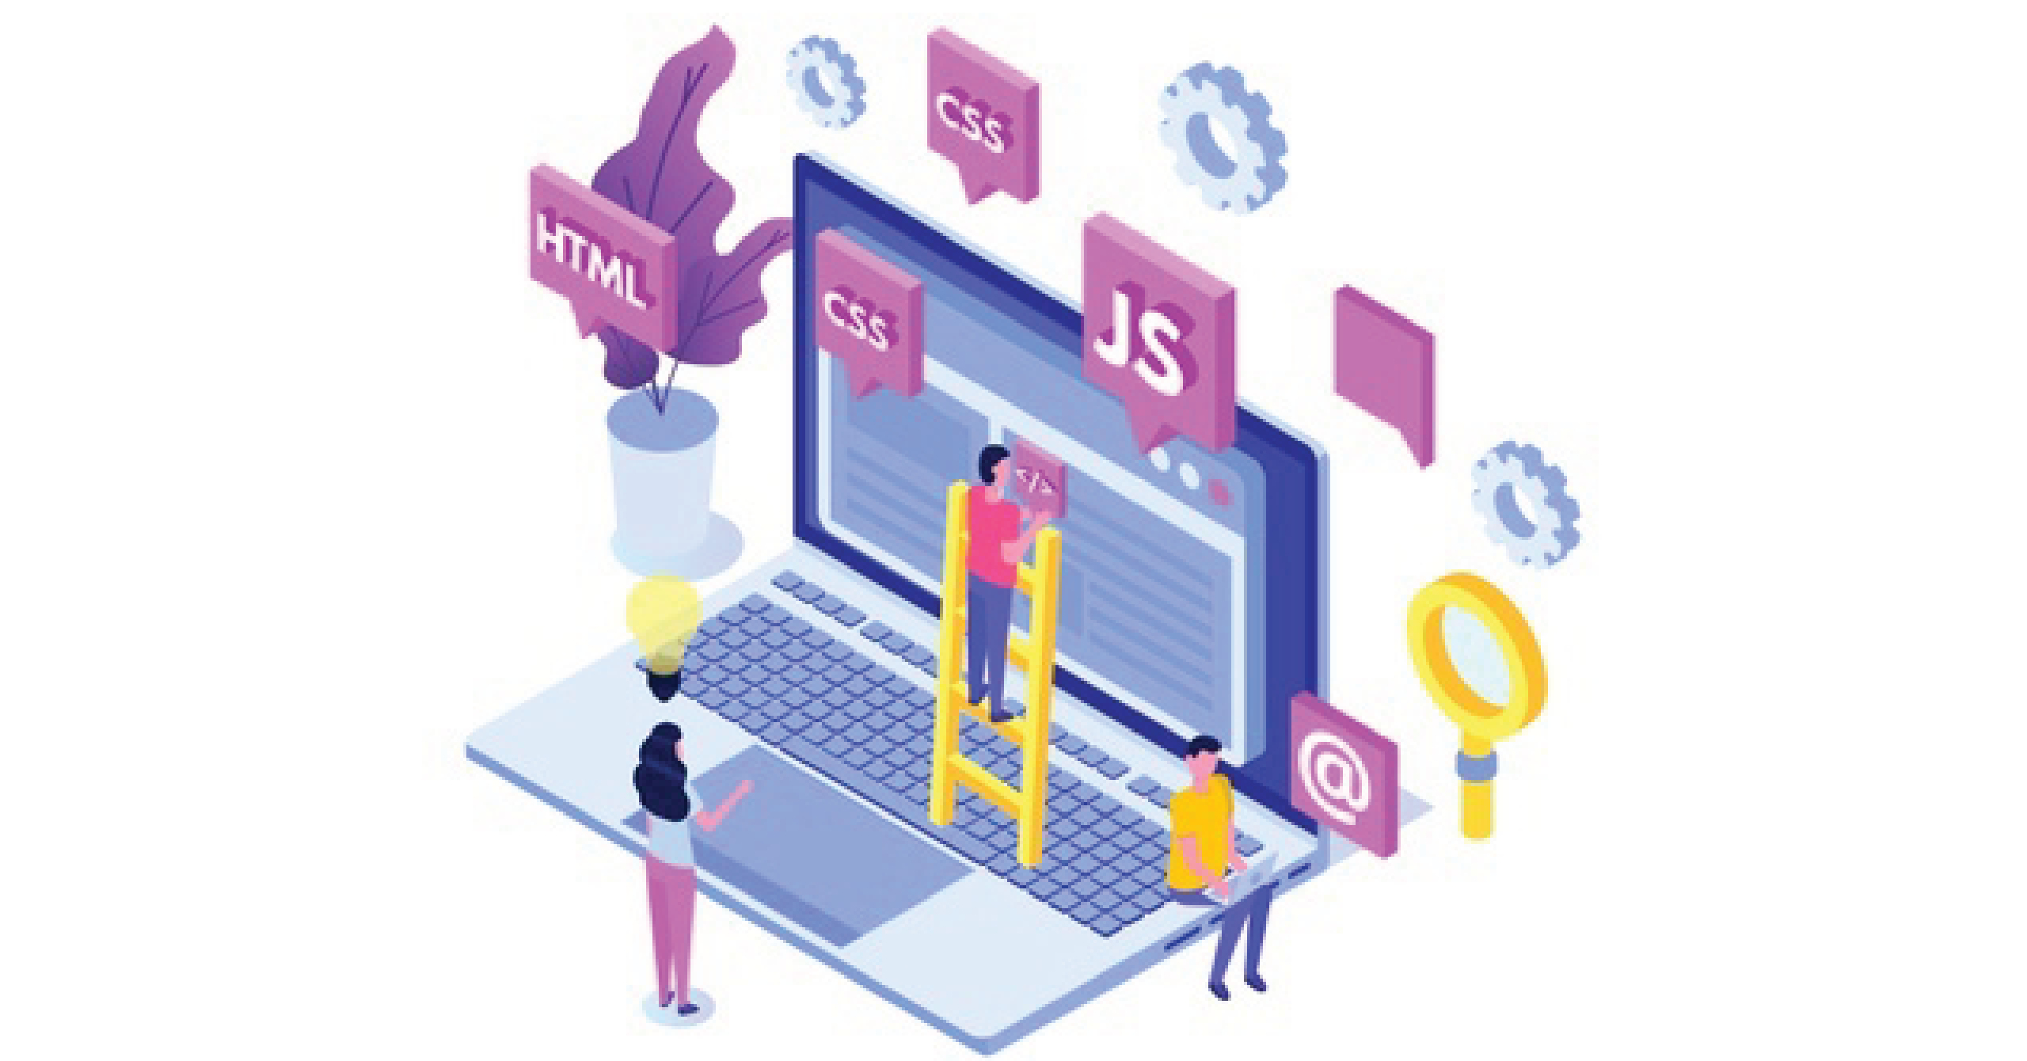
Front-End Development
Introduction
Improves Branding
Build Trust And Reliability
Better Navigation
Easy To Work

Slide 3

Current And Upcoming Trends
Dynamic Website
Motion UI And Animations
Serverless Architecture
Low-code Development
Artifical-Intelligence

Slide 4

Future Of Front-End Developer
Artificial-Intelligence
React Js
Low-Code
Serverless-Architecture

Slide 5

Learning At Tops Technology
HTML
CSS
JAVASCRIPT
JQUERY
BOOTSTRAP
REACT JS

Slide 6

Why I Choose
Creativity
Flexibility
Good Salary
High-Demand

Slide 7
Always Develop Your Self.
Thank you

