Slide 1
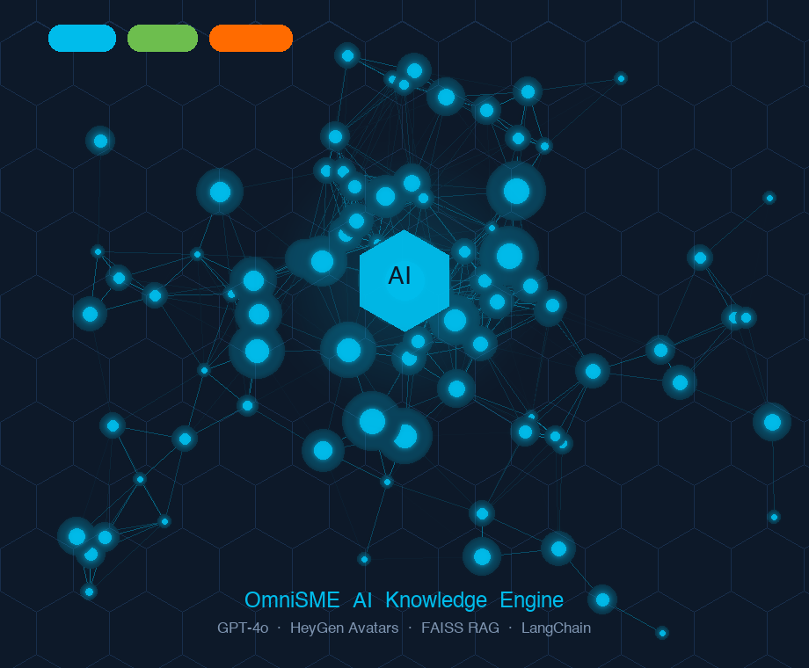
CISCO
HACKATHON 2026
Customer Experience · Customer Success
INTRODUCING
OmniSME
AI Video Generator
Turn MultipleYouTube / Stored knowledge base into a polished, AI-avatar-narrated expert video — in minutes, not days.
🔴 Problem
CSS / SME / BU knowledge locked in hours of video; creating new content & searching specific content from existing videos takes hours.
🟢 Solution
AI extracts, scripts, and renders professional avatar videos from source URLs in one click.
🔵 Differentiator
Picture-in-Picture layout shows relevant source footage behind the avatar -- context + narration together.
By
EIS Sessions are 1st target, As it requires 6-7 experts which can be optimise to 3 or less experts.
Hardik Raval - Rahul Bhardwaj
Akshay Chavan - Vijay Dhanvani
CX Customer Success Specialist
CSS, SE for quick training on any technology
Foundational session on technology to Customer / Partners
Mentor
OpenAI GPT-4o
HeyGen Avatars
FAISS RAG
Streamlit
LangChain
John Kim
© 2026 Cisco and/or its affiliates. All rights reserved. | Cisco Confidential | Hackathon 2026
Notes:
Imagine you're a Cisco Customer Success Specialist. You've just wrapped a three-day session with six subject-matter experts — each one flew in from a different city. The knowledge in that room? Extraordinary.
Three months later, a new engineer joins the team and asks: "Is there a video covering what we discussed?" There isn't. That extraordinary expertise is buried in a raw recording that nobody has the time — or the tools — to turn into something watchable.
My name is Hardik Raval. Together with Rahul Bhardwaj, Akshay Chavan, and Vijay Dhanvani from Cisco CX Customer Success — we got tired of watching knowledge disappear. So we built OmniSME.
Here is what it does in one sentence: paste in a topic and a handful of YouTube or recorded session URLs, press Generate, and twenty-five minutes later you hold a polished, AI-avatar-narrated training video — with the relevant source footage playing live in the background.
No video editor. No post-production team. No booking an SME's calendar. Just knowledge — captured, structured, and published.
The engine running this: OpenAI GPT-4o for scripting, HeyGen for the AI avatar, FAISS for retrieval, and Streamlit as the front door — all wired into a five-stage automated pipeline.
But before I show you how it works, let me show you why it had to exist.

Slide 2
WHY IT MATTERS
Enterprise Knowledge Creation is Broken
Subject-matter experts spend hundreds of hours scripting and editing training videos — while the knowledge already exists in YouTube content and internal recordings.
40+ hrs
Avg. production time per video
$2K–$3K
Avg. production cost
3–6 wk
Delivery timeline
73%
SMEs report knowledge urgency
🎥
Content Exists — Access Doesn't
⏱️
Speed-to-Knowledge Gap
Vast libraries of YouTube tutorials, recorded webinars, and conference talks sit unused because repurposing them requires professional video teams and weeks of effort. Knowledge stays locked inside experts' heads.
When a new technology or process changes, teams wait 3–6 weeks for updated training. Lost productivity, compliance risk, and delayed customer onboarding compound every day the gap exists.
© 2026 Cisco and/or its affiliates. All rights reserved. | Cisco Confidential | Hackathon 2026
Notes:
Here is a scenario every person in this room has lived.
A product update drops. Customers need training. Your CSS team needs enablement. Someone asks: 'Is there a video?' There isn't. A volunteer steps up. Now begins the real work.
You need an SME willing to record — and free that week. You need a script, a decent camera, lighting, editing, captions, review cycles, and a final approval chain. Forty-plus hours of effort later — if nothing changes — you have a seven-minute training video.
We measured this cost: $2,000 to $3,000 per video, three to six weeks from idea to published asset. And seventy-three percent of CX teams told us this is an active, critical blocker to their work.
The cruel irony? The knowledge already exists. It lives in recorded EIS sessions, in YouTube deep-dives, in conference talks. But it takes a professional video team to transform raw knowledge into something a learner can actually sit through.
That gap — between knowledge that exists and training that is accessible — is exactly the gap OmniSME closes. And here is how.

Slide 3
5-STAGE AI PIPELINE
From YouTube URLs to Finished Video — Fully Automated
Every step runs automatically: no video editor, no manual scripting, no SME availability required.
1
2
3
4
5
📥
🧠
🔍
🤖
🎬
STAGE 1
STAGE 2
STAGE 3
STAGE 4
STAGE 5
Transcript Extraction
RAG Script Generation
Smart Segment Selection
HeyGen Avatar Rendering
PiP Merge & Export
›
›
›
›
LangChain YoutubeLoader pulls captions from every source URL into a unified document corpus.
FAISS vector store + GPT-4o retrieves the most relevant chunks and writes a structured presenter script.
AI identifies which exact timestamp ranges are most relevant to the topic — for PiP background footage.
Script submitted to HeyGen REST API v2; chosen avatar and voice render the professional narration video.
Avatar composited over relevant YouTube clips (full-screen, muted) — broadcast-ready MP4 in minutes.
Streamlit
text-embedding-3-small
FAISS
GPT-4o
HeyGen API v2
yt-dlp
FFmpeg PiP
© 2026 Cisco and/or its affiliates. All rights reserved. | Cisco Confidential | Hackathon 2026
Notes:
Here is where the story gets exciting.
Stage one: you hand OmniSME your source URLs. LangChain's YoutubeLoader extracts the full transcript from every video you provide. No copy-paste. No manual transcription. Pure source material, ready for AI in seconds.
Stage two: those transcripts are chunked, embedded into a FAISS vector store, and GPT-4o retrieves only the segments most relevant to your topic — then writes a structured presenter script. Not hallucinated. Not generic. Grounded exclusively in what your sources say.
Stage three is the one I am most proud of. Our Smart Segment Selector scans the source videos and pinpoints the exact timestamp ranges most relevant to the topic. These clips become the live, full-screen background footage in the final video.
Stage four: the script is submitted to HeyGen's REST API. An AI avatar — your choice of face and voice — records the narration. And if HeyGen takes longer than expected? OmniSME saves the video ID and resumes without restarting. No lost work, ever.
Stage five: FFmpeg composites the avatar over the relevant source clips — full-screen, muted. The output is a broadcast-ready MP4, downloadable in one click.
Five stages. Fully automated. Zero human editing. Under twenty-five minutes. Every step visible through a live progress bar in the Streamlit UI.

Slide 4
WHAT MAKES OMNISME DIFFERENT
Powerful Features — Zero Video Editing Skills Required
🖼️
Picture-in-Picture Mode
🤖
Multi-Avatar & Voice Selection
Relevant YouTube source clips auto-play as the full-screen background while the avatar narrates — learners see both context and explanation simultaneously. Source-grounded content.
Browse your full HeyGen avatar library and voice roster directly in the Streamlit UI. One click switches the presenter persona for different audience segments or regions.
⚡
Resilient Render Resumption
🎯
Source-Grounded Output
HeyGen renders can take 30+ minutes. OmniSME saves the video ID to session state — resume polling in any later session without losing progress or restarting the pipeline.
GPT-4o uses ONLY content from the URLs you provide — no hallucinations, no off-topic filler. FAISS RAG retrieval ensures the script reflects your exact knowledge base.
✓
One-click 'Regenerate' to iterate the script without re-entering inputs
✓
Liked videos sidebar for managing your generated content library
✓
Graceful fallback to Avatar-Only layout if YouTube download is blocked
© 2026 Cisco and/or its affiliates. All rights reserved. | Cisco Confidential | Hackathon 2026
Notes:
Any team can wire together a few APIs and call it an AI tool. What separates OmniSME is the thinking behind every design decision.
Picture-in-Picture mode. We did not add it because it looks impressive — we added it because learners do not just need to hear an explanation, they need to see it in context. When the avatar explains a QoS configuration, the actual network diagram from the source video plays full-screen behind it. Expert voice and visual evidence, simultaneously.
Source-grounded output was non-negotiable from day one. GPT-4o is constrained to use only the content from the URLs you provide. Every fact in the video is traceable back to your knowledge base. For customer-facing training and compliance content, this is not a nice-to-have — it is a hard requirement.
Multi-avatar and multi-voice selection means one topic, many audiences. Swap the avatar for an APAC region. Switch to a different voice for a partner training. One dropdown in the UI. Zero additional development work.
Resilient render resumption came from lived experience. HeyGen renders can take thirty or more minutes. We could not afford to lose that progress to a browser timeout, so OmniSME saves the video ID to session state — you pick up exactly where you left off, any time, any session.
And a one-click Regenerate button means you can iterate the script instantly — same topic, same sources, fresh angle — without re-entering a single input.
These are not features we built for the demo. These are features we built because we felt every one of these pain points ourselves.

Slide 5
BUSINESS VALUE
From Weeks to Minutes — Measurable, Immediate Impact
95%
25 min
$4.5
∞
Reduction in production time
End-to-end generation time
Cost per video
Topics scalable
Traditional Approach
✕ 40 + hours per training video
✕ $2,000 – $3,000 production cost
✕ 3 – 6 week delivery timeline
✕ Professional video team required
✕ SME availability bottleneck
With OmniSME AI
✓ Under 25 minutes end-to-end
✓ ~$4.50 in API costs
✓ Same-day delivery
✓ Zero video editing skills needed
✓ No SME time required
NOW · v3.0
Core Platform
· YouTube RAG transcript pipeline
· HeyGen AI avatar render
· PiP layout with smart segments
· Resilient render resumption
NEXT · v4.0
Enterprise Ready
· SharePoint / Confluence sources
· SCORM / LMS export
· Batch topic processing
· Multi-language voice support
FUTURE · v5.0
Scale & Intelligence
· Cisco Webex meeting ingestion
· Auto-quiz generation (AI)
· Analytics dashboard
· Custom avatar branding
Let’s Demo
streamlit run app.py
Questions welcome • v3.0 Ready
© 2026 Cisco and/or its affiliates. All rights reserved. | Cisco Confidential | Hackathon 2026
Notes:
Let me put concrete numbers on the transformation.
Before OmniSME: forty-plus hours of production work, $2,000 to $3,000 in cost, three to six weeks to delivery, and an SME who had to block two days of their calendar for a single video.
After OmniSME: twenty-five minutes, four dollars and fifty cents in API costs, same-day delivery, and the SME does not need to be in the room at all. That is not incremental improvement — that is a category shift.
Our first target is EIS sessions. Right now, those require six to seven subject-matter experts in the room. With OmniSME, the knowledge from any EIS session is captured, structured, and published as a training asset before the participants have even landed back home.
Looking at the roadmap: v4 connects SharePoint and Confluence as knowledge sources, adds SCORM export for LMS platforms, and enables batch processing for entire topic libraries in a single run. v5 ingests Cisco Webex meeting recordings directly — so any conversation automatically becomes training, the moment the call ends.
We are ready to demonstrate this live right now. One command — streamlit run app.py — and you will watch a topic become a published training video in under twenty-five minutes.

Slide 6
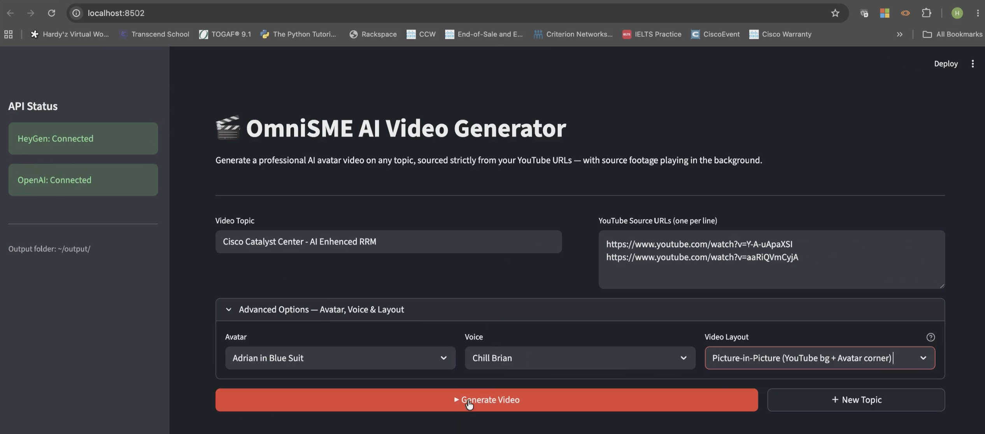
OmniSME App - Screenshot
Video Demo available at : https://app.vidcast.io/share/cb5d873f-f41b-4f88-9a27-a7bce77d84e3
Notes:
The ask is straightforward: help us integrate OmniSME into Cisco's CX enablement pipeline and connect us with the Learning and Development team. Let's turn this hackathon project into Cisco's AI knowledge engine.
Thank you.

