Slide 1





KJ SOMAIYA COLLEGE OF ENGINEERING
COVI-SHOOT
HARDIK JAIN - 16010420053
AVISH RODRIGUES - 160104200
NIRMIT SANGANERIA - 16010420063
PYTHON MINI PROJECT

Slide 2

PROBLEM STATEMENT
KJ SOMAIYA COLLEGE OF ENGINEERING
CREATE AN INTERACTIVE GAME THAT SPREADS AWARENESS ABOUT GETTING VACCINATED. THE GAME MUST BE ABLE TO TRACK THE USER'S SCORE, DISPLAY WHEN THE GAME IS OVER AND CAPTIVATE THE USER BY VARYING THE DIFFICULTY LEVELS
PYTHON MINI PROJECT
PAGE 02

Slide 3
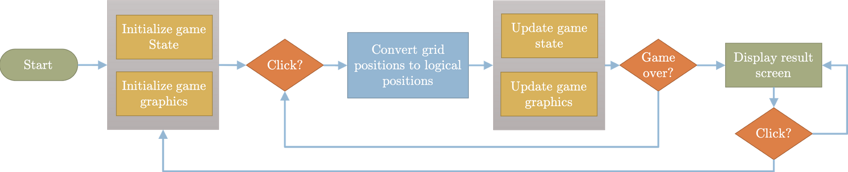
SYSTEM ARCHITECTURE
KJ SOMAIYA COLLEGE OF ENGINEERING
MAKE A FLOWCHART OF THE EVENTS IN THE ORDER OF WHICH THE YOUTUBE VIDEO WAS MADE
PYTHON MINI PROJECT
PAGE 03

Slide 4

01
Game is able tp detect multiple key presses
02
Game gets progessively tougher giving the user an incentive to keep playing
KJ SOMAIYA COLLEGE OF ENGINEERING
FEATURES OF DESIGNED SYSTEM
03
Game can simulataneously move multiple enemies and keep track of each individual movement
04
Game can simulataneously move multiple enemies and keep track of each individual movement
05
Game can keep track of the score
PYTHON MINI PROJECT
06
PAGE 02
It spreads awareness

Slide 5
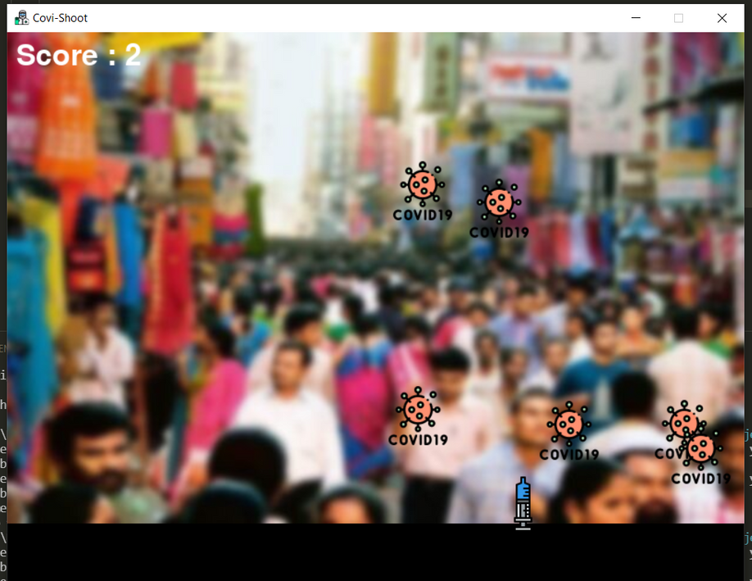
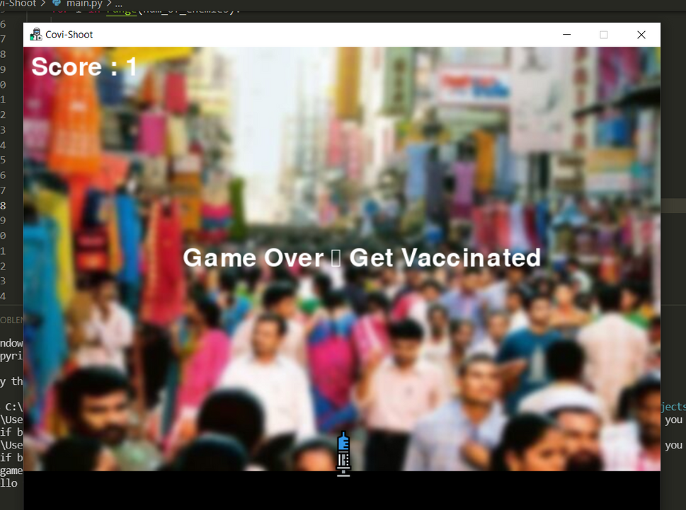
KJ SOMAIYA COLLEGE OF ENGINEERING
RESULT
PYTHON MINI PROJECT
PAGE 06

Slide 6
VIDEO ILLUSTRATION
OLDMEAD SECONDARY SCHOOL
SCIENCE CLASS
PAGE 07

Slide 7
CONCLUSION
OLDMEAD SECONDARY SCHOOL
PROBLEMS FACED
SCIENCE CLASS
PAGE 04

Slide 8

CONCLUSION
KJ SOMAIYA COLLEGE OF ENGINEERING
THIS GAME WAS MADE USING THE APPLICATION OF PYGAME, MATH AND RANDOM MODULE IN PYTHON. THE IDEA WAS TAKEN FROM THE REFERENCE GAME (ATTACHED) AND WE ADDED MULTIPLE FEATURES OF OUR OWN SUCH AS MULTIPLE ENEMIES, SCORE TRACKER, TOUGHER LEVELS AND A POSITIVE MESSAGE TAHT SPREADS AWARENESS ABOUT THE PANDEMIC WE ARE FACING TODAY.
PYTHON MINI PROJECT
PAGE 03

Slide 9
01
https://www.geeksforgeeks.org/introduction-to-pygame/ to learn pygame
KJ SOMAIYA COLLEGE OF ENGINEERING
REFERENCES
02
https://www.flaticon.com/ for icons
03
https://www.youtube.com/playlist?list=PLjcN1EyupaQkAQyBCYKyf1jt1M1PiRJEp for learning implementation of pygame
PYTHON MINI PROJECT
PAGE 20

