Slide 1
Predicting Tox21 toxicity from molecular structure
• 12 in-vitro toxicity endpoints from a SMILES string
• Question: how much accuracy survives on unseen chemical scaffolds?
• Phase 1: Morgan fingerprints + RDKit descriptors with LR / RF / XGBoost
• Phase 2 (next): GNNs and a hybrid, on the same splits and scorer
Project 8 · Molecular Toxicity Prediction · Phase 1 (ML)

Slide 2
Problem and dataset
• Tox21 (MoleculeNet / DeepChem): 7,831 compounds, 12 binary endpoints
• NR: nuclear receptors (AR, ER, AhR, aromatase, PPAR-γ); SR: stress response (ARE, ATAD5, HSE, MMP, p53)
• Many labels are missing: each endpoint is trained and scored on its labelled rows only
• Positives are rare (about 3-15% per endpoint): the metric must respect imbalance

Slide 3
Data quality
• 8 unparseable SMILES dropped; salts and counter-ions removed (largest fragment kept)
• Charges and stereochemistry deliberately kept
• Deduplicated BEFORE splitting: 72 duplicate groups (114 rows) merged
• 44 (molecule, task) labels conflicted and were set to NaN: assay noise
• Final: 7,709 molecules, 2,285 unique Murcko scaffolds

Slide 4
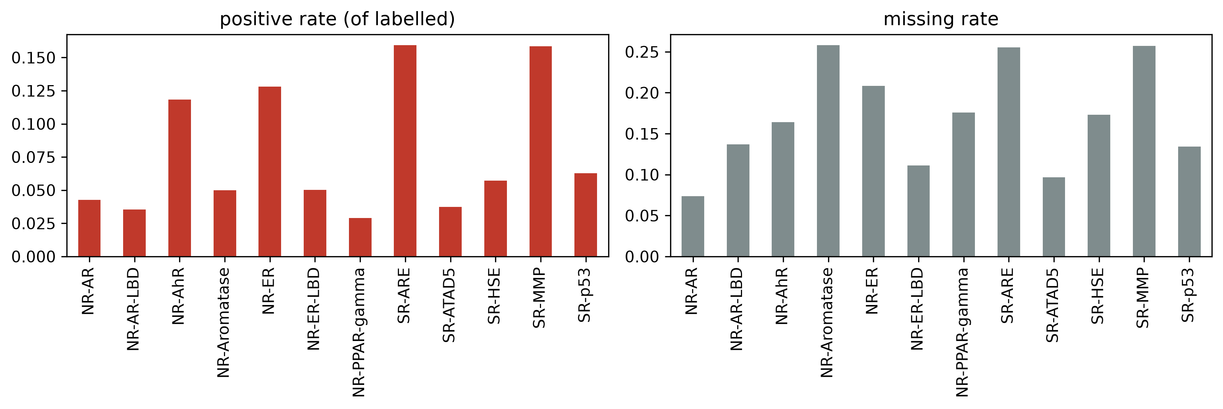
EDA: sparse and imbalanced labels
• Positive rate differs several-fold between endpoints
• Missing rate is high on several tasks, so we mask rather than fill with 0
• NR-AR / NR-AR-LBD and NR-ER / NR-ER-LBD are strongly correlated

Slide 5
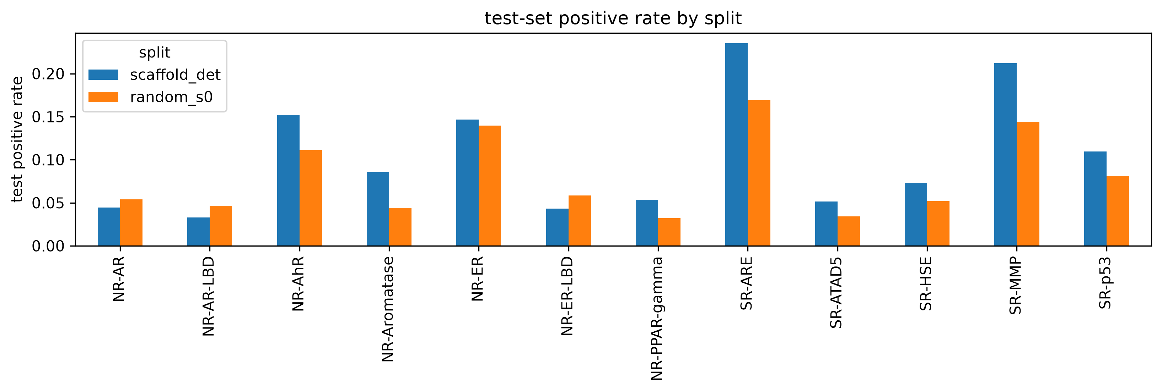
Splits: why scaffold, not random
• Random splits put close analogues in train and test, overstating performance
• scaffold_det: DeepChem convention (largest scaffold groups to train); scaffold_s0-2: balanced, seeded; random_s0-2: reference
• Mean test positive rate is 0.103 (scaffold) vs 0.077 (random)
• That rate is also the PR-AUC of a random classifier, so compare PR-AUC within a split type

Slide 6
Feature engineering
• Morgan fingerprint, radius 2, 2048 bits: presence of circular substructures
• 217 RDKit descriptors: size, polarity, rings, fragment counts (Ipc log-transformed)
• Imputer + scaler fit on train rows only, inside a sklearn Pipeline
• Ablation (XGB, scaffold_det ROC): r1/1024 0.704, r2/2048 0.696, descriptors only 0.761
• Radius and length barely matter; descriptors alone beat every fingerprint setting

Slide 7
Models and protocol
• Logistic regression, random forest (500 trees), XGBoost; each on FP and FP+descriptors
• One model per endpoint, imbalance handled by class weights / scale_pos_weight (train only)
• Small grid tuned on validation PR-AUC; test touched once for reporting
• 7 splits x 3 seeds; one shared scorer (tox.metrics) for every number
• Honest caveat: validation is reused for tuning and early stopping, so val scores are optimistic

Slide 8
Results: test, 12-endpoint mean ± std
model | ROC scaffold_det | ROC scaffold | ROC random | PR scaffold_det | PR random
lr_fp | 0.715 | 0.775 ± 0.036 | 0.801 ± 0.013 | 0.319 | 0.435
lr_fpdesc | 0.722 | 0.788 ± 0.039 | 0.826 ± 0.010 | 0.299 | 0.463
rf_fp | 0.732 | 0.803 ± 0.019 | 0.833 ± 0.009 | 0.366 | 0.484
rf_fpdesc | 0.782 | 0.839 ± 0.024 | 0.862 ± 0.002 | 0.406 | 0.531
xgb_fp | 0.696 | 0.767 ± 0.045 | 0.801 ± 0.012 | 0.306 | 0.435
xgb_fpdesc | 0.761 | 0.813 ± 0.032 | 0.855 ± 0.007 | 0.391 | 0.520

Slide 9
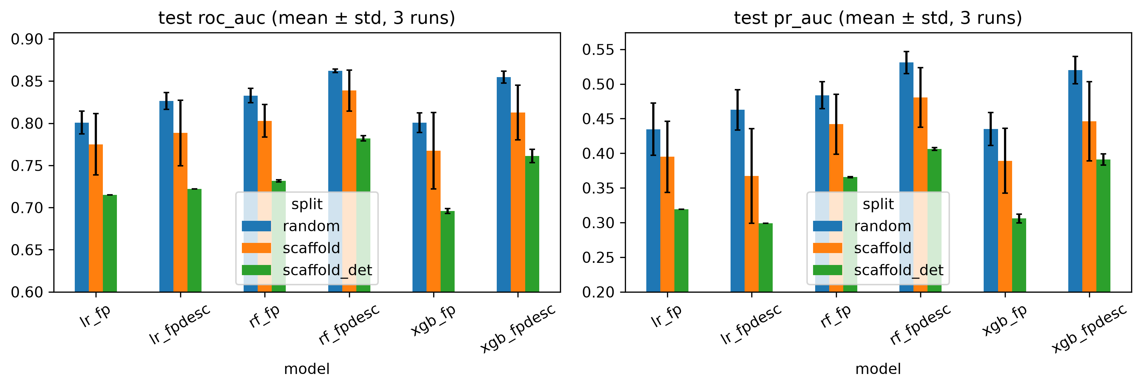
Result: the scaffold penalty
• Best on scaffold_det: rf_fpdesc, ROC 0.782
• Same model family loses roughly 0.08-0.11 ROC-AUC moving from random to scaffold splits
• The gap is as big as the spread between worst and best classical model
• Descriptors help most on unseen scaffolds

Slide 10
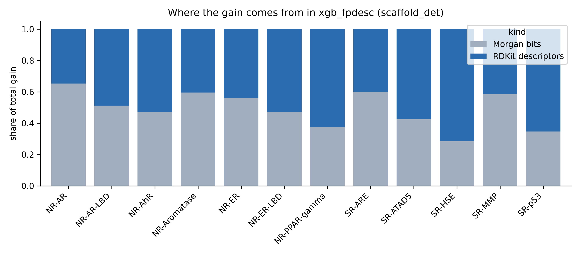
What drives predictions? (XGBoost gain)
• Descriptors take 35-72% of total gain per endpoint
• NR-AhR: fr_benzene, aromatic ring counts: planar polyaromatics, a known AhR ligand trait
• SR-MMP: fr_benzene and fr_phenol lead
• SR-p53 / SR-HSE: size and surface-area descriptors, not specific groups

Slide 11
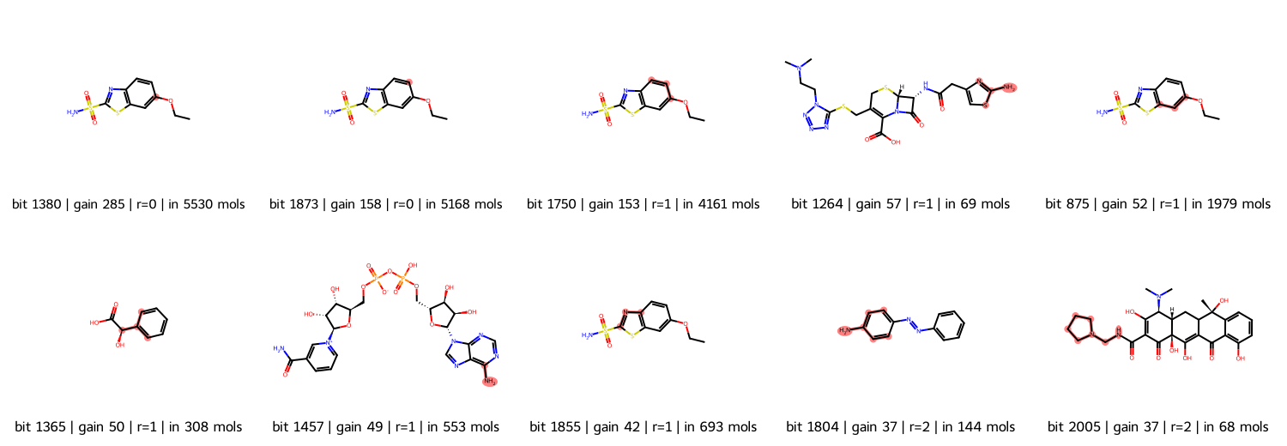
Recovering substructures behind top bits (NR-AhR)
• Highlighted atoms: environment of each top fingerprint bit in an example molecule
• Top bits are generic (radius 0-1, present in thousands of molecules): aromatic atoms, not specific toxicophores
• Bit collisions mean one bit can stand for several substructures

Slide 12
Limitations and Phase 2
• Tox21 are in-vitro screens, not whole-organism toxicity
• Labels are noisy and heavily missing; some endpoints have very few positives
• A scaffold split is still retrospective, not prospective validation
• Phase 2: GCN / MPNN / AttentiveFP with masked loss, hybrid models, ablations, similarity-bin analysis

