Slide 1
Project Presentation of Industry Oriented Hands on Experience (22CS422)
On
“Role of Product Lifecycle Management (PLM) in Digital Transformation of Manufacturing Industries”
Hardik Singh (2210990358)
Supervised By
Dr. Gifty Gupta
Department of Computer Science and Engineering,
Chitkara University, Punjab

Slide 2
Introduction
Industry 4.0 is transforming manufacturing industries through advanced digital technologies and automation systems.
Traditional manufacturing systems suffer from fragmented data management, delayed workflows, poor communication, and inefficient coordination between departments.
Product Lifecycle Management (PLM) systems provide a centralized platform to manage product-related information throughout the complete product lifecycle.
PLM improves collaboration, workflow management, engineering change handling, and operational efficiency in manufacturing industries.
Integration of PLM with technologies such as Cloud Computing, IoT, AI/ML, and ERP systems supports digital transformation and smart manufacturing.
This project analyzes the role of PLM in enabling digital transformation and demonstrates a dashboard-based workflow management system for manufacturing industries.
2

Slide 3
PROBLEM STATEMENT
Manufacturing industries face several challenges in traditional product management systems. These problems reduce efficiency and slow down digital transformation.
Problems Identified
Fragmented product data across departments
Lack of real-time collaboration
Delays in engineering change management
Poor workflow coordination
Production discrepancies and version control issues
Difficulty integrating Industry 4.0 technologies
Impact
Increased development time
Reduced operational efficiency
Higher production costs
Delayed decision-making
Reduced product quality
This project uses Product Lifecycle Management (PLM) concepts to improve workflow management and manufacturing efficiency.
3

Slide 4
OBJECTIVES
Objectives of the Project
To analyze the role of Product Lifecycle Management (PLM) in digital transformation
To improve workflow and collaboration management in manufacturing industries
To study integration of PLM with Industry 4.0 technologies such as IoT, Cloud Computing, and AI/ML
To reduce manufacturing inefficiencies and improve operational performance
To develop a dashboard-based PLM workflow management system
To analyze the benefits of centralized product lifecycle management systems

Slide 5
PLM ARCHITECTURE
1. Authoring Layer
Bus design and engineering models
CAD/CAE/CAM tools for manufacturing planning
2. PLM Core Layer
Product data management
Workflow and version control
3. Integration Layer
ERP and MES integration
Department coordination and tracking
4. Enterprise Layer
Manufacturing operations management
Real-time workflow monitoring

Slide 6
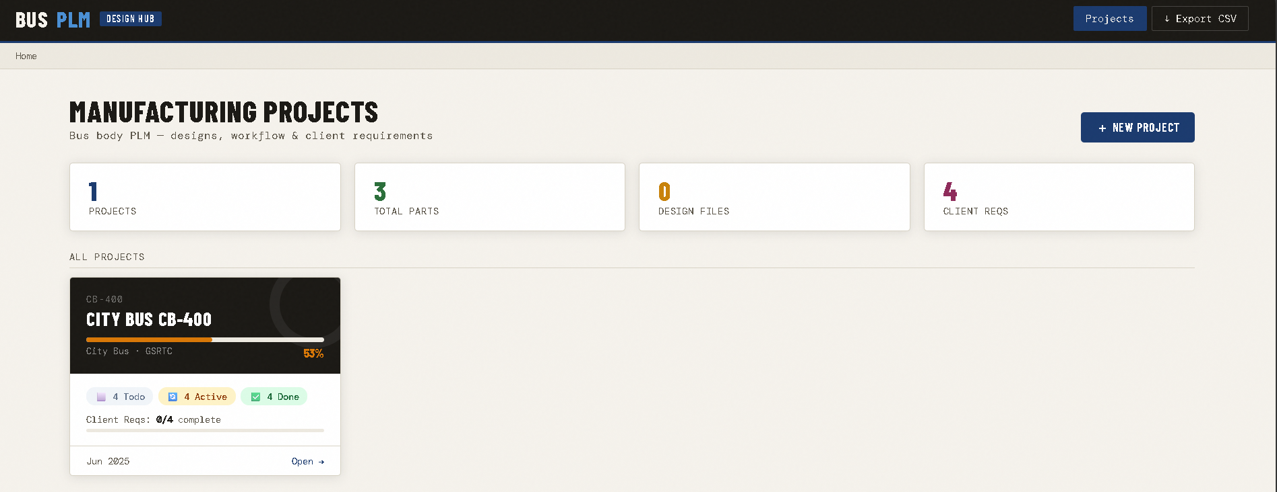

Slide 7
TOOLS AND TECHNOLOGIES
Technology | Purpose
HTML | Dashboard structure
CSS | Styling and responsive design
JavaScript | Dynamic functionality
PLM Concepts | Product lifecycle workflow management
Cloud Computing | Centralized data accessibility
IoT | Real-time manufacturing monitoring
AI/ML | Predictive analysis and automation
ERP Integration | Enterprise-level coordination
Digital Twin | Virtual manufacturing simulation
Technologies Used in Project
The dashboard-based bus manufacturing workflow system was developed using HTML, CSS, and JavaScript while implementing PLM concepts for workflow management, department tracking, and manufacturing process monitoring.

Slide 8
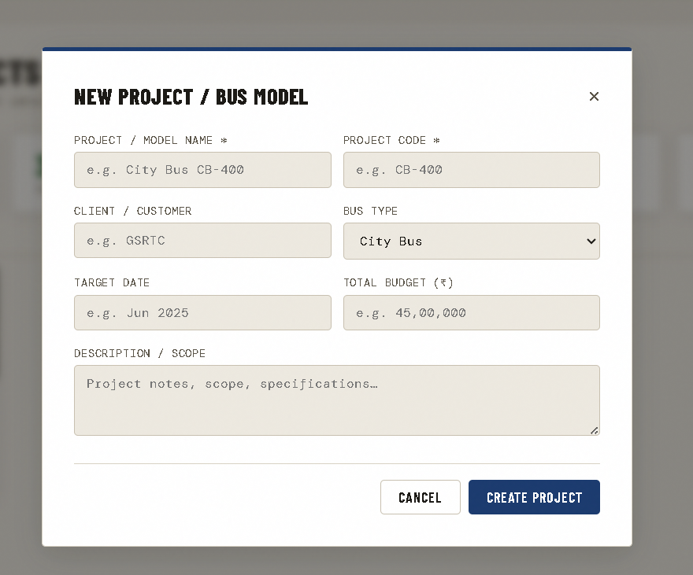

Slide 9
IMPLEMENTATION
Dashboard-Based Bus Manufacturing Workflow System
A dashboard-based Product Lifecycle Management (PLM) system was developed to simulate workflow management in bus manufacturing industries.
Features of the Implementation
Manufacturing project tracking
Department-wise workflow monitoring
Mechanical and Electrical status management
Body structure and paint process tracking
Benefits of the System
Improved collaboration between departments
Better workflow visibility and monitoring
Reduced data inconsistency

Slide 10
MAJOR FINDINGS / RESULTS
Major Findings
Improved workflow coordination between manufacturing departments
Better centralized management of product-related information
Enhanced collaboration and communication among teams
Reduced engineering change management delays
Improved manufacturing process monitoring and tracking
Results Observed
28% reduction in product development cycle time
35% improvement in Engineering Change Order (ECO) processing
Reduced production discrepancies and workflow errors
Improved operational efficiency and product quality
The project demonstrates how Product Lifecycle Management (PLM) systems help manufacturing industries achieve better productivity and digital transformation.

Slide 11
CHALLENGES
Challenges in PLM Implementation
High initial implementation cost
Complexity in integrating PLM with existing systems
Data migration and management difficulties
Resistance to change in organizational workflow
Training requirements for employees and staff
Cybersecurity and data protection concerns
Despite these challenges, PLM systems provide long-term benefits in workflow management, manufacturing efficiency, and digital transformation.

Slide 12
CONCLUSION
This project successfully analyzed the role of Product Lifecycle Management (PLM) in digital transformation of manufacturing industries. The dashboard-based bus manufacturing workflow system demonstrated improved collaboration, centralized data management, and better workflow coordination between departments.
PLM systems help manufacturing industries improve efficiency, reduce operational delays, and support Industry 4.0 technologies such as IoT, Cloud Computing, and AI/ML.

Slide 13
THANK YOU

