Slide 1
Multi-Threading

Slide 2
Multitasking and Multithreading
Multitasking
Refers to a computers ability to perform multiple jobs where more than one program are running concurrently e.g. UNIX
Multithreading
A thread is a single sequence of execution within a program.
Refers to multiple threads of control within a single program.
Each program can run multiple threads of control within it , e.g. Web Browser

Slide 3
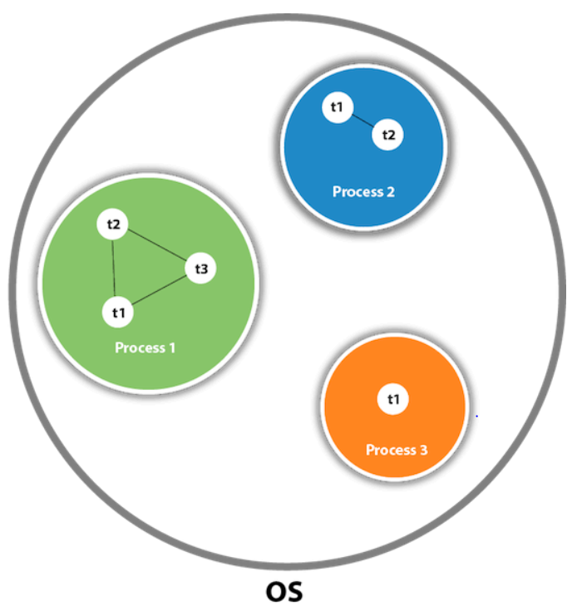
What are Threads?
Threads are lightweight compared to processes
Threads share the same address space and therefore can share both data and code
Threads allow different tasks to be performed concurrently.

Slide 4
Thread Methods
public void run(): is used to perform action for a thread.
public void start(): starts the execution of the thread JVM calls the run() method on the thread.
public void sleep(long milliseconds): Causes the currently executing thread to sleep (temporarily cease execution) for the specified number of milliseconds.
public void resume(): is used to resume the suspended thread (deprecated).
public void stop(): is used to stop the thread (deprecated).

Slide 5
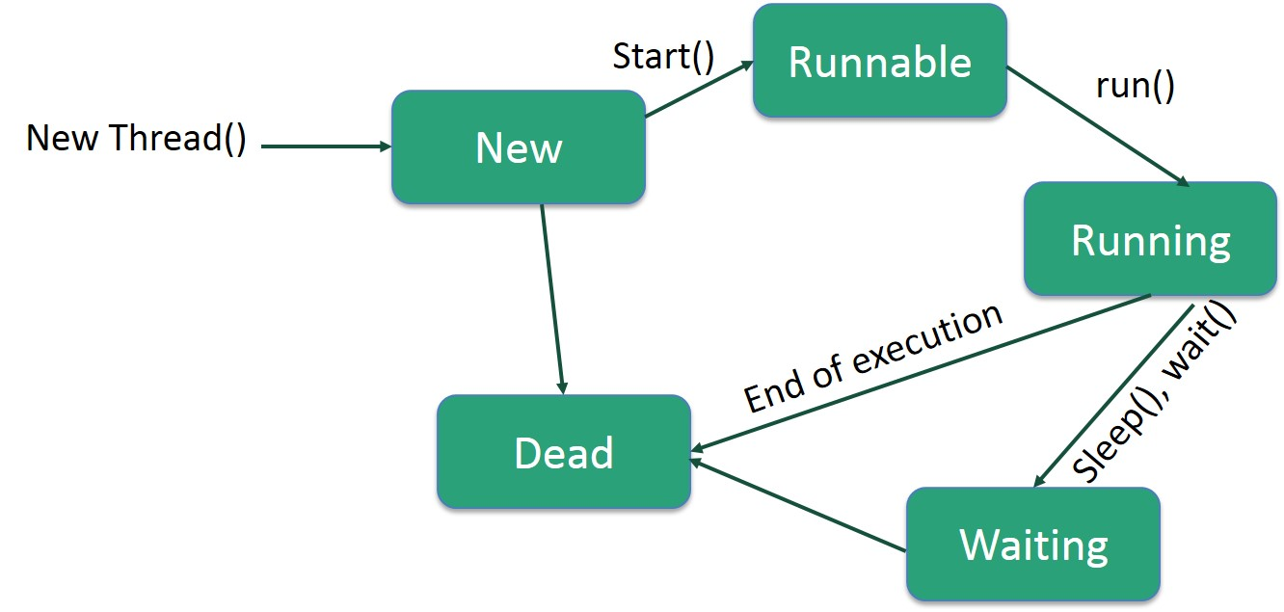
Life Cycle of Threads

Slide 6
Thread Priorities
Every thread in Java has a priority that helps the thread scheduler to determine the order in which threads scheduled.
Priority is an integer value that must range between 1 and 10, with 10 being the highest priority, 1 being the lowest and 5 being the default.
These include MIN_PRIORITY, NORM_PRIORITY, and MAX_PRIORITY representing values 1,5 and 10 respectively.

Slide 7
Summary
In multithreading, users are not blocked as threads are independent and can perform multiple operations at time
Various stages of life cycle of the thread are,
New
Runnable
Running
Waiting
Dead
Multithreading makes many more application tasks easier.

Slide 8
Thank You

