Slide 1

GENRE CLASSIFICATION OF HARMONIC AND
PERCUSSIVE COMPONENTS OF SEPARATED SIGNALS
USING DEEP EMBEDDINGS
Music Information Retrieval
Valentín Malpica Gómez

Slide 2
DATASET
GTZAN (Tzanetakis and Cook (2002)):
1000 audio tracks of 30s duration divided in 10 genres
Genres: Blues, Classical, Country, Disco, HipHop, Jazz, Metal, Pop, Reggae, Rock

Slide 3
Methodology
1) Separate tracks into sources: Drums, Bass, Others and Vocals [Demucs v4] [1]
2) Generate new datasets:
GTZAN Percussive: Combine drums+bass
GTZAN Harmonic: Combine others+vocals
3) Compute embeddings for GTZAN, GTZAN Percussive and GTZAN Harmonic (*):
msd-musicnn
audioset-vgg
disocgs-effnet
4) Classification using SVM (* whole datasets except ‘classical’ audios)

Slide 4
RESULTS
Test accuracy:
Dataset | msd-musicnn | audioset-vggish | discogs-effnet
GTZAN | 0.94 | 0.78 | 0.98
GTZAN Harmonic | 0.83 | 0.60 | 0.88
GTZAN Percussive | 0.83 | 0.70 | 0.86

Slide 5
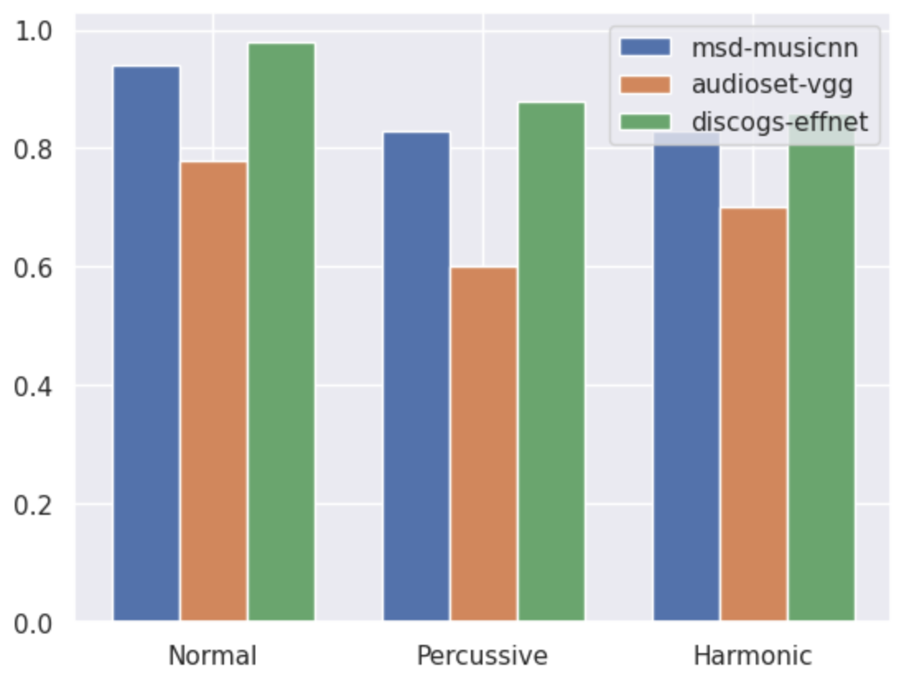
RESULTS
Results Distribution:

Slide 6

Thanks for your attention

