Slide 1

MCA Major Project Mid Term Evaluation
UI/UX Implementation for wiZe(MyLamp.Ai)
Under the guidance of
Ms. Veerpal Kaur
Department of Computer Applications
Faculty of Science, Technology and Architecture
Manipal University Jaipur
By
ASHOK SHARMA
23FS20MCA00096
2023-25

Slide 2
Introduction
Wize is an AI-driven hiring platform designed for recruiters and students.
It simplifies the recruitment process by using AI to match students with job opportunities based on skills, experience, and preferences.
The platform enhances efficiency, transparency, and accessibility in the hiring process.

Slide 3
Motivation
Challenges faced by students: Difficulty in finding relevant job opportunities.
Challenges faced by recruiters: Sorting through large pools of applicants.
Lack of AI-driven solutions: Existing platforms rely on manual filtering and outdated processes.
Goal: To create an intelligent, automated, and unbiased hiring process.

Slide 4
Process Model
Software Development Approach:
Requirement Analysis: Understanding recruiter and student needs.
Design: UI/UX for seamless interaction.
Development: Implementing AI algorithms for job matching.
Testing: Ensuring platform accuracy and performance.
Deployment & Maintenance: Continuous upgrades and user feedback.

Slide 5
Software Requirement Specification (SRS)
Functional Requirements:
User authentication & profile management.
AI-driven job recommendations.
Resume parsing and skill assessment.
Automated interview scheduling.
Non-Functional Requirements:
High scalability to support large user traffic.
Data security & privacy compliance.
Fast response time for job recommendations.

Slide 6
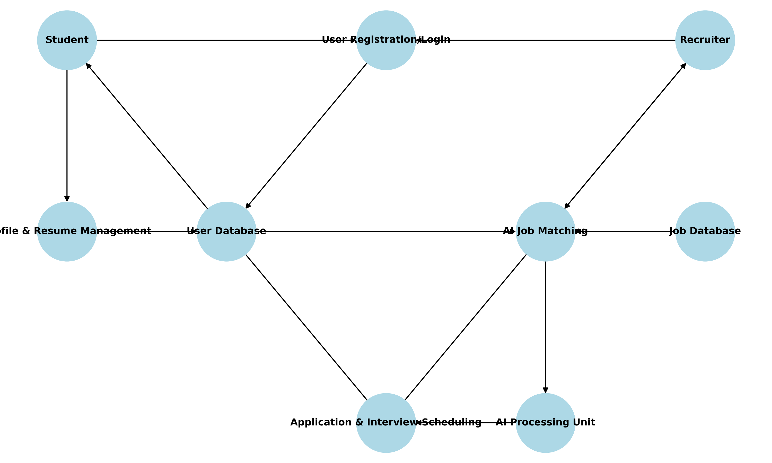
Data Flow Diagram (DFD)

Slide 7
Level 0 DFD (Context Diagram):
Recruiters post job openings.
Students upload resumes and apply for jobs.
AI processes data and recommends best matches.
Interview scheduling and hiring decisions.

Slide 8
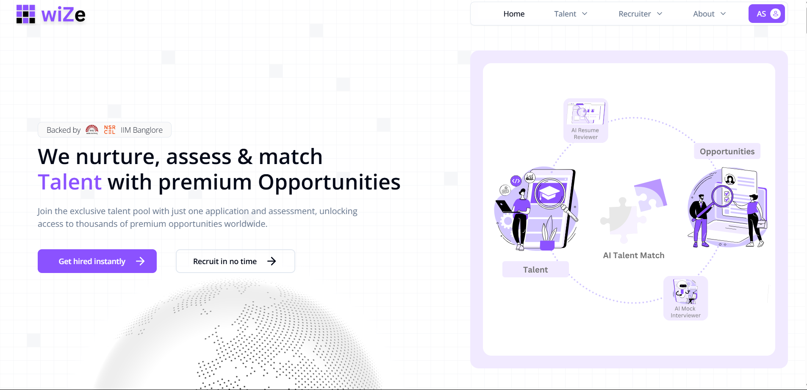
Output

Slide 9
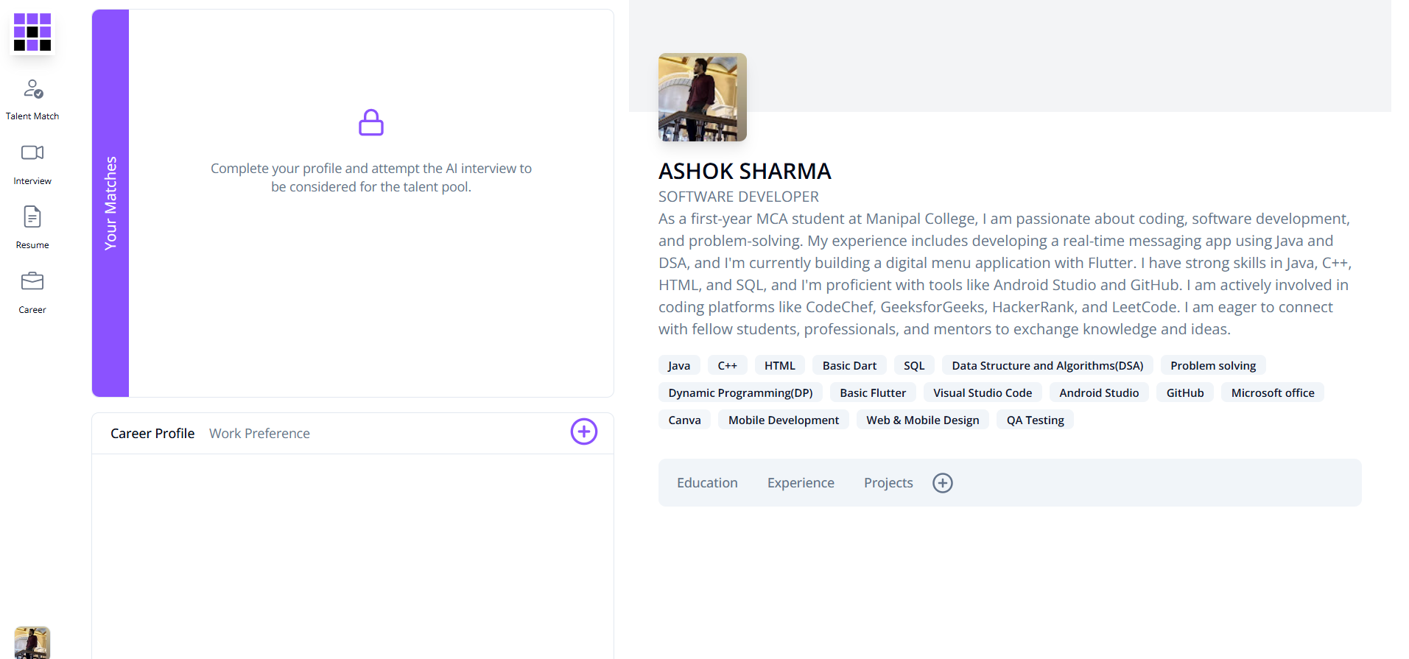
Talentmatch

Slide 10
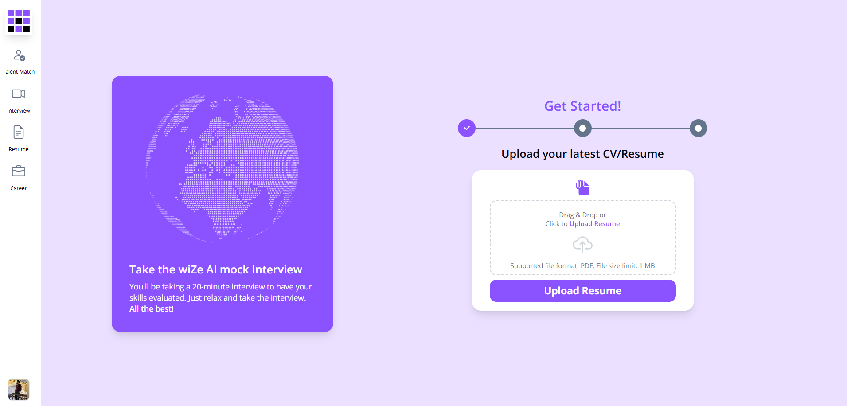
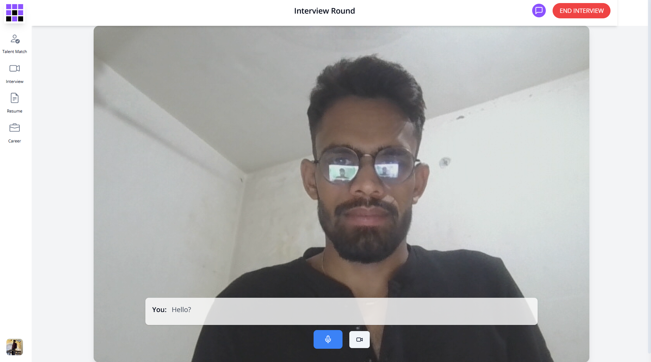
MockInterview

Slide 11
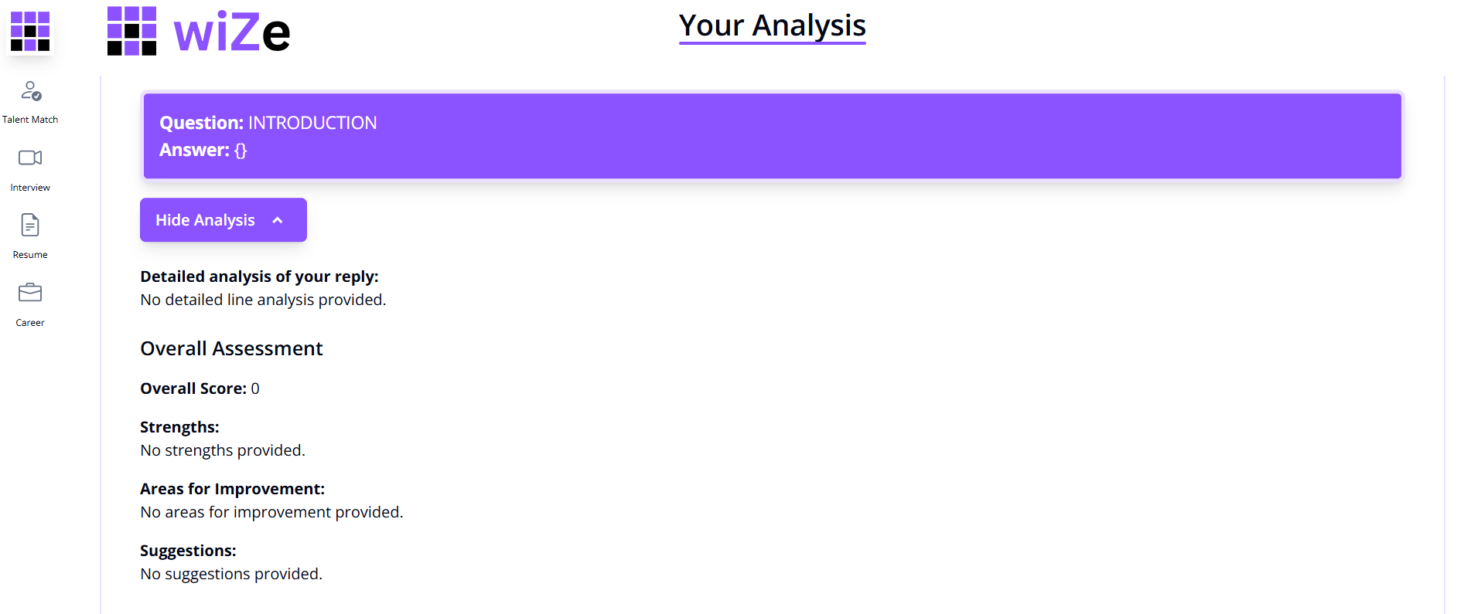
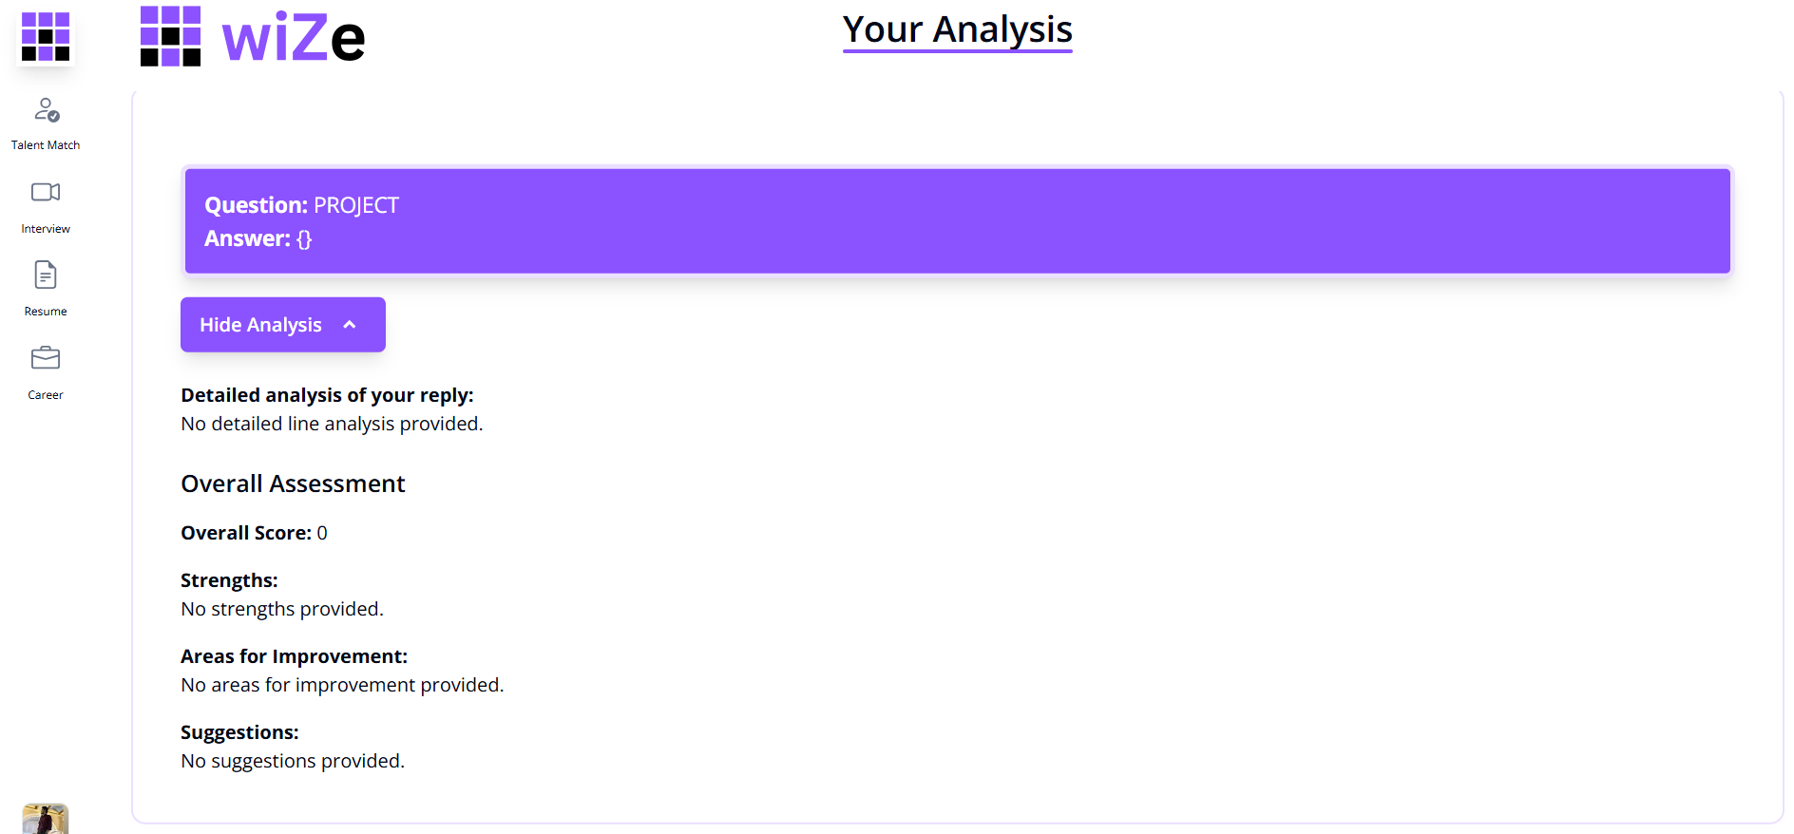
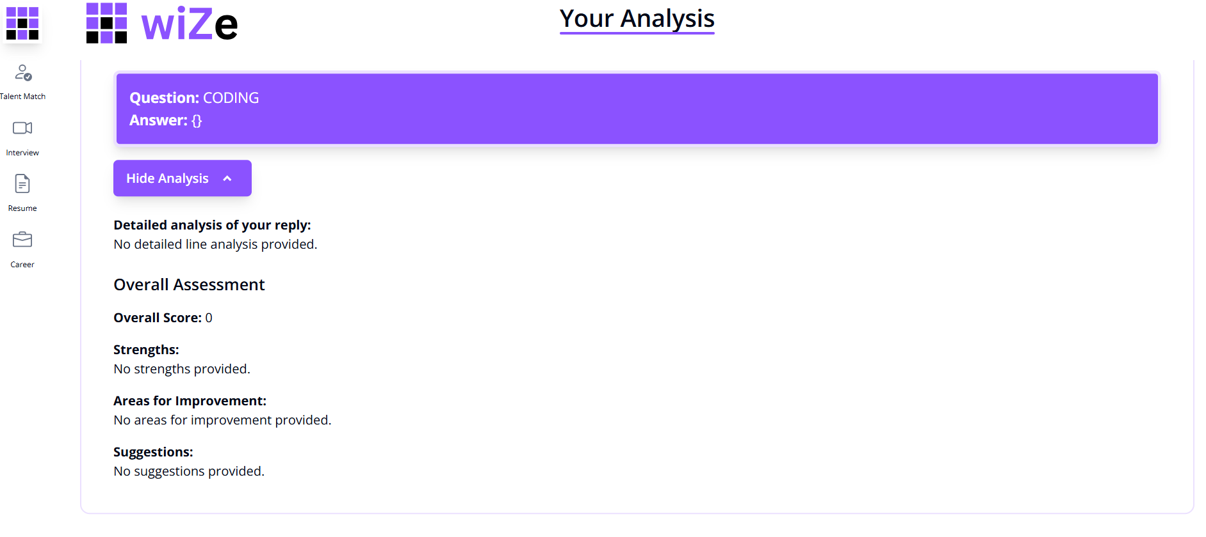
Analysis

Slide 12
Conclusion
Wize revolutionizes the hiring process by using AI for intelligent matchmaking.
The platform reduces manual effort, increases efficiency, and ensures fair hiring.
It is fast, scalable, and designed for real-world recruitment challenges.

Slide 13
Future Scope
Scalability: Expand to universities and global hiring platforms.
Integration: Connect with LinkedIn, HRMS tools, and ATS systems.
AI Improvements: More advanced resume analysis and interview evaluation.

Slide 14
Thank You

