Slide 1


Slide 2
Embeddings
and RAG

Slide 3


Gemini Python API
RAG and Embeddings
RAG stands for Retrieval Augmented Generation and makes great use of the model’s ability to generate vector embeddings of text.
Let’s explore this idea with a motivational thought experiment…

Slide 4
Gemini Python API
RAG and Embeddings
While Google Gemini is a very powerful model, there will be content it doesn’t know about.
For example, Google Gemini probably doesn’t know about the vacation policies at a specific company.
So how could we leverage AI to build a corporate HR assistant?

Slide 5
Gemini Python API
RAG and Embeddings
What we need is the ability to “augment” Gemini by providing the model with extra context when asking a question.
For example, if we could provide the text about a corporate vacation policy along with our query, then Gemini could read the text and give us a reasonable answer.

Slide 6
Gemini Python API
RAG and Embeddings
How many weeks off do employees of ACME Corp get?

Slide 7

Gemini Python API
RAG and Embeddings
How many weeks off do employees of ACME Corp get?

Slide 8
Gemini Python API
RAG and Embeddings
I'm sorry, I can't answer your question about how many weeks off employees of ACME Corp get. I don't have access to internal HR information for specific companies.
However, I can offer some general information about vacation policies in the United States.
How many weeks off do employees of ACME Corp get?

Slide 9
Gemini Python API
RAG and Embeddings

Slide 10
Gemini Python API
RAG and Embeddings
How many weeks off do employees of ACME Corp get?
Here is some context:

Slide 11
Gemini Python API
RAG and Embeddings
How many weeks off do employees of ACME Corp get?
Here is some context:
ACME HR
3 Weeks Vacation per year. With one additional day per year with the company.

Slide 12
Gemini Python API
RAG and Embeddings
How many weeks off do employees of ACME Corp get?
Here is some context:
ACME HR
3 Weeks Vacation per year. With one additional day per year with the company.

Slide 13
Gemini Python API
RAG and Embeddings
How many weeks off do employees of ACME Corp get?
Here is some context:
ACME HR
3 Weeks Vacation per year. With one additional day per year with the company.

Slide 14
Gemini Python API
RAG and Embeddings
How many weeks off do employees of ACME Corp get?
Here is some context:
According to the ACME HR vacation policy documents, employees receive 3 weeks of vacation per year, with one additional day per year with the company.
ACME HR
3 Weeks Vacation per year. With one additional day per year with the company.

Slide 15
Gemini Python API
RAG and Embeddings
Now we can see that LLMs can answer any question if they have the correct and appropriate context and documents for an answer, this is “augmented generation” because we augmented the original query with the context of the ACME HR policy documents.
But how can we retrieve this context?

Slide 16
Gemini Python API
RAG and Embeddings
Recall our models ability to embed text into vectors.
If we had all our text documents stored as vectors and matched to the original text, we could perform vector similarity searches to find the most relevant documents.

Slide 17
Gemini Python API
Most Likely
Tokens
“what”
“is”
“cap”
“ital”
“of”
“france”
[0,1,3]
[4,1,3]
[5,3,6]
[8,4,1]
[9,1,3]
[0,5,1]
[0,1,3]
[4,1,3]
[5,3,6]
[8,4,1]
[9,1,3]
[0,5,1]
95%
What is the capital of France?
Paris
2%
1%
0.5%
0.2%
0.1%
[5,2,2]
[5,1,6]
[8,2,1]
[7,3,9]
[2,9,8]
[3,7,4]
Paris
Tours
Laon
Troyes
Versailles
Orleans

Slide 18
Gemini Python API
Most Likely
Tokens
“what”
“is”
“cap”
“ital”
“of”
“france”
[0,1,3]
[4,1,3]
[5,3,6]
[8,4,1]
[9,1,3]
[0,5,1]
[0,1,3]
[4,1,3]
[5,3,6]
[8,4,1]
[9,1,3]
[0,5,1]
95%
What is the capital of France?
Paris
2%
1%
0.5%
0.2%
0.1%
[5,2,2]
[5,1,6]
[8,2,1]
[7,3,9]
[2,9,8]
[3,7,4]
Paris
Tours
Laon
Troyes
Versailles
Orleans

Slide 19

Gemini Python API
RAG Process:

Slide 20
Gemini Python API
RAG Process:

Slide 21
Gemini Python API
RAG Process:

Slide 22

Gemini Python API
RAG Process:

Slide 23
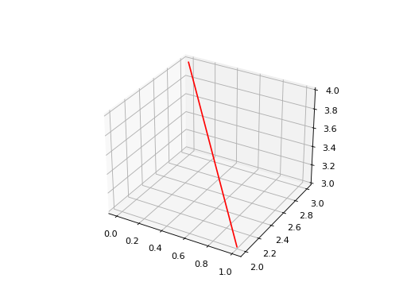
Gemini Python API
RAG Process:

Slide 24
Gemini Python API
RAG Process:

Slide 25
Gemini Python API
RAG Process:

Slide 26

Gemini Python API
RAG Process:

Slide 27
Gemini Python API
RAG Process:

Slide 28
Gemini Python API
RAG Process:
Prompt:
“What can you tell me about vacation policy?”
Context below:
{Insert Document}

Slide 29
Gemini Python API
RAG Process Steps
Read in Documents (text, PDF, etc.)
Load Embedding Model
Embed Documents as Vectors
Store Vector Embeddings (Vector Store)
Embed new query
Perform Similarity Search
Augment text generation with original document

Slide 30
Gemini Python API
RAG Process Steps
Remember that as long as you can convert a document into a text string, you should be able to then embed that string and link the connection to the original document.
There exists many libraries specific to a document type (e.g. PyPDF2 for PDF files) you should search for relevant libraries or explore unstructured.io for multiple files.

Slide 31
Gemini Python API
RAG Process Steps
Let’s explore RAG with Python in the next lecture!

Slide 32
RAG
Part One

Slide 33
RAG
Part Two

