Slide 1
Introduction to Machine Learning Lab 02. Naive Bayes' Classifier
Prof. Chang-Chieh Cheng
Information Technology Service Center
National Chiao Tung University

Slide 2
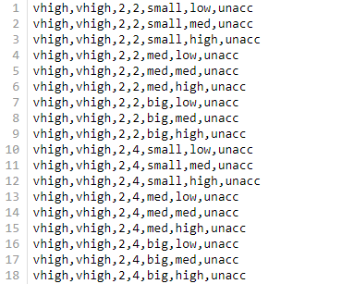
Dataset
Predict the car evaluation
There are 7 features in the dataset.
buying: vhigh, high, med, low.
maint: vhigh, high, med, low.
doors: 2, 3, 4, 5more.
persons: 2, 4, more.
lug_boot: small, med, big.
safety: low, med, high.
Values: unacc, acc, good, vgood

Slide 3
Exercise File I/O
Read the car.txt
Print how many cars have 4 doors(10%)
Print how many cars for each values(unacc,acc,good,vgood)(10%)

Slide 4
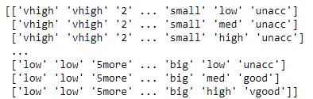
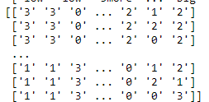
Exercise Data preprocessing
Use label encoder
Print the corresponding labels and target name(5%)
Split dataset to the training dataset and testing dataset
Testing dataset = 0.2 * dataset
Print the number of testing dataset(5%)

Slide 5
Exercise Naïve Bayes’ method implement
Use Gaussian Naive Bayes' method, then print the accuracy.(15%)
Use Bernoulli Naive Bayes' method, then print the accuracy.(15%)
Use Complement Naive Bayes' method, then print the accuracy. (15%)
Use Multinomial Naive Bayes' method, then print the accuracy. (15%)
Print the confusion matrix of the highest accuracy method, which target ha s the most wrong prediction?(10%)
(Bonus)According to the results, can you adjust some parameters to get the accuracy that higher then 0.8?(5%)

Slide 6
評分
原始分數
上課繳交：20%
在當天 16:20 前上傳至 new E3 作業，請將以下打包成 .zip 上傳：
程式原始檔 (.ipynb）
程式 .html 檔
並填寫表單上傳程式執行結果(可以直接到中間demo，確認對錯)
請上傳 .html 檔案至表單
表單連結
https://docs.google.com/forms/d/e/1FAIpQLSdlbNU_u9kb1QpCdXsgX42gx6UcRYCtVnX4E0xVlkjYyEOgug/viewform
程式分數：80%
調整分數
你的調整分數 =
(你的原始分數 - 全部人原始分數平均) x (15. / 全部人原始分數標準差) + 80.

Slide 7
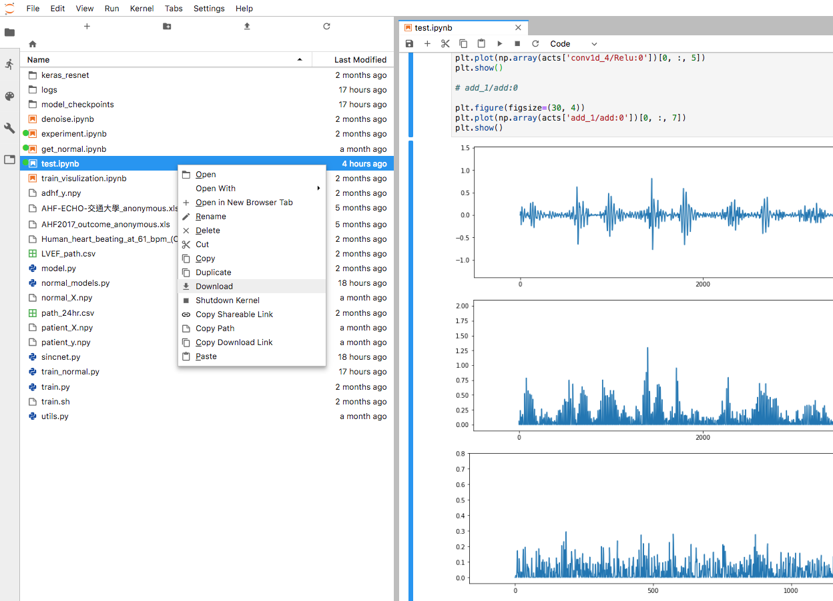
下載程式原始檔

Slide 8
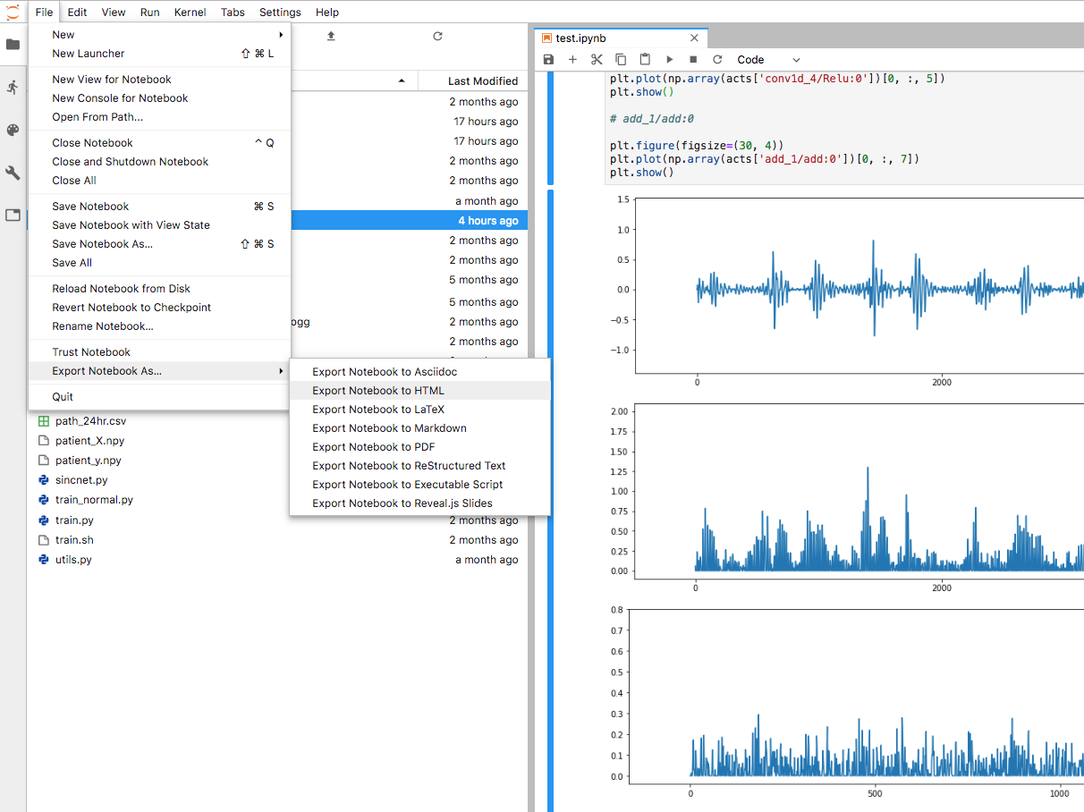
下載成 .html 檔

