Slide 1
Introduction to Machine Learning Lab 01. Data Analysis
Prof. Chang-Chieh Cheng
Information Technology Service Center
National Chiao Tung University

Slide 2
Toydata in scikit-learn
https://scikit-learn.org/stable/datasets/index.html
load_boston
boston house-prices dataset (regression).
load_iris
the iris dataset (classification).
load_diabetes
the diabetes dataset (regression).
load_digits
the digits dataset (classification).
load_linnerud
the linnerud dataset (multivariate regression).
load_wine
the wine dataset (classification).
load_breast_cancer
the breast cancer wisconsin dataset (classification).

Slide 3
Wine dataset
Write a program to load the wine dataset from scikit-learn
Print the shape of Wine (10%)
Print the names of all features (10%)
Print the names of all targets (10%)
Print any data instance including its target (10%)
Print the 39th , 48th , 99th, 170th data instances

Slide 4
Analysis
Calculate the following attributes of each feature (10%)
Minimum, maximum, median, mean, and standard deviation
For example, feature 0 (alcohol):
alcohol
11.03, 14.83, 13.05, 13.00061797752809, 0.8095429145285168

Slide 5
Analysis
Draw a scatter figure for each feature and assign different colors for all targets, for example, the figure of feature 0: (10%)
﻿feature 0 alcohol
￼

Slide 6
Analysis
Choose two features to classify the data precisely.
Drawing a scatter figure for the selected features, where the color of each point depends on its target. (10%)
For example, feature 0 and 1:
Tell me why do you choose these two feature? (5%)
Write down your opinion as a commend at the beginning of your program.

Slide 7
評分
原始分數
上課繳交：25%
在當天 18:20 前上傳至 new E3 作業，請將以下打包成 .zip 上傳：
程式原始檔 (.ipynb）
程式 .html 檔
並填寫表單上傳程式執行結果
請上傳 .html 檔案至表單
表單連結
https://docs.google.com/forms/d/e/1FAIpQLSdlbNU_u9kb1QpCdXsgX42gx6UcRYCtVnX4E0xVlkjYyEOgug/viewform
程式分數：75%
調整分數
你的調整分數 =
(你的原始分數 - 全部人原始分數平均) x
(15. / 全部人原始分數標準差) + 80.

Slide 8
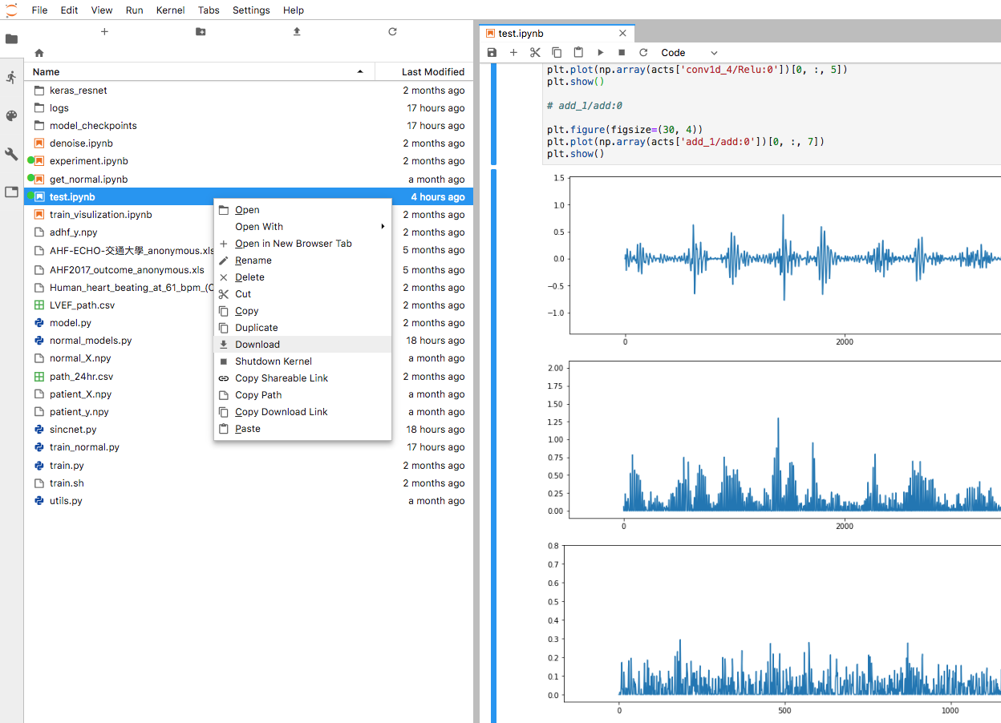
下載程式原始檔

Slide 9
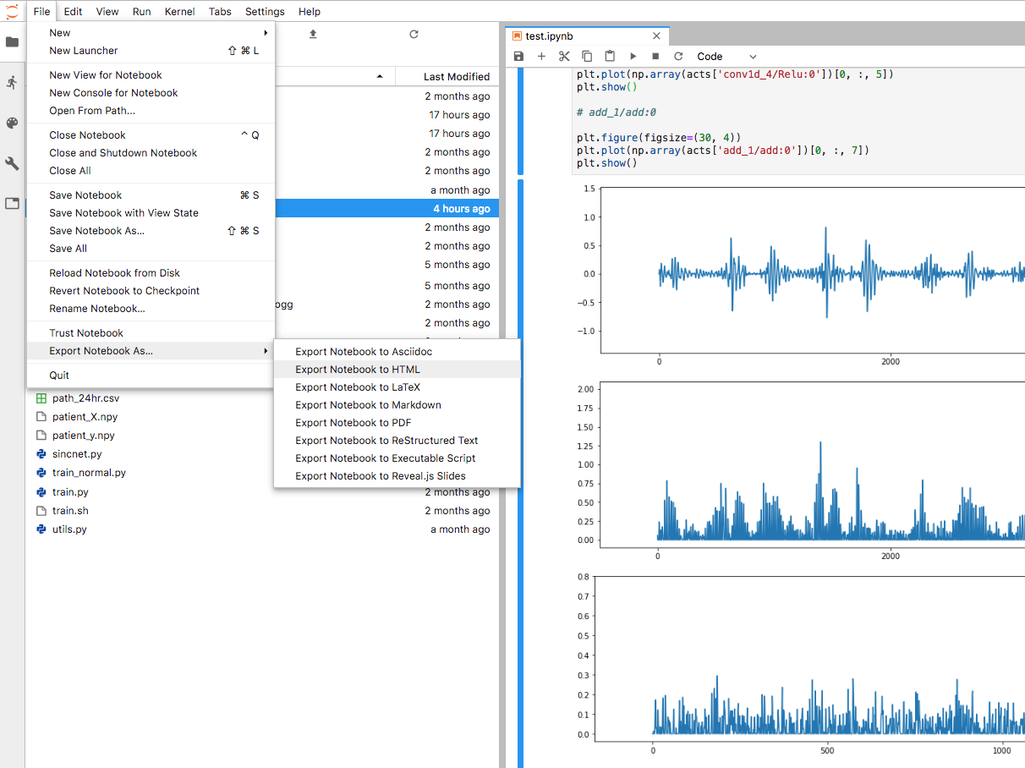
下載成 .html 檔

