Slide 1
SQL-SQOOP-DATA-INGESTION-ETL

Slide 2
Objective:
In Big data field when there is need to transfer the data from transactional databases to Hadoop ecosystem the best practice is to by doing with Sqoop which can transfer the data from MySQL, PostgreSQL, Oracle, etc to Hadoop cluster and vice-versa.
Benefits:
Easy to write the Sqoop Query rather than typical map-reduce job.
Point to Point delivery that means Sqoop does not hold the data for certain amount of time likewise kafka.

Slide 3
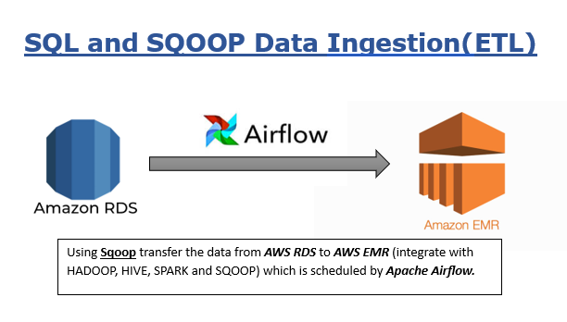
Architecture

Slide 4
AWS RDS:
After setting up AWD RDS on cloud the next step is to create the E-commerce Schema which is in TableSchema.sql file.
In this step connect AWS RDS to your MySQL Workbench or SQL Workbench providing host, username and password which is available at the time of creating the AWS RDS cloud database.
Please Keep in mind that enable the “Publicly accessible”: Yes, otherwise it will not be connect to your workbench.
Now copy the all the commands from TableSchema.sql and paste into MySQL workbench and run it.
Now copy the records which is present in TableRecords.sql file and run it.
Just cross verify with any select query statement and see the result window.

Slide 5
AWS EMR:
Now after setting up the AWS RDS and create the E-commerce database followed by loading records, the next step is to create the EMR cluster on AWS.
In this project I have integrate EMR with Hadoop, Hive, Spark, HCatalogs and Sqoop. Along with configuration I have also install the Mysql-connector.jar through Bootstrap action.
After start the cluster, configure the security groups i.e.
Add one SSH connection having port 22 and traffic Anywhere ipv4.
Add one MYSQL connection having port 3306 and traffic Anywhere ipv4.
Here In IAM roles I have add two policies i.e, AWS S3 full access and AWS EMR full access.

Slide 6
AWS EC2:
Create the AWS EC2 having t2.micro system configuration and add the IAM role.
Now make a SSH connection using Putty and add the SSH security group for successful connection.
Following steps to install the python and Apache airflow:
sudo apt-get update
sudo apt install python3-pip
sudo pip install apache-airflow
sudo pip install pandas
Now just run the “airflow standalone” and a demon process will start.

Slide 7
Conclusion
After successfully run all the amazon services and establish the connection to your local machine. I have run the Apache airflow and schedule the Sqoop job on daily basis so that whatever new data came in AWS RDS (MySQL database) it will automatically run the command and a new part file will creates in Hadoop.
Hence A simple Sqoop pipeline is working properly.

