Slide 1
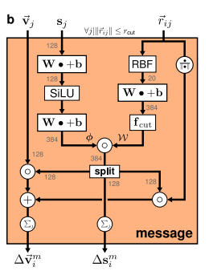
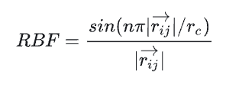

scalar_feature [from embending(atoms)]
Init: zeros
w
w
PaiNNMessageBlock.scalar_network
PaiNNMessageBlock.rbf_network
times
phi_W_ss
index_add_

Slide 2
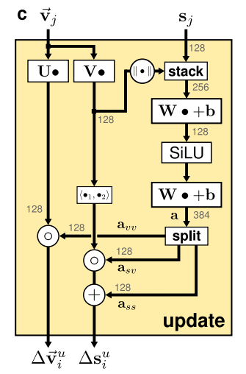
[norm] torch.linalg.vector_norm()
w
torch.cat()
bias=False
[dot product] < U, V >

Slide 3
target：https://www.pnas.org/doi/10.1073/pnas.1815117116

