Slide 1


NHDPlusV2 Content Cindy McKay
NHDPlus Training Series
Notes:
Welcome to the NHDPlus Training Series. This webinar is about what components come in the NHDPlusV2 package. I’m Cindy McKay, a member of the NHDPlus Team
The NHDPlusV2 Training Series is designed for NHDPlus users who have studied the NHDPlusV21 User Guide, downloaded and installed some NHDPlus data, and spent time exploring the content of NHDPlus. Users new to NHDPlus will benefit most from the Training Series after completing these recommended prerequisite tasks:
1. Read the NHDPlusV21 User Guide, through section on “NHDPlusV2 Versioning”
2. Perform Exercises 0 and 1 found on the NHDPlusV2 Documentation webpage.
The Training Series does not cover how the NHDPlus components were built. This information can be found in Appendix A of the NHDPlusV21 User Guide.

Slide 2
Objectives
Understand the Source Datasets from which NHDPlusV2 is built
Learn what datasets are found within NHDPlusV2
Objectives
Notes:
The objectives of this session are to understand the source datasets from which NHDPlusV2 is built and to learn what data components are found within NHDPlusV2

Slide 3
Agenda
Source Datasets
NHDPlusV2 Content
Agenda
Notes:
We will first cover the major source datasets that are used to build NHDPlus. Then we’ll look at the content of NHDPlusV2 from a dataset level. Details about each dataset are covered in other sessions.

Slide 4
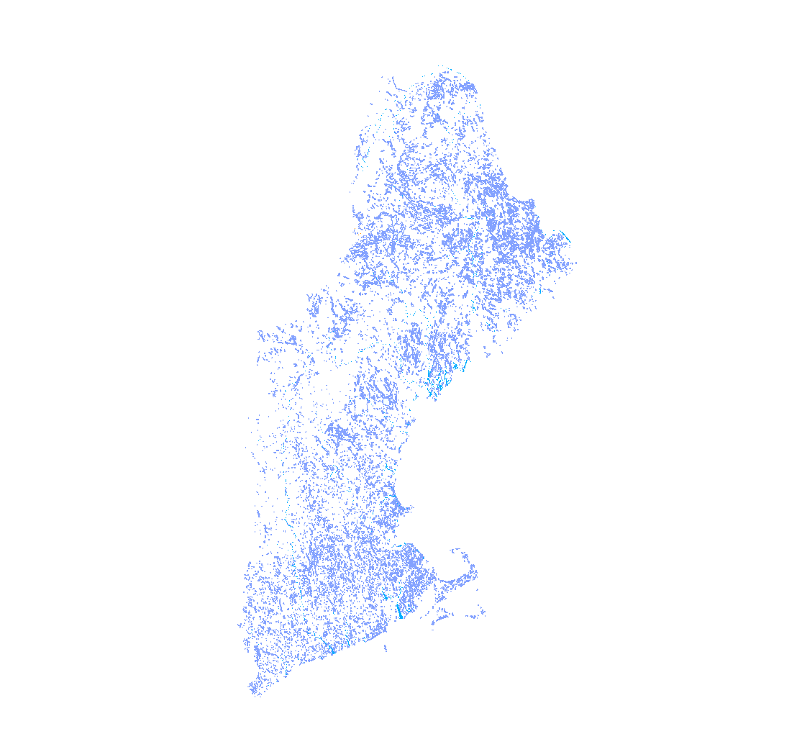
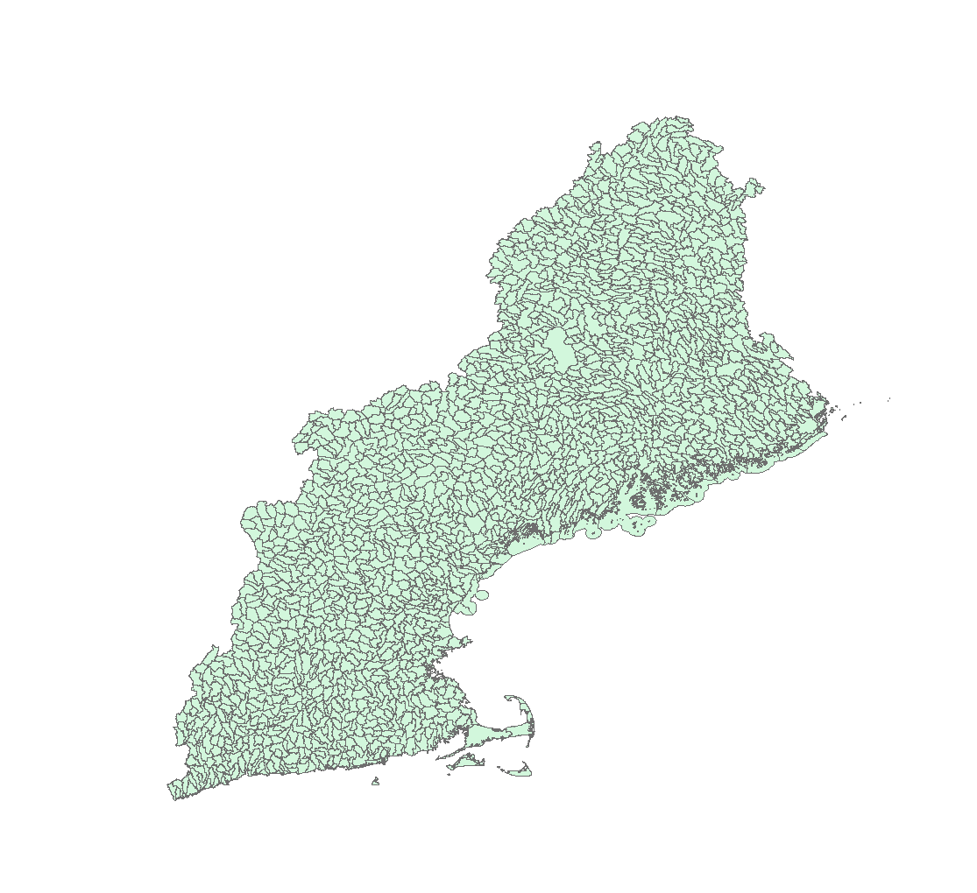
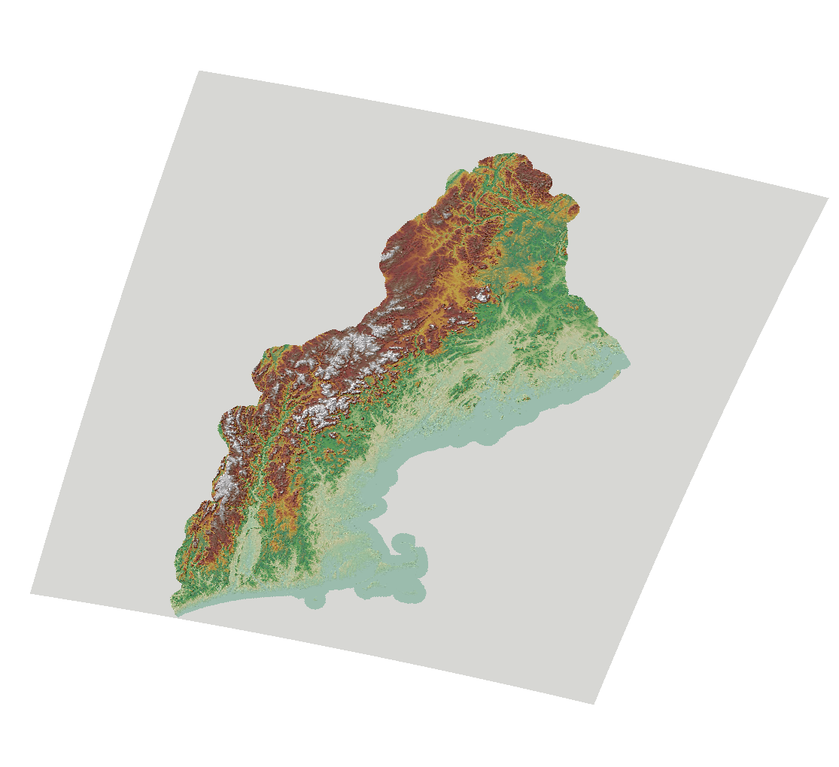
NHDPlusV2 Begins with: NHD, WBD, and NED
National
Hydrography
Dataset (NHD)
Watershed
Boundary
Dataset (WBD)
National
Elevation
Dataset (NED/3DEP)
Source Datasets
Notes:
NHDPlusV2 is built from three primary datasets. These are all national datasets maintained by the U.S. Geological Survey.
First, and most importantly, is the National Hydrography Dataset.
Second is the Watershed Boundary Dataset.
And finally is the National Elevation Dataset, commonly known as NED, but which is now called 3DEP. 3DEP stands for 3D Elevation Program.

Slide 5
Source Data Snapshots
NEDSnapshot Digital Elevation Model
NHDSnapshot
Stream Network
Waterbodies
Feature Names
WBDSnapshot
Hydrologic Unit Boundaries
Source Datasets
Notes:
As NHDPlusV2 production proceeded from 2010 to 2012, snapshots of these national datasets were taken for the geographic areas about to be processed. The NHDPlusV2 data packages include a snapshot of each of these datasets that was used to build NHDPlus in a particular geographic area.

Slide 6
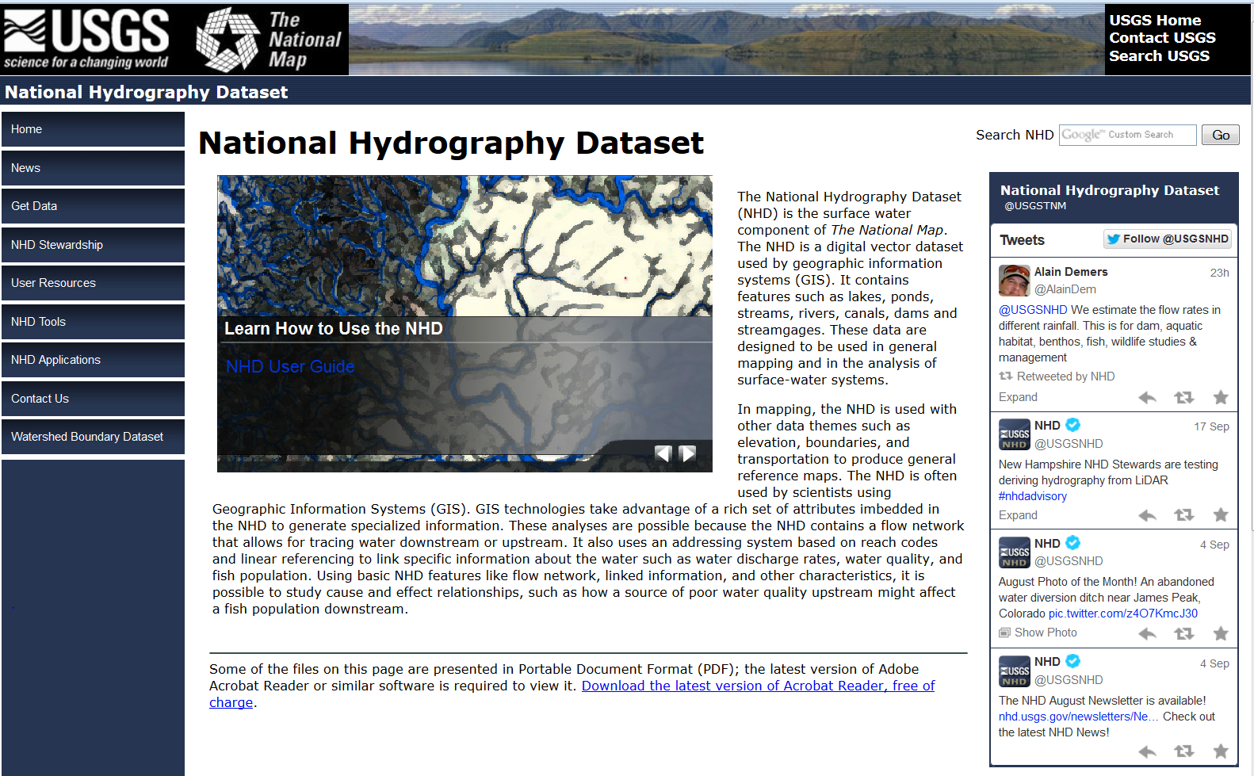
NHD
nhd.usgs.gov
Source Datasets
Notes:
NHDPlus got its name from the National Hydrography Dataset (NHD), because NHD provides the heart of the NHDPlus data and capabilities. The USGS NHD webpage is shown here and detailed NHD documentation is available on this webpage.

Slide 7
NHDPlusV2 – NHD
1:100,000-scale, Medium Resolution
EPA is the data steward
NHD Snapshot – April 2010
Many updates for NHDPlus:
Feature names
Network connectivity
Additional waterbodies
NHDPlus contains the most up-to-date 1:100,000-scale hydrography
Source Datasets
Notes:
The version of NHD that is included in NHDPlus is sometimes referred to as medium resolution NHD. It is nominally 1:100,000-scale or better. EPA is the data steward for medium resolution NHD and has performed a considerable number of updates on the data prior to building NHDPlusV2. Three of the most notable updates are to feature names, network connectivity (including connecting up isolated networks), and adding waterbodies. The NHD Snapshot that is included in the NHDPlus is the most up-to-date version of the medium resolution NHD.

Slide 8
NHD Information Content Stream Network (80% of NHD Features)
NHDFlowline Feature Class
ATTRIBUTES
Feature Name
GNIS ID
Feature Type
Reachcode
Feature Length
Flow Direction
Containing Waterbody ID
FEATURE TYPES
Stream/River
Canal/Ditch
Pipeline
Artificial Path
Connector
Coastline
1
2
“Network Flow” Relationships
1
3
2
3
3
Source Datasets
Notes:
We’ll briefly cover the feature classes in NHD beginning with the NHDFlowline feature class which holds the surface water network features and the coastline features. 80% of the NHD features are found in NHDFlowline. There are 6 feature types in NHDFlowline as shown here. Each feature has key attributes such as feature name, the Geographic Names Information System (GNIS) ID of the feature name, and a reachcode for linear referencing. The network power of NHD, and consequently of NHDPlus, comes from the network flow relationships that describe how water flows from one feature to another. These relationships enable the capability to navigate upstream and downstream in NHD and NHDPlus.

Slide 9
NHD Information Content Waterbodies & Areas (14% of NHD Features)
NHDWaterbody Feature Class
ATTRIBUTES
Feature Name
GNIS ID
Feature Type
Reachcode
Feature Area
Lake/Pond
Swamp/Marsh
Reservoir
Playa
Ice Mass
Wash
Estuary
Artificial Paths
are the flow paths
through
Waterbodies and Areas.
NHDArea Feature Class
Stream/River
Canal/Ditch
Area of Complex Channel
Sea/Ocean
Source Datasets
Notes:
NHDWaterbody and NHDArea together form the second largest feature set which consists of 14% of the NHD feature content. NHDWaterbody has seven (7) feature types as listed here. NHDArea has four (4) feature types which are mostly of areal representations of linear stream/river and canal/ditch features that exist in NHDFlowline. Linear paths through NHDWaterbody and NHDArea are included in NHDFlowline artificial path features.

Slide 10
NHD Information Content Landmark (6% of NHD Features)
NHDLine Feature Class
Dam
Lock
Rapids
Etc…
ATTRIBUTES
Feature Name
GNIS ID
Feature Type
Feature Area
NHDPoint Feature Class
Dam
Sink
Spring
Fumarole
Etc…
Source Datasets
Notes:
The smallest group of features in NHD are the landmark features found in NHDLine and NHDPoint. These features are included in NHD because of their usefulness when making cartographic products.

Slide 11
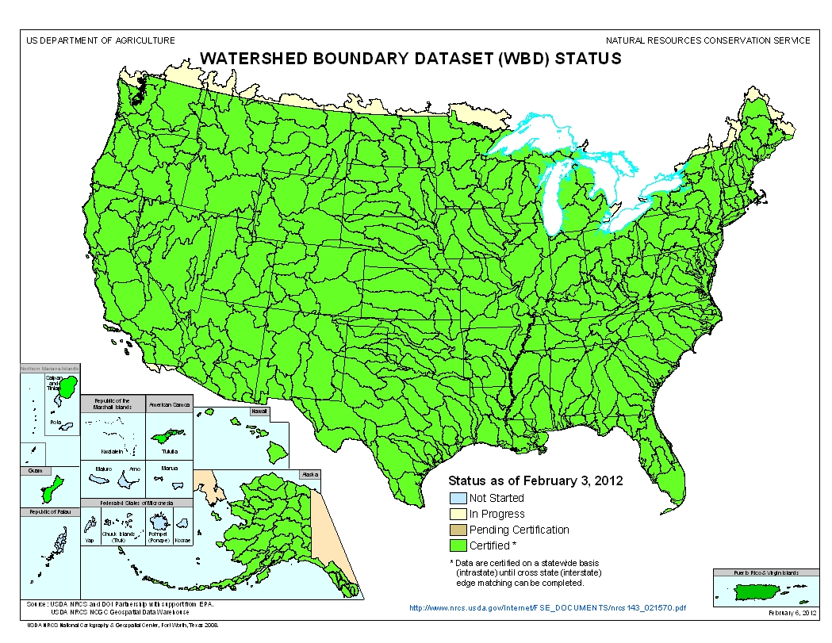
NHDPlusV2 – WBD 2011-12
(nhd.usgs.gov)
WBD is now part of
the NHD database.
And also hosted
by NRCS.
NHDPlusV2 used
7 snapshots of
WBD.
Source Datasets
Notes:
Our second source dataset, the Watershed Boundary Dataset, is a set of hydrologically-based, nesting divisions of the U.S. Their purpose is to provide a stable set of administrative units that can be used to report and track water resources information. In general, the boundaries of the WBD polygons represent the drainage divides on the landscape.

Slide 12
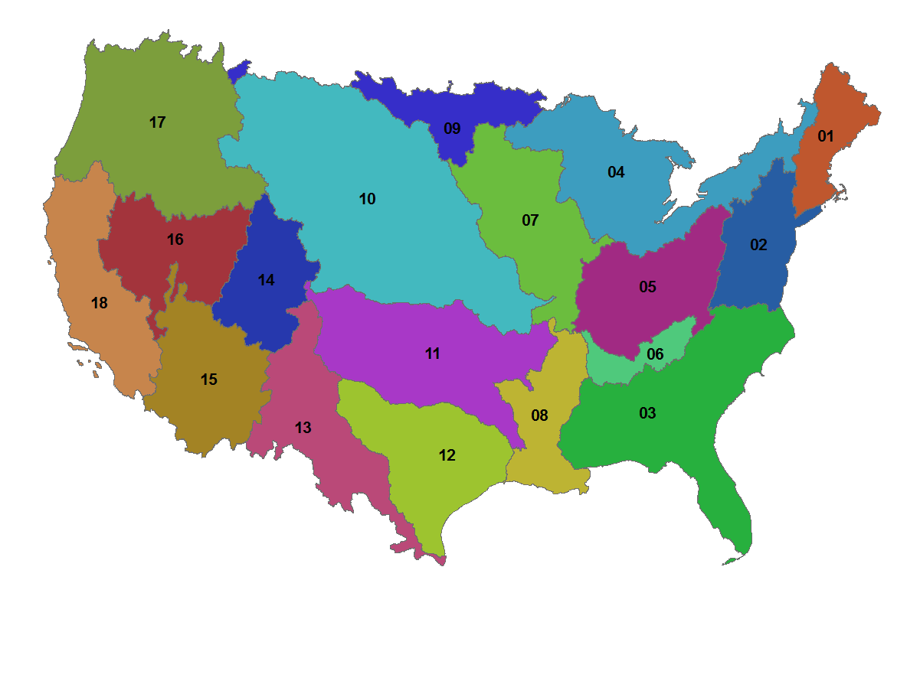
Hydrologic Units – (HUC2, 2-digit HUC)
19
20
22
21
Source Datasets
Notes:
WBD units are coded with two digits for each level of nesting. The largest level is HUC2, also called 2-digit HUCs. Each HUC2 is assigned a 2-digit code. There are 22 HUC2s. 01 through 18 make up the continental U.S.. 19 is Alaska. 20 is Hawaii. 21 is Puerto Rico and the US Virgin Islands. And 22 is the islands of Guam, Northern Mariana, and American Samoa.

Slide 13
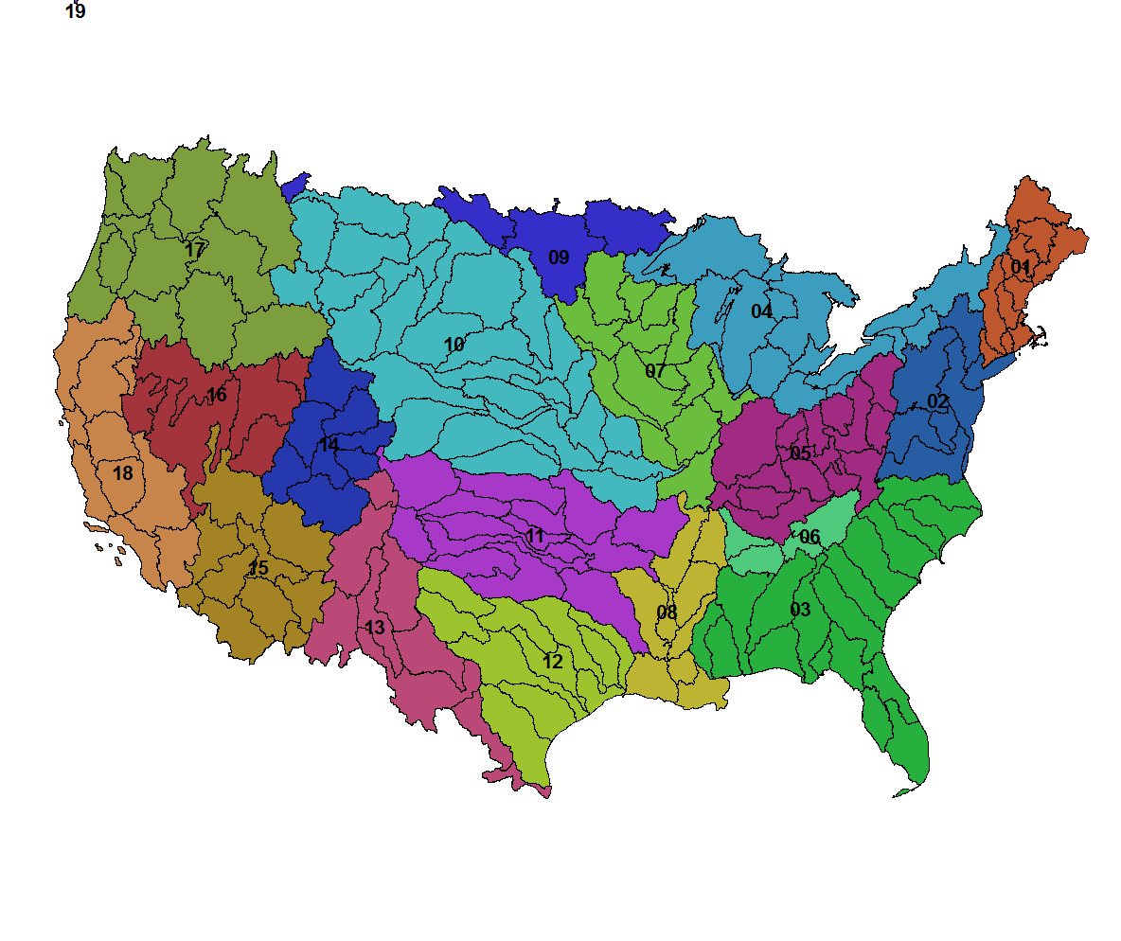
HUC4, 4-digit HUC - 202
Example
1201
Source Datasets
Notes:
Each HUC level adds 2 digits to the HUC codes. The second level of HUCs are known as HUC4s or 4-digit HUCs. The first 2 digits of the HUC4 designates the HUC2 and each HUC4 subdivision receives a unique 2 digits in the 3rd and 4th digits of the code. There are 202 4-digit HUCs in the continental U.S.

Slide 14

HUC6, 6-digit HUC - 336
Example 120101
Source Datasets
Notes:
The third level of HUCs are known as HUC6s or 6-digit HUCs. The first 4 digits of the HUC6 code designate the HUC4 and each HUC6 subdivision receives a unique 2 digits in the 5th and 6th digits of the code. There are 336 6-digit HUCs in the continental U.S.

Slide 15
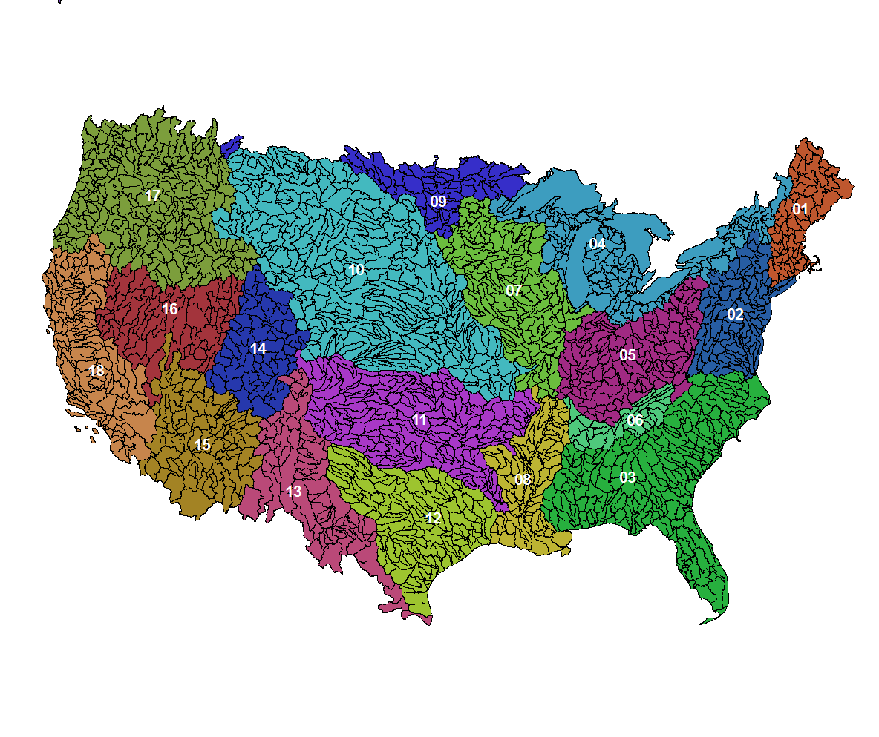
HUC8, 8-digit HUC - 2121
Example 12010101
Source Datasets
Notes:
The fourth level of HUCs are known as HUC8s or 8-digit HUCs. The first 6 digits of the HUC8 code designates the HUC6 and each HUC8 subdivision receives a unique 2 digits in the 7th and 8th digits of the code. There are 2121 8-digit HUCs in the continental U.S.

Slide 16
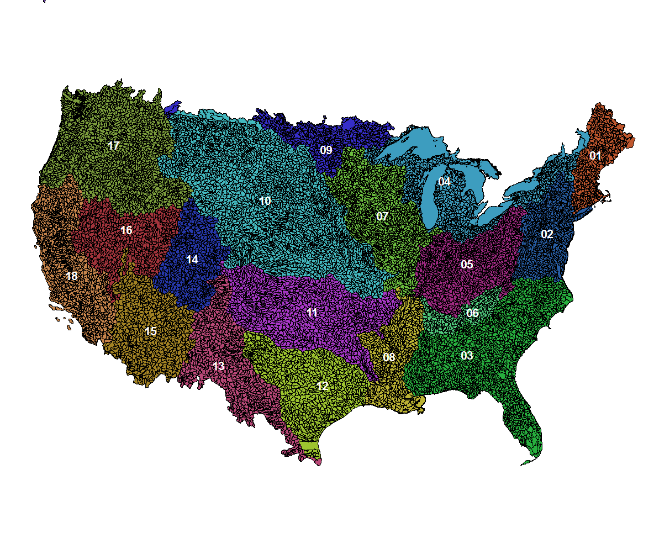
HUC10, 10-digit HUC - 15,945
Example 1201010101
Source Datasets
Notes:
The fifth level HUCs are known as HUC10s or 10-digit HUCs. The first 8 digits of the HUC10 code designates the HUC8 and each HUC10 subdivision receives a unique 2 digits in the 9th and 10th digits of the code. There are 15,945 10-digit HUCs in the continental U.S..

Slide 17
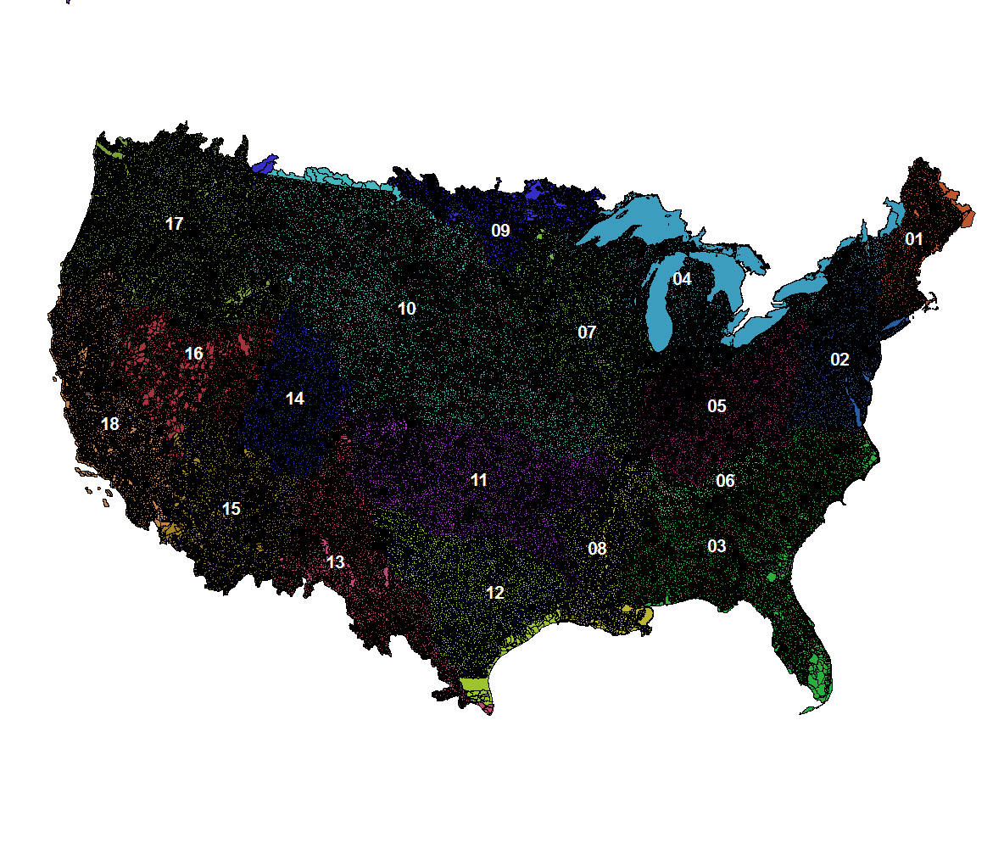
HUC12, 12-digit HUC, Level 6 HUC 86,123
Example 120101010101
Source Datasets
Notes:
The sixth level of HUC, or HUC12, is the smallest nationally available HUC level. There are allowances in the WBD standard for states to define HUC14s and HUC16s, however these have not been defined in many places. The first 10 digits of the HUC12 code designate the HUC10 and each HUC12 subdivision receives a unique 2 digits in the 11th and 12th digits of the code. There are 86,123 12-digit HUCs in the continental U.S..
The standard size of a HUC12 is 40-162 sq-kms. As you can see, there are some areas that are much larger than the standard size. For example, there are HUC8s along the Canadian border that have yet to be sub-divided. Also, the Great Lakes and other large U.S. waterbodies are not sub-divided. Excluding these very large un-subdivided areas, the average HUC12 is 97 sq-km.

Slide 18
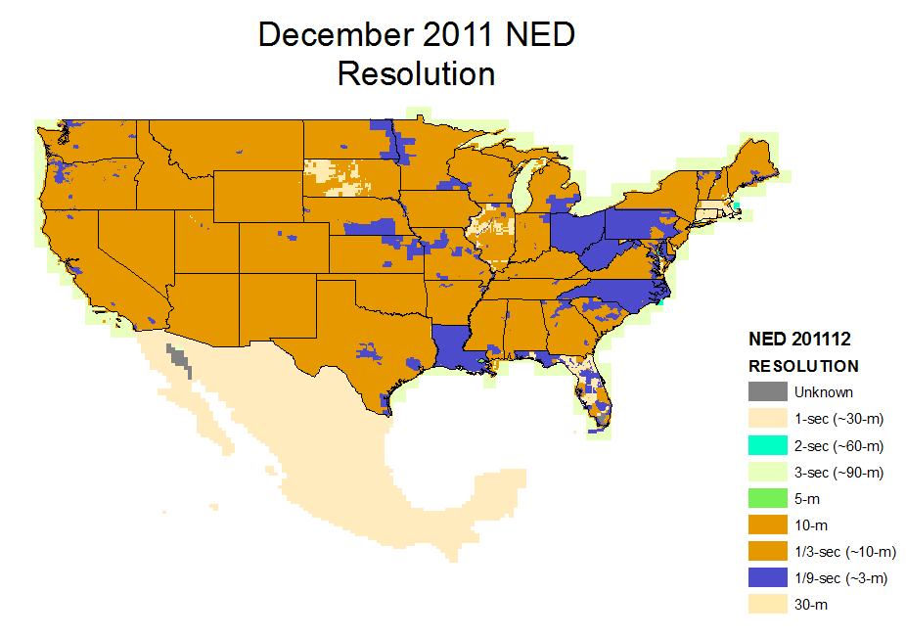
NHDPlusV2 – NED 2011-12
(ned.usgs.gov)
30m
re-sampled from
10 and 3 meter
NHDPlusV2 used
5 snapshots of
NED.
Source Datasets
Notes:
Now lets move to our final primary input dataset, the National Elevation Dataset known as NED and 3DEP. The NED snapshots used for the NHDPlus were taken from 2011 to 2012. As you can see by the legend, most of the continental US was at the 1/3rd arc-sec resolution which is about 10 meter elevation point spacing. There were also significant areas of very high resolution data, for example from LiDAR, of 1/9th arc-sec resolution which is about 3 meter elevation point spacing. The NHDPlus processing is done with a 30 meter DEM which is generated by re-sampling the higher resolution data to 30 meters.

Slide 19
NHDPlusV2 Content Source Snapshots
NEDSnapshot Digital Elevation Model
NHDSnapshot
Stream Network
Waterbodies
Feature Names
WBDSnapshot
Hydrologic Unit Boundaries
NHDPlusV2 Content
Notes:
The NHDPlus components include a snapshot of each of the three primary input datasets. These snapshots contain the exact data used to produce NHDPlus.

Slide 20
NHDPlusV2 – Content
PlusFlowlineVAA
CumulativeArea
DivFracMP
Elev_cm
Fdr & Fac
FdrNull
CatSeed
FilledAreas
Hydrodem
MegaDiv
ElevSlope
Cat
FeatureIDGridCode
PlusFlow
Catchment
NHDFlowline
PlusARPointEvent
NHDWaterbody
PlusFlowAR
Burn Components
EROMMA & EROMMMnn
Catchment Attributes
WBD_Subwatershed
Drainage Area Attributes
NHDPlusV2 Content
Notes:
This slide shows a diagram of the NHDPlus datasets. The grey datasets are the source data snapshots. The green datasets are the rich collection of NHDPlus attributes. The blue datasets are NHDPlus vector layers. The brown datasets are the NHDPlus raster layers.

Slide 21
Vector Layers
BurnLineEvent
BurnWaterbody
BurnAddLine
Burn Components
Catchment
BurnAddWaterbody
LandSea
Sink
NHDPlus V2Content
Notes:
We’ll look a bit closer at the datasets, but the real details will be presented in other sessions in the training series. Here are the vector layers that are unique to NHDPlus. The 6 datasets on the left are primarily included in NHDPlus as documentation of the process used to build NHDPlus. These are known as the Burn Components. In various ways, these 6 layers were used to hydro-enforce the surface water hydrography into the elevation data. BurnLineEvent and BurnWaterbody come from the NHDFlowline and NHDWaterbody/NHDArea features, respectively. BurnAddLine and BurnAddWaterbody are additional flowlines and waterbodies, not found in NHD, that were needed during the enforcement process. The LandSea polygons were used to ensure that water drained off the land into the ocean. And finally, the sinks represent locations where water leaves the surface water network and drainages into the ground or into closed lakes.
The Catchment layer which is built from the hydro-enforced elevation is the primary output of the NHDPlus build process and is the key to the NHDPlus link between the landscape and the surface water network.

Slide 22

Raster Layers
Fdr
Flow Direction
Flow Accumulation
Cat Seed
Filled Areas
FdrNull
Hydro-enforced DEM
Catchments
Fac
CatSeed
FilledAreas
FdrNull
Hydrodem
Cat
NHDPlusV2 Content
Notes:
A number of raster layers are developed as artifacts of the process that builds the NHDPlus catchments. These are published as part of NHDPlus due to their usefulness in various ways. One thing to note is that the catchments are also distributed as a raster. These rasters will be discussed in detail in another training session.

Slide 23
Value Added Attributes
1. PlusFlowlineVAA
Commonly called “The Network VAAs”
Elevation & Slope
2. ElevSlope
3. HeadWaterNodeArea
Area Draining to Headwater Node
Attributes Allocated to Catchments
4. Catchment Attributes
5. Drainage Attributes
Total Upstream Attributes
Mean Annual Flow/Velocity
6. EROM_MA
7. EROM_MM
Mean Monthly Flows/Velocities
NHDPlusV2 Content
Notes:
This slide illustrates the many NHDPlus value added attributes.
The first group is the PlusFlowlineVAA which contains many attributes known as the Network VAAs.
Second is a table that provides slope and elevation for each feature in the NHDPlus network.
The third table contains the size of the drainage area for each network headwater.
The fourth table is actually a set of tables that hold various landscape attributes for catchments.
While the fifth table is a corresponding set of tables that hold the accumulated values for each catchment attribute at each flowline in the network.
The sixth table holds the mean annual stream flow estimates for each flowline in the network.
And finally, the seventh group of tables contains January through December mean monthly stream flows for each flowline in the network.
These tables and their attributes will be discussed in other sessions in the training series.

Slide 24
Resources
Additional information on NHDPlus is available from the NHDPlus website documentation page. You are encouraged to read and reference the NHDPlusV21 User Guide and other NHDPlus documentation.
The NHDPlus team maintains a user email list and periodically sends emails regarding new tools, data, documentation, and events. If you would like to be on the user list, send an email to nhdplus-support@epa.gov
The NHDPlus team also provides technical support to users of the data and tools. If you have a technical support question, please send a detailed email to nhdplus-support@epa.gov
Notes:
Additional Resource information on NHDPlus is available from the NHDPlus website documentation page. You are encouraged to read and reference the NHDPlusV21 User Guide and other NHDPlus documentation.
The NHDPlus team maintains a user email list and periodically sends emails regarding new tools, data, documentation, and events. If you would like to be on the user list, send an email to NHDPlus@hscnet.com
The NHDPlus team also provides technical support to users of the data and tools. If you have a technical support question, please send a detailed email to NHDPlus@hscnet.com

Slide 25

Notes:
Thank you…..This concludes the NHDPlusV2 Content webinar.

