Slide 1

Financial Literacy: fin-game
Many people lack financial knowledge. This leads to poor money management. We offer an engaging mobile app. It teaches essential financial concepts. Our target audience is all age groups.
Developed by:
24BYB1137
24BYB1148
24BCE1372
24BPS1093

Slide 2
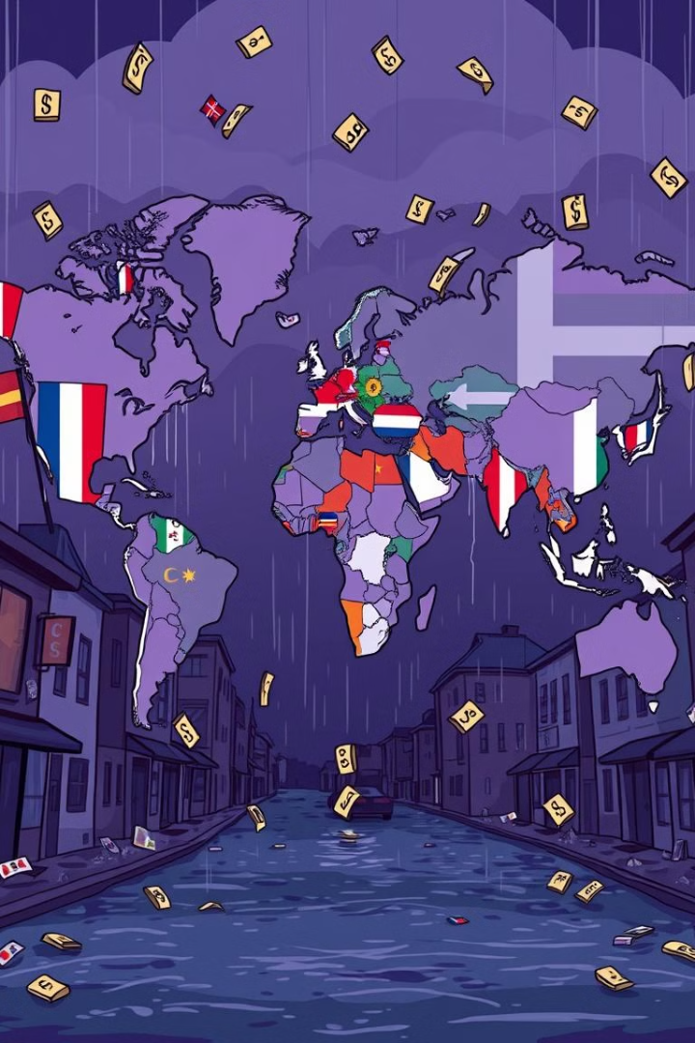
The Financial Literacy Crisis
Financial literacy is low
Poor decisions cost money
Only 33% of U.S. adults are financially literate.
$414 billion is lost annually due to poor financial decisions.
Debt increases
People are vulnerable to financial scams.
Over 50% of Americans can't answer basic questions. Financial literacy is a clear and present danger.

Slide 3
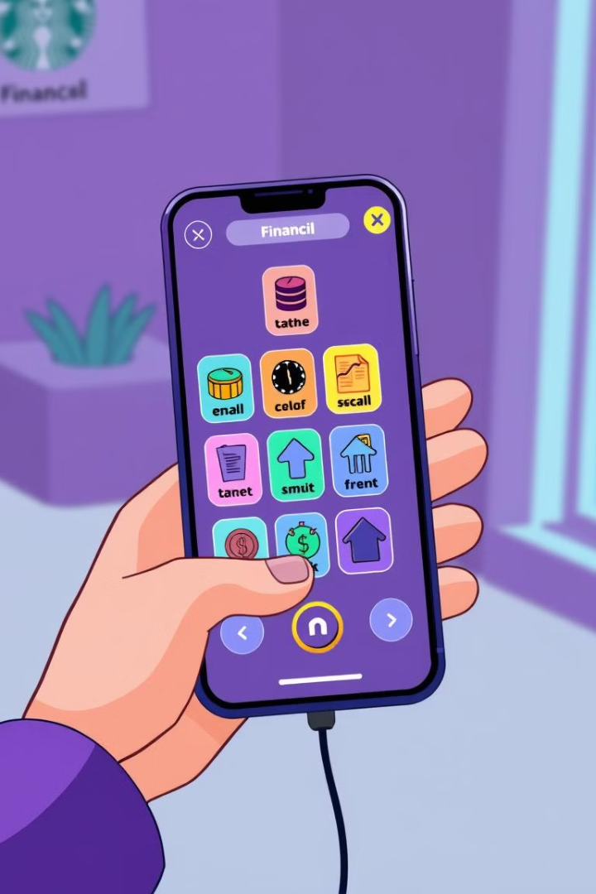



Introducing "Fin-Game"
Accessible
Engaging
Effective
Our mission is to make financial education fun. We transform complex topics. Points, badges, and leaderboards included. Our design is intuitive and adaptive.

Slide 4

Leveling Up Your Financial Skills
Budgeting Bootcamp
Create budgets with real-time feedback.
Savings Simulator
Visualize compound interest. Set savings goals.
Investment Island
Learn about investing in a risk-free environment.
Debt Destroyer
Develop strategies for managing and eliminating debt.

Slide 5
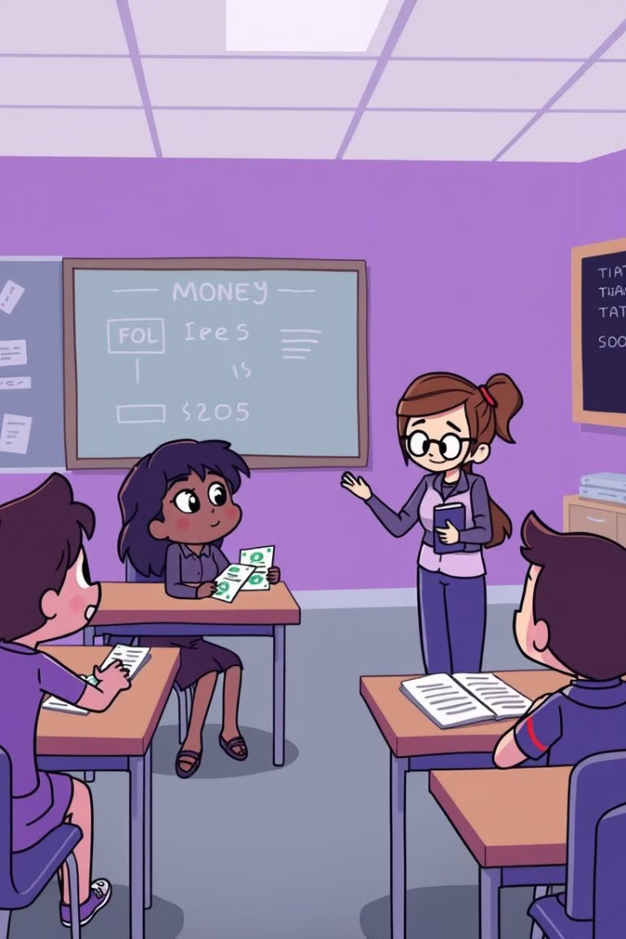




How MoneyQuest Works
Personalized learning
Content adapts to your skill level.
Bite-sized lessons
Short modules for easy learning.
Interactive scenarios
Apply concepts in real-life situations.
Progress tracking
See your achievements. Find areas for improvement.

Slide 6
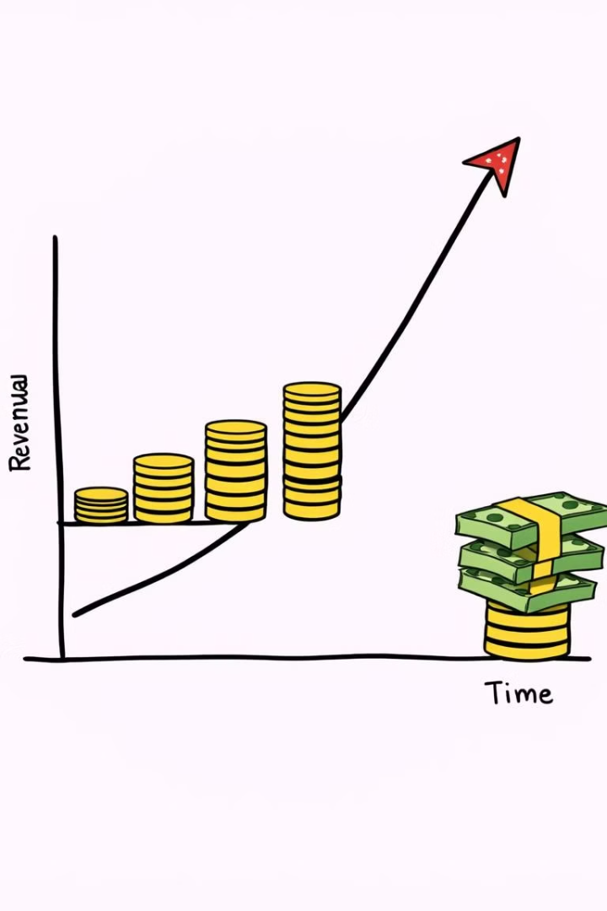
Market Opportunity
$1.4B
Market Size
Spent on financial literacy programs yearly.
76%
Millennials Use Mobile Banking Apps
Fintech app users are mostly millennials and Gen Z.
Gamification, personalized learning give us a competitive edge. We use a freemium model with optional premium features.

