Slide 1

Azure Chaos Studio Resilience Experiment
P087 | Resilience Engineering
Team T087
Skill Palaver Hackathon — Slot 1
Course: 24CC3046 — Microsoft Certified: Azure Administrator Associate
Team Members:
Gurrala Hareesh Reddy (2400090155) — Team Lead
Namathoti Nandu (2400090190)
Alamalakala Sneha (2400090174)
Rao Rupesh Sai (2400090150)
Room: R507A

Slide 2
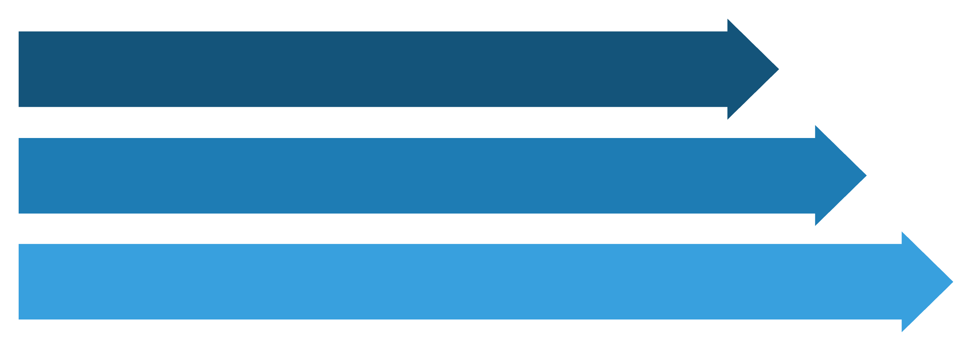
Problem Statement
Modern cloud applications must remain available during infrastructure failures
Challenge: Validate multi-zone architecture under zone-associated failure
Use cases: Inject zone failure, produce recovery evidence
Bottlenecks: Blast radius control, permissions setup
Failure
Load Balancer
Service Continuity

Slide 3

Project Objectives
Build multi-zone Azure workload
Place behind Load Balancer
Prepare VMSS as Chaos Studio target
Design controlled VMSS shutdown experiment
Measure service behavior during failure
Success evidence: HTTP availability, instance state, and recovery state.

Slide 4


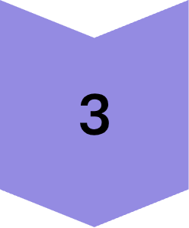
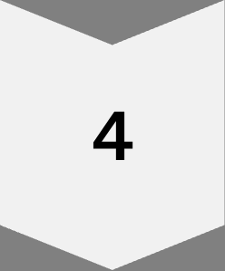

Our Approach
Step 1: Deploy multi-zone VMSS
Step 2: Configure Load Balancer + health probe
Step 3: Deploy Nginx HTTP workload
Step 4: Onboard VMSS to Chaos Studio
Step 5: Validate failure/recovery behavior
Note: Chaos Studio deployment blocked by subscription policy; controlled VMSS failure used for validation.

Slide 5
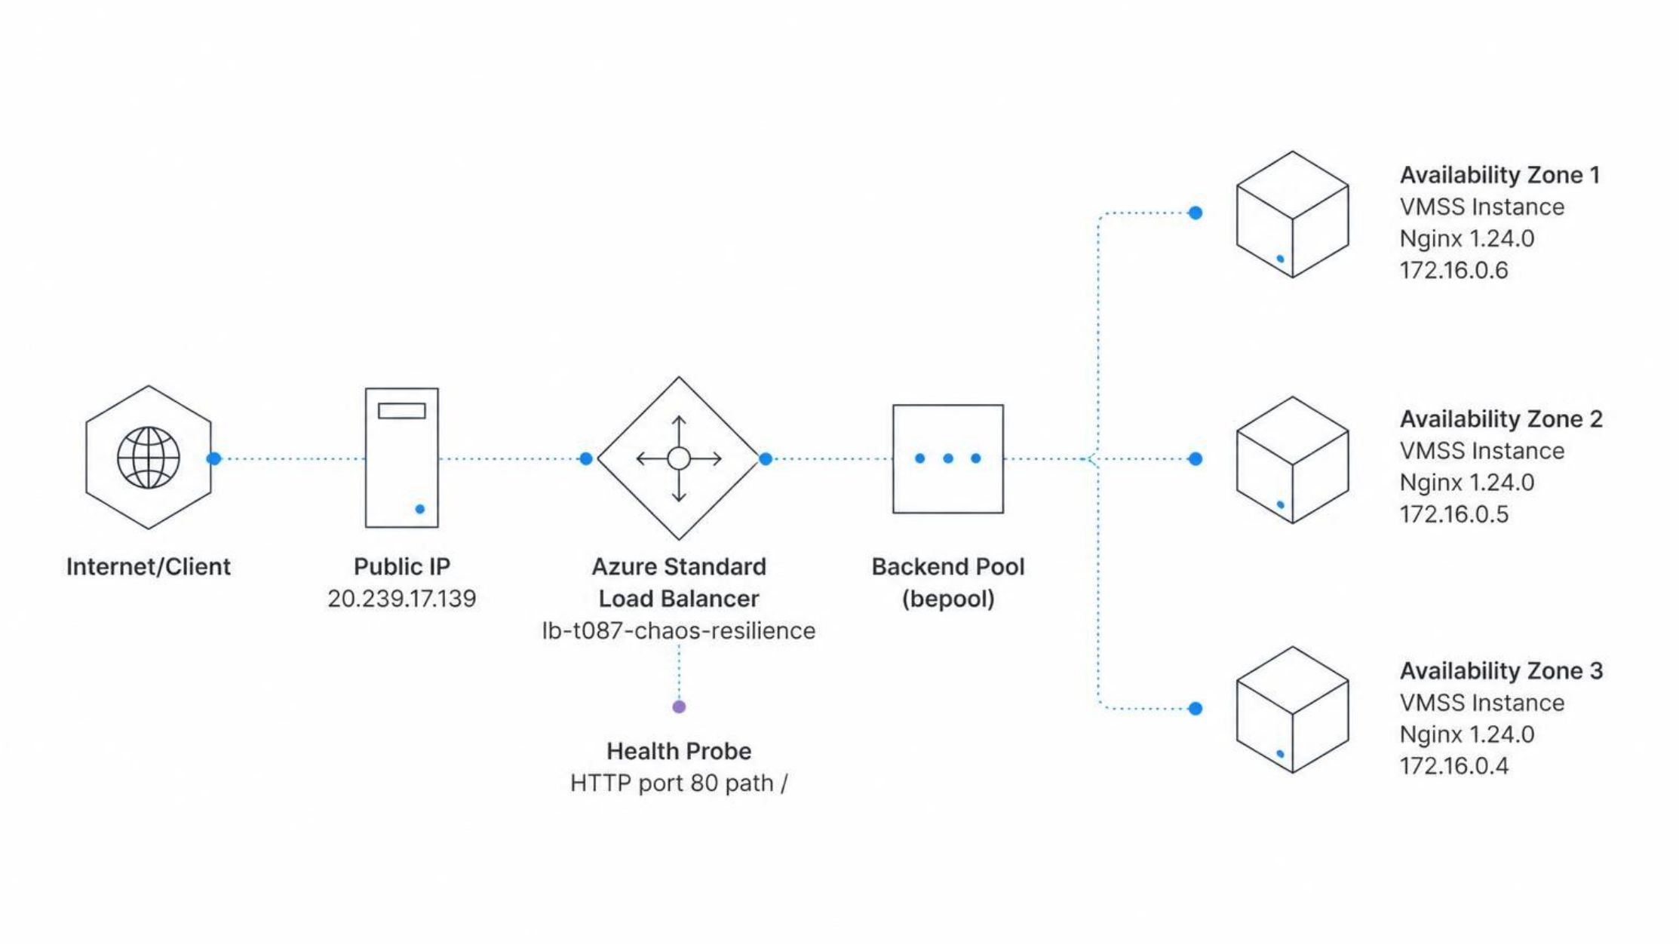
Azure Resilience Architecture
Architecture Overview:

Slide 6
Infrastructure Implementation
Resource | Configuration
Resource Group | rg-t087-chaos-resilience
VM Scale Set | vmss-t087-chaos-resilience
Region | East Asia
Availability Zones | 1, 2, 3
Instances | 3
VM Size | Standard_B2ats_v2 (2 vCPU, 1 GiB RAM)
Load Balancer | lb-t087-chaos-resilience
Web Server | Nginx 1.24.0

Slide 7





Traffic Flow and Health Detection
Traffic Path:
Client request
Public Load Balancer IP (20.239.17.139)
Load Balancer rule (TCP 80 → TCP 80)
Healthy VMSS backend instance
Nginx on port 80
Health Probe Configuration:
Protocol
Port
Path
HTTP
80
/

Slide 8
Chaos Studio Target Configuration
Target Configuration:
Target: vmss-t087-chaos-resilience
Targeting Mode: Service-direct
Status: Enabled
Why Service-Direct Targeting:
Service-direct was used so the VMSS could be enabled as a Chaos Studio target without guest-agent setup.

Slide 9
Planned Chaos Experiment Configuration
Experiment Name | exp-t087-zone-failure
Fault Type | VMSS Shutdown v2.0
Duration | 10 minutes
Abrupt Shutdown | False
Target | vmss-t087-chaos-resilience
Scope | Zone 1
Identity | System-assigned managed identity
Role | Azure built-in role (Virtual Machine Contributor)
Scoped to Zone 1 to limit blast radius. CONFIGURED/PLANNED — NOT EXECUTED

Slide 10
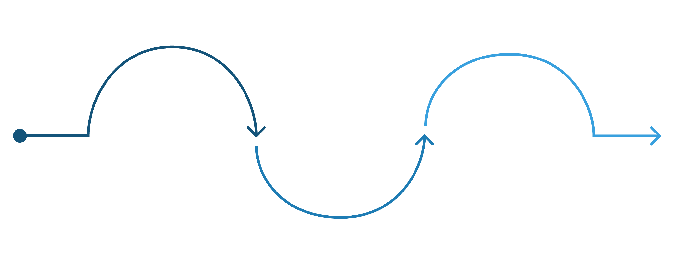
Chaos Studio Deployment Constraint
Initiation
Blocking
Start deployment request
East US denied
Validation
Check region policy
Policy Details
Policy: Allowed resource deployment regions
Assignment: sys.regionrestriction
Attempted Location: East US
Effect: Deny
Environment constraint discovered during implementation, not a team failure.

Slide 11
Controlled Failure Validation
Test methodology: Because Chaos Studio deployment was blocked by subscription policy, we validated resilience with a controlled VMSS instance failure.
01
02
03
Baseline
Controlled Failure
Traffic Validation During Failure
20 HTTP requests to Load Balancer IP
Result: 20/20 HTTP 200
Deallocated VMSS Instance 0 (Zone 1)
Command: az vmss deallocate --resource-group rg-t087-chaos-resilience --name vmss-t087-chaos-resilience --instance-ids 0
20 HTTP requests to Load Balancer IP
Result: 20/20 HTTP 200
04
05
Recovery
Post-Recovery Validation
Started VMSS Instance 0
Result: All three instances running
20 HTTP requests to Load Balancer IP
Result: 20/20 HTTP 200
Note: This simulates an instance-level failure, not an entire Azure availability zone failure.

Slide 12
Experimental Results
Results Summary:
Test Stage | Infrastructure State | HTTP Result
Baseline | 3 instances running (Zones 1, 2, 3) | 20/20 HTTP 200
During Controlled Failure | Zone 1 instance deallocated; Zones 2 & 3 running | 20/20 HTTP 200
After Recovery | All 3 instances running (Zones 1, 2, 3) | 20/20 HTTP 200
Key Observation: The Load Balancer continued serving HTTP traffic when the Zone 1-associated VMSS instance was deallocated.
Note: These are 20 sampled HTTP requests per stage.

Slide 13
What the Results Demonstrate
Key Findings:
Finding 1: Load Balancer Continuity
Load Balancer traffic continued during the Zone 1 VMSS deallocation.
Finding 2: Multi-Zone Redundancy
Zones 2 and 3 continued serving traffic without interruption.
Finding 3: Successful Recovery
The failed instance was restarted successfully with Azure CLI.
Finding 4: Post-Recovery Validation
Post-recovery testing again returned 20/20 HTTP 200 responses.
Conclusion:
The architecture demonstrated service continuity under the controlled instance-failure scenario.
Scope of Evidence:
This evidence applies to the controlled VMSS instance failure tested in this project and validates the multi-zone redundancy design at the VMSS instance level.
Note: This is a targeted test of the specific failure scenario, not a full SLA or all-zone resilience validation.

Slide 14
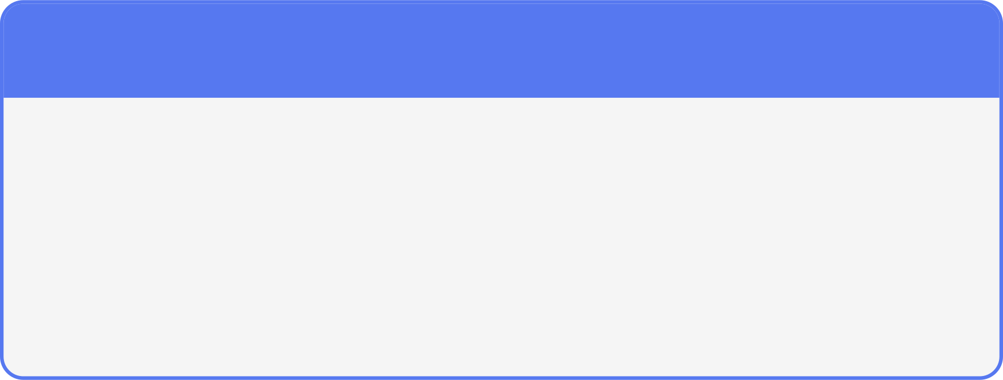

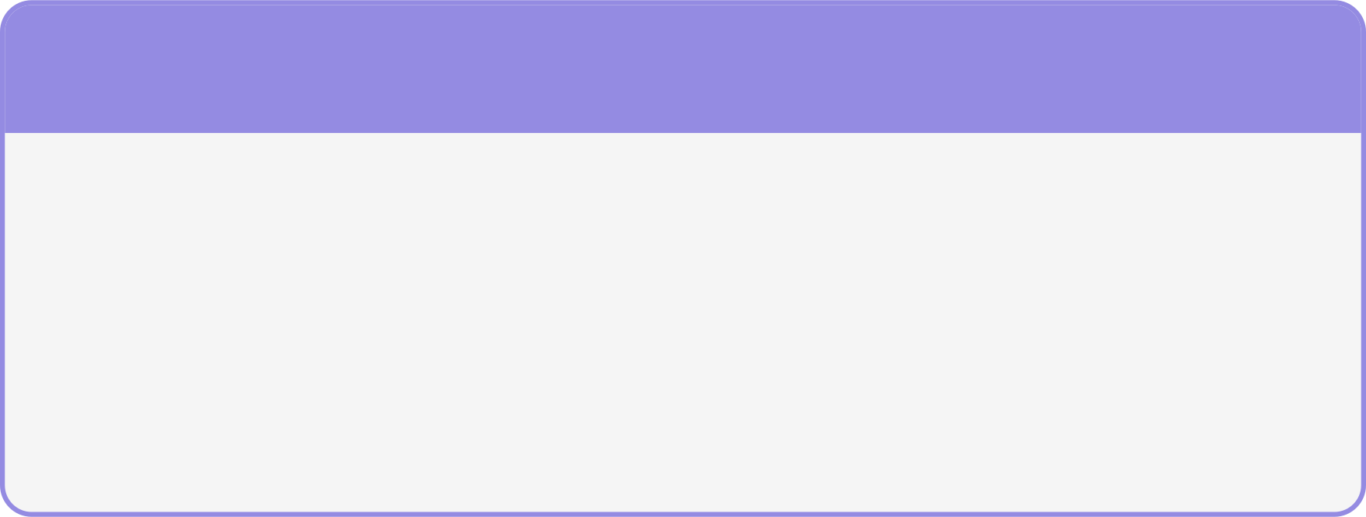
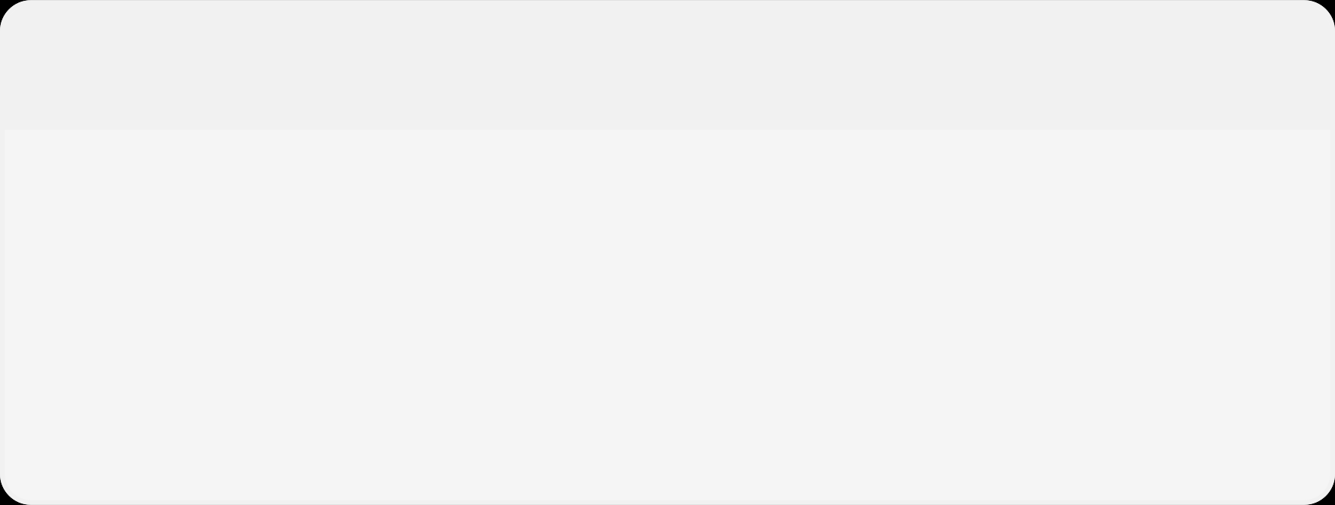
Team Contributions
1
2
Gurrala Hareesh Reddy (2400090155)
Namathoti Nandu (2400090190)
Overall architecture and project coordination
Azure infrastructure design and resilience validation
Experiment planning and final integration
VMSS and Load Balancer deployment
Nginx configuration and health probe setup
Networking troubleshooting and validation
3
4
Alamalakala Sneha (2400090174)
Rao Rupesh Sai (2400090150)
Monitoring and evidence collection setup
Baseline/failure/recovery validation
HTTP test documentation and analysis
Chaos Studio investigation and research
Service-direct onboarding and configuration
Experiment design and policy investigation

Slide 15
Conclusion & Next Step
Project Summary:
A three-zone VMSS architecture was implemented behind an Azure Load Balancer
Chaos Studio target onboarding was completed successfully
The planned VMSS Shutdown experiment was configured with controlled Zone 1 scope
20/20 sampled HTTP requests returned HTTP 200 during the tested failure
Recovery was verified after restarting the failed instance
Next Step:
Run the Chaos Studio experiment in a permitted environment or region.
Final Statement:
Controlled failure. Measured behavior. Evidence-based resilience validation.

