Slide 1
Sentinel AI – Autonomous Cybersecurity Threat Detection System
AI-Powered Threat Detection & Security Monitoring Platform
Hack & Break: Generative AI & Cybersecurity Innovation Challenge
Team Members:
ANU RANJANA M J
HAMSARAJ A
HAREESH S
Department of Information Technology
Easwari Engineering College

Slide 2
Problem Statement
• Increasing cyber threats such as phishing, malware, and data breaches
• Traditional security systems rely on fixed rules
• Difficulty detecting new or evolving cyber attacks
• Need for intelligent automated threat detection systems
• Security analysts must review thousands of alerts, making it difficult to identify genuine threats quickly.
• Organizations require an AI-driven solution that can automatically analyze security data and detect suspicious patterns in real time.

Slide 3

Proposed Solution
• Sentinel AI analyzes system logs and network activity
• Uses machine learning to detect anomalies
• Generates real-time alerts for suspicious behavior
• Provides AI‑generated security insights and mitigation suggestions
•When suspicious behavior is detected, the system immediately sends alerts through a monitoring dashboard to notify administrators.

Slide 4
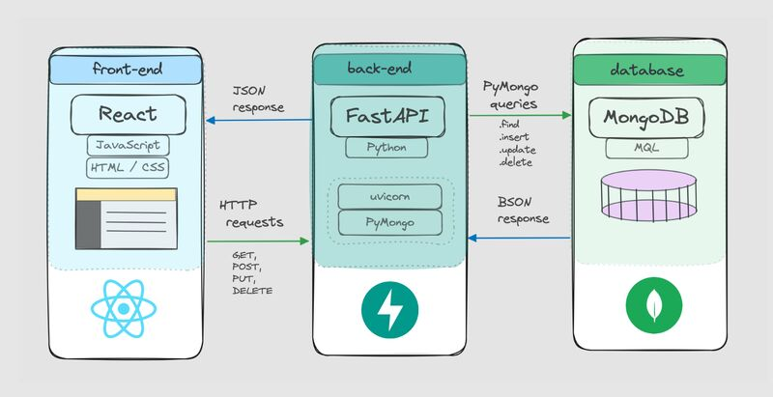
Technology Stack
• Backend: Python / FastAPI
• Frontend: Streamlit Dashboard
• AI Models: Machine Learning + Generative AI
• Database: MongoDB
• Security Analysis: Log monitoring and anomaly detection
• AI-driven threat detection capable of identifying unknown attack patterns.

Slide 5
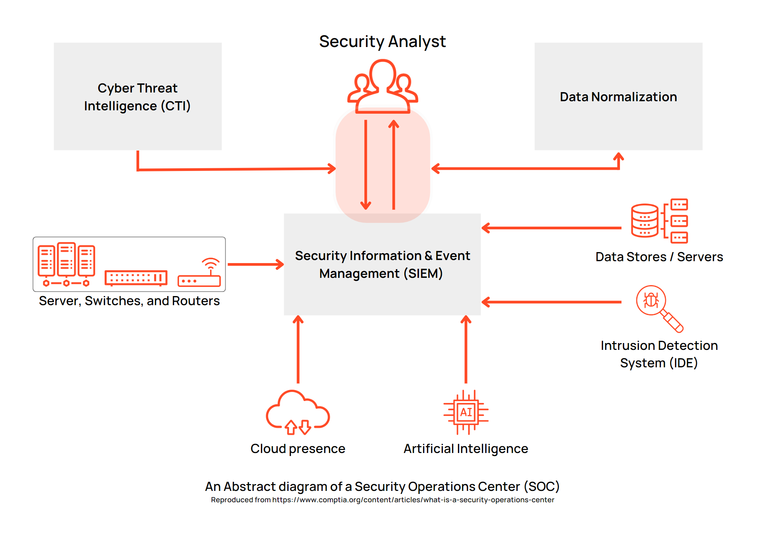
System Architecture

Slide 6
Key Features of Sentinel AI
• Real-Time Threat Detection Continuously monitors system logs and network activity to identify suspicious patterns.
• AI-Driven Anomaly Detection Machine learning models detect unusual behavior that may indicate cyber attacks.
• Generative AI Threat Explanation Automatically generates explanations and mitigation suggestions for detected threats.
• Interactive Monitoring Dashboard Provides administrators with a clear overview of system security status and alerts.
• Automated Alert System Instant notifications when potential threats are detected.

Slide 7

Real-World Applications
• Enterprise Security Monitoring Protects company systems and sensitive data from cyber threats.
• Educational Institutions Monitors and protects student databases and internal networks.
• Cloud Infrastructure Security Detects vulnerabilities in cloud environments.
• Small Business Protection Provides affordable AI-based cybersecurity solutions.

Slide 8

Why Sentinel AI is Better
Traditional Security | Sentinel AI
Rule-based detection | AI-powered detection
Manual analysis | Automated insights
Slow response | Real-time alerts
Limited adaptability | Learns from new patterns

Slide 9

Implementation Plan
Step 1 Collect system logs and network data.
Step 2 Preprocess and clean the data.
Step 3 Train machine learning model for anomaly detection.
Step 4 Integrate generative AI to analyze threats.
Step 5 Develop dashboard for monitoring alerts.

Slide 10
Future Scope
• Integration with SIEM tools to enable centralized security monitoring and event correlation across enterprise systems.
• Real-time network packet monitoring to detect suspicious traffic and cyber attacks as they occur.
• Automated threat response mechanisms that can instantly block malicious IPs or isolate compromised systems.
• AI-powered vulnerability scanning to identify potential security weaknesses before attackers exploit them.
• Cloud security integration to monitor and protect cloud infrastructure and distributed systems.

Slide 11
Conclusion
Sentinel AI is an intelligent cybersecurity solution that leverages machine learning and generative AI to detect, analyze, and respond to cyber threats efficiently.
• AI-powered threat detection improves the ability to identify suspicious activities and cyber attacks.
• Generative AI insights help security teams understand threats and take appropriate actions.
• Real-time monitoring and alerts allow faster response to potential security incidents.
• Scalable architecture makes the system suitable for organizations of different sizes.

