Slide 1
Drug Sentiment Analysis
Predicting how a patient comment feels about one specific drug
LinearSVC on the sentences that mention the drug - weighted F1 0.735 out of fold
Analytics Vidhya Blackbelt capstone

Slide 2
The task is not plain sentiment analysis
Each row asks about one drug, so the same comment can carry two different labels.
• Input: a patient comment plus the name of one drug. Output: 0 positive, 1 negative, 2 neutral.
• 186 training rows share a comment with another drug — the text alone cannot decide the label.
• Long comments bury the drug: in 6.9% of rows it first appears after word 380.
• 72.5% of rows are neutral, so accuracy is misleading; the metric is weighted F1.
• Always answering 'neutral' scores 0.609 weighted F1 — the bar to beat.
2

Slide 3
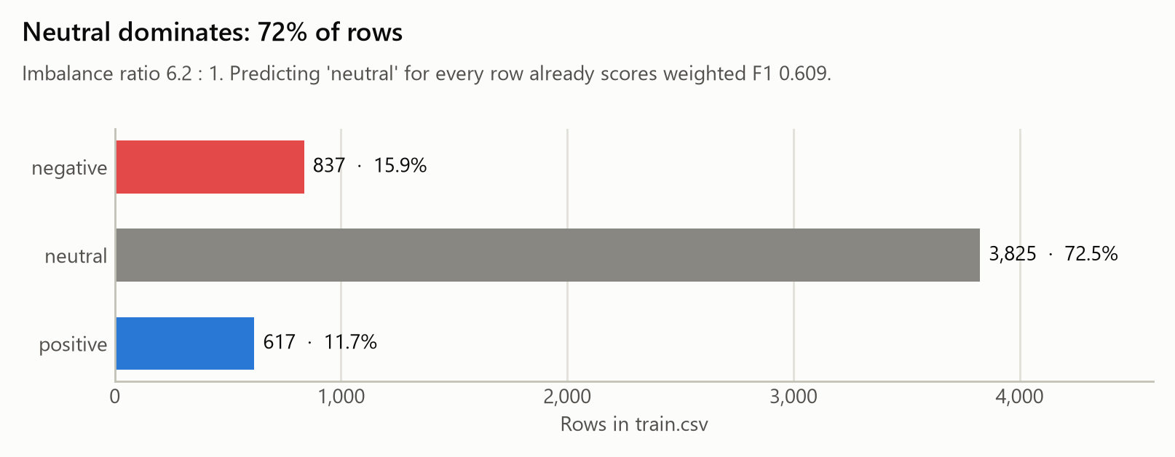
The data, and one finding about it
The brief's 5,619 / 3,107 are line counts; the files hold 5,279 train and 2,924 test records.
• Comments contain line breaks inside quoted CSV fields, which is why line counts differ from rows.
• sample_submission has 2,924 ids in test order, confirming the record count.
• No missing values, no duplicate ids, no conflicting labels for the same (comment, drug).
• 102 drugs in train, 95 in test, 9 of them unseen — mostly misspellings of known drugs.
3

Slide 4
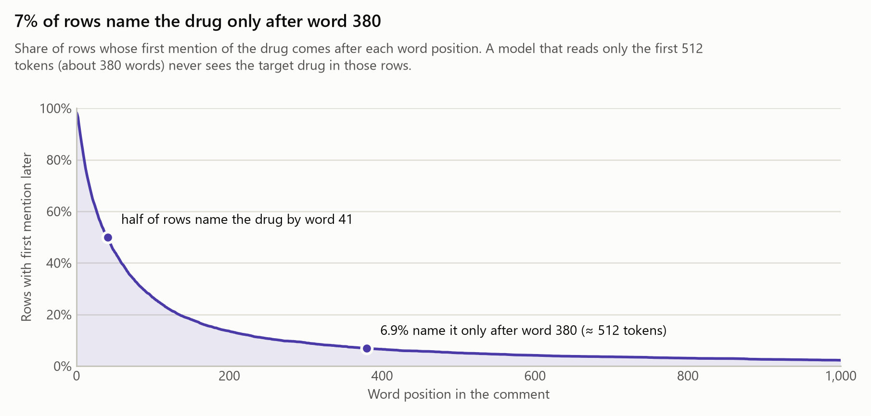
Why a window around the drug, not the whole comment
Half the comments mention the drug early, but the tail is long: the drug can sit past word 380.
• Median comment: 807 characters; the longest is 128k — package inserts and forum dumps.
• Feeding the whole comment mixes in sentences about other drugs and other topics.
• The model reads only the sentences that mention the drug, capped at 250 words - measured against wider windows and against the whole comment.
• Ablation: the window is worth +0.011 weighted F1 over the drug-blind full comment.
4

Slide 5
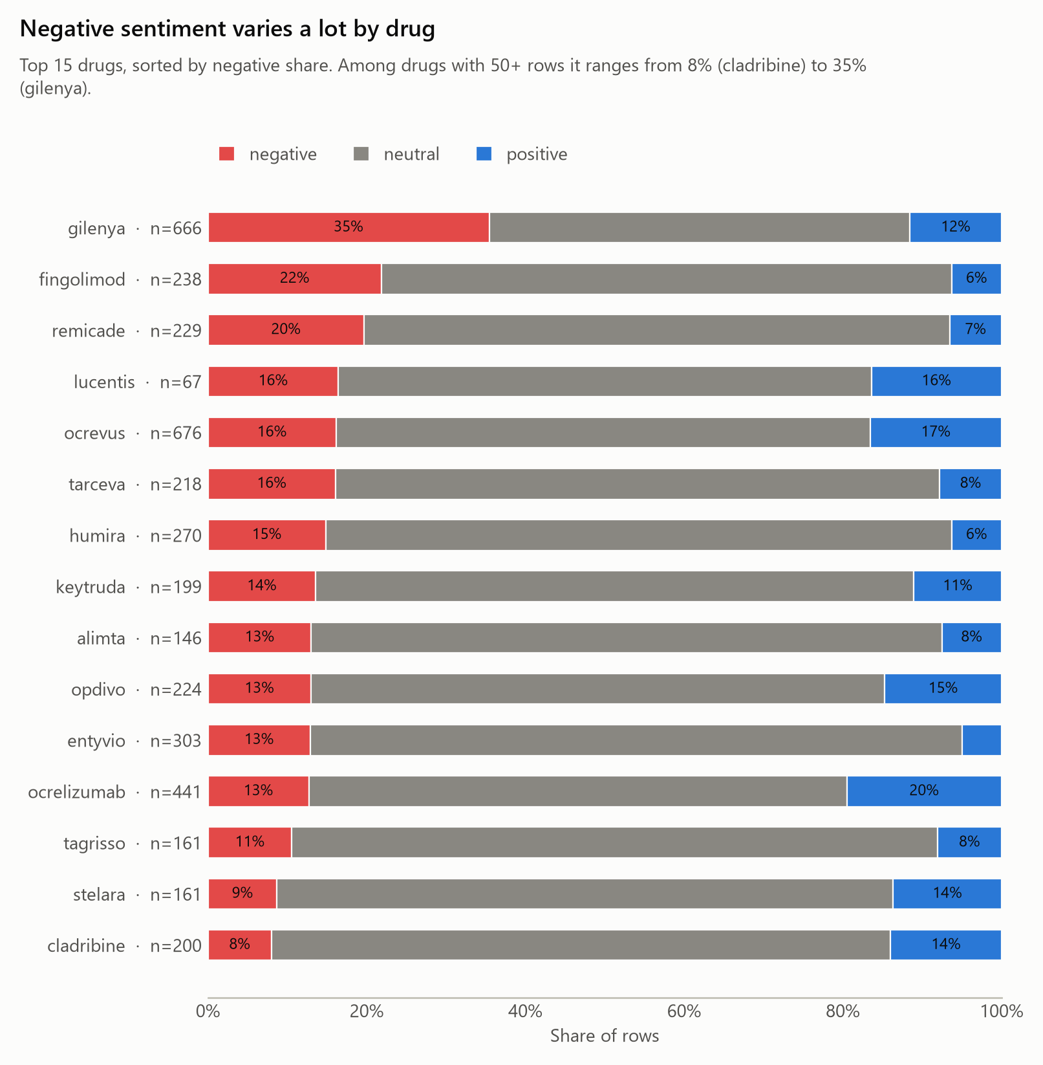
How each row is made about its own drug
The target drug becomes `targetdrug`, every other known drug becomes `otherdrug`.
• A lexicon of 102 train drug names plus a hand-written brand/generic synonym file.
• rapidfuzz catches misspellings (stellara → stelara) so unseen test drugs still match.
• Masking stops the model memorising drug names and forces it to read the sentiment words.
• The drug identity is still available as a one-hot feature, so drug priors are learnable.
5

Slide 6
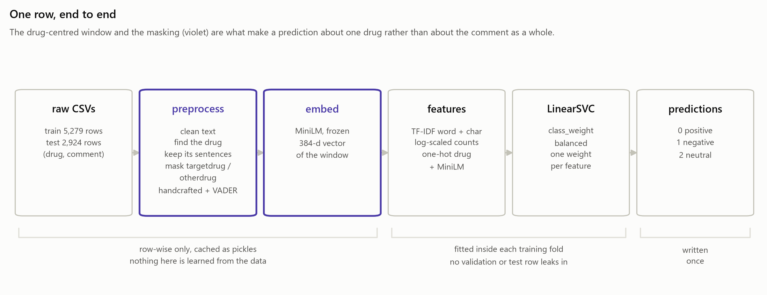
The pipeline
Row-wise preprocessing is cached; everything fitted on data lives inside the CV folds.
6

Slide 7
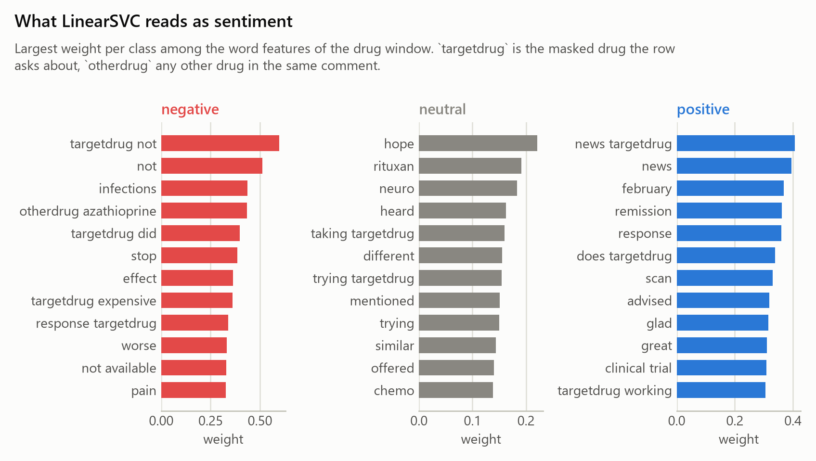
What the model sees
Four feature blocks, all built from the drug window.
• TF-IDF: word 1–2-grams and character 2–5-grams (typo-tolerant), stop words minus negations.
• Handcrafted: mention count and position, other drugs, lengths, negations, first-person words.
• VADER: sentiment of the window, and the mean sentence score of the whole comment.
• MiniLM: a 384-d frozen sentence embedding of the unmasked window.
• 48,988 features in total for the fitted model.
7

Slide 8
Validation that cannot flatter itself
5 folds, stratified by label and grouped by comment text, fixed once and reused by every model.
• 88 comments appear with several drugs; grouping keeps them inside one fold, so no model can memorise a comment it will be scored on.
• TF-IDF, SVD, scalers and the drug encoder are fitted inside each training fold only.
• The preprocessed pickles hold row-wise values only — nothing learned from the labels.
• test.csv is touched once, by the predict stage, to write the submission.
8

Slide 9
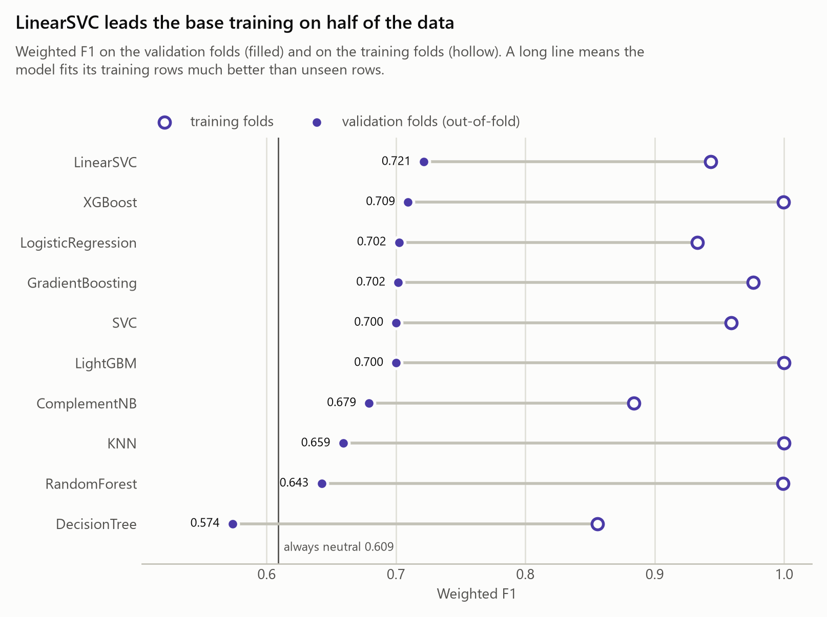
Ten models, one honest comparison
Base settings, half the training data, identical folds. Linear models on sparse text win.
Model | Weighted F1 | Macro F1
LinearSVC | 0.721 | 0.554
XGBoost | 0.709 | 0.490
LogisticRegression | 0.702 | 0.554
GradientBoosting | 0.702 | 0.533
SVC | 0.700 | 0.545
LightGBM | 0.700 | 0.471
9

Slide 10
Tuning the top 3, and why LinearSVC ships
Optuna (TPE + median pruning) on the full training data, same folds, weighted F1 as the objective.
• Tuned settings: C=0.05, class_weight=balanced, max_iter=20000.
• Best weighted F1 and the best macro F1 of the three, so the small classes survive.
• Lowest spread across folds, and seconds — not minutes — to refit.
• A linear model on TF-IDF stays explainable: one weight per word.
Model | Base F1 | Tuned F1 | Macro F1 | Fold std
LinearSVC | 0.725 | 0.727 | 0.572 | 0.004
XGBoost | 0.708 | 0.715 | 0.524 | 0.009
LogisticRegression | 0.697 | 0.709 | 0.553 | 0.006
10

Slide 11
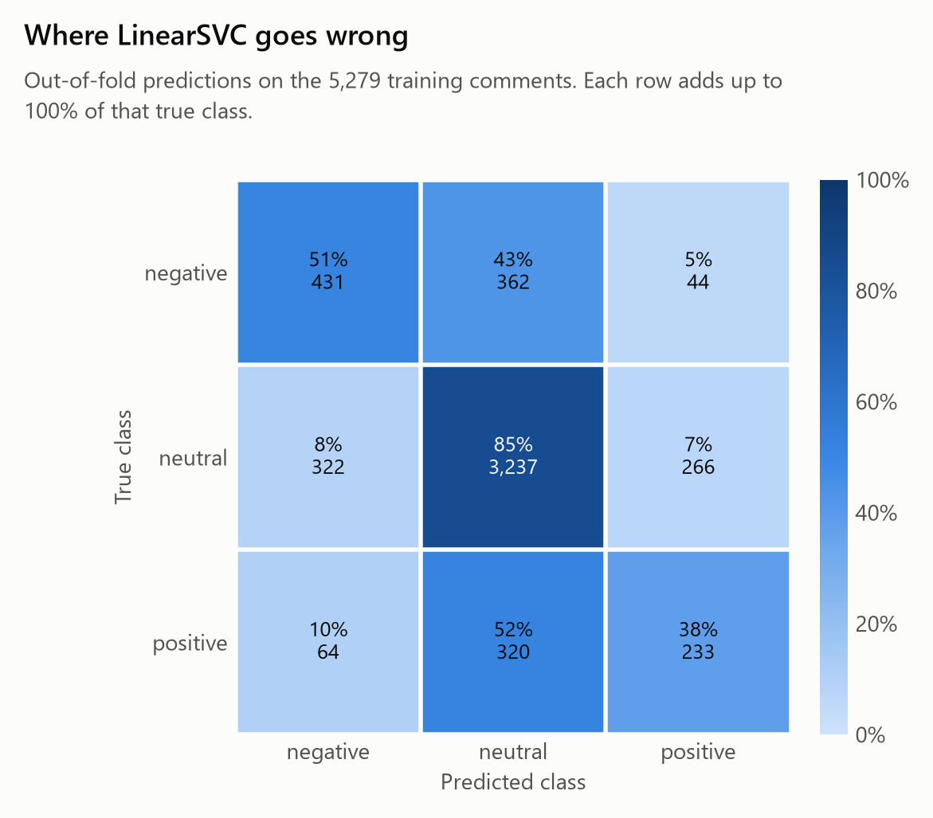
Results
Weighted F1 0.735 out of fold, +0.126 over the majority-class baseline; macro F1 0.586.
Class | Precision | Recall | F1 | Rows
positive | 0.429 | 0.378 | 0.402 | 617
negative | 0.528 | 0.515 | 0.521 | 837
neutral | 0.826 | 0.846 | 0.836 | 3825
11

Slide 12
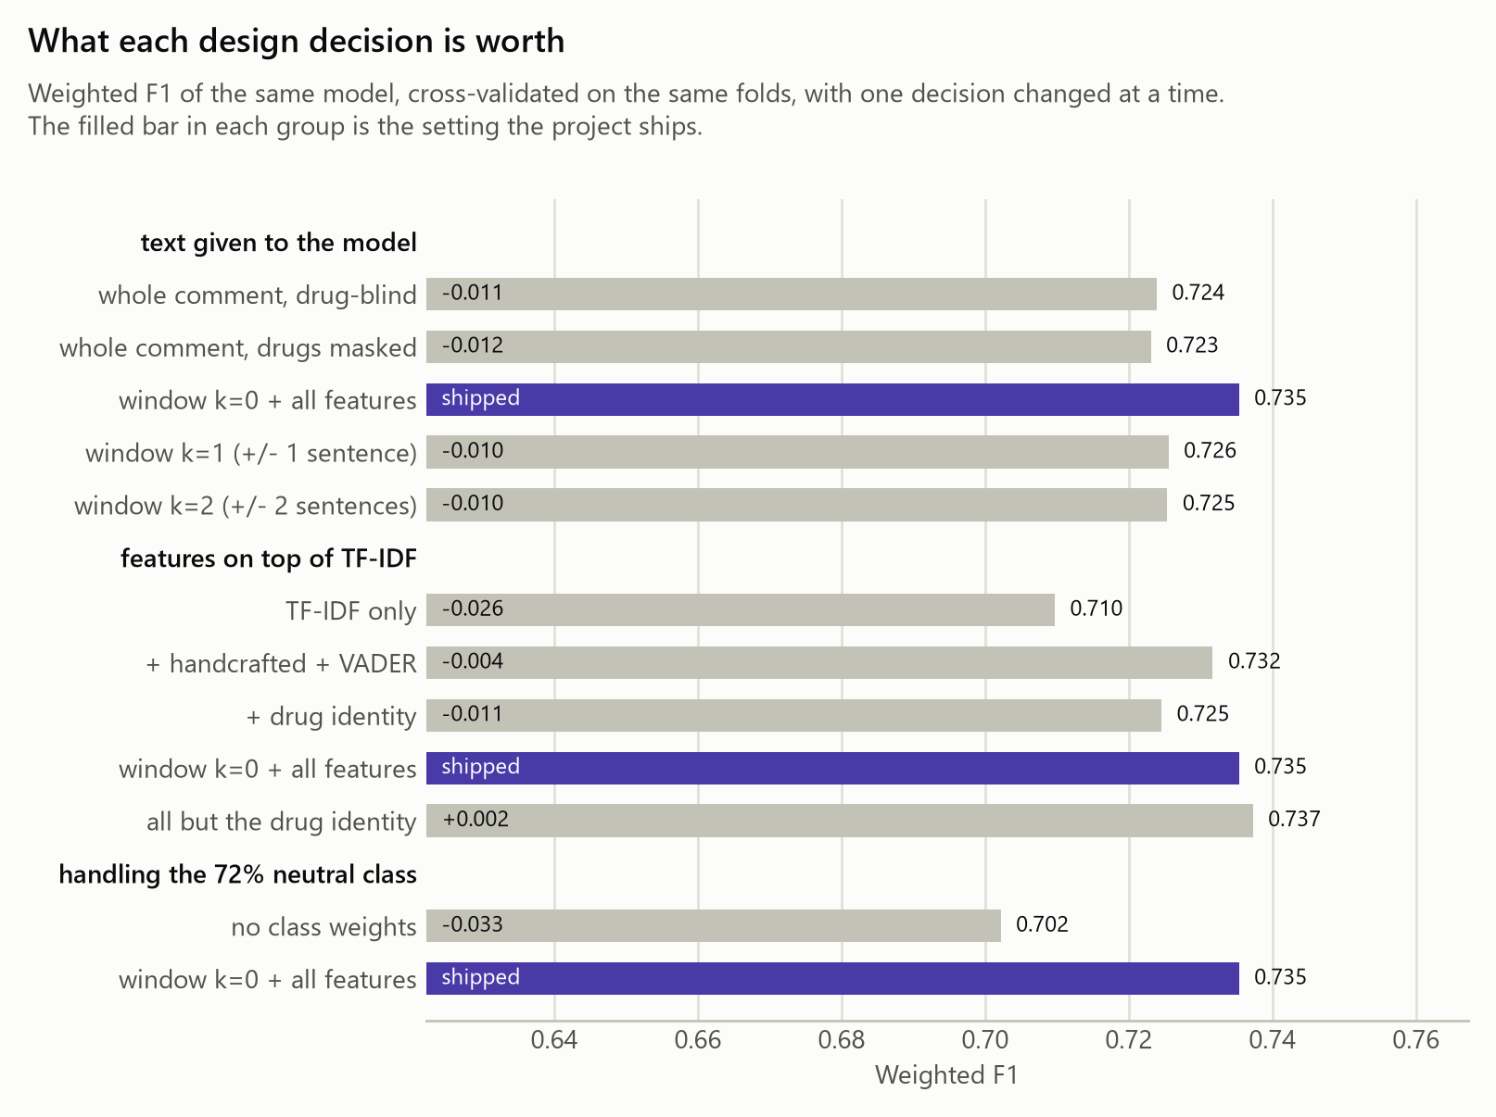
What each design decision is worth
Same model, same folds, one decision changed at a time.
12

Slide 13
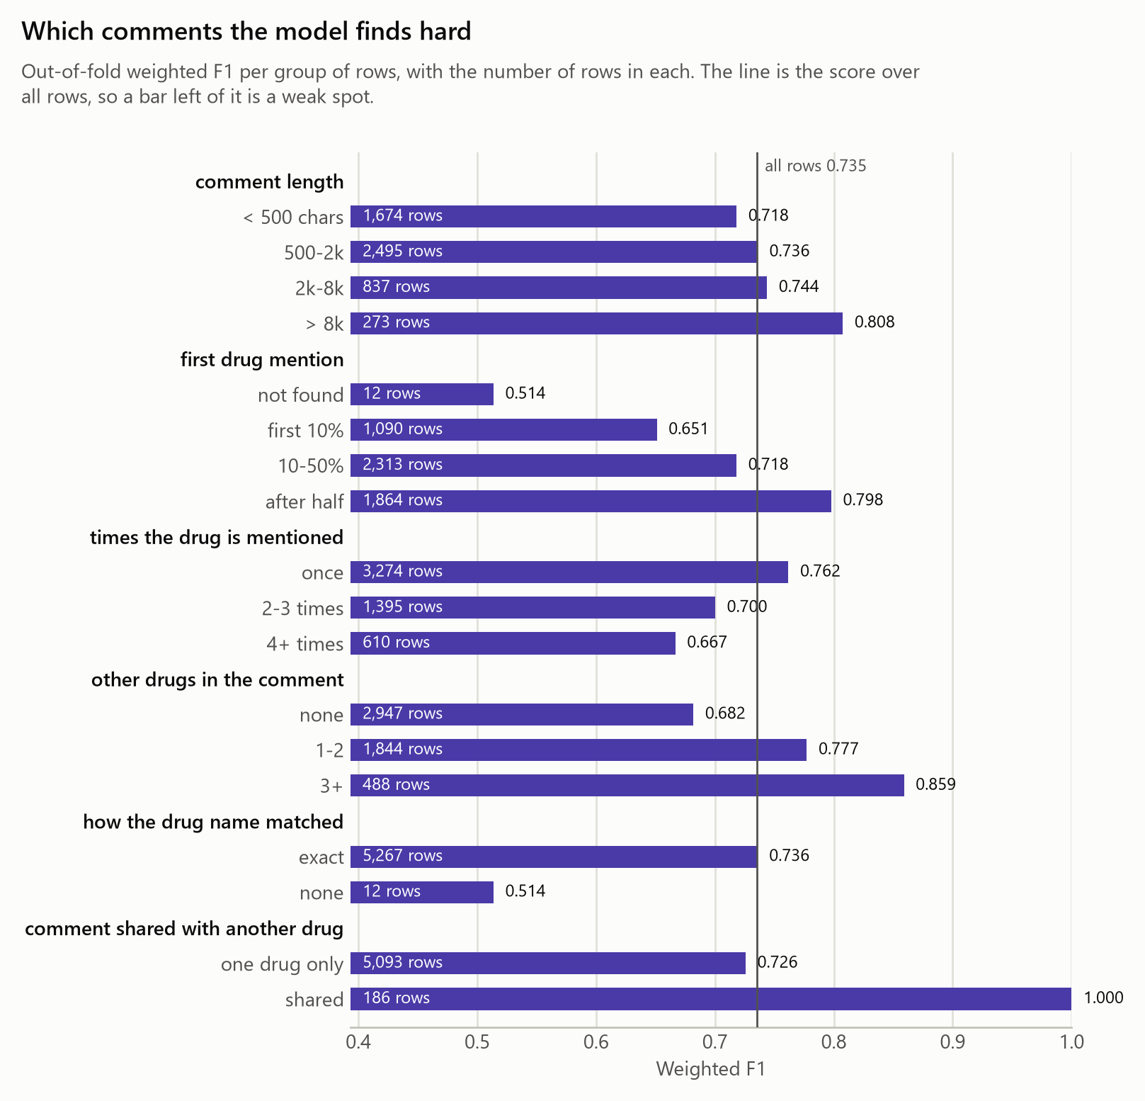
Where it still fails
The weakest group is “first drug mention: not found” at F1 0.514 on 12 rows.
• first drug mention — not found: F1 0.514 on 12 rows
• how the drug name matched — none: F1 0.514 on 12 rows
• first drug mention — first 10%: F1 0.651 on 1,090 rows
• Neutral rows absorb most mistakes: the class is 72% of the data and its wording is the least marked.
• Sarcasm and mixed reports ('worked but the rash was awful') stay hard for a bag-of-words model.
13

Slide 14
The submission, and how to rebuild everything
predictions.csv: 2,924 rows, ids in test order, labels positive 9%, negative 15%, neutral 76%.
• uv run python main.py all — ingest → preprocess → embed → train → evaluate → predict.
• Fitting the final model on all 5,279 rows takes 16s on a laptop CPU; no GPU anywhere in the project.
• Seed 42 everywhere; the model card records params, features, scores and the training time.
• python -m drug_sentiment.inference.predict --drug ... --text ... scores a brand-new comment.
• Re-run from the raw CSVs end to end, predictions.csv came back byte for byte identical.
14

Slide 15
What I would do next
The ceiling here is the bag-of-words view of a medical comment.
• Fine-tune a domain transformer (BioBERT / PubMedBERT) on the masked windows — needs a GPU.
• Model the neutral class explicitly: many neutral rows are news or trial reports, not opinions.
• Use the drug-level label prior as a proper target encoding fitted inside the folds.
• Blend the linear model with XGBoost on the dense features; their errors differ.
• Collect per-sentence labels so multi-drug comments can be scored sentence by sentence.
15

