Slide 1
Deep Neural Network

Slide 2

Deep Neural Network
Disclaimer and Acknowledgement
The content for these slides has been obtained from books and various other source on the Internet
I here by acknowledge all the contributors for their material and inputs.
I have provided source information wherever necessary
I have added and modified the content to suit the requirements of the course

Slide 3
Session Agenda
Activation functions
Weight initialization

Slide 4
Nonlinearity in MLP
A nonlinear Multi-Layer Perceptron (MLP) is a type of neural network with multiple layers and nonlinear activation functions.
In contrast to a linear model, which can only model linear relationships in data, a nonlinear MLP can capture complex, nonlinear patterns and relationships.
These activation functions allow the network to model complex relationships in the data that wouldn't be possible with linear transformations alone.

Slide 5
Activation function
Activation function of a neuron defines the output of that neuron given an input or set of inputs.
Activation functions decide whether a neuron should be activated or not by calculating the weighted sum and adding bias with it.
They are differentiable operators to transform input signals to outputs, while most of them add non-linearity.
Artificial neural networks are designed as universal function approximators, they must have the ability to calculate and learn any nonlinear function.

Slide 6
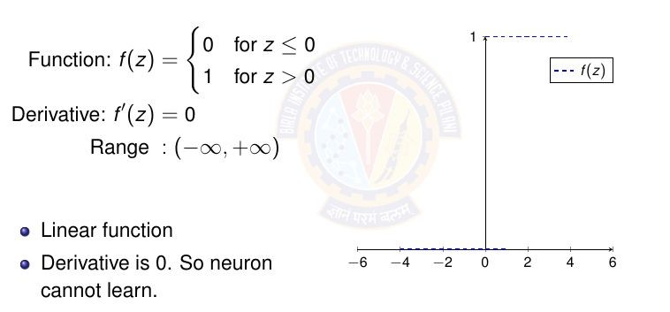
1. Step Function

Slide 7
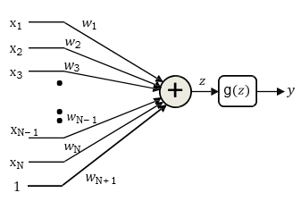
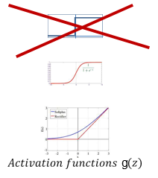
Differentiable activation functions
The perceptron is a flat function with zero derivative everywhere, except at 0 where it is non-differentiable
  You can vary the weights a lot without changing the error
  There is no indication of which direction to change the weights to reduce error
Lets make the neuron differentiable, with non-zero derivatives over much of the input space
  Small changes in weight can result in non-negligible changes in output
  This enables us to estimate the parameters using gradient descent techniques..

Slide 8
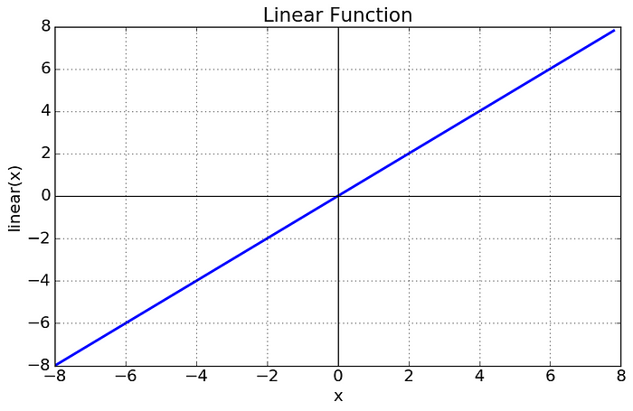


2. Linear activation function
Also known as "no activation," or "identity function" (multiplied x1.0)
Activation is proportional to the input.

Slide 9
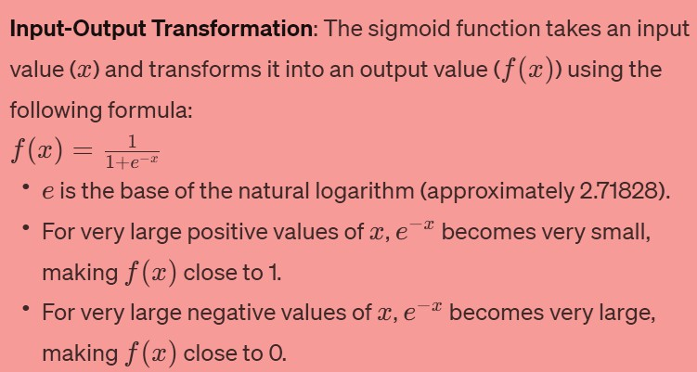
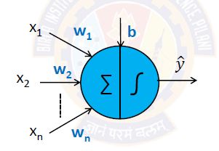
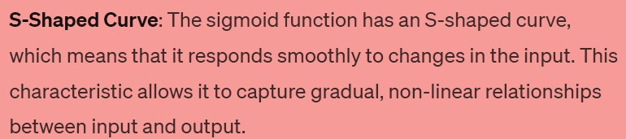
3. Sigmoid function
Often referred to as the logistic sigmoid
S-shaped curve transforms the input into an output in the range of (0, 1)
When the neuron’s activation are 0 or 1, sigmoid neurons saturate Gradients at these regions are almost zero (almost no signal will flow)
Here's an explanation of how the sigmoid activation function works:

Slide 10
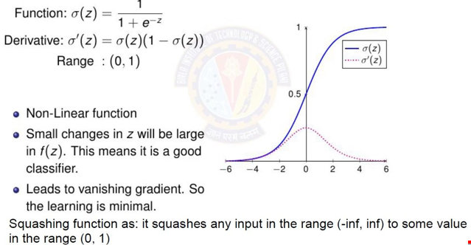
3. Sigmoid function

Slide 11
Drawbacks of Sigmoid
High computational complexity
  The sigmoid function contains the exponential operation. Thus, the computation is inefficient
Neuron Saturation problem
Vanishing gradient problem
Nonzero-centered outputs

Slide 12
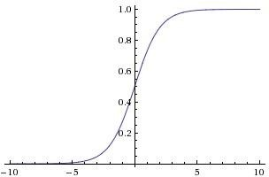




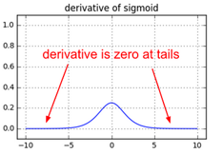
Neuron Saturation problem
x
What happens when x = -10? What happens when x = 0?
What happens when x = 10?
Saturated neurons “kill” the gradients
When gradients are zero, during gradient descent, weights will not update

Slide 13
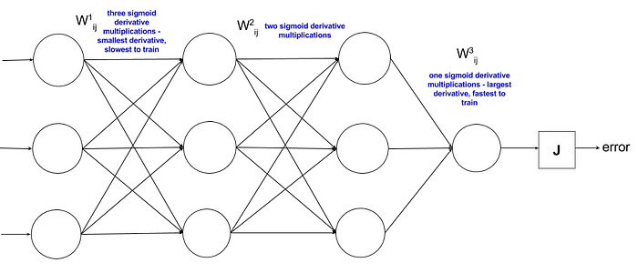


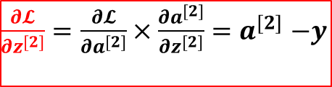
Vanishing gradient problem
Derivative of the sigmoid function is in the range of 0, 0.25
Absolute values of the initialized weights are generally less than 1,
Gradient would approach 0, thus causing the vanishing gradient problem.
$$σ^{`}\left(z^{\left[2\right]}\right)$$
$\frac{∂𝓛}{∂z^{[2]}}=\frac{∂𝓛}{∂a^{[2]}}×\frac{∂a^{[2]}}{∂z^{[2]}}$ ${=a}^{[2]}−y$
$$\frac{∂𝓛}{∂w^{[1]}}=\frac{∂𝓛}{∂a^{[2]}}×\frac{∂a^{[2]}}{∂z^{[2]}}×\frac{∂z^{[2]}}{∂a^{[1]}}×\frac{∂a^{[1]}}{∂z^{[1]}}×\frac{∂z^{[1]}}{∂w^{[1]}} =\frac{∂𝓛}{∂z^{[1]}}{ x}^{T}$$
Image credit: https://ayearofai.com/rohan-4-the-vanishing-gradient-problem-ec68f76ffb9b

Slide 14
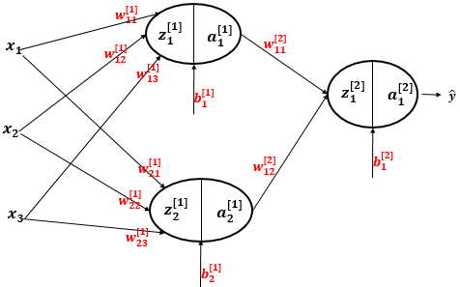
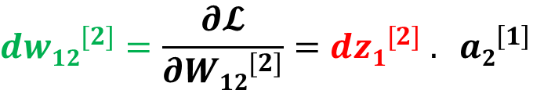
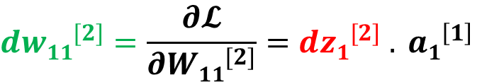
Nonzero-centered outputs
Consider what happens when the input to
a neuron is always positive:
$$d{w11}^{[2]}=\frac{∂𝓛}{∂{W11}^{[2]}}=d{z1}^{[2]}{ . a1}^{\left[1\right]}$$
$$d{w12}^{[2]}=\frac{∂𝓛}{∂{W12}^{[2]}}=d{z1}^{[2]}{ . a2}^{\left[1\right]}$$
Always positive why?
Fei-Fei Li & Justin Johnson & Serena Yeung Lecture 6 - April 20, 2017
What can we say about the gradients on w?

Slide 15

Nonzero-centered outputs
allowed gradient update directions
What can we say about the gradients on w? Always all positive or all negative :
(this is also why you want zero-mean data!)
Affects the network convergence
allowed gradient update directions
zig zag path
hypothetical optimal w vector

Slide 16
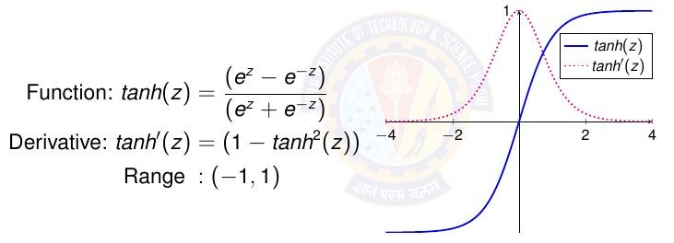

4.Hyperbolic Tangent (tanh) Function
Like sigmoid it has S shaped curve and models non linear relationship in data
Squashes numbers to range [-1,1]
Zero centered (nice) – faster convergence, hence uses in hidden layers
still kills gradients when saturated
Still computationally expensive
This looks very similar to sigmoid. In fact, it is a scaled sigmoid function!

Slide 17
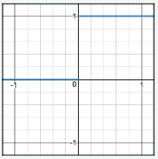
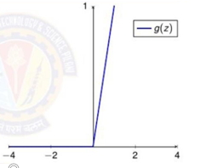
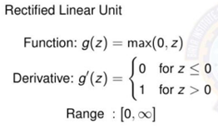
5. Relu (rectified linear unit) Function
Because the rectified function is linear for half of the input domain and nonlinear for the other half, it is referred to as a piecewise linear function or a hinge function
Kills negative values; thus, stops further propagation of negative values, hence known as rectifier

Slide 18
5. Relu
Advantages:
Does not saturate (in +region)
Very computationally efficient
Converges much faster than sigmoid/tanh in practice (e.g. 6x)
Sparse activation (in a randomly initialized network, only about 50% of hidden units are activated i.e have a non-zero output)
Disadvantages:
Non-differentiable at zero (not a major problem as neural network training algorithms do not usually arrive at a local minimum of the cost function)
Not zero-centered: Unbounded – (use Batch mormalization)
Dying ReLU problem – (use leaky Relu)

Slide 19
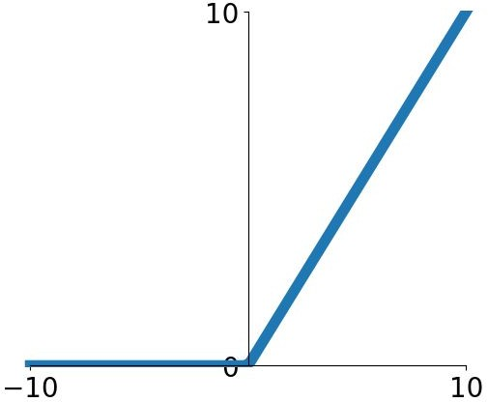

Dying Relu
hint: what is the gradient when x < 0?
This is a form of the vanishing gradient problem
x
ReLU
gate
What happens when x = -10? What happens when x = 0?
What happens when x = 10?
Fei-Fei Li & Justin Johnson & Serena Yeung Lecture 6 - April 20, 2017

Slide 20


Dying Relu
active ReLU
DATA CLOUD
dead ReLU
will never activate
=> never update
=> people like to initialize ReLU neurons with slightly positive biases (e.g. 0.01)

Slide 21
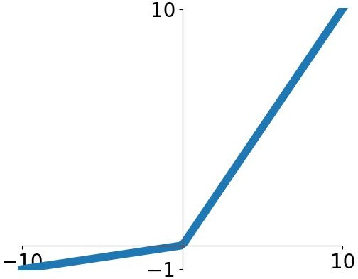


Leaky ReLU
Does not saturate
Computationally efficient
Converges much faster than sigmoid/tanh in practice! (e.g. 6x)
- will not “die”.
Parametric Rectifier (PReLU)
backprop into \alpha (parameter)

Slide 22
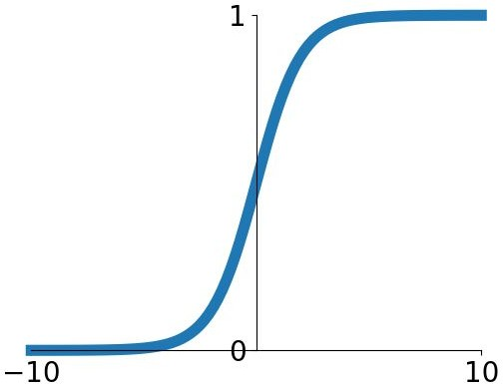


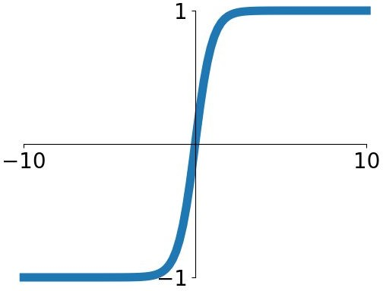


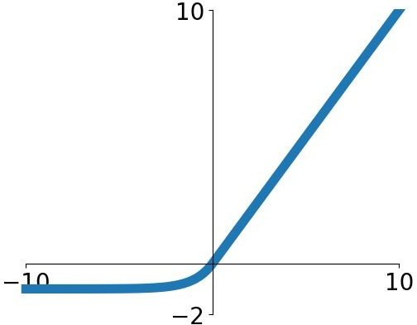

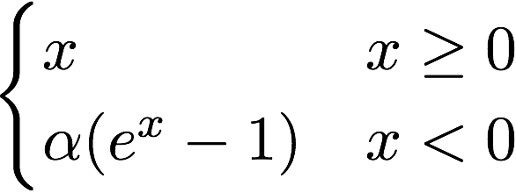
Activation Functions: Summary
Sigmoid
tanh
Leaky ReLU
Maxout
ReLU
ELU
Fei-Fei Li & Justin Johnson & Serena Yeung Lecture 6 - April 20, 2017
Fei-Fei Li & Justin Johnson & Serena Yeung

Slide 23
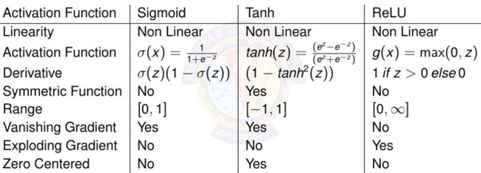
Activation Functions: Summary

Slide 24
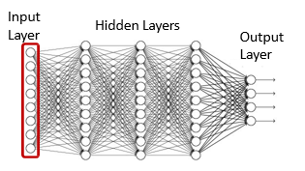
Representing the input
Vectors of numbers
  (or may even be just a scalar, if input layer is of size 1)
  E.g. vector of pixel values
  E.g. vector of speech features
  E.g. real-valued vector representing text
  Other real valued vectors

Slide 25
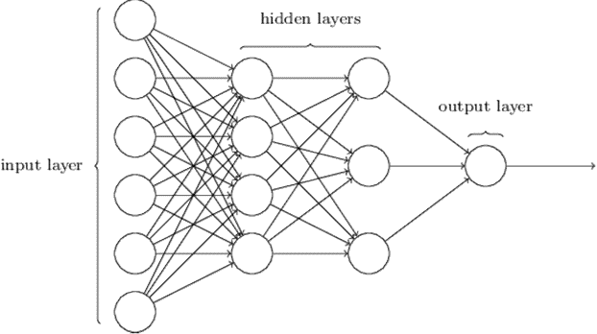
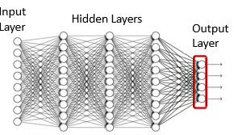
Representing the output
If the desired output is real-valued, no special tricks are necessary
  Scalar Output : single output neuron
    d = scalar (real value)
  Vector Output : as many output neurons as the dimension of the desired output
    d = [d₁ d₂ .. d_{L}] (vector of real values)

Slide 26
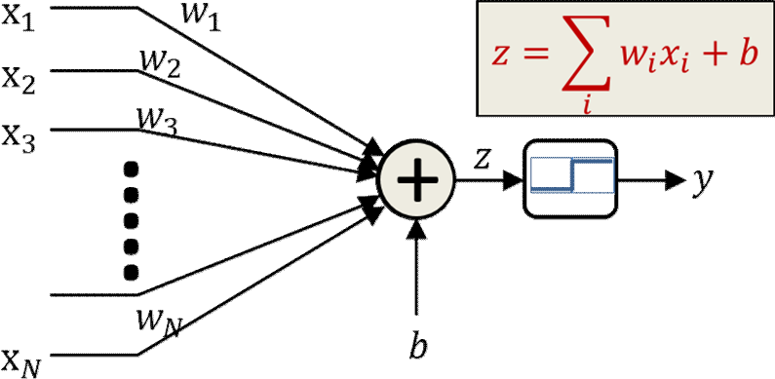
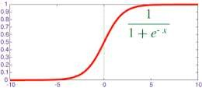
Representing the output : binary class
𝜎(𝑧)
If the desired output is binary (is this a cat or not), use a simple 1/0 representation of the desired output
  1 = Yes it’s a cat
  0 = No it’s not a cat
Output activation: Typically a sigmoid
  Viewed as the probability P(Y=1|X) of class value 1
    Indicating the fact that for actual data, in general a feature value X may occur for both classes, but with different probabilities
    Is differentiable

Slide 27
Multi-class output: One-hot representations
Consider a network that must distinguish if an input is a cat, a dog, a camel, a hat, or a flower
We can represent this set as the following vector: [cat dog camel hat flower]^{T}
For inputs of each of the five classes the desired output is: cat: [1 0 0 0 0] ^{T}
dog: [0 1 0 0 0] ^{T}
camel: [0 0 1 0 0] ^{T}
hat: [0 0 0 1 0] ^{T}
flower: [0 0 0 0 1] ^{T}
For an input of any class, we will have a five-dimensional vector output with four zeros and a single 1 at the position of that class
This is a one hot vector

Slide 28
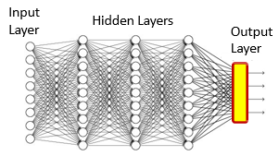
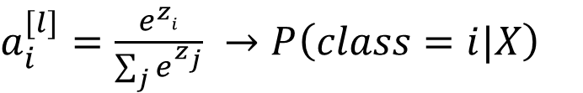
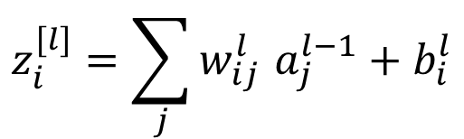
Multi-class networks
$$z_{i}^{[l]}=\sum_{j}{w_{ij}^{l } a_{j}^{l−1}}+b_{i}^{l}$$
$a_{i}^{[l]}=\frac{e^{zi}}{\sum_{j}{e^{z_{j}}}} →P\left(class=i|X\right)$
For a multi-class classifier with N classes, the one-hot representation will have N binary target outputs
The neural network’s output too must ideally be binary (N-1) zeros and a single 1 in the right place)
More realistically, it will be a probability vector
  N probability values that sum to 1.
Softmax vector activation is often used at the output of multi-class classifier nets

Slide 29
A sigmoid Layer
3
0.95
1
0.73
-3
0.05

Slide 30
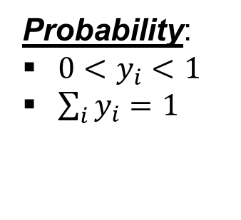
Softmax Layer
Probability:
$0<y_{i}<1$
$\sum_{i}{y_{i}=1}$
  The values z inputted to the softmax layer are referred to as logits
A Softmax Layer
3
20
0.88
1
2.7
0.12
-3
0.05
≈0
Slide credit: Hung-yi Lee – Deep Learning Tutorial

Slide 31
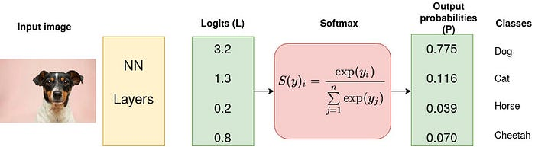
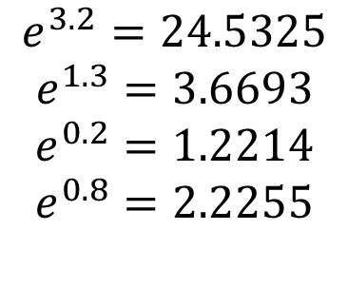
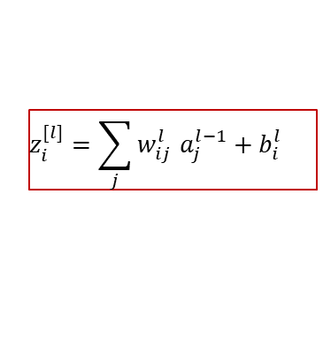

Multiclass classification example
$$z_{i}^{[l]}=\sum_{j}{w_{ij}^{l } a_{j}^{l−1}}+b_{i}^{l}$$
$$e^{3.2}=24.5325$$
$$e^{1.3}=3.6693$$
$$e^{0.2}=1.2214$$
$$e^{0.8}=2.2255$$
$$S\left(3.2\right)=\frac{e^{3.2}}{e^{3.2}+e^{1.3}+e^{0.2}+e^{0.8}}$$
$=0.775$
Example credit: https://towardsdatascience.com/softmax-activation-function-how-it-actually-works-d292d335bd78

Slide 32


Multi-class cross entropy loss
Binary cross entropy is calculated on top of sigmoid outputs, whereas Categorical cross-entropy is calculated over softmax activation outputs.
Here, y^{(k)} is 0 or 1, indicating whether class label k is the correct classification for predicting ŷ^{(k)}
With softmax activation

Slide 33
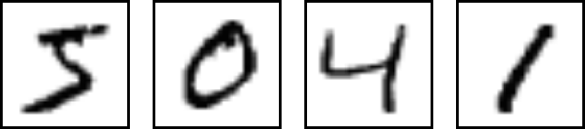
Typical Problem Statement
We are given a number of “training” data instances
E.g. images of digits, along with information about which digit the image represents
Tasks:
  Binary recognition: Is this a “2” or not
  Multi-class recognition: Which digit is this? Is this a digit in the first place?

Slide 34
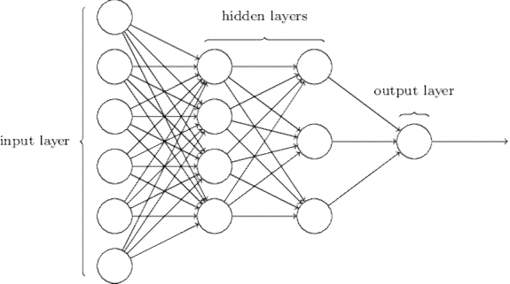
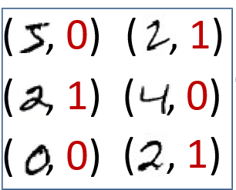
Typical Problem statement : binary classification
Training data
Output: sigmoid
Input: vector of pixel values

Slide 35
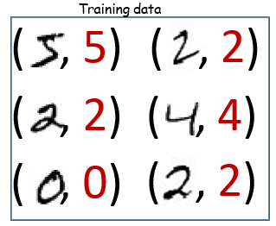
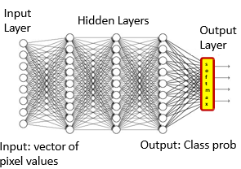
Typical Problem statement: Multiclass classification

Slide 36
Initializing neural networks
The choice of initialization is crucial for maintaining numerical stability.
The choices of initialization can be tied up in interesting ways with the choice of the nonlinear activation function.
Which function we choose and how we initialize parameters can determine how quickly our optimization algorithm converges.
Poor choices can cause to encounter exploding or vanishing gradientswhile training.

Slide 37
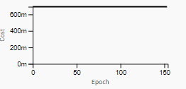
Initializing neural networks
Zero initialization for weights
  All the neurons learn the same features during training
  hidden units will have identical influence on the cost, which will lead to identical gradients.

Slide 38
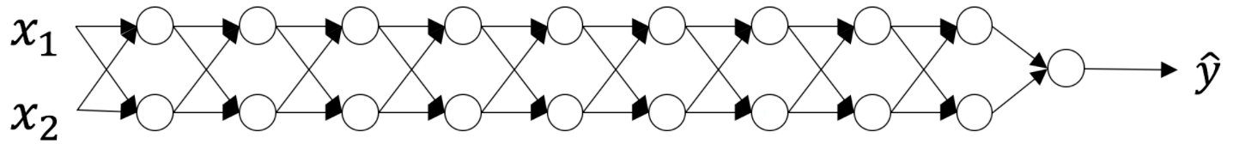



Initializing neural networks
Consider linear activation for the above NN, weights are all matrices of size (2,2)
A too-large initialization
A too-small initialization
Values of 𝑎^{[𝑙]} increase exponentially with 𝑙
Gradients explodes due to large activations leads to the exploding gradient problem
Cost oscillates around its min.
values of 𝑎[𝑙] decrease exponentially with 𝑙
Gradients vanishes due to small activations leads to the vanishing gradient problem
Fails to converge

Slide 39

Xavier Initialization
Samples weights from a Gaussian distribution with zero mean and variance
n_{i} = size of i^{th} layer
Now-standard and practically beneficial
https://proceedings.mlr.press/v9/glorot10a/glorot10a.pdf?hc_location=ufi

Slide 40
References
Ref TB- Dive into Deep Learning chapter 5

Slide 41
Thank You All !

