Slide 1
Deep Neural Network
Acknowledgement: IIT M CS7015 (Deep Learning)

Slide 2

Deep Neural Network
Disclaimer and Acknowledgement
The content for these slides has been obtained from books and various other source on the Internet
I here by acknowledge all the contributors for their material and inputs.
I have provided source information wherever necessary
I have added and modified the content to suit the requirements of the course

Slide 3
Session Agenda
Training Error and Generalization Error
Fit of the model
Model complexity
Regularization
    l₂ regularization
    Dataset augmentation
    Early stopping
    Ensemble methods
    Dropout

Slide 4
Training Error and Generalization Error
Training error is the error of our model as calculated on the training dataset.
  Obtained while training the model.
Generalization error is the expectation of our modelʼs error, if an infinite stream of additional data examples drawn from the same underlying data distribution as the original sample were applied on the model.
  Cannot be computed, but estimated.
  Estimate the generalization error by applying the model to an independent test set,
  constituted of a random selection of data examples that were withheld from the training set

Slide 5
Factors that influence the generalizability of a model
The number of tunable parameters.
  When the number of tunable parameters, called the degrees of freedom, is large, models tend to be more susceptible to overfitting.
The values taken by the parameters.
  When weights can take a wider range of values, models can be more susceptible to overfitting.
The number of training examples.
  It is trivially easy to overfit a dataset containing only one or two examples even if your model is simple.
  But overfitting a dataset with millions of examples requires an extremely flexible model.

Slide 6
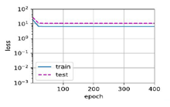
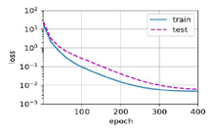
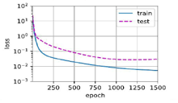
Fit of the model
Underfitting
Overfitting
High Training loss
High Validation loss
Little gap between both
Low Training loss
Low Validation loss
Low Training loss
High Validation loss

Slide 7
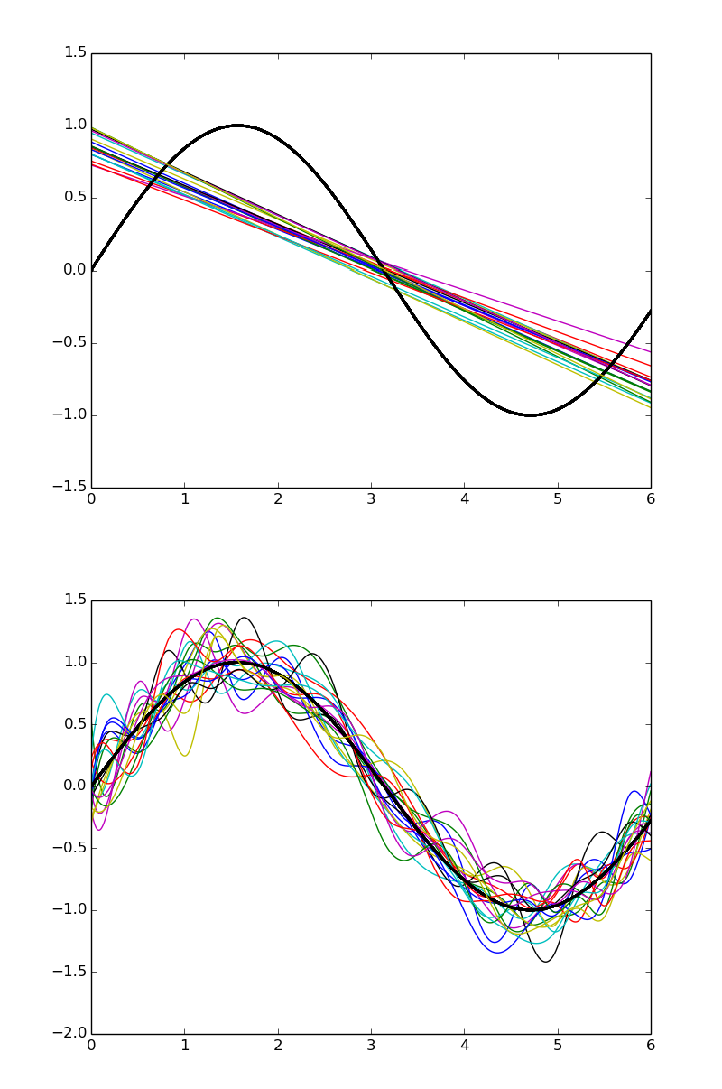
Bias- variance
Simple models trained on different samples of the data do not differ much from each other
However they are very far from the true sinusoidal curve (under fitting)
On the other hand, complex models trained on different samples of the data are very different from each other (high variance)
Simple model: high bias, low variance
Complex model: low bias, high variance
Slide credit: IITM CS7015

Slide 8
Model complexity
Simple models and abundant data
  Expect the generalization error to resemble the training error.
More complex models and fewer examples
  Expect the training error to go down but the generalization gap to grow.
Model complexity
  A model with more parameters might be considered more complex.
  A model whose parameters can take a wider range of values might be more complex.
  A neural network model that takes more training iterations are more complex, and
  One subject to early stopping (fewer training iterations) are less complex.

Slide 9
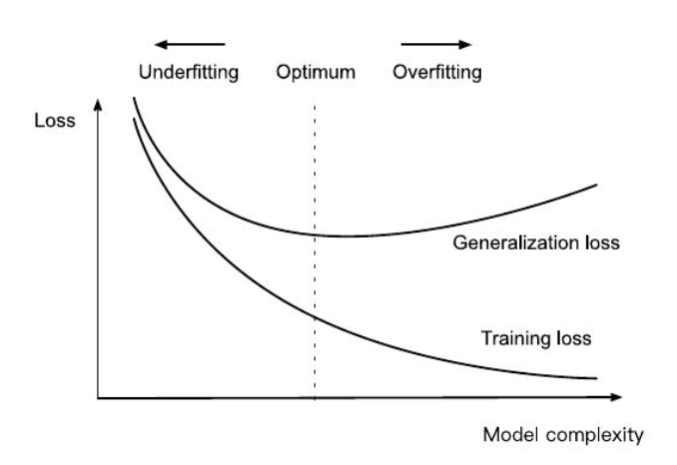
Model complexity

Slide 10
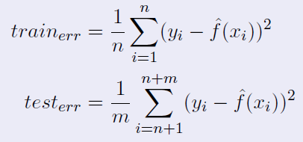
Model complexity
Let there be n training points and m test (validation) points
As the model complexity increases train_{err} becomes overly optimistic and gives us a wrong picture of how close f̂ is to f
The validation error gives the real picture of how close f̂ is to f

Slide 11
Model selection
Model selection is the process of selecting the final model after evaluating several candidate models.
With MLPs, compare models with
  different numbers of hidden layers,
  different numbers of hidden units
  different activation functions applied to each hidden layer.
We should touch the test data once, to assess the very best model or to compare a small number of models to each other
Use Validation dataset to determine the best among our candidate models
In deep learning, with millions of data available, the split is generally
  Training = 98-99 % of the original dataset
  Validation = 1-2 % of training dataset
  Testing = 1-2 % of the original dataset
Notes:
n principle we should not touch our test set until after we have chosen all our hyperparameters. Were we to use the test data in the model selection process, there is a risk that we might overfit the test data. Never rely on the test data for model selection.
Risk of overfit the test data
Do not rely solely on the training data for model selection
We cannot estimate the generalization error on the very data that we use to train the model.
Split the data three ways, incorporating a validation dataset in addition to the training and test datasets.
If we overfit our training data, there is always the evaluation on test data to keep us honest. But if we overfit the test data, how would we ever know?
Thus, we should never rely on the test data for model selection. And yet we cannot rely solely on the training data for model selection either because we cannot estimate the generalization error on the very data that we use to train the model.

Slide 12
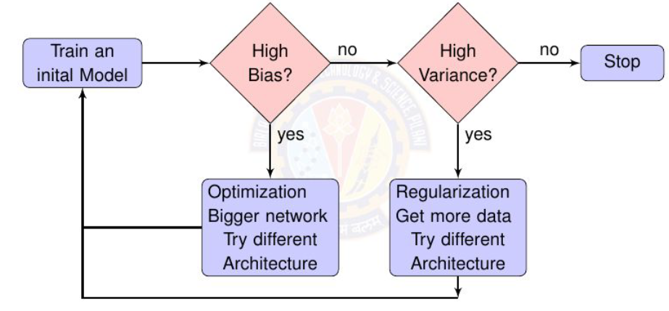
Model selection

Slide 13
Model complexity
Why do we care about this bias variance tradeoff and model complexity?
Deep Neural networks are highly complex models. Many parameters, many nonlinearities.
It is easy for them to overfit and drive training error to 0.
Hence we need some form of regularization.

Slide 14
Different forms of regularization
l₂ regularization
Dataset augmentation
Early stopping
Ensemble methods
Dropout

Slide 15
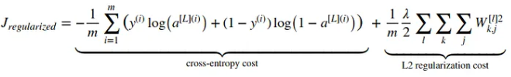
l₂ regularization- weight decay
Regularized Cost function
Add the norm as a penalty term to the problem of minimizing the loss. This will ensure that the weight vector is small.
Regularized Cost function – Logistic regression
w_{t+1} = w_{t} — η∇L (w_{t}) — η λ w_{t}
w₀​ is not regularized
Regularized Cost function – Neural network
Notes:
The idea of weight decay is simple: to prevent overfitting, every time we update a weight w with the gradient ∇J in respect to w, we also subtract from it λ∙w. This gives the weights a tendency to decay towards zero, hence the name.
For λ = 0, we recover the original loss function.
● For λ > 0, we restrict the size of ∥w∥.
● Smaller values of λ correspond to less constrained w, whereas larger
values of λ constrain w more considerably.
● By squaring the L2 norm, we remove the square root, leaving the sum of
squares of each component of the weight vector.
● The derivative of a quadratic function ensure that the 2 and 1/2 cancel
out.
23

Slide 16
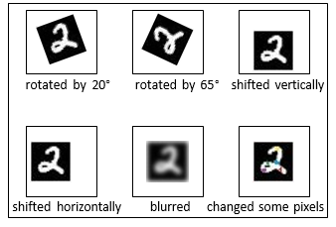
Dataset augmentation
label = 2
[given training data] We exploit the fact that certain transformations to the image do not change the label of the image.
Typically, More data = better learning
Works well for image classification / object recognition tasks Also shown to work well for speech
For some tasks it may not be clear how to generate such data
[augmented data = created using some knowledge of the task]
Slide credit: IITM CS7015

Slide 17
Early stopping
Track the validation error
Have a patience parameter p
If you are at step k and there was no improvement in validation error in the previous p steps then stop training and return the model stored at step k — p
Basically, stop the training early before it drives the training error to 0 and blows up the validation error
Error
V alidation error
Training error
k stop
Steps
k − p
return
this model

Slide 18
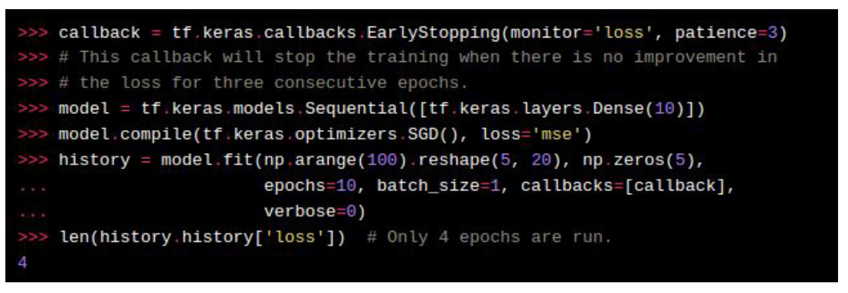
Early stopping

Slide 19
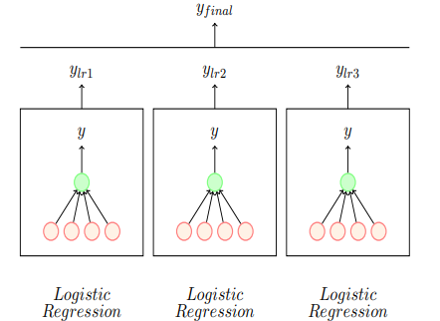
Ensemble - Bagging
Each model trained with a different sample of the data (sampling with replacement)

Slide 20
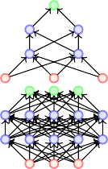
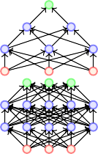
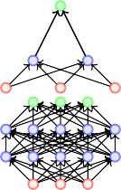
Ensemble - Bagging
Typically model averaging(bagging ensemble) always helps
Training several large neural net- works for making an ensemble is prohibitively expensive
Option 1: Train several neural networks having different architectures(obviously expensive)
Option 2: Train multiple instances of the same network using different training samples (again expensive)
Even if we manage to train with option 1 or option 2, combining several models at test time is infeasible in real time applications

Slide 21
Drop out
Dropout is a technique which addresses both these issues.
Effectively it allows training several neural networks without any significant computational overhead.
Also gives an efficient approximate way of combining exponentially many different neural networks.

Slide 22
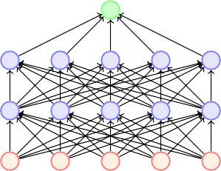



Drop out
Dropout refers to dropping out units
Temporarily remove a node and all its incoming/outgoing connections resulting in a thinned network
Each node is retained with a fixed probability (typically p = 0.5) for hidden nodes and p = 0.8 for visible nodes

Slide 23
Drop out
Suppose a neural network has n nodes
Using the dropout idea, each node can be retained or dropped
For example, in the above case we drop 5 nodes to get a thinned network Given a total of n nodes, what are the total number of thinned networks that can be formed? 2^{n}
we cannot possibly train so many networks
Trick: (1) Share the weights across all the networks
(2) Sample a different network for each training
instance

Slide 24
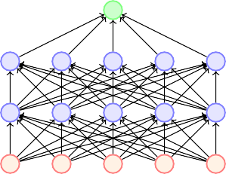
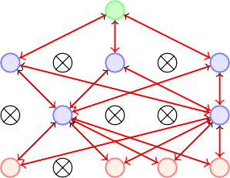
Drop out
We initialize all the parameters (weights) of the network and start training
For the first training instance (or mini-batch), we apply dropout resulting in the thinned network
We compute the loss and back propagate
Which parameters will we update? Only those which are active

Slide 25


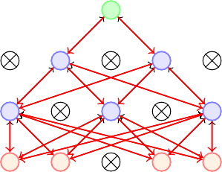
Drop out
For the second training instance (or mini-batch), we again apply dropout resulting in a different thinned network
We again compute the loss and backpropagate to the active weights
If the weight was active for both the training instances then it would have received two updates by now
If the weight was active for only one of the training instances then it would have received only one updates by now
Parameter sharing ensures that no model has untrained or poorly trained parameters

Slide 26
Drop out
Prevents hidden units from coadoption
Dropout gives a smaller neural network, giving the effect of
regularization.
In general,
  Vary keep probability (0.5 to 0.8) for each hidden layer.
  The input layer has a keep probability of 1.0 or 0.9.
  The output layer has a keep probability of 1.0.

Slide 27
References
https://www.cs.toronto.edu/~hinton/absps/JMLRdropout.pdf
Ref TB Dive into Deep Learning Sections 5.4, 5.5, 5.6 online version
IIT M CS7015 (Deep Learning) : Lecture 8

Slide 28
Thank You All !

