Slide 1
Looking Back

Slide 2
Midsem exam Details:
Total Questions: 6
Marks per Question: 5
The exam will cover the following types of questions:
Definitions and Theoretical Concepts
Short Calculations or Problem-Solving Tasks
Comparison and Contrast
Applications to New Scenarios
Diagrams and Interpretation
Explanation of Steps or Algorithms
Open-Ended Design Problems
Real-World Applications

Slide 3
Example 1
Two friends Ravi and Vira, while experimenting with a deep neural network, found that their model is over-fitting the given training data. The friends referred to the available literature and materials and came up with a solution to reduce the over-fitting. Ravi decided to add drop out along with batch normalization to his model. Whereas Vira decided to go with a deeper model, hence he added more layers. But he found that his model is struggling to train because of his hardware limitations. So he decided to employ early stopping. Assess whether the decisions Ravi and Vira are taking helps them to proceed in the right direction.

Slide 4
Discussion
Both Ravi and Vira are correct in their decisions.
Both are regularization techniques.
Dropout prevents overfitting due to a layer’s over-reliance on a few of its neurons.
Early stopping provide guidance as to how many iterations can be run before the learner begins to over-fit.

Slide 5
Example - 2
Two friends Meera and Reema were working on a deep neural classifier. While training , Meara's classifier obtains a training set error of 25% and validation set error of 27%; whereas Reema obtained a training set error of 4.5% and validation set error of 6%. Examine the classifiers Meera and Reema have designed and suggest one technique they should use to modify their classifier if required.

Slide 6
Discussion
Meera’s classifier is having high bias.
So Meera has to use optimization techniques like SGD, mometum, RMSProp or Adam classifier.
Reema’s classifier is having low bias and variance.
So no change required

Slide 7
Example - 3
The following code snippet is used for a classification problem
dnnModel = models . Sequential( )
dnnModel . add ( l a y e r s . Dense (60 , a c t i v a t i o n=’tanh ’ ,input_shape= ( 6 4 * 6 4 , ) ) )
dnnModel . add ( l a y e r s . Dense (40 , a c t i v a t i o n=’tanh ’ ) )
dnnModel . add ( l a y e r s . Dense (20 , a c t i v a t i o n=’tanh ’ ) )
dnnModel . add ( l a y e r s . Dense (10 , a c t i v a t i o n=’tanh ’ ) )
dnnModel . add ( l a y e r s . Dense ( 4 , a c t i v a t i o n=’softmax ’ ) )
Find the number of hidden layers and the number of categories that are being classified.
Compute the size of input vector.
Compute the number of parameters learned in each layer.

Slide 8
Discussion
The following code snippet is used for a classification problem
dnnModel = models . Sequential( )
dnnModel . add ( l a y e r s . Dense (60 , a c t i v a t i o n=’tanh ’ ,input_shape= ( 6 4 * 6 4 , ) ) )
dnnModel . add ( l a y e r s . Dense (40 , a c t i v a t i o n=’tanh ’ ) )
dnnModel . add ( l a y e r s . Dense (20 , a c t i v a t i o n=’tanh ’ ) )
dnnModel . add ( l a y e r s . Dense (10 , a c t i v a t i o n=’tanh ’ ) )
dnnModel . add ( l a y e r s . Dense ( 4 , a c t i v a t i o n=’softmax ’ ) )
Find the number of hidden layers and the number of categories that are being classified.
hidden layers= 4 and number of categories = 4
Compute the size of input vector.
Size of input vector = 64*64=4096
Compute the number of parameters learned in each layer.
number parameters = connections between layers + biases in every layer
= (64*64*60+60) + (60*40+40) + (40*20+20) + (20*10+10) + (10*4+4)

Slide 9
Continued…..
A ML engineer suggested to the following. Do you agree with the engineer. Justify your answer.
Use sigmoid activation function in the last layer.
Use sigmoid activation function in the last layer.

Slide 10
Continued…..
A ML engineer suggested to the following. Do you agree with the engineer. Justify your answer.
Use sigmoid activation function in the last layer.
Sigmoid function is used to represent a probability distribution over a binary classification.
Softmax function is used to represent a probability distribution over multiclass classification.
This is 4-class classification problem. Hence Softmax has to be used.
Use RMSprop for the training instead to SGD.
RMSProp can be used when there is too much oscillations in the training phase.
SGD is gradient descent algorithm which can take long time to converge.
Without knowing how long it takes to converge or if there are oscillations which are slowing down the training process, we cannot conclude whether RMSProp will be better than SGD.

Slide 11
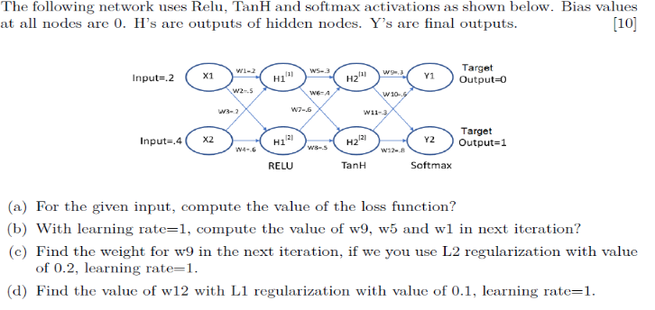
Example - 4

Slide 12
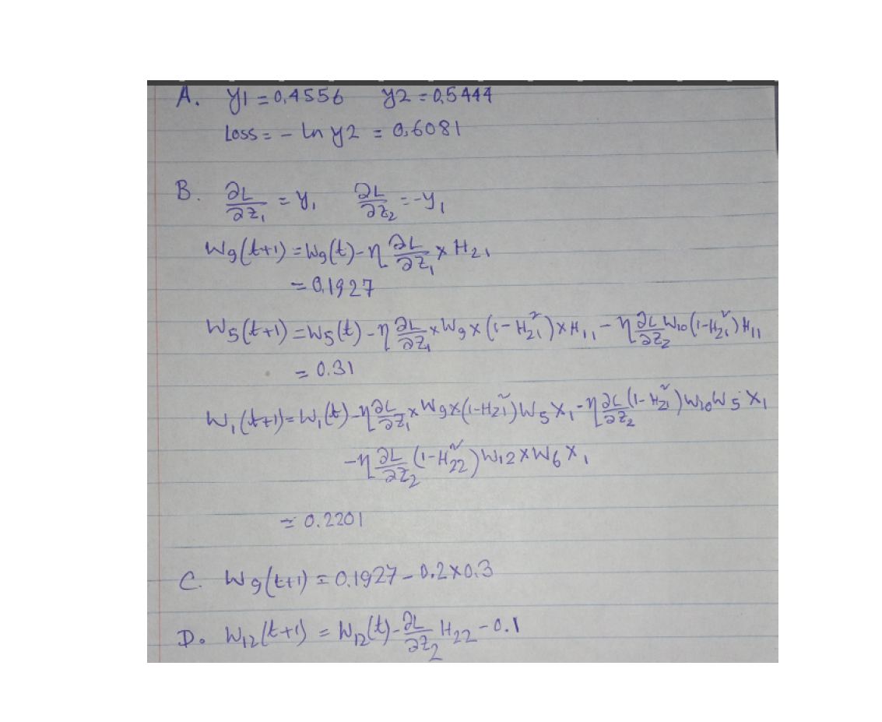

Slide 13
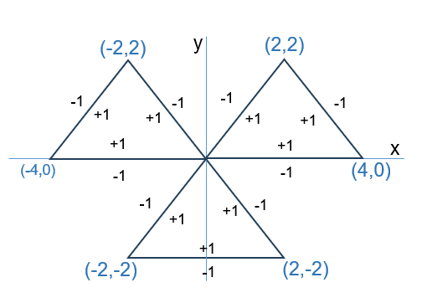
Example - 5
Design a fully connected multilayer perceptron network with minimum number of hidden layers and hidden nodes required to classify the below decision boundary with 100% accuracy.
(x, y) are input features and target classes are either +1 or -1 as shown in the figure.Step activation functions are used at all nodes, i.e., output=+1 if total weighted input >= threshold (mention inside node) at a node, else output = -1.

Slide 14
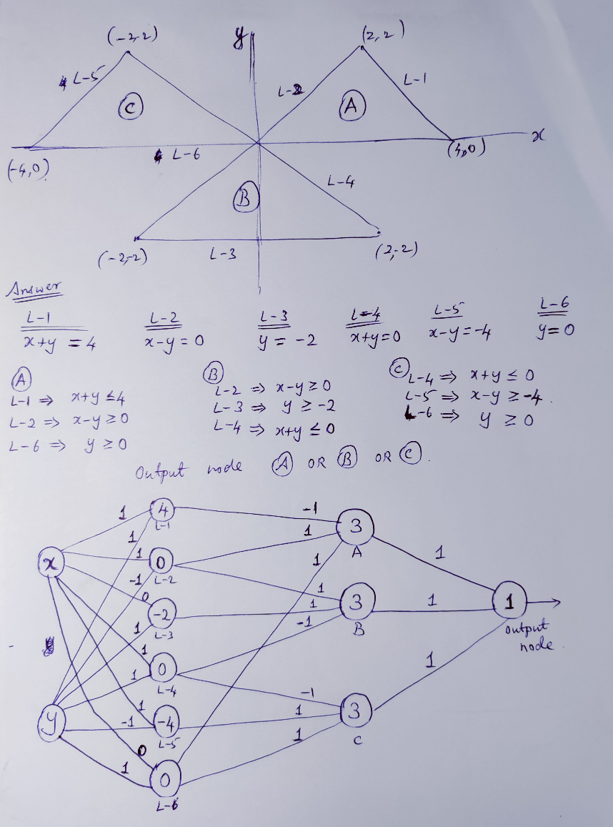
Discussion
6 neurons in first layer, 3 neurons in 2nd layer, 1 neuron in last layer

Slide 15
Example 6
Mr Ram has a dataset data_1.csv with 1 million labelled training examples for classification, and dataset data_2.csv with 100 labelled training examples. Mr Rakesh trains a model from scratch on data_2.csv. Mr Ram decided to train on data_1.csv, and then apply transfer learning to train on data_2.csv.
Differentiate between these approaches and the advantages / problems both of them faces and how to solve them, if possible? State one problem Mr Rakesh is likely to find with his approach. How does Mr Ram approach address this problem?

Slide 16
Discussion
Mr Rakesh is likely to see overfitting. Model is not going to generalise well to unseen data. By using transfer learning and freezing the weights in the earlier layers, Mr Ram reduce the number of learnable parameters, while using the weights which have been pretrained on a much larger dataset.

Slide 17
Example 7

Slide 18
Thanks

