Slide 1



Eduwins -The education academy
Presenter
Sabith

Slide 2
Agenda
Problem statement
Project overview
Who are the end users
Your solution and its valuable proposition
The wow in our solution

Slide 3
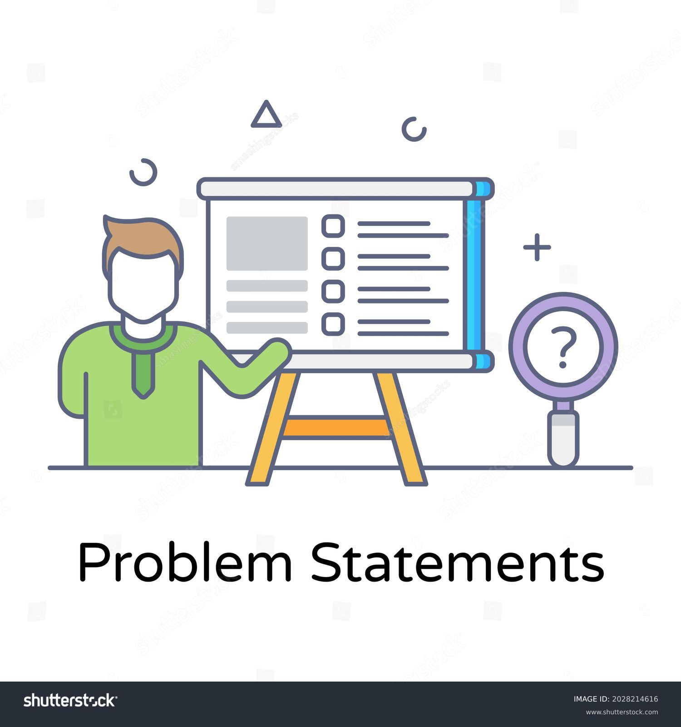
Problem Statement
Our company, Eduwins, provides a user-friendly platform for learners of all ages. Offering both day school facilities and online education, we ensure accessibility for everyone, fostering a connected and skilled community.
3

Slide 4

Project Overview
Our project, Eduwins, addresses the pressing need for accessible language learning solutions by providing a dynamic platform for individuals of all ages to improve their English, Hindi, and Malayalam skills. Eduwins offers flexible and convenient access to expert-led courses taught by educated and skilled teachers, interactive learning materials, personalized learning paths, and job-oriented interview demos.
We empower learners to enhance their reading, writing, and speaking abilities with a user-friendly interface and a focus on inclusivity. Eduwins aims to bridge the gap in language education, fostering a more connected and skilled global community while creating opportunities for personal and professional growth.
4
Eduwins

Slide 5
Who are the Users
Students : Seeking to improve their language skills in English, Hindi, and Malayalam.
Professionals : Aiming to enhance their communication abilities for career advancement.
Job seekers : Preparing for interviews and wanting to improve their employability.
Individuals : Interested in learning or mastering English, Hindi, or Malayalam for personal development.
People of all ages : Looking for accessible and flexible language learning solutions.
Non-native speakers : Of English, Hindi, or Malayalam wanting to become proficient in these languages.
Anyone interested : In fostering a more connected and skilled global community through language education.
5

Slide 6

OUR SOLUTION AND ITS VALUE PROPOSITION
Dynamic Learning Platform: Eduwins offers an innovative platform for mastering English, Hindi, and Malayalam, both through our day school facility and online resources.
Flexible Scheduling: Learners enjoy the freedom to access us at anytime, anywhere, fitting seamlessly into their busy lives.
Empowerment and Accessibility: Through empowerment and accessibility, we breaks down barriers, offering language mastery to learners worldwide.
Community Building: Eduwins fosters a vibrant global community where language becomes a gateway to boundless opportunities.
6

Slide 7

THE WOW IN OUR SOLUTION
We provide high-quality language education that's accessible to learners of all ages,
Our mission is to connects you with experienced educators passionate about teaching and supporting your learning journey.
Our job-oriented interview demos boost confidence and prepare learners for professional settings..
Together, we can break down barriers, empower individuals, and create a world where language proficiency opens doors to endless opportunities.
Learn languages anytime, anywhere whether at home, in the office, or even while traveling.
7

Slide 8

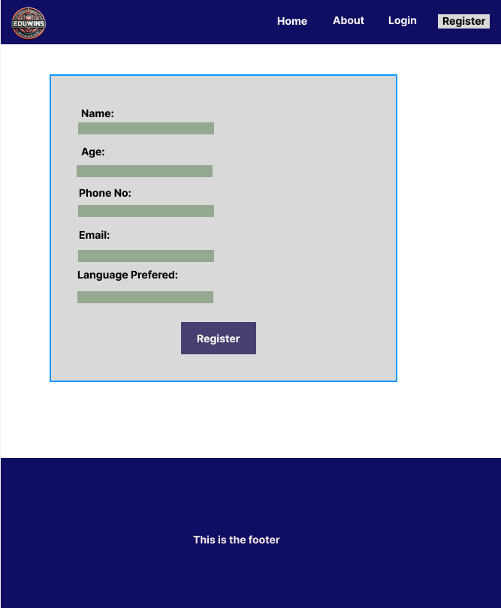
MODELLING
8

Slide 9

Thank you

