Slide 1
Group 6 Project
( EggEbb Team)
Unimaginable Super
Magic App
Use case+sequence diagram

Slide 2

Outline
Recap
Our ideas
Idea 1
Idea 2
Idea 3
Questions

Slide 3




Recap
Ideation from last presentation
“
App name：
ePost App 2.0
Goal：
Improve Chunghwa Post’s older version of the App
- make sure that no one has difficulties in managing
their own account.
“
1
2
3
4
e動郵局
(ePost)
Security App

Slide 4

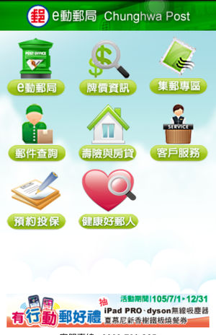
Recap
Science Behind from last presentation
User comments from four social platforms
Google play, App Store, PTT, Dcard
Product use problem
Login problem
Transaction problem
Interface unpractical
Network connection problem
1
2
3
4

Slide 5
Our Ideas
Log in
3
Transaction
1
2
Bitcoin transaction
Customer Service
Account information searching
4
10
Overall
ideas
Security&personal data
Design personal stamp
5
9
Package tracking
Receipt lottery
8
7
6
Payment
Postage calculation
Interest/exchange rate inquiry
interface

Slide 6
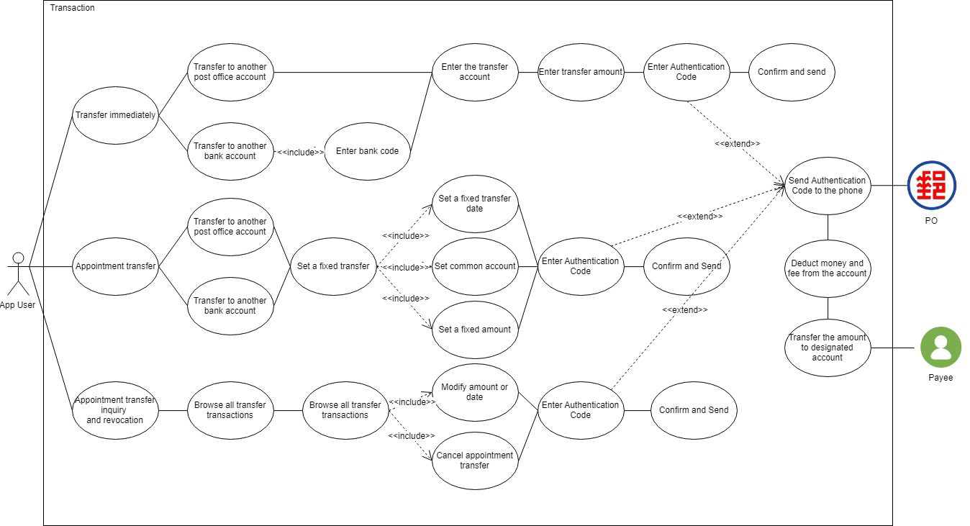
Idea 1 Transaction
Use case diagram

Slide 7
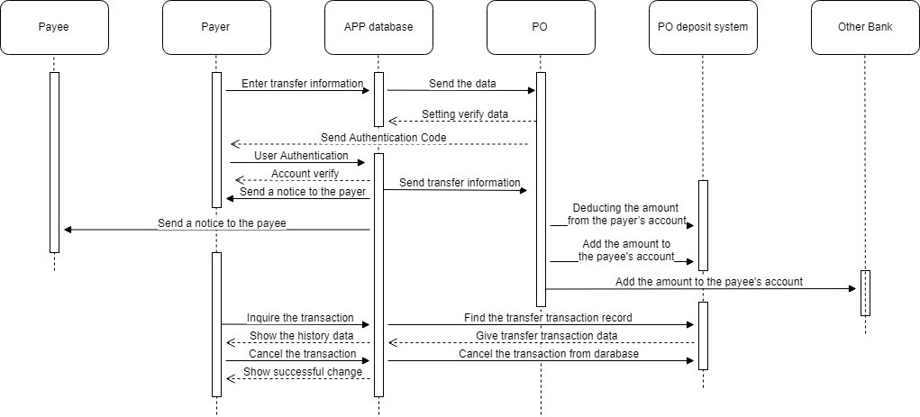
Idea 1 Transaction
Sequence diagram
Sequence diagram
Sequence diagram

Slide 8
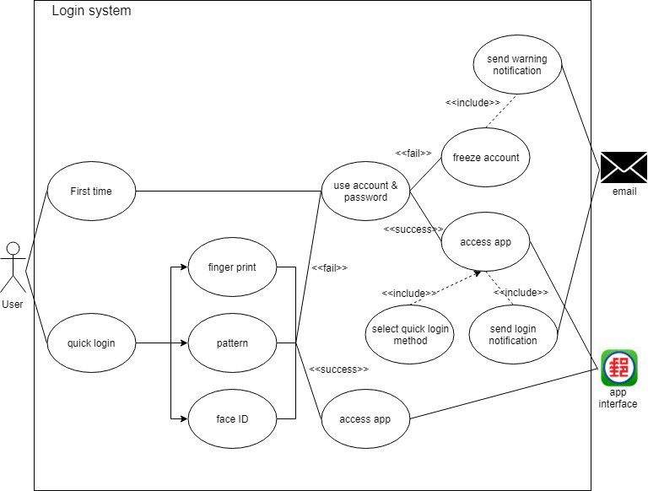
Idea 2
Log in
Use case diagram

Slide 9
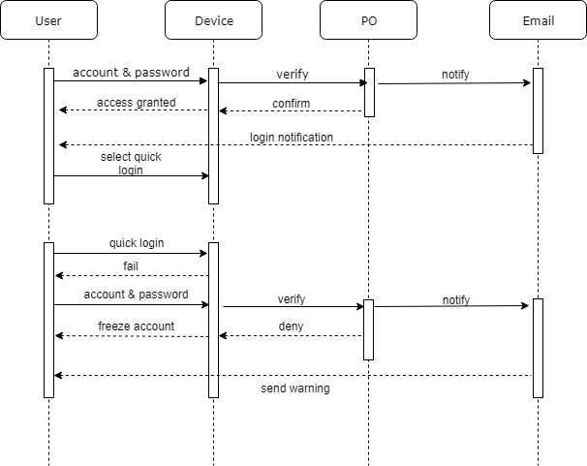
Idea 2
Log in
Sequence diagram

Slide 10
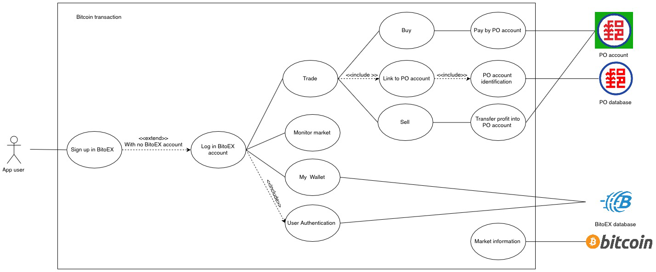
Idea 3
Bitcoin
Transaction
Use case diagram

Slide 11
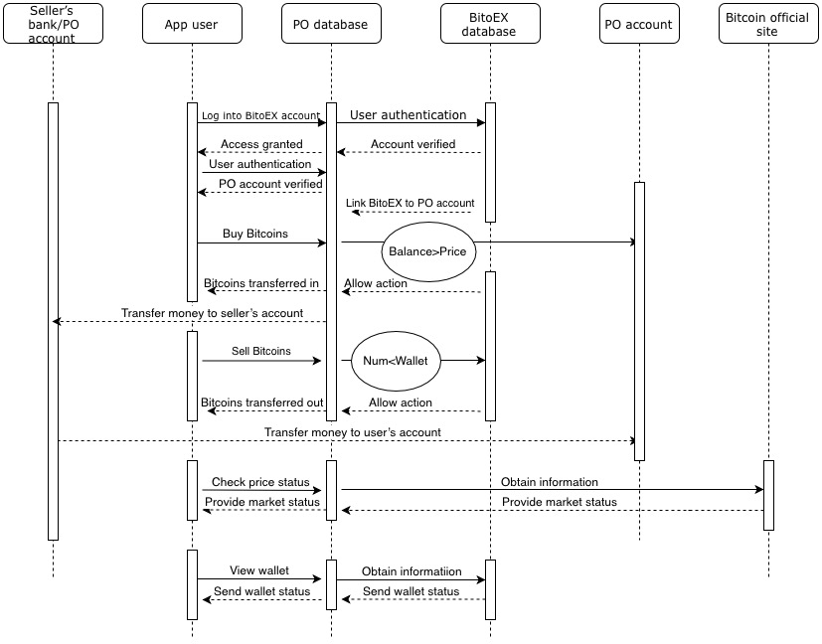
Idea 3
Bitcoin
Transaction
Sequence diagram
*Send message to confirm logging in Bitcoin transaction ( make sure it’s you)

Slide 12
Questions?

