Slide 1
Team 9
HW3

Slide 2
Idea : Classification of letters & packages
Currently, Chunghwa Post Co. classifies letters or packages by seeing the ZIP code on them, and they are all done by human. So we came up with an idea of changing the ZIP code into something that can be scanned. Just by scanning the code and go through the programming we designed, the classification then can be done easily.

Slide 3
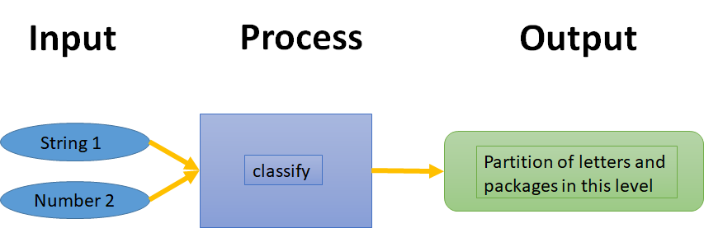
I-P-O Cycle
String 1 ：ZIP code( 5 integers )
Number 2 ：the least digit we hope to classify(1~5)

Slide 4
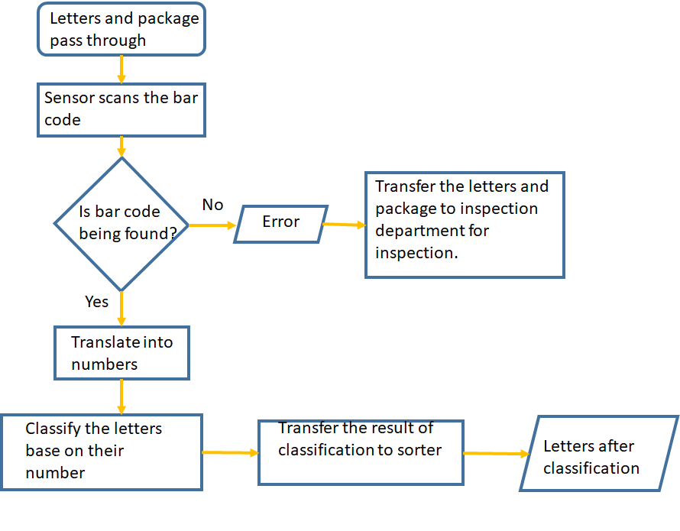
Flow chart

Slide 5
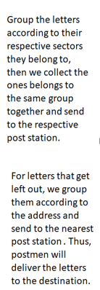
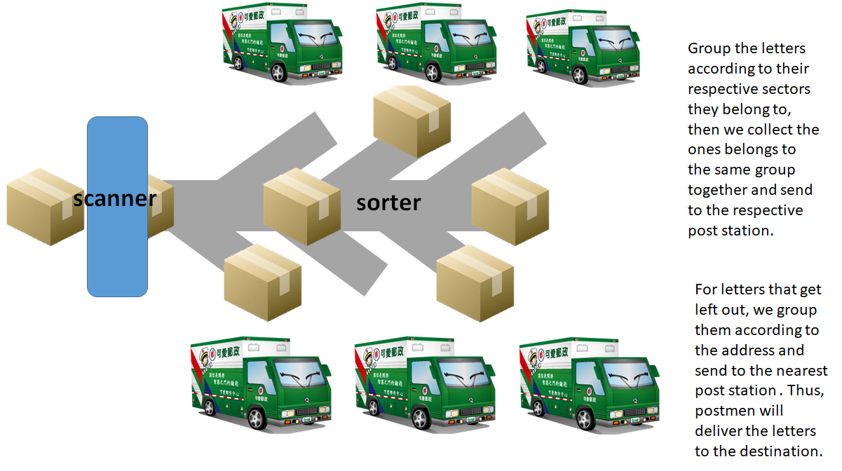
Sorting route

Slide 6
Searching
destination
scan
include
1
Trucks
classification
destination
include
packages
Weight
classification
1..*
conveyance

Slide 7
Searching
destination
Scan
include
1
Classification
Trucks
Destination
letters
1..*
Conveyance
Sorting system

Slide 8
sender
Post office
postman
recipient
package size
destination
Urgent/normal
quotation
money
receipt
package
package
sign

Slide 9
postman
computer
conveyor
trucks
destination
scan
information
Destination
(Postal code)
Urgent/normal
package
package
package

Slide 10
Thanks for listening !!

