Slide 1
Database
Android Nachos
Presentation-1
Presentation by:
Gandhapuneni Seshu Kumar
Yerasi Sridhar Reddy
Yeddluri Harish
Kurma Vinod Kumar
Bhootham Rakshit Anand
Peruru Ashish
Yanala Harish Reddy

Slide 2
Contents
What is a Database?
Types of data?
Types of databases?
NoSQL
Mobile backend as a service
What is Kinvey?
Advantages of Kinvey
What is SQLite?
Advantages of SQLite
Different databases for Android

Slide 3

What is a Database ?
A database is a collection of information that is organized, so that it can easily be accessed, managed and updated.
In one view databases can be classified according to types of content: bibliographic, full-text, numeric and images.
Image source: http://blog.hackerrank.com/new-domain-tuesday-hackerrank-reveals-data-structure-database-sql-challenges/

Slide 4
Types of Data ?
Relational
Tables/ Transaction/ Legacy Data
Text/ Semi structure
Web/XML
Graph
Social Network, Semantic Web

Slide 5
Types of Databases?
Relational Database
Operational Database
Distributed Database
End-User Database
Data Warehouses

Slide 6
NoSQL
NoSQL
Not Relational
Highly distributable and Scalable
High availability and fault tolerant
Supports large volumes of data
Example: Oracle NoSQL, Cassandra(Apache), BigTable(Google),
SimpleDB(Amazon), MongoDB

Slide 7
What is MBaaS ?
MBaaS stands for Mobile backend as a Service
It is an approach for providing web and mobile app developers with a way to connect their applications to backend cloud storage and processing while also providing common features such as user management, push notifications, social media integration, server side computing and other features that mobile users demand from their apps these days

Slide 8


Features of MBaaS
Rule Platform
Seamless Integration
Offline & Server Side rules to establish standard operating procedures as well as ensure compliance
BaaS helps reduce time-to-market. Implement with 50% less effort
Technology
App Security
MBaaS features, ensures application and data security
Low Memory footprint based platforms to support truly asynchronous operations with significant flexibility
MBaaS
Notifications
Multi Channel notifications through push, SMS, email across devices and platforms.
Data Synchronization
MBaaS provides End – to – End data sync framework, this ensures user always has latest data available on mobile Application
Enhanced Semantics
Ready Made Apps
Identity federation through Oauth to extract data from external platforms for augmented information
Kick start your customer mobility journey using ready made apps.

Slide 9
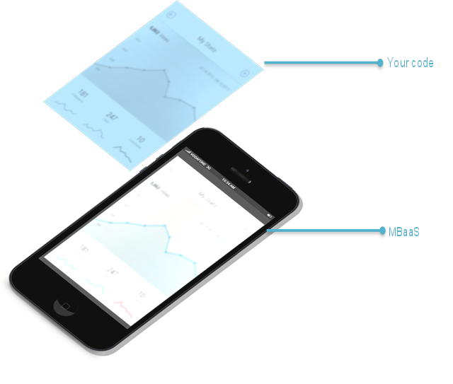
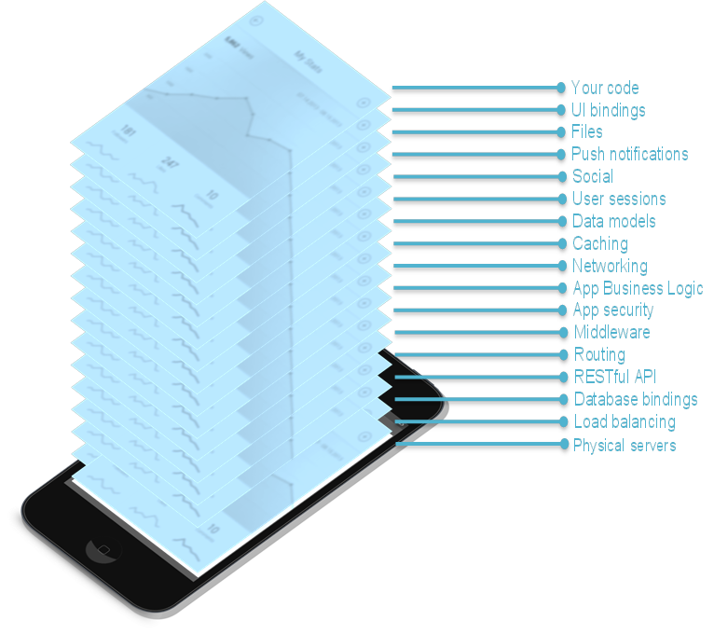
Why MBaaS is needed ?
When you are thinking to develop a new app, you have lot of steps like server setup, database creation, routing, social integration, UI binding, file management etc. that need to be solved:
Just imagine, you just focus only on your frontend code and the rest will bind together provided as a service as follows:

Slide 10











Major Players in MBaaS
We have a wide variety of MBaaS providers available in market. Main players are shown in the figure below. Major acquisitions MBaaS-focused expected to rule the mobile technology in the next years, like in these past examples: facebook-parse, google - kinvey, intel – Feedhenry ect

Slide 11
What is Kinvey ?
Kinvey Brings Identity To Mobile Backend As A Service (MBaaS)
Helps enterprises, agencies and developers launch successful and engaging apps with our MBaaS

Slide 12
Advantages of Kinvey
Supports native, hybrid and mobile web apps and delivers out of the box enterprise capabilities including
User authentication
Integration with enterprise data sources
Customized business logic

Slide 13
Advantages of Kinvey(Contd..)
Rich set of mobile services including
SMS
Push notification
Email alerts
Location services

Slide 14
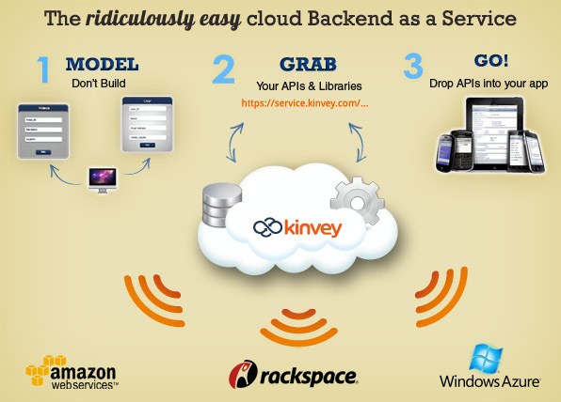
Image source: https://techcrunch.com/2011/08/04/kinvey-closes-2m-seed-round-for-its-backend-as-a-service-product/

Slide 15
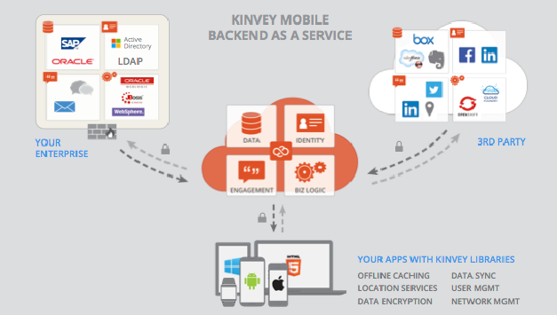
Image source: https://vcloudair.kinvey.com/

Slide 16
Benefits of using Kinvey
Empower Developers
Proven Platform
Up-to-Date
Time and Cost Savings

Slide 17
What is SQLite?
SQLite is an in-process library that implements a self-contained, server less, zero-configuration, transactional SQL database engine
The code for SQLite is in the public domain and is thus free for use for any purpose, commercial or private
By default, android supports SQLite for storing data in the mobile.

Slide 18
Advantages of SQLite
Database For The Internet Of Things
Application File Format
Website Database
Stand-in For An Enterprise RDBMS
Internal or temporary databases
Data analysis

Slide 19
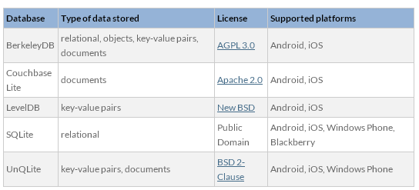
Different databases for Android

Slide 20
Thank You!!

