Slide 1
Introduction to Source Control
Team: Android Nachos
Harish Yeddluri
Harish Reddy Yanala
Vinod Kumar Kurma
Rakshith Anand Bootham
Ashish Peruru
Sridhar Yerasi
Seshu kumar Gandhapuneni

Slide 2
What is Source Control?
Source control is about managing versions of code, documents, etc.
Almost all the real-time projects use some kind of source control
It is essential for team projects and very useful for individual projects.

Slide 3
Why Source Control?
Working by yourself:
It gives you a chance to go back and check your earlier versions
Working with others:
It simplifies concurrent work, merging changes

Slide 4
Bitbucket
It is a web-based hosting service
Git is one of the Distributed Version Control (DVCS) tools that transfers code between your local system and Bitbucket Cloud
Notes:
Bitbucket is a web-based hosting service for projects that use either the Mercurial (since launch) or Git (since October 2011)revision control systems

Slide 5
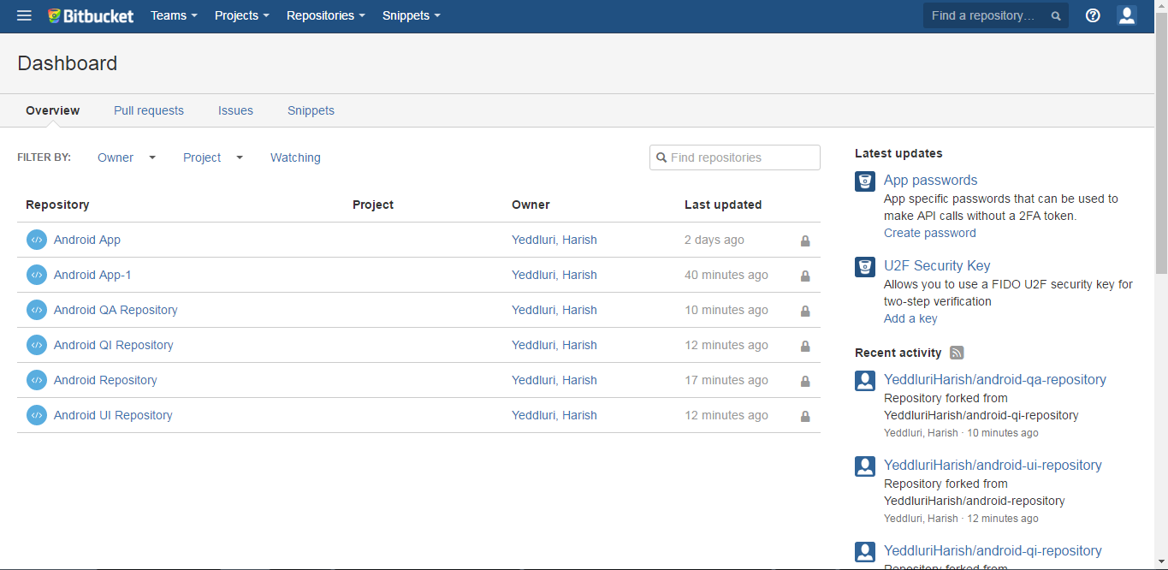
Bitbucket (Contd…)

Slide 6
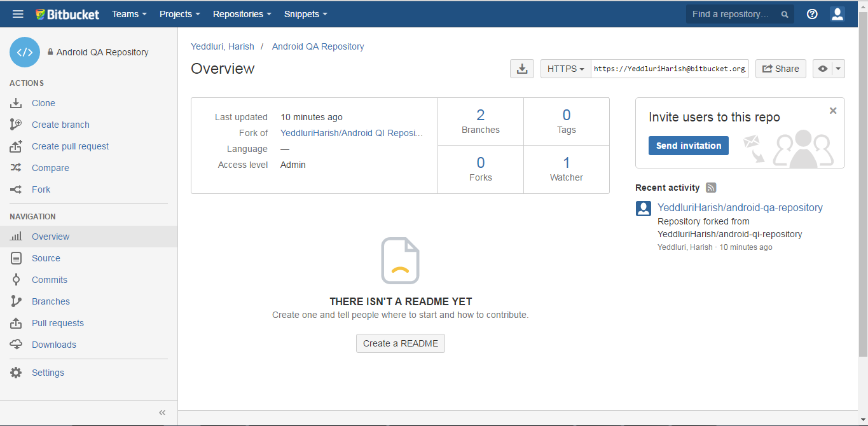
Bitbucket (Contd…)

Slide 7
Alternatives of Bitbucket
GitHub
GitLab
SourceForge
Launchpad
Phabricator
CodePlex
GitBucket
Kallithea & many more

Slide 8
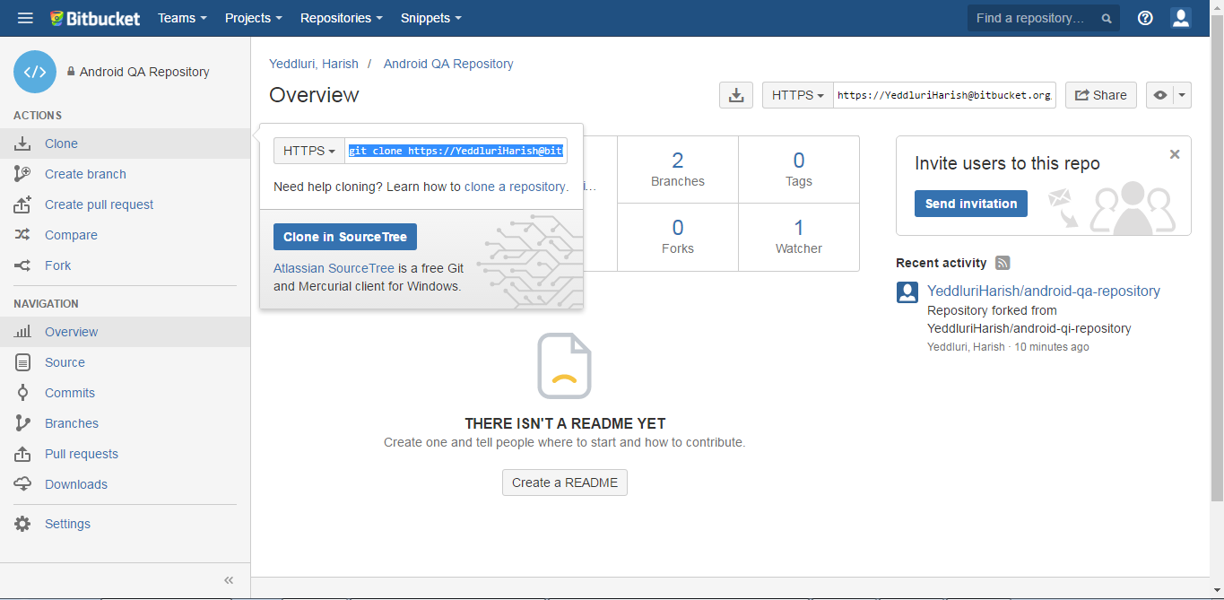
Bitbucket – fetch Repo URL

Slide 9
Diff b/w GitHub and Bitbucket
GitHub | Bitbucket
Private Repos – Not free | Unlimited Private Repos
Unlimited Collaborators | Free for 5 users
Provides enhanced search by showcasing popular topics | Provides simple search. Projects are only found if someone is specifically looking for it
Not easy to import from Bitbucket | Easy to import from GitHub

Slide 10
SourceTree

Slide 11
SourceTree
SourceTree is an open source GUI tool for handling the repositories.
SourceTree is a product of Atlassian
SourceTree simplifies interaction with repositories
It supports Bitbucket, GitHub etc.
Perfect for newbies

Slide 12
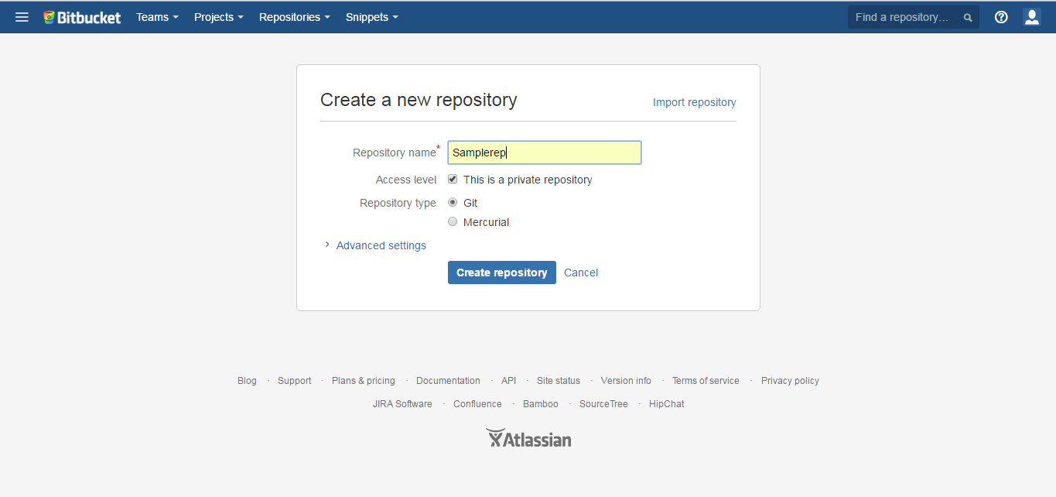
Steps for using SourceTree

Slide 13
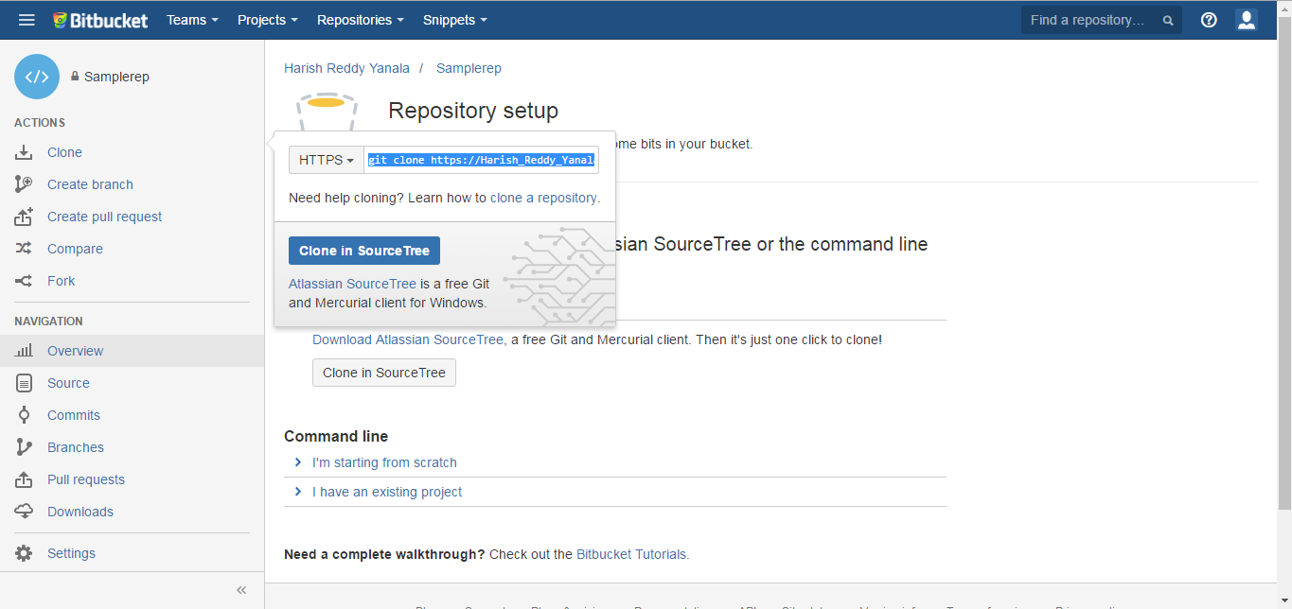
Steps for using SourceTree (Contd...)

Slide 14
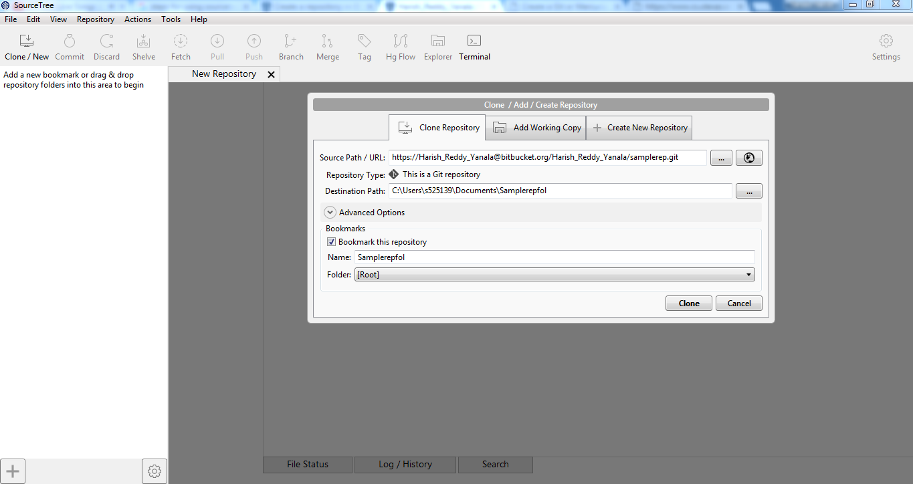
Steps for using SourceTree (Cont...)

Slide 15
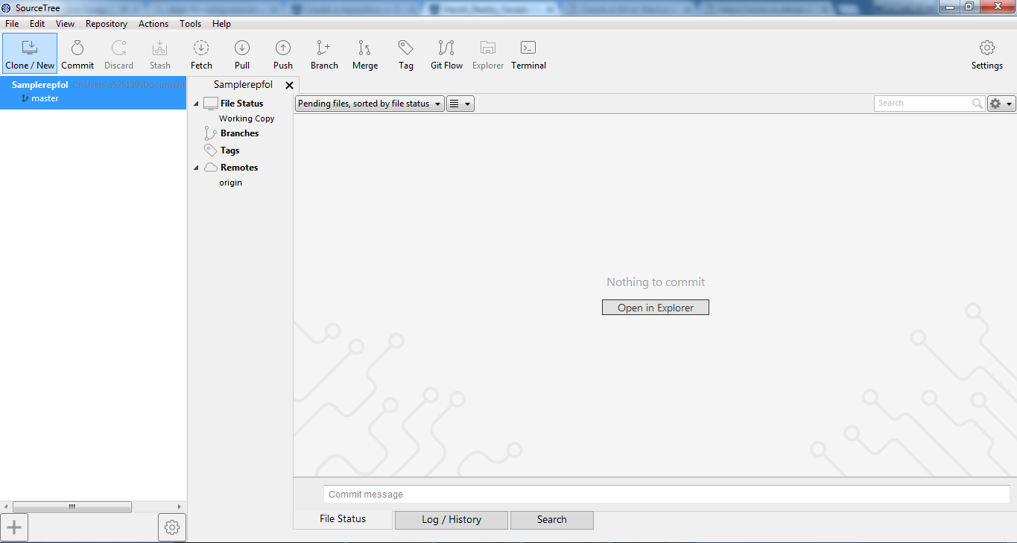
Steps for using SourceTree (Contd...)

Slide 16
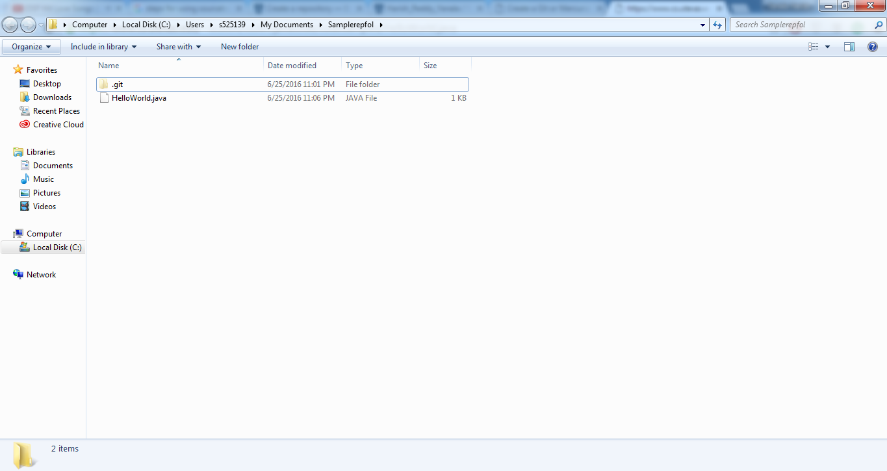
Steps for using SourceTree (Contd...)

Slide 17
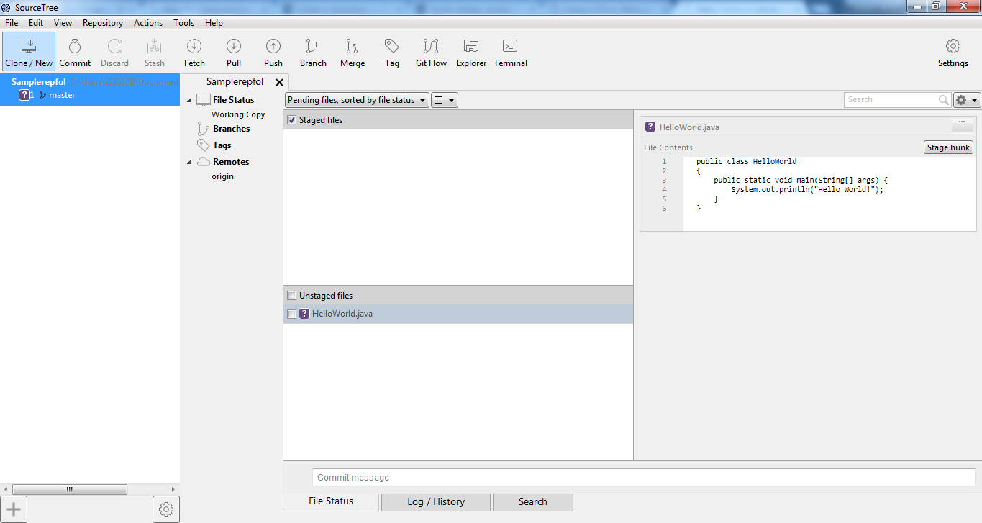
Steps for using SourceTree (Contd...)

Slide 18
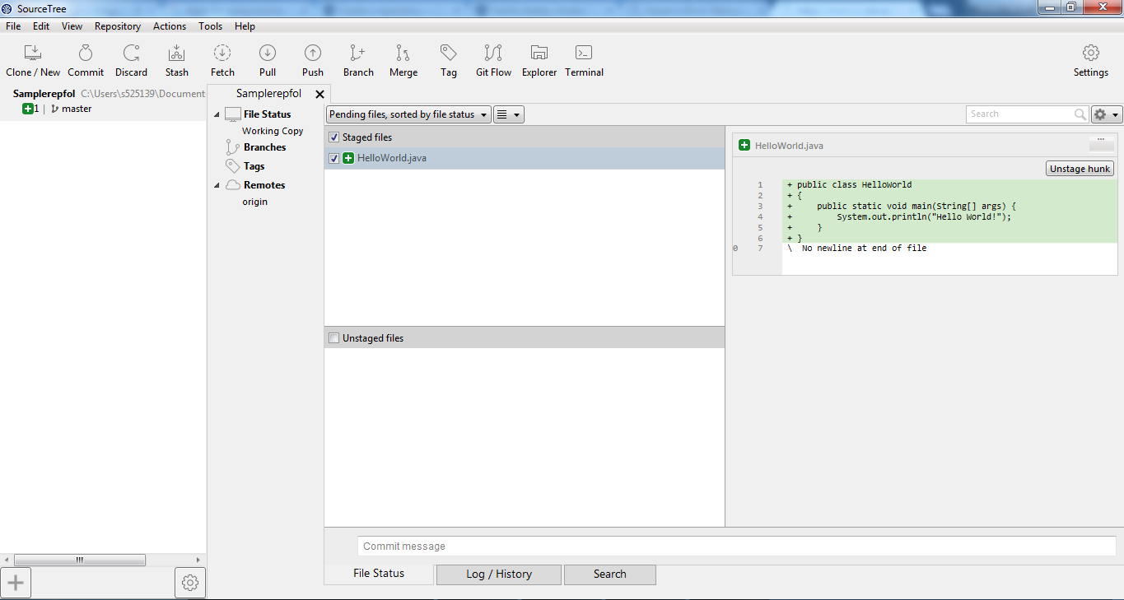
Steps for using SourceTree (Contd...)

Slide 19
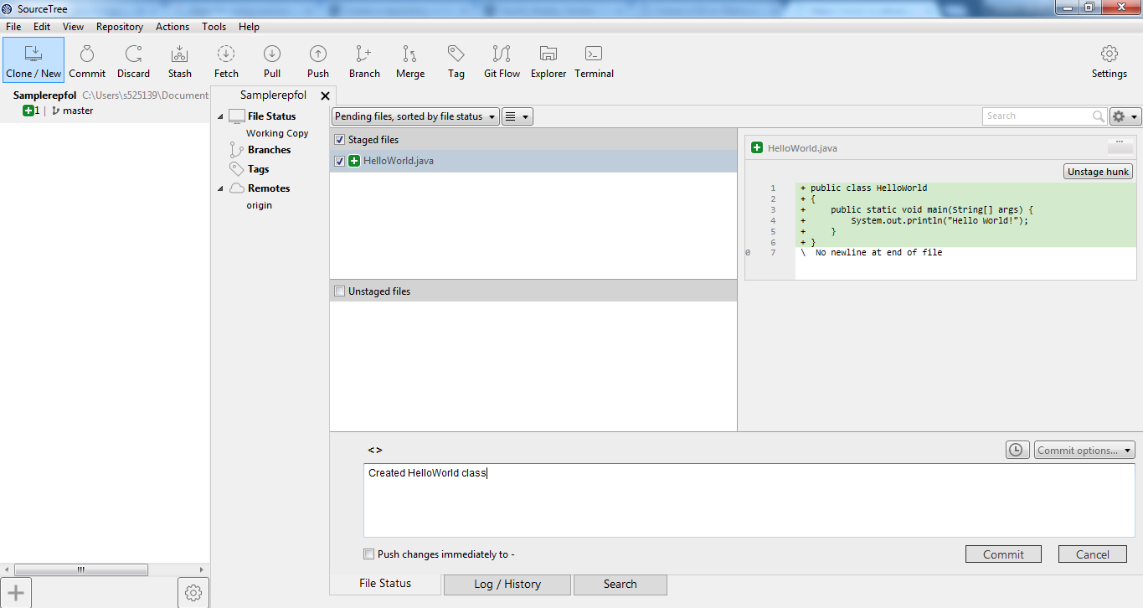
Steps for using SourceTree (Contd...)

Slide 20
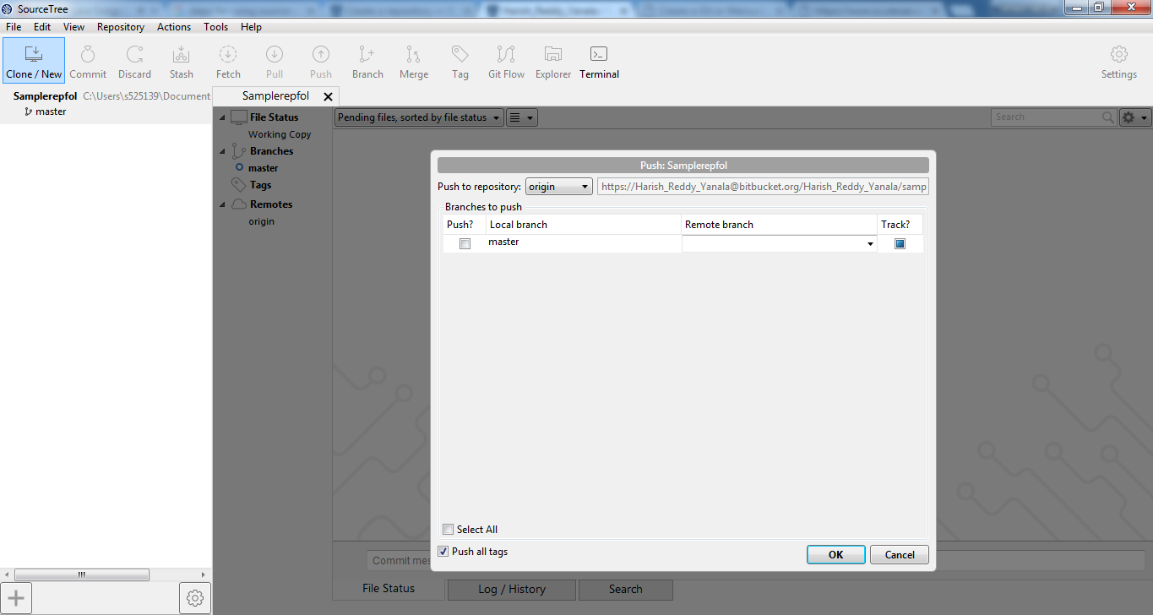
Steps for using SourceTree (Contd...)

Slide 21
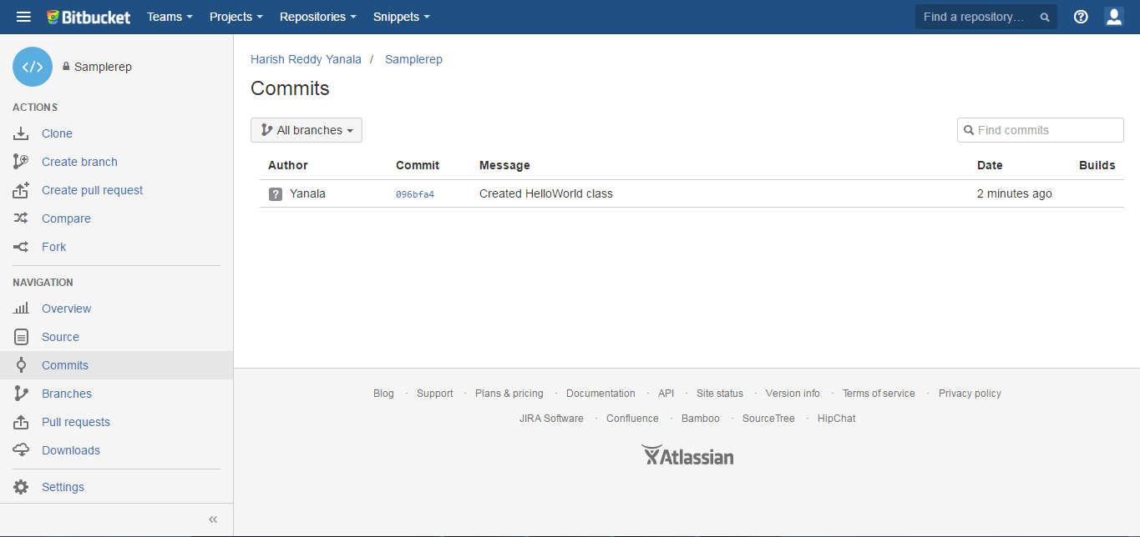
Steps for using SourceTree (Contd...)

Slide 22
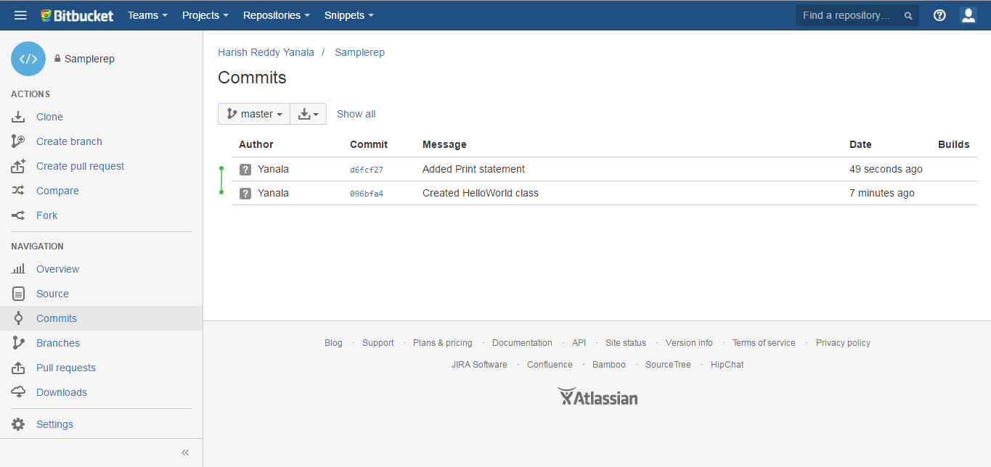
Steps for using SourceTree (Contd...)

Slide 23
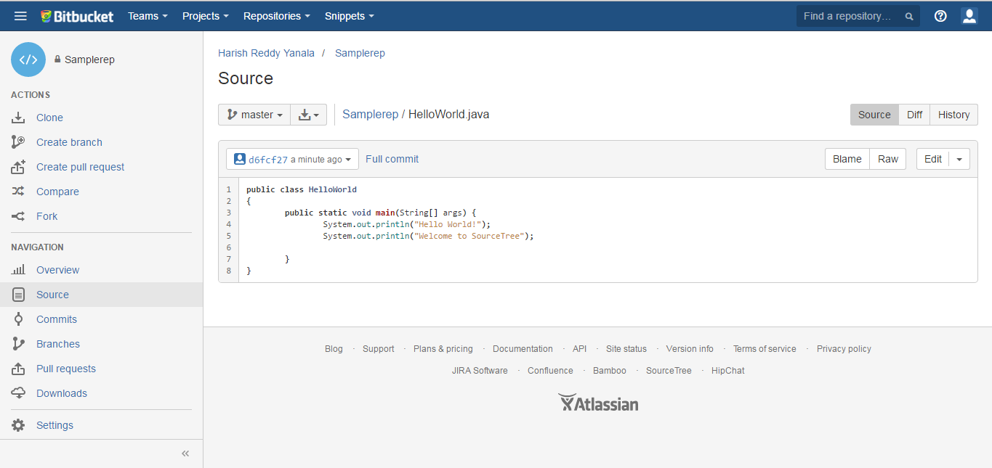
Steps for using SourceTree (Contd...)

Slide 24
Source Control (SC) using IDEs

Slide 25
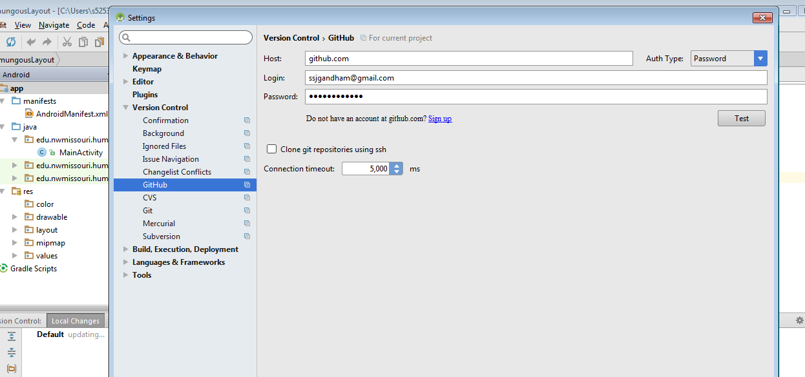
VCS – Android Studio

Slide 26
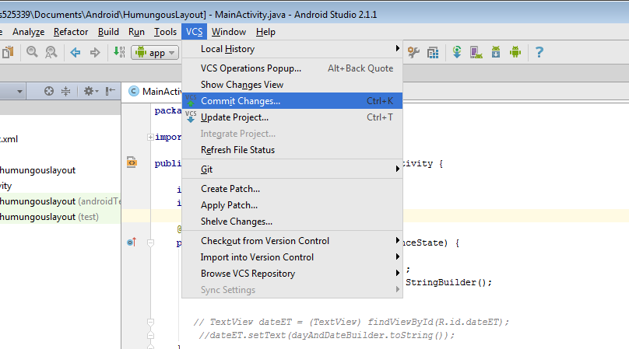
VCS – Android Studio (Contd…)

Slide 27
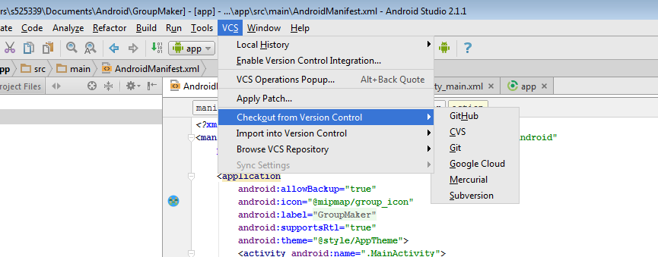
VCS – Android Studio (Cont…)

Slide 28
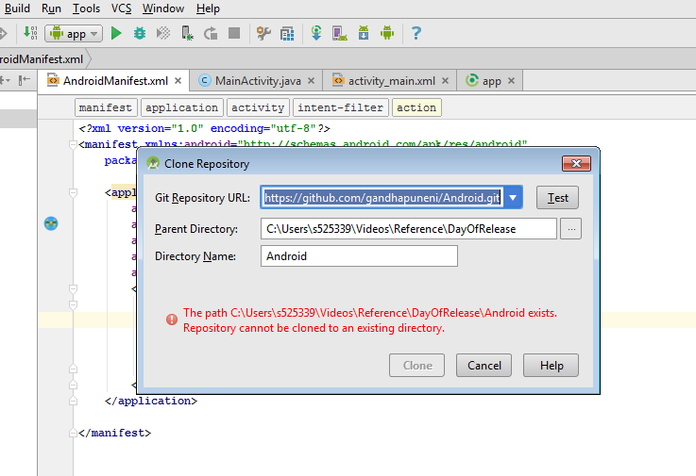
VCS – Android Studio (Cont…)

Slide 29
IDE Source Control
Benefits
Easier for developers to manage code.
Avoids checking-in wrong versions of code.
Users can instantly compare the code versions from the Repository.
Limitations
Procedure varies from Repository to Repository.
Too many options avoids using this feature in an IDE.
Users without proper training might mishandle these features.
Sometimes dependent on GitBash.

Slide 30
IDE – Support for SC
NetBeans
Eclipse
Xcode
Xamarin Studio
Visual Studio (Visual Studio Team services)

Slide 31
Git Bash

Slide 32
What is Git Bash?
Git is a mature, actively maintained open source project originally developed in 2005 by Linus Torvalds, the famous creator of the Linux operating system kernel.
Git Bash is a command line tool, which can be used to run Git commands in Windows.
Installation link
https://git-scm.com/download/win

Slide 33
Create and fill a repository
Tell git who you are..
git config --global user.name “Sam Smith”
git config --global user.email sam@example.com
Create a new local repository
git init
Add files
git add <filename> (or) git add *

Slide 34
Create and fill a repository
Commit
git commit -m “Commit message” (or)
git commit -a
Push
git push origin master
Status
git status
Search
git grep “foo()”

Slide 35
Pros and Cons of Git Bash
PROS:
Gives a better understanding of how git functions
Cross-platform
More control on file management
Works on any application that uses Git
CONS:
Steeper learning curve as compared to a GUI solution
Recalling is more difficult than recognizing

Slide 36
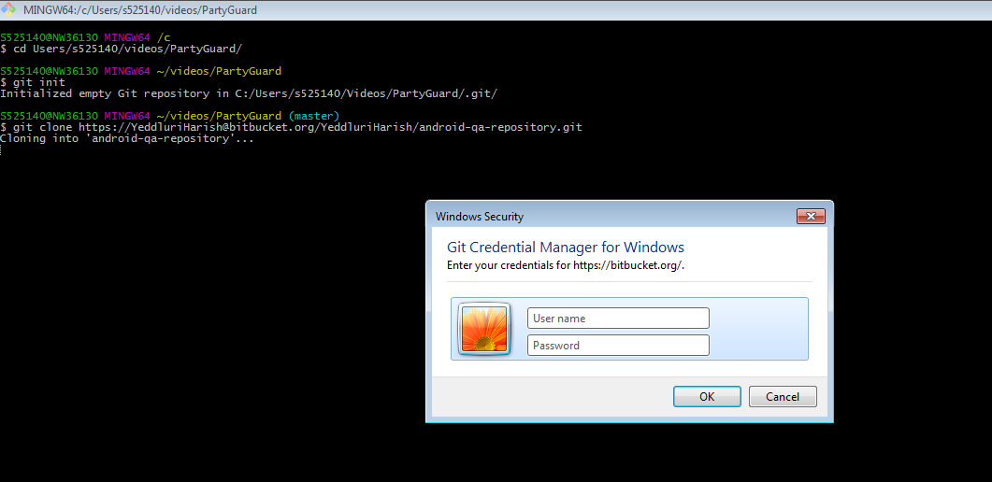
Git Bash – Command Line

Slide 37
THANK YOU

