Slide 1
Project Demonstration
- Android Nachos

Slide 2
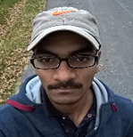
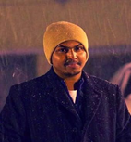
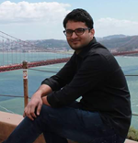
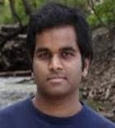
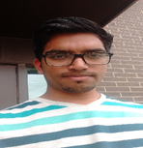
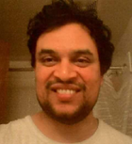
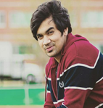
Team Members
Harish Reddy
Rakshith
Vinod Kumar
Seshu
Harish Yeddluri
Sridhar
Ashish Peruru

Slide 3
Outline
What have we done?
What are we doing?
What needs to be done?
Challenges faced
Lessons Learnt

Slide 4
What have we done?
Profile screens with services for basic, guard and host users
Edit profile for the basic user
Refresh functionality for Alert list in Guard
PGTeam screen with services
Guard Availability(PGTeam Toggle) with services
We have completed integrating the following functionalities with services:

Slide 5
What have we done?
Guard Alert List
Host Alert List
Claim Alert List
Resolve Alerts
Guard Alert History
Resolved validation issues with Login Activity and basic, guard user registration
We have completed integrating the following functionalities with services:

Slide 6
What are we doing?
Integrate screens as and when services are ready
Unit testing for the developed screens
User Documentation, User manual and cross team testing
We are working on:

Slide 7
What needs to be done?
Integrating the list of services for various users
Basic User : 4
Host User : 3
Guard User : 3
Unit testing and Integration testing
Documentation
We need to work on:

Slide 8
Challenges faced
Services Integration time frame
Data availability in the existing services
Collaborating with different teams
The following are the challenges that we faced while working on the project:

Slide 9
Lessons Learnt
It’s not all about programming
The following are the lessons that we learnt while working on the project:

Slide 10
Thank You

