Slide 1
PartyGuard Android - PM Briefing
Team: Android Nachos
Harish Yeddluri
Harish Reddy Yanala
Vinod Kumar Kurma
Rakshith Anand Bootham
Ashish Peruru
Sridhar Yerasi
Seshu kumar Gandhapuneni

Slide 2
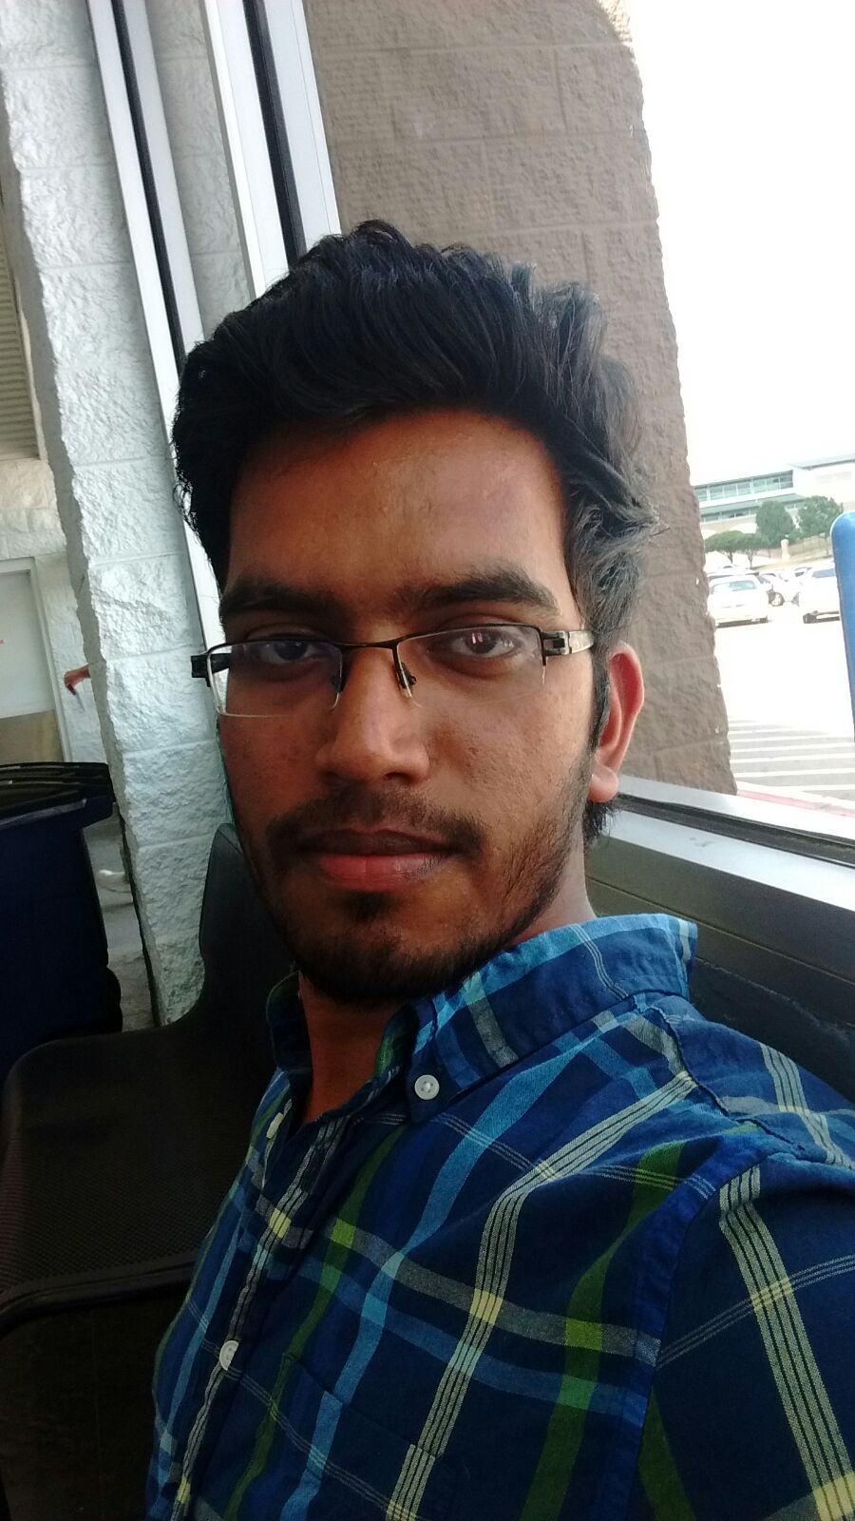
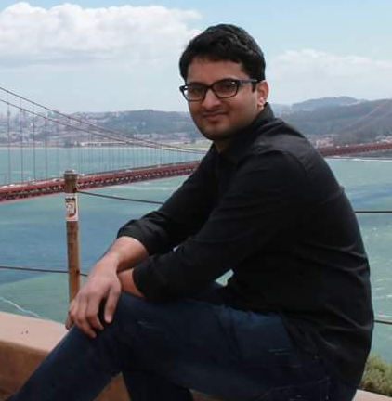
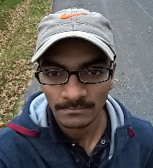
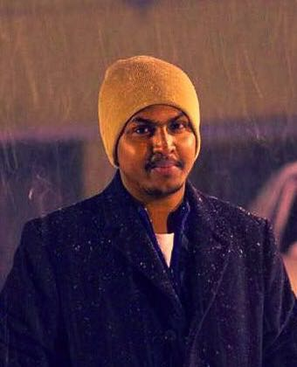
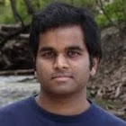
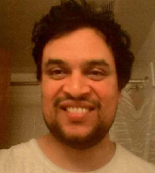
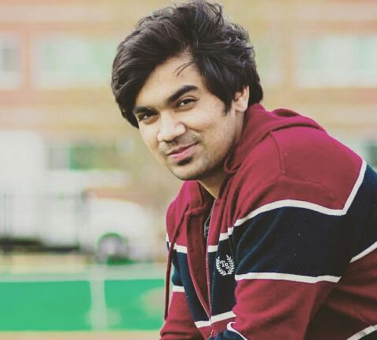
Android Nachos - Team Members
Harish Yeddluri
Vinod kumar Kurma
Harish Reddy Yanala
Rakshith Anand Bootham
Seshu Kumar
Gandhapuneni
Sridhar
Yerasi
Ashish
Peruru

Slide 3
Client Details
Name: Jacob Stansbury
E-Mail: S516098@mail.nwmissouri.edu

Slide 4
Agenda
Roles and Responsibilities in GDP -1
Introduction to “PartyGuard Android”
PartyGuard Architecture
Technologies Used
App Functionality
Roles and Responsibilities in GDP -2
Pending Artifacts
Team Dependency

Slide 5
Roles and Responsibilities – GDP 1
Requirements Discovery & Documentation – Seshu kumar Gandhpuneni
Creating UML diagrams – Rakshith Anand
User Interface Sketches (50%) – Harish Yeddluri
Feasibility Analysis – Harish Reddy Yanala
Documentation Formatting – Sridhar Yerasi
User Interface Sketches(50%) – Ashish Peruru
Interacting with the client – Vinod Kumar Kurma

Slide 6
PartyGuard Android
“PartyGuard” is an Android app that could be used by students of Northwest Missouri State University.
During a party at a fraternity house, if a person faces any problem, she can report about that issue to the fraternity members. She can report about various problems like fights, someone is too drunk/sick, inappropriate behavior, and assaults of any kind. The fraternity members can view the reported notifications and they will send the rescue team to the spot. Separate to these other alerts, the emergency button feature will have a running timer and if the problem is not solved within 15 minutes an alert message will be sent to campus police.

Slide 7
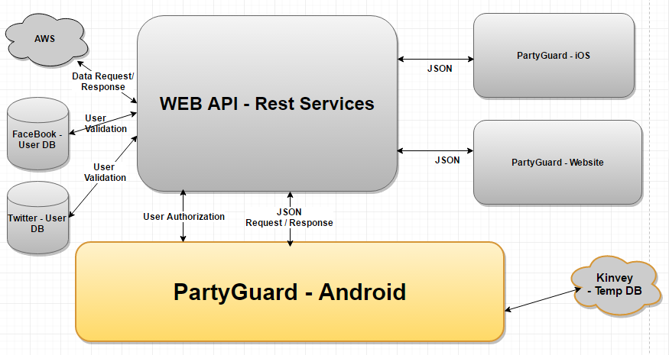
PartyGuard Architecture
Seshu Kumar
Gandhapuneni

Slide 8
Technologies & Tools
Java
Android Studio
GenyMotion (Emulator for Android)
Kinvey DB
BitBucket (Source code hosting site)
Lint (Code scanning tool for Android Studio)

Slide 9
App Deployment
During development, we are planning to deploy this app to a mobile or a tablet.
We will be providing demo using Vysor app.
Note: Vysor app lets you view and control your Android on your computer.
For production, Android apps can be published only through google store
Developers need to register for a Google Play publisher account
Details about publishing the app
https://developer.android.com/distribute/googleplay/start.html

Slide 10
App Functionality - Basic User

Slide 11
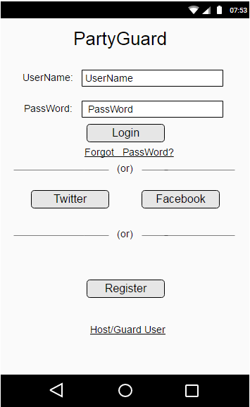
User Login Screen
Rakshith Anand Bootham

Slide 12
User Login Screen – Cont..
Username can have small case letters, upper case letters and numbers. It must have a length of 3 to 15 characters.
Password must consist of at least one small case letter, upper case letter, a number and a special character. It must have a length of 8 to 16 characters.
Password is encrypted before storing it in Database.
User can also login from Facebook, twitter by clicking on respective icons.
If user clicks on Register button, user will be redirected to registration page.
If the login is successful, user should be redirected to “How to use app?” screen. “How to use the app” will be a short video/picture tutorial to help users recognize on how to use the app
Rakshith Anand Bootham

Slide 13
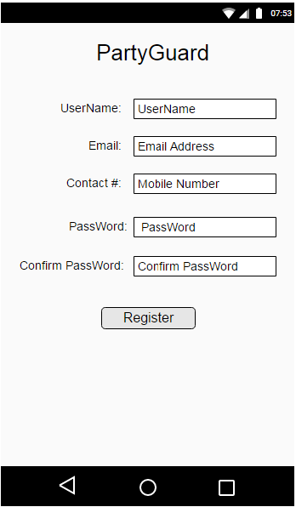
Registering User Screen
Rakshith Anand Bootham

Slide 14
Registering User Screen – Cont..
User should provide following details during registration like Username, E-mail, Contact number, Password, Profile picture, Birth date, University
Application checks the availability of the username and if the password match
Application should send a confirmation SMS message to the phone number entered to make sure the correct phone number is linked up to the app
New user details are added to the database
Rakshith Anand Bootham

Slide 15
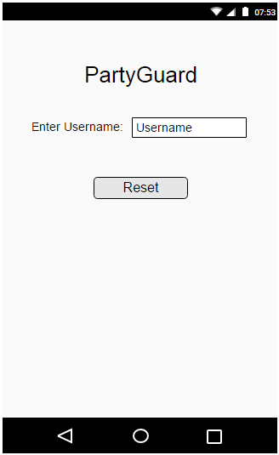
Reset Password
Harish Reddy Yanala

Slide 16
Reset Password-Cont..
User can reset his/her password by providing the user id.
User needs to provide “User ID” of his/ her account and click on “Reset” button
Based on the user id provided by the user, app fetches the corresponding email of the user from database. It is mandatory that every user should provide their email ID during registration.
An email is sent to the user with password details.
Harish Reddy Yanala

Slide 17
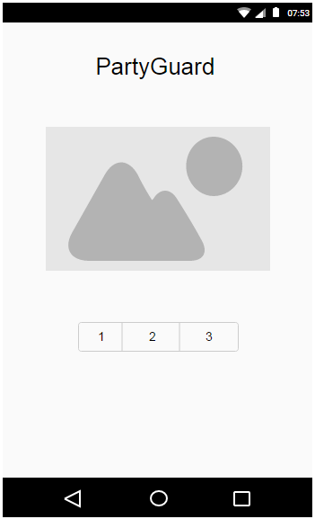
How to use this app?
Harish Reddy Yanala

Slide 18
How to use this app? - Cont..
User will be redirected to “How to use this app?” screen, when user logins for the first time.
User will be provided with a slider that contains images/ video that instructs user on how to use “PartyGuard” app.
Images and Video links are shown on the page in the slider.
Harish Reddy Yanala

Slide 19
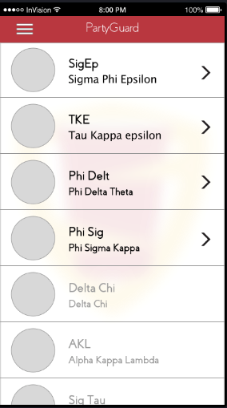
Fraternities Screen
Seshu Kumar
Gandhapuneni

Slide 20
Fraternities Screen – Cont..
The List of fraternities that are available in the user’s location are enabled for user to select.
Along next to the names should be a small image of the fraternity house provided by the Host user via the website.
Fraternity houses need to pay fees in order utilize this app.
If the fraternity has not paid for the usage of this app, the fraternity option is not enabled in this screen.
Seshu Kumar
Gandhapuneni

Slide 21
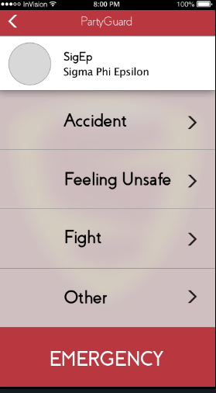
Report Issue Screen
Seshu Kumar
Gandhapuneni

Slide 22
Report Issue Screen – Cont..
User can select from a category of the issue from the list.
By selecting the type of issue, user would be navigated to Locations screen i.e., alerts are not sent from this screen.
User can also select emergency button which would then ask the user if they were sure if they wanted to send the alert. If it is confirmed this feature allows the user to skip the location screen in order to send the alert faster. This is the only button that will trigger the University Police alert after 15 minutes.
All other alert types are treated as less severe and will not trigger Police regardless of Guard User response time.
Seshu Kumar
Gandhapuneni

Slide 23
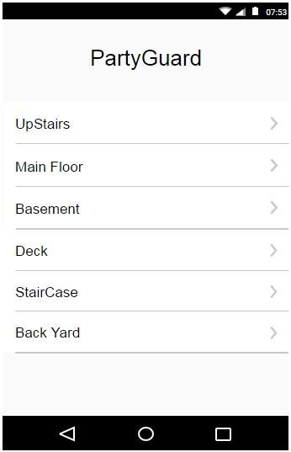
Report Location Screen
Harish Yeddluri

Slide 24
Report Location Screen – Cont..
User selects the place where the issue is..
The location (or) floor list in this screen is populated based on the data provided by host user during registration of a Fraternity house.
The location selected in this screen will be included in the notification that is sent to the respective Fraternity members
If the location list is not loaded from the database, app should not crash.
Harish Yeddluri

Slide 25
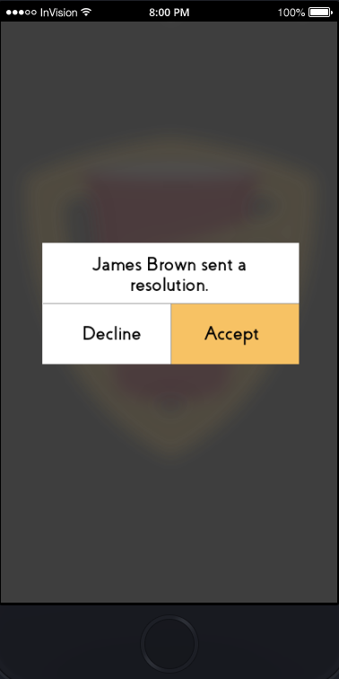
Resolution Alert
Harish Yeddluri

Slide 26
Resolution Alert - Cont..
Host user can push a notification to the basic user (user who submitted the issue) to confirm if the issue is resolved.
A pop-up message is shown on the screen of the basic user to confirm the resolution of the issue.
The option chosen by the basic user from the popup (Accept or Decline) is notified to the Host (or) Guard user.
Harish Yeddluri

Slide 27
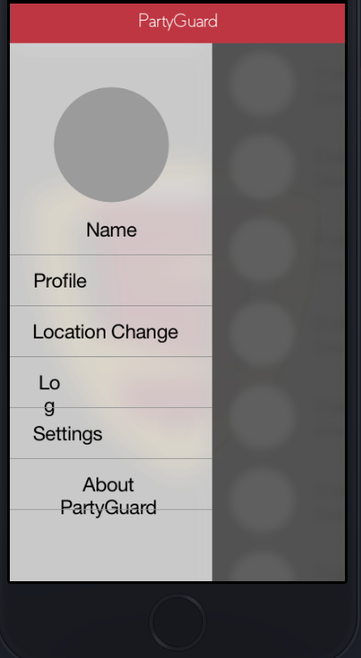
Profile Dropdown Menu Screen
Vinod kumar Kurma

Slide 28
Profile Dropdown Menu Screen-cont..
This screen can be navigated by swiping from the left end of the screen (or) by clicking the dropdown menu from the top left end of the screen.
By selecting the Location change option the user can change his current location.
When the user selects the settings option he can change the profile picture or name on the profile
When the user selects About Party Guard option he will be directed to the detail information page about Party Guard where he can read and know how to use the App.
Vinod kumar Kurma

Slide 29
App Functionality - Host (or) Guard User

Slide 30
Host User Login Screen
Vinod kumar Kurma

Slide 31
Host User Login Screen – Cont..
The host user would be redirected to the login page when he/she opens the app and clicks on the Host User Login
User would be auto logged in after the first login
Vinod kumar Kurma

Slide 32
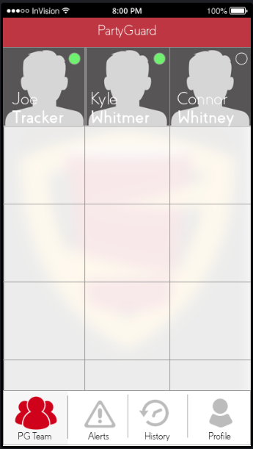
PG Team Screen
Sridhar
Yerasi

Slide 33
PG Team - Cont..
This screen shows the guard members who are in that fraternity
The ones in green are the only members who will receive alerts. If they are not highlighted green by the host user, they will not receive any alerts
Host user can switch on/off the option of receiving notifications for this user
The profiles of the guard members will be displayed when the host user clicks on the image
Sridhar
Yerasi

Slide 34
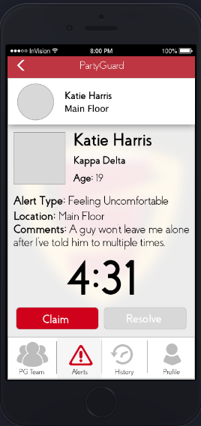
Alert Screen
Sridhar
Yerasi

Slide 35
Alert Screen- Cont..
Host user can see the list of all unresolved alerts reported to the fraternity.
The information regarding the alert, will be populated. The time elapsed after submitting the issue will be shown on the screen.
If no one is handling that particular alert, “claim” button will be enabled. Any fraternity member can claim and confirm it.
The name of the person who claimed the alert will be sent to the basic user. To all the other guard members “Claim” button in the screen will be replaced by the name of person who claimed the alert.
Sridhar
Yerasi

Slide 36
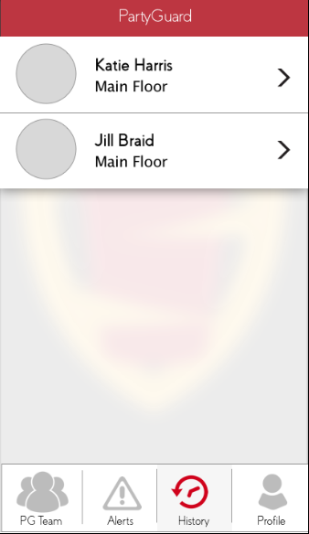
History Screen
Ashish
Peruru

Slide 37
History Screen – Cont..
The host user can be able to see the issues that were resolved from the past few days when he clicks on the History tab.
All the issues will have the time at which the issue was solved and all the information about the issue such as the user and type of the issue.
Ashish
Peruru

Slide 38
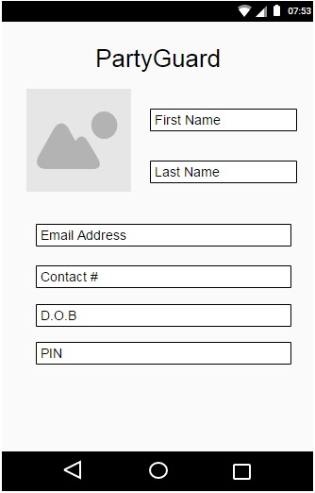
Host/Guard Profile Screen
Ashish
Peruru

Slide 39
Host/Guard Profile Screen - Cont..
Host/Guard User should be re-directed to the profile page when he clicks on Profile tab in the Host/Guard landing screen
Host/Guard could edit his/her details in the screen
New user details are updated to the database
The updated details are shown on the profile screen of the Host/Guard user.
Ashish
Peruru

Slide 40
Roles and Responsibilities – GDP 2
Primary Contact – Rakshith Anand
Client Management – Vinod Kumar Kurma
Requirement Management – Seshu
Data Management(Kinvey & Rest Services) – Harish Yeddluri & Sridhar Yerasi
Quality & Testing Management – Ashish Peruru
Documentation & Communication Management – Seshu
Issue Management – Harish Reddy Yanala

Slide 41
Pending Artifacts
Test Case documents

Slide 42
Team Dependencies
We would need to work with Rest Services team
Android app needs to integrate with REST services to perform CRUD operations on AWS data.

Slide 43
THANK YOU

