Slide 1

Workshop-2
Srilatha Reddy Abbu
Navya Bachati
Harish Reddy Yanala
Sai Sumanth Kattekola
Pushpak Godavarthi
Gowtham Karanam
Sharath Regonda
Kishore Varakala

Slide 2








TEAM
Srilatha Reddy Abbu
Navya Bachati
Harish Reddy Yanala
Sai Sumanth
Pushpak Godavarthi
Gowtham Karanam
Sharath Regonda
Kishore Kumar Varkala

Slide 3
Overview
Usability Requirements
Testing
Types of testing
Testing Tools
Issue Tracking

Slide 4
Usability Requirements
Srilatha Reddy Abbu
Navya Bachati

Slide 5
Usability
It refers to the elegance and clarity
Consists of 5 factors
Ease of learning
Task efficiency
Ease of remembering
Understandability
Subjective satisfaction
Srilatha Reddy Abbu
Notes:
- In human-computer interaction and computer science, Usability refers to the elegance and clarity with which the interaction with a computer program or a website is designed

Slide 6
Usability Requirements
Requirement specification deals with functional requirements
Every designer wants to build high-quality interfaces
Helps to measure the usability
Must be tangible
Srilatha Reddy Abbu
Notes:
Quality means features such as usability, usefulness, and universality
Usability requirement specifies that to what a product can be used by specified users

Slide 7
Usability Requirements (Contd..)
Goals for requirement analysis:
Ascertain the users’ needs
Ensure proper reliability
Promote appropriate standardization, integration, consistency, and portability
Complete projects on schedule and within budget
Srilatha Reddy Abbu
Notes:
Usability requires project management and careful attention to requirement analysis and testing for clearly defined objectives.

Slide 8
Components of Usability Requirements
What task should the user accomplish?
Who will accomplish the task?
What conditions will the task be performed under?
How well should the task be performed?
Srilatha Reddy Abbu

Slide 9
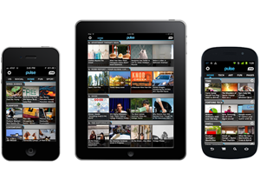
Usability Issues example
Pulse App
The Pulse news reader interface was designed for iPad
Srilatha Reddy Abbu
Notes:
Pulse is a classic example of how not to design for multiple devices. Its interface was designed for iPad and it worked great there, but the problem started when the exact same UI was scaled down for the iPhone
Users expect delightful experiences across devices.
UIs created for one device may not work for others.

Slide 10
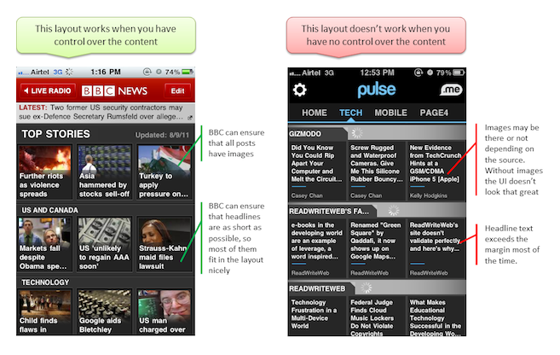
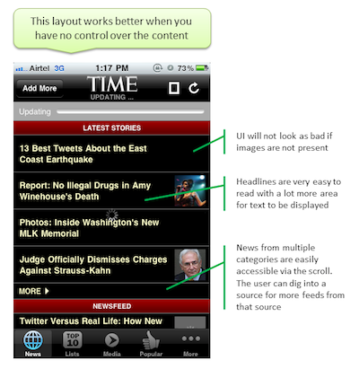
Pulse app (contd..)
Suggestion
Srilatha Reddy Abbu

Slide 11
Usability Requirements (contd..)
Examples of potential requirements:
Understandability
Learnability
Operability
Attractiveness
Navya Bachati
Notes:
Usability requirements are hard because the only way to know if your system is usable is by having real users try it out.

Slide 12
Usability Requirements (contd..)
Usability includes:
Human factors: what characteristics will make it more pleasant to use
Help: what Help will the user have available
Documentation: what documentation will be created to help how to use the product
Navya Bachati

Slide 13
Usability Requirements (contd..)
Understandability
All the content in the interface should be designed in such a way that it should be easily understand
Attractiveness
The screen layout and color should be appealing
Navya Bachati

Slide 14
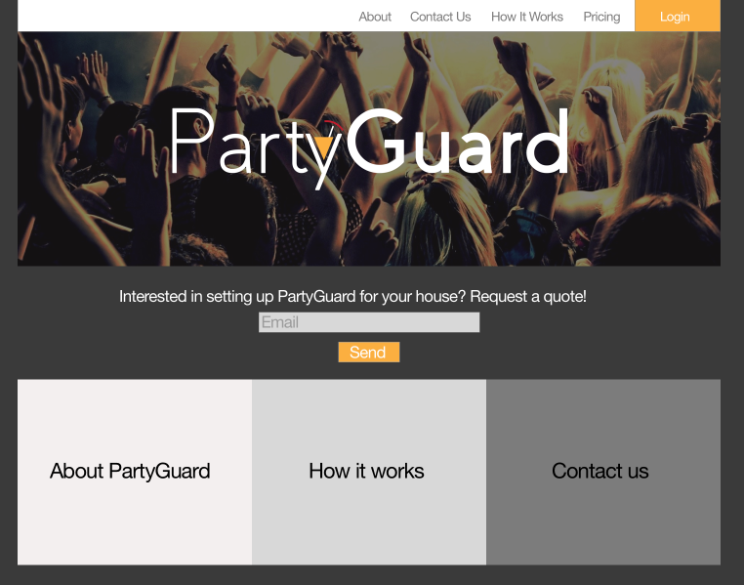
Usability Requirements (contd..)
Navya Bachati

Slide 15
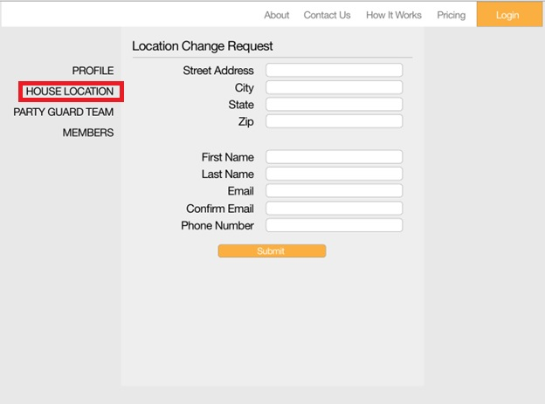
Usability Requirements (contd..)
Navya Bachati

Slide 16
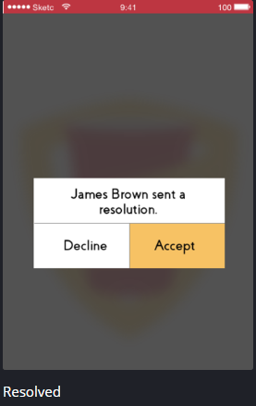
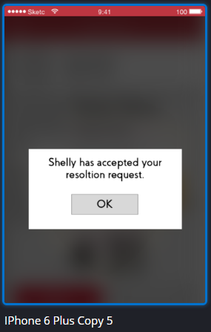
Usability Requirements (contd..)
Navya Bachati

Slide 17
Issue tracking and “to-do” items
Issue tracking:
By Issue tracking tools in Bitbucket raise issue tickets to relevant member
To-Do:
Trello-web-based project management application
Navya Bachati

Slide 18
Testing
Harish Reddy Yanala
Sai Sumanth Kattekola

Slide 19
Software testing
A process of executing a program or application with the intent of finding the software bugs
Validating and verifying that a software program meets the intended requirements
It helps to identify any gaps, errors, or missing requirements.
Harish Reddy Yanala

Slide 20
Types of testing
Based on the way of testing, testing can be classified into two types.
Manual testing
Automated testing
Testing can be done in either of the two ways
Even both can be performed
Harish Reddy Yanala

Slide 21
Manual testing
Testing a software manually, i.e. without using any automated tool or any script
Tester takes over the role of an end-user and tests the software to identify the bugs
Test plan document is prepared which acts as a guide
Test cases, which are has a set of test data, expected and actual results, status etc.
Harish Reddy Yanala
Notes:
Test plan document- workflow of testing, types of methods , coverage of modules etc.

Slide 22
Test case template
Test Case ID: | Test Designed by:
Test Priority (Low/Medium/High): | Test Designed date:
Module Name: | Test Executed by:
Test Title: | Test Execution date:
Test case Id | Test case description | Test steps | Test data | Expected result | Actual result | Status | Notes
Harish Reddy Yanala

Slide 23
Stages of manual testing
Unit Testing
Integration Testing
System Testing
Acceptance Testing
Harish Reddy Yanala

Slide 24
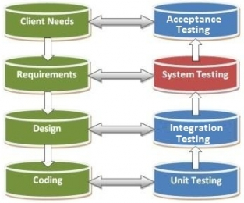
Stages of manual testing (cont..)
Source: http://www.professorrao.com/2014/04/system-testing-what-why-how.html
Harish Reddy Yanala

Slide 25
Unit testing
Very first level of software testing process
A testing technique in which smallest part of individual modules are tested to determine if there are any issues
Performed by developer himself
Performed by using white box, black box and grey box testing
Harish Reddy Yanala
Notes:
whole point of white-box testing is the ability to know which line of the code is being executed and being able to identify what the correct output should be

Slide 26
Unit testing (cont..)
White box testing- testing the application at the level of the source code
Black box testing- testing the user interface, input and output
Grey box testing- combination of both white box & black box testing techniques
Harish Reddy Yanala

Slide 27
Integration testing
Process in which all the individual units of software are combined together and tested
Performed by developer himself
Purpose is to expose faults in the interaction between integrated units
Test stubs and test drivers are used
White box testing is used
Harish Reddy Yanala
Notes:
Stubs and drivers (dummy programs) are used to replace the missing software. Stubs are "called programs“. Drivers are "calling programs”.

Slide 28
System testing
Performed on complete integrated software application to ensure requirements are met
Carried out after the completion of integration test
Testers try to break the system/software by entering invalid data that may cause the system to fail
Doesn’t required knowledge of internal design or structure or code
Harish Reddy Yanala

Slide 29
Acceptance testing
Performed to determine whether or not the software system has met the requirement specifications
Main purpose of this test is to evaluate the system's compliance with the business requirements
Basically done by the user or customer although other stakeholders may be involved as well.
Harish Reddy Yanala

Slide 30
Acceptance testing (cont..)
Types of Acceptance testing:
Alpha testing- performed by members of Product Management, Sales and/or Customer Support
Beta testing- performed by end users of the software
Harish Reddy Yanala

Slide 31
Roles & responsibilities of s/w tester
Analyzing the requirements from the client
Participating in preparing test plans
Preparing test scenarios
Preparing test cases for module, integration and system testing
Preparing test data for the test cases
Preparing test environment to execute the test cases
Analyzing the test cases prepared by other team members
Executing the test cases
Sai Sumanth

Slide 32
Roles & responsibilities of s/w tester (cont..)
Defect tracking
Giving mandatory information of a defect to developers in order to fix it
Preparing summary reports
Preparing lessons learnt documents
Preparing suggestion documents to improve the quality of the application
Communication with the test lead / test manager
Conducting review meetings within the team
Sai Sumanth

Slide 33
Advantages of manual testing
Short-term cost is lower
More likely to find real user issues
Manual testing is flexible
It allows the tester to perform more ad-hoc (random testing)
Manual testing of UIs is most effectively done by humans
A software’s UX can only be evaluated by human testers
Sai Sumanth

Slide 34
Disadvantages of manual testing
Repetitive and boring
Running test manually is very time consuming job
Certain tasks are difficult to do manually
Relative to the amount of code coverage, manual tests are inefficient
Prone to human error leading to misleading results
Load testing and performance testing is not possible
Sai Sumanth

Slide 35
Automated testing
Also known as Test Automation
Tester writes scripts (VB script) and uses another software to test the product
Used to re-run the test scenarios that were performed manually, quickly, and repeatedly
All GUI items, connections with databases, field validations, etc. can be efficiently tested
Sai Sumanth

Slide 36
Automated testing process
Identifying areas within a software for automation
Selection of appropriate tool for test automation
Writing test scripts
Development of test suits
Execution of scripts
Create result reports
Identify any potential bug or performance issues
Sai Sumanth

Slide 37
Automated testing tools
Selenium
TestComplete
HP Quick Test Professional
IBM Rational Functional Tester
SilkTest
WinRunner
LoadRunner
Visual Studio Test Professional
Testing Anywhere
Sai Sumanth

Slide 38
Selenium
Selenium is a suite of software tools to automate Web Browsers.
It is an Open source suite of tools mainly used for Functional and Regression Test Automation.
It supports various Operating environments.
It supports various browsers
Create Test Cases, Test suites
Pushpak Godavarthi

Slide 39
Selenium IDE
It is a Test tool in Selenium tools suite, to develop and execute Test cases.
It is a Firefox plug in, works only on Firefox browser.
It provides Graphical user interface for recording user actions using Firefox browser, and we can Insert/Edit/delete statements/steps.
Pushpak Godavarthi

Slide 40
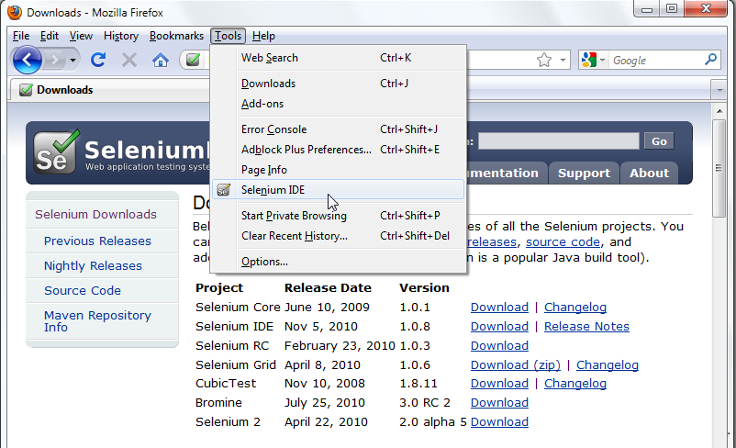
Selenium IDE (cont..)
Pushpak Godavarthi

Slide 41
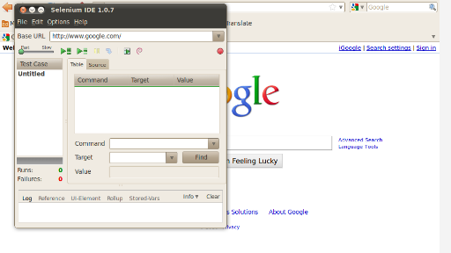
Selenium IDE (cont..)
Pushpak Godavarthi

Slide 42
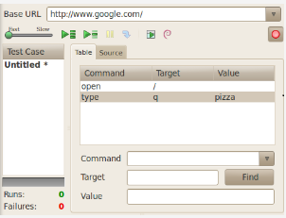
Selenium IDE (cont..)
Pushpak Godavarthi

Slide 43
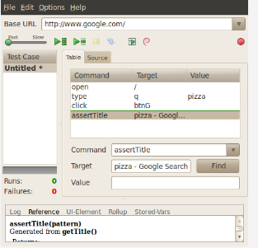
Selenium IDE (cont..)
Pushpak Godavarthi

Slide 44
TestComplete
TestComplete is an automated testing tool that lets you create, manage and run tests
Can test applications that were created in C#, C++, Delphi, Java or any other development language
Automate your tests and you can run them anytime, day or night by using a continuous integration tool or by using Task Scheduler
Gowtham Karanam

Slide 45
TestComplete IDE
TestComplete IDE includes:
Test Project Management
Test Execution tool for both manual and automated test cases
Reporting
Web Load/Performance tool
Gowtham Karanam

Slide 46
Creating Tests
Define the test goal: functionalities to be tested, create a simple test aimed to one objective only
Plan testing steps: decide which action the test will perform
Check test results: decide how to determine that the test passed successfully or failed
Logging the result: file, images, test complete log
Create your test
Gowtham Karanam

Slide 47
Running the Created Test
Run from Application Menu: solution, project, script
Run from Tested items
Run from Code editor
Run from Project Explorer
Gowtham Karanam

Slide 48
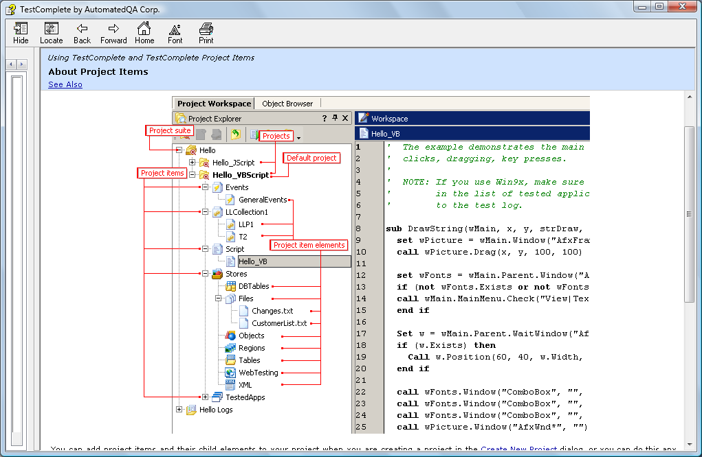
TestComplete Project Workspace
Gowtham Karanam

Slide 49
Advantages of automated testing
Runs tests quickly and effectively
Far more code is covered in a shorter time
Can be cost effective in long run
Everyone can see results
It relieves human testers from highly repetitive, low-value test work
Allows non-technical staff or customers to run tests
Gowtham Karanam

Slide 50
Disadvantages of automated testing
Tools can be expensive
Can’t test for visual considerations like image color or font size
Proficiency is required to write the automation test scripts.
Debugging the test script is major issue. If any error is present in the test script, sometimes it may lead to deadly consequences.
Maintenance of test data files is difficult, if the test script tests more screens
Gowtham Karanam

Slide 51
Issue Tracking
Sharath Regonda
Kishore Kumar Varkala

Slide 52
Issue Tracking
Issues are unexpected problems (defects), gaps, inconsistencies, or conflicts which may occur during a project.
When they arise, we should be ready to tackle them.
Issue Log:
Issue tracking is a computer software package that manages and maintains lists of issue, as needed by an organization.
Keeps track of all the issues occurring with the project
Sharath Regonda

Slide 53
Priority of an Issue
An issue is any query or occurrence that might have an impact on a project
Issues are often categorized in terms of severity levels
Critical
High
Medium
Low
Trivial
Sharath Regonda

Slide 54
Issue Log
Issue log contains
Issue Description
What is the issue impact on the project
Date reported
Issue reported by?
Issue Assigned to?
Priority of the issue
Due date
Status, etc.
Sharath Regonda

Slide 55
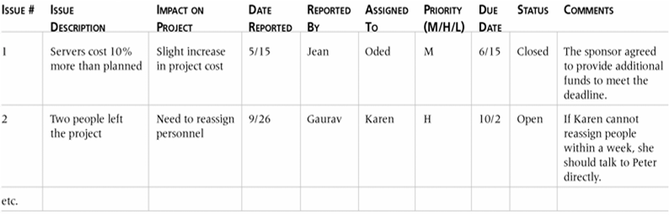
Issue Log Example
Sharath Regonda

Slide 56
Issue Log in Issue Management:
An issues log allows us to do the following:
Have a safe and reliable method for the team to raise issues.
Track and assign responsibility to specific people for each issue.
Analyze and prioritize issues more easily.
Record issue resolution for future reference and project learning.
Monitor overall project health and status.
Sharath Regonda

Slide 57
Issue Tracking Vs Bug Tracking
Generally referred to as bug tracking, which is wrong
Bug tracking is specific to the errors in the code
Bug tracking is a type of Issue tracking
Issues related to requirements, design and specifications
Sharath Regonda

Slide 58
Issue Management Tools
BitBucket
DoneDone
JIRA
Redmine
Sharath Regonda

Slide 59
Bitbucket Issue Tracking
Report project bugs and errors
Track project feature requests
Created automatically when a repository is created.
Kishore kumar varkala
Notes:
Library borrowing of publications

Slide 60
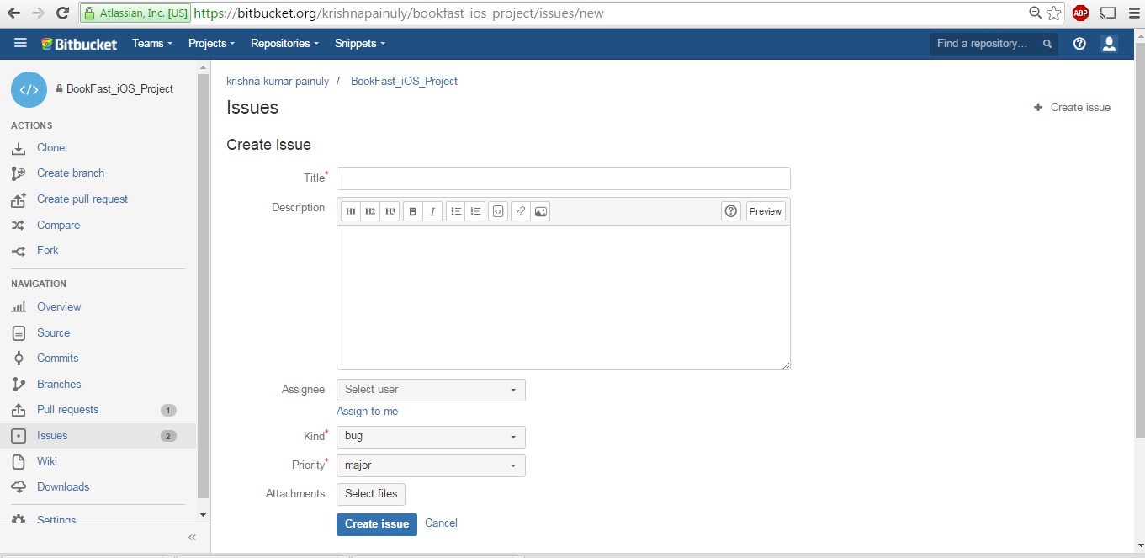
Create an Issue
Kishore kumar varkala

Slide 61
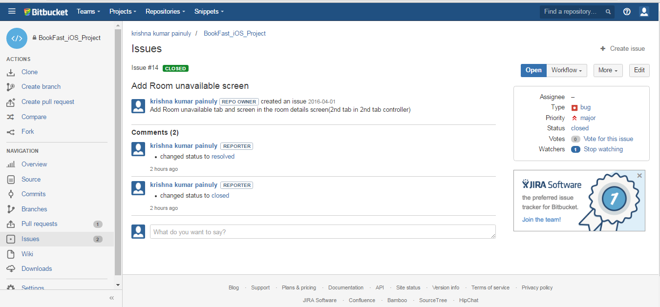
Issue status
Kishore kumar varkala

Slide 62
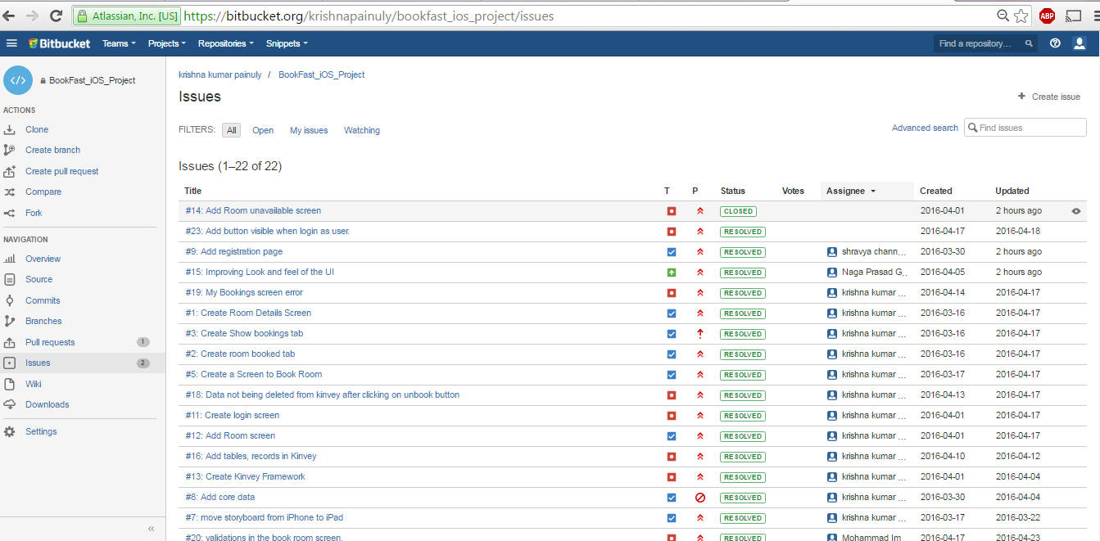
Overview of Issue tracker
Kishore kumar varkala

Slide 63


