Slide 1
Communications and Documentation Management Workshop

Slide 2




THRISHA SINGI
GOPINADH CHERUPALLY
SRAVANTHI PALLETI
MOUNICA RAMINI

Slide 3
Overview
Project Documentation
Types Of Documentation
Requirement Documentation
Design Documentation
Technical Documentation
User Documentation
Industry Standards Of Documentation
THRISHA SINGI

Slide 4
4
Project Documentation
“I am focused on delivering the project. This is a low priority.”
Sounds Familiar?
“Hmmm…I would prefer to use that time meaningfully by doing some other project activities.”
“Let’s do it after completing all project activities, not right now”
“I am focused on delivering the project. This is a low priority.”
Common complaints by project managers and developers
Less interesting area for project managers
key component of project management
Carries through start to finish of all projects.
THRISHA SINGI

Slide 5
What is Documentation?
“If its not in writing, it didn’t happen”
Important part of project management.
Substantiated by two essential functions
Project requirements are fulfilled
What has been done, who has done it, and when it has been done.
Must lay the foundation for quality, traceability, and history
Well arranged, easy to read, and adequate.
THRISHA SINGI

Slide 6
Why is it Important
Define the project scope and ensure agreement
Written account of activities as they happen
Written proof that something was done or said.
Helpful in proper communication
Everything is clearly explained
Resolution of disputes between various stakeholders.
Ensure the success of future projects.
THRISHA SINGI

Slide 7
Experience shared by a developer
A developing team delivered a project with an unknown issue, to the client.
They found the issue at client side and the quality assurance team were held responsible
The issue was something regarding the compatibility of one website.
When this reached QA team, they claimed that they did not get such requirement document which state they have to check compatibility of the website also.
They were safe and shared that they realized the importance of documentation and from that day, started to work on documents and created testing documents like Test plan, Test cases, sanity testing checklist, bug report etc.
THRISHA SINGI

Slide 8
Types of Documentation
Requirements – Statements that identify attributes, capabilities, characteristics, or qualities of a system. This is the foundation for what will be or has been implemented.
Architecture/Design – Overview of software. Includes relations to an environment and construction principles to be used in design of software components.
Technical – Documentation of code, algorithms, interfaces, and APIs.
End user – Manuals for the end-user, system administrators and support staff.
THRISHA SINGI

Slide 9
Tool for Documentation of code
Ghost Doc
GhostDoc is a Visual Studio extension
Automatically generates XML documentation comments for methods and properties
Generates based on their type, parameters, name, and other contextual information.
Demo
THRISHA SINGI

Slide 10
Requirements Document
Explains why the product is needed
Describes what the finished product will be like
Formal list of the requirements
GOPINADH CHERUPALLY

Slide 11
Purpose of Requirements Document
More likely to select the right software
Saves time and money in the long run
Reduces project risks
Increases understanding
Future Reference
GOPINADH CHERUPALLY
Notes:
Key to the project success
Not doing so is a common cause of failed projects
Provides reassurance and confidence

Slide 12
Requirements Document include
Functional requirements
Non functional requirements
UI requirements
User requirements
System requirements
GOPINADH CHERUPALLY

Slide 13
Benefits of a Requirements Document
Customers can see early on if their needs will be met
Developers can estimate the effort involved in creating the application
Development project leader has a basis for a project plan
Quality assurance people have a basis for testing the application
Cost management
Time management
GOPINADH CHERUPALLY

Slide 14
What is a Design Document
Written description of a software product
Software designer writes it in order to give a software development team overall guidance to the architecture of the project
Blueprint for the programmers to follow
GOPINADH CHERUPALLY

Slide 15
Purpose of a Design Document
Requirements Traceability
Developer Blueprint
System Architecture finalized
Project member training
GOPINADH CHERUPALLY
Notes:
Requirements Traceability
The software design document helps to determine whether all necessary requirements have been addressed. In addition, it provides a forum to discuss design elements which do not align with a requirement in order to determine whether the design element is necessary.
Developer Blueprint
The software design document gives the software development team an overall guidance of the architecture of the software project. The document should be as detailed as possible in order to keep the software development team focused and aligned.
System Architecture Finalized
The software design document details the system architecture. During the development and reviews of the software design document, the system architecture will be finalized and any gaps, defects and/or inconsistencies should be resolved.
Project Member Training
The software design document serves as a training manual for any new project members. In addition, the software design document may be used as a training manual throughout the life of the system.

Slide 16
Design Document includes
Database design
Interface design
User stories
System description
GOPINADH CHERUPALLY

Slide 17
Benefits of a Design document
Well documented code is more easy to reuse
Captures important design decisions such as responsibilities that drive the implementation
Unit testing of the associated modules by describing their interfaces
Supports Integration testing of the package by describing its interface, structure, and behavior.
GOPINADH CHERUPALLY

Slide 18
Technical Documentation
Technical Documents are the code documents which include guidelines to operate a specific software application or software product
Used by developers, testers and end users using that software application
Examples: README, API
Auto generate the documents using tools, literate programming and elucidative programming
Tools: Javadoc(Java), Sandcastle(.NET)
SRAVANTHI PALLETI

Slide 19
Elucidative Programming
Elucidative Programming is the result of practical applications of Literate Programming in real programming contexts.
The Elucidative paradigm proposes that source code and documentation be stored separately.
SRAVANTHI PALLETI

Slide 20
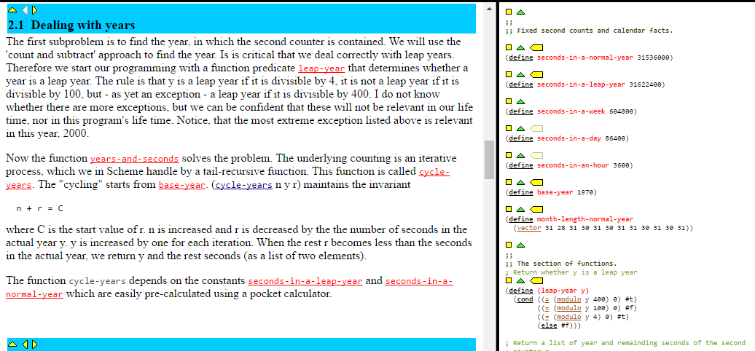
SRAVANTHI PALLETI
Notes:
Reference : http://people.cs.aau.dk/~normark/elucidative-programming/time-conversion/time/time.html

Slide 21
Literate Programming
Donald Knuth introduced this style of programming
A literate program is a method of writing a program which gives explanation of each of the programming language line in natural language.
1a (message[1](), lang=text) ≡ Hello World! 1b (message-print[1](), lang=c) ≡ printf(“(message 1a)\n”); 1c (main[1](?), lang=c) ≡ int main(int argc, char** argv){ (message-print 1b) 1d (main[1](?), lang=c) ≡ return 0; }
SRAVANTHI PALLETI
Notes:
Reference: https://en.wikipedia.org/wiki/Literate_programming

Slide 22
Tools
Javadoc: It is a document generator created by sun microsystems for the java language for generating API documentation in HTML format
/** * @author Firstname Lastname <address @ example.com> *
@version 1.6 (current version number of program) *
@since 1.2 (the version of the package this class was first added to) */
public class Test { // class body }
SRAVANTHI PALLETI

Slide 23
Sandcastle: A documentation compiler which creates API reference topics by combining the XML documentation comments (/// in C# or ' in VB) that are embedded in your source code with the syntax and structure of the types, which it acquires from reflecting against the associated .NET Framework assembly.
Demo
SRAVANTHI PALLETI

Slide 24
User Documentation
Assists the user in understanding and using the features of the software application or product
Provide thorough troubleshooting assistance
Consistency and Simplicity
Example: API Writers
SRAVANTHI PALLETI

Slide 25
Three ways to provide user documentation
Tutorial: most useful approach
Thematic: one particular area is concentrated
List or Reference: useful to advanced users
SRAVANTHI PALLETI

Slide 26
Composing User Documentation
User Analysis - research Phase
Planning - actual documentation phase
Draft Review - self explanatory phase
Usability Testing - testing phase
Editing - final phase
SRAVANTHI PALLETI

Slide 27
Industry Standard Documentation
Specifications
Templates
Manual
Standard Operating Procedure
Progress Record
Test Reports
Copies Of Documents
MOUNICA RAMINI

Slide 28
Documentation of Meetings
Brief to the point
List Agenda of the meeting
List Action Plan
Status of the Project
List new ideas for future reference
MOUNICA RAMINI

Slide 29
Software Documentation
Complete information on the capabilities, design details, features and limitations of a system or application software
Types Of Documentation
Requirements
Architecture/Design
Technical
User
MOUNICA RAMINI

Slide 30
Things to be followed in Software Documentation
Determine what information needs to be included
Choose appropriate Documentation tool
Determine the reasons for your documentation
Determine the appropriate formats for the documentation
Choose the amount of the documentation ought to be inside the program code.
MOUNICA RAMINI

Slide 31
Things to be considered in selecting a Templates
Determine exactly what kind of information do you need
A good template should be customizable for your Organization
A good template should be flexible
MOUNICA RAMINI

Slide 32
Templates
MOUNICA RAMINI

Slide 33
Workshop
MOUNICA RAMINI

Slide 34
ANY QUESTIONS?

Slide 35
THANK YOU

