Slide 1



Title:Groundnut Leaf Disease Classification using Deep Transfer Learning
Subtitle:One step towards sustainable and precision agriculture
Presented by: J.A.R.V.I.S.
Group Members:
Jagabandhu Kundu
Satyajit Bhunia
Pritam Bhattacharya
Harekrishna Maity
Daraknath Mahata
College:Midnapore City College
-:IBM AI-ML Internship Project:-

Slide 2
Introduction:
Groundnut Farming in India:
A vital oilseed crop for millions of farmers.
Challenges Faced:
Leaf diseases reduce productivity & quality.
Role of Deep Learning:
Enables early and accurate identification of diseases using leaf images.

Slide 3
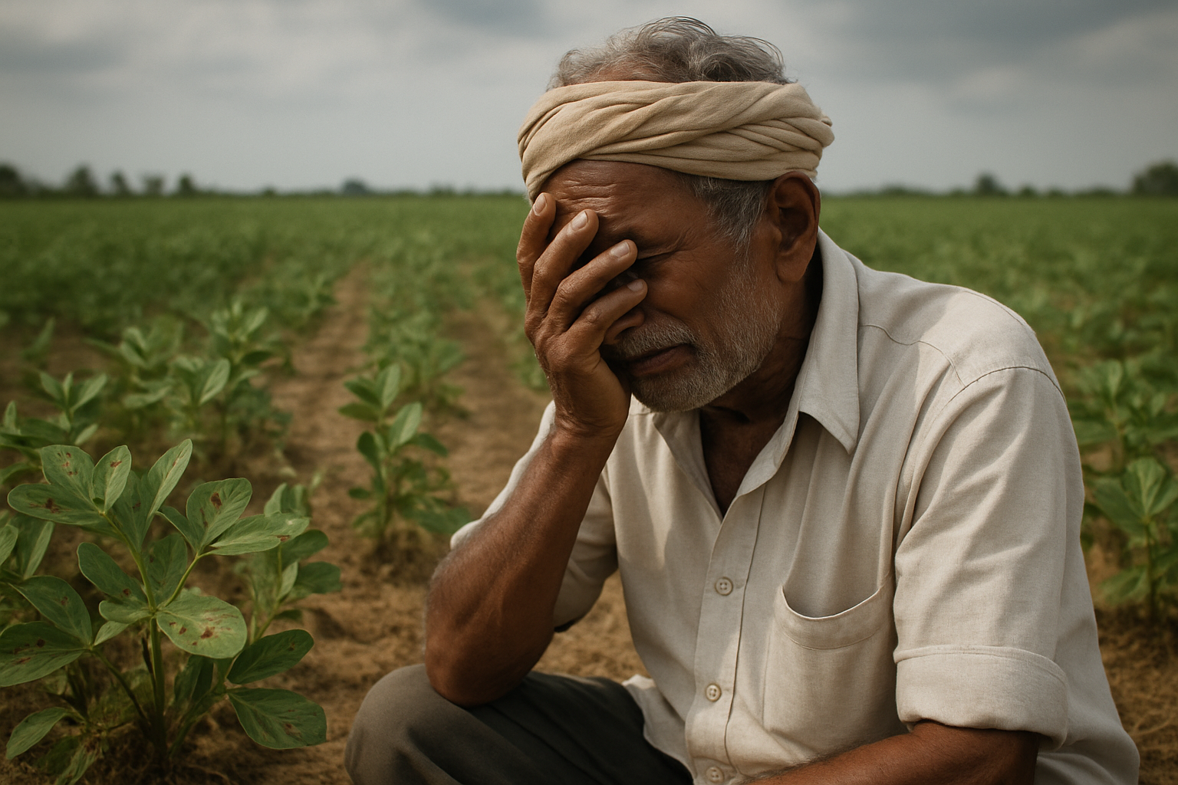
Problem Statement:
Objective:
Develop a deep transfer learning model for classifying groundnut leaf diseases from images.
Specific Goals:
Image collection and labeling.
Data preprocessing and augmentation.
Model selection and training.
Performance evaluation.
Deployment and usage by farmers.

Slide 4


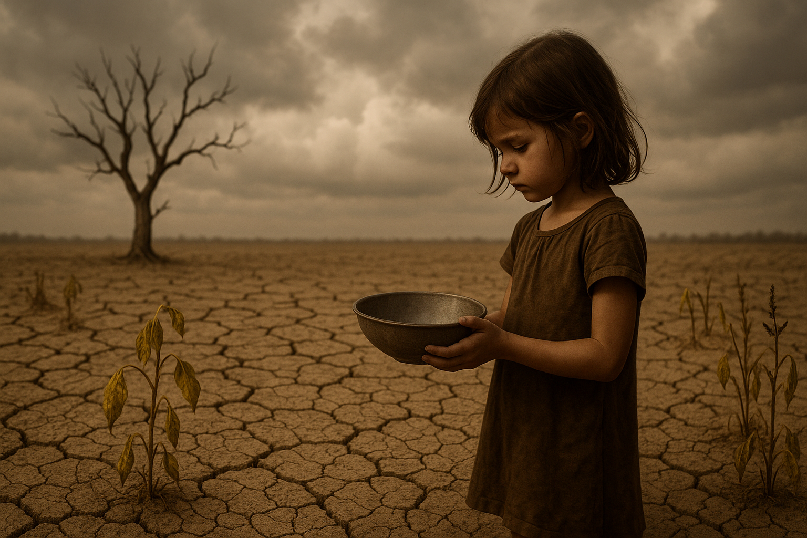
Sustainable Development Goal:
Goal Chosen:Goal 2 – Zero Hunger & Goal 12 – Responsible Consumption and Production
Problem Statement:
Crop loss due to late disease identification.
Rationale:
Supports food security and sustainable agricultural practices by reducing pesticide overuse and enabling timely interventions.

Slide 5

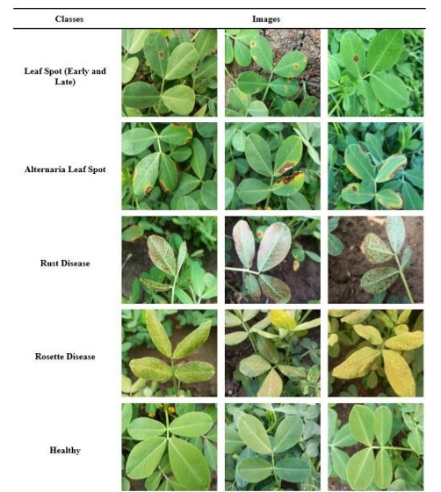
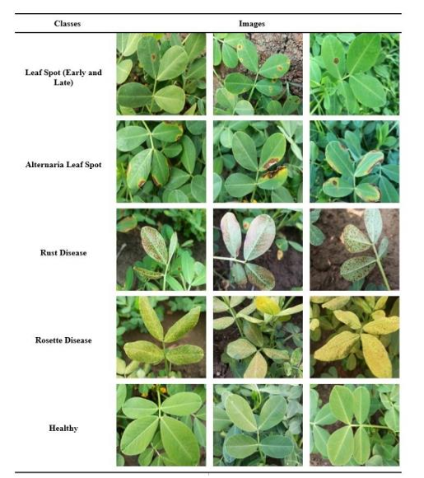
Dataset Collection and Preprocessing:
Dataset Size: 6000+ annotated groundnut leaf images.
Classes: Healthy, Rust, Early and Leaf Spot, Alternaria leaf spot and Rosette.
Preprocessing Techniques:
Resizing, normalization.
Data augmentation: Rotation, zoom, flip.

Slide 6
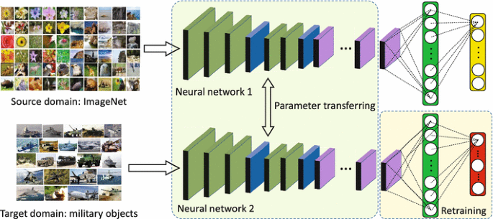
Deep Transfer Learning Model:
Model Used: ResNet50, ResNet152V2, Xception, DenseNet201, DenseNet121 and Inception V3.
Why Transfer Learning?
Leverages pre-trained models for faster convergence and higher accuracy on small datasets.
Training Details:
Optimizer: Adam
Loss: Categorical Crossentropy.
Epochs: 100
Validation Split: 10%

Slide 7

Model Evaluation:
Metrics Used:
Accuracy: Measures the proportion of true results (both true positives and true negatives) among the total number of cases examined.
Precision: Indicates the proportion of true positive results out of all the predicted positives.
Recall: Reflects the proportion of true positive results out of all actual positives.
F1-score: Harmonic mean of precision and recall, providing a balance between the two.
ROC-AUC: Area under the Receiver Operating Characteristic curve, evaluating the trade-off between true positive rate and false positive rate.
Results:
Achieved high classification accuracy.
Detected multiple diseases with robust precision.

Slide 8
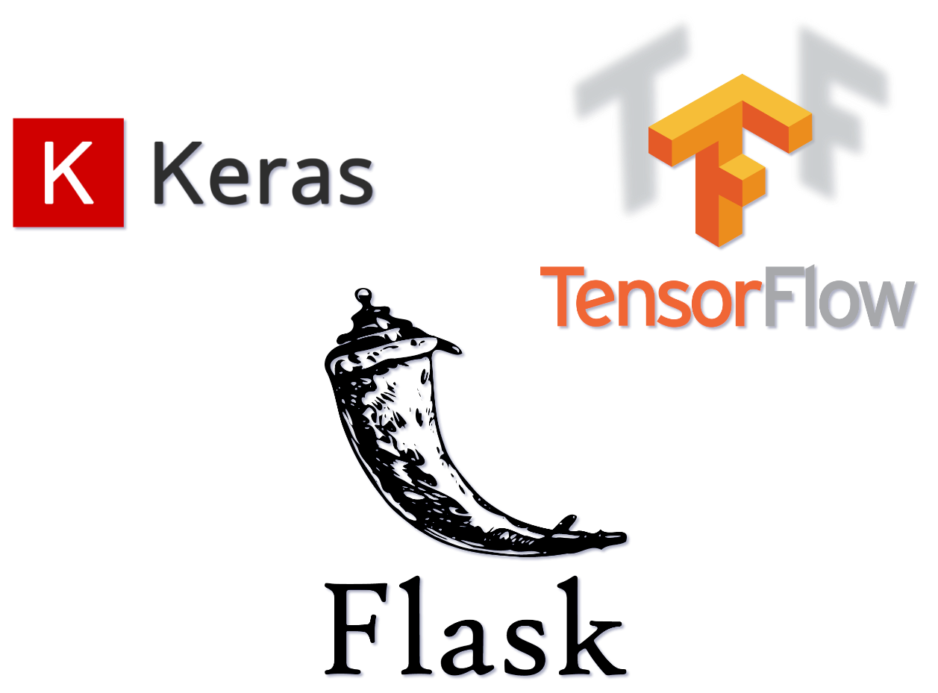
Tools and & Platforms Used:
Tools:
TensorFlow / Keras
Google Colab
LabelImg / Roboflow (for annotation)
Deployment Platform::
Streamlit / Flask / Google Sites

Slide 9
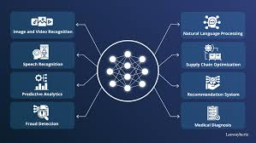
Model Impact:
Problem Solving:
Early Detection:
Prevents large-scale crop loss.
Non-Invasive and Efficient:
Reduces pesticide usage..
Scalable Solution:
.

Slide 10

Why It Will Work:
Real Images from Fields
Transfer Learning = Better Accuracy with Less Data
Deployed Interface = Easy Access
Custom Trained for Local Groundnut Conditions

Slide 11
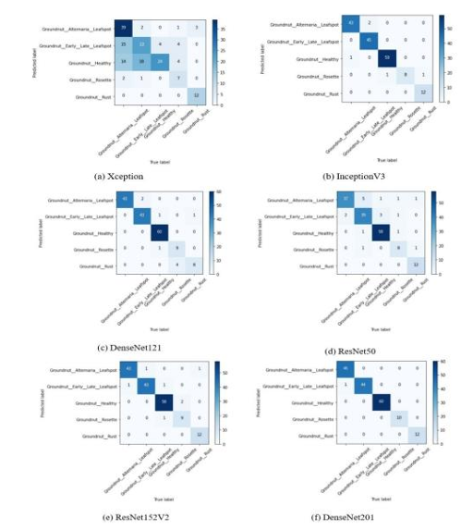
Results or Outcome:
Confusion Matrix:

Slide 12
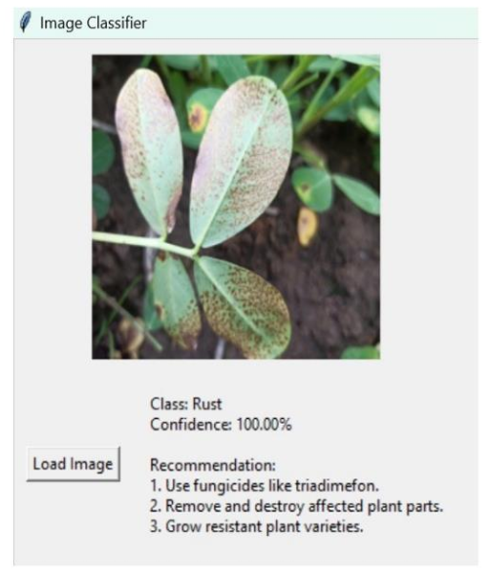
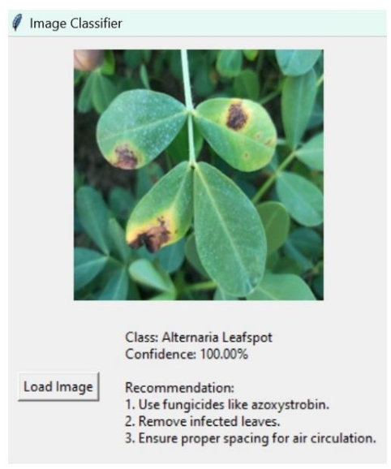
Deployed Model:

Slide 13
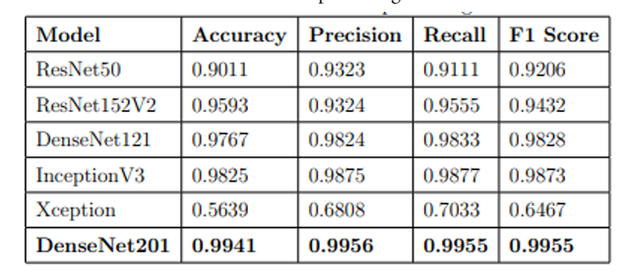
Prediction Result of Model:

Slide 14

Conclusion:
Summary:
Successfully built and evaluated a deep learning model for groundnut leaf disease classification.
Demonstrated its practical applicability for precision agriculture.
Supports farmers with AI-driven disease diagnostics.
Future Work:
Add more diseases and region-specific images.
Improve model robustness under various lighting/background conditions.
Multilingual farmer interface.

