Slide 1

Vehicle Number Plate Detection and Recognition
Presented by: Harekrishna Shah[10633772]
Date: 31st August 2024

Slide 2
Introduction
- Automatic Number Plate Recognition (ANPR) Is A Technology Used To Read Vehicle Registration Plates Using Optical Character Recognition.
- Applications Include Traffic Management, Security, And Toll Collection.
- Deep Learning Models Like Efficientnet And YOLO Have Shown Promising Results In Object Detection Tasks, Including ANPR.

Slide 3
Research Question
How effective are deep learning models, specifically EfficientNet, NasNet, and YOLOv9, in accurately detecting and localizing vehicle number plates in varied image conditions, and can Optical Character Recognition (OCR) reliably extract text from these detected number plates?
Novelty: Comparative analysis of Yolo-V9 with other deep learning models evaluating their performance also using the OCR on the best identified model to detect number plate text.

Slide 4
Literature Review
- Importance of vehicle plate detection for security and transportation efficiency.
- Challenges include varying light conditions, high speeds, and diverse environmental factors.
- Identification of research gaps leading to opportunities for enhancing detection accuracy and speed.
- Reviewed studies focusing on machine learning models for image recognition.
- Identify trends in accuracy improvements and computational demands.

Slide 5
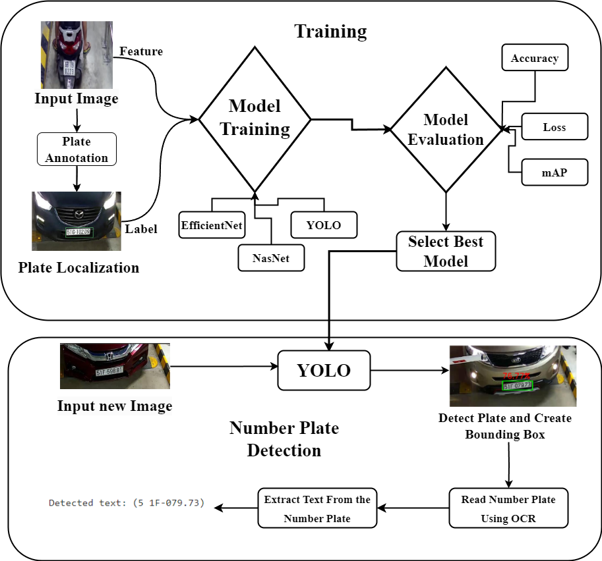
Methods
Dataset Link – Https://Huggingface.Co/Datasets/Keremberke/License-plate-object-detection
Fig. 1: Schematic diagram of methodology

Slide 6
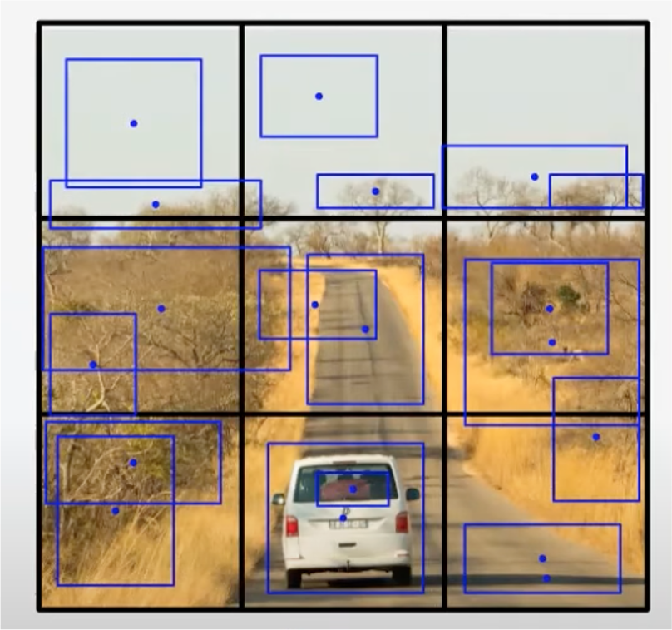
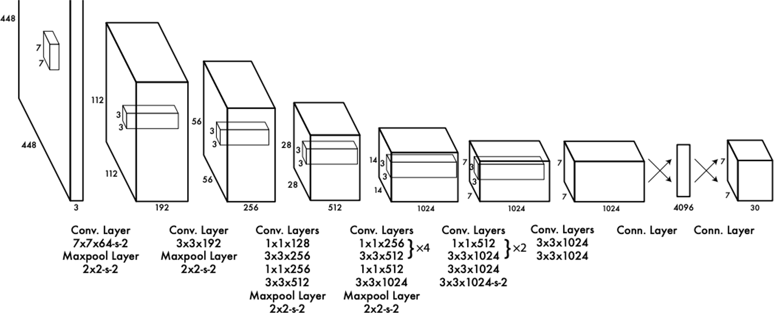
YOLO –Model
Given an image generate bounding boxes, one for each detectable object in image
For each bounding box, there are 5 output predictions: x, y, w, h, confidence.
x, y (coordinates for center of bounding box)
w,h (width and height)
Each grid cell predicts B bounding boxes and class probabilities.
class (classification of object in bounding box)
Fig.3 Grid-based object detection visualization (Image is referred from Reference-1)
Fig.2 Yolo Architecture((Image is referred from Reference-2)
Notes:
An image is divided into multiple grid cells. Each cell contains potential bounding boxes for detected objects, represented by blue rectangles. The size and position of these boxes indicate the object's location and dimensions within the image.
Object detection is the problem of both locating AND classifying objects
Goal of YOLO algorithm is to do object detection both fast AND with high accuracy

Slide 7
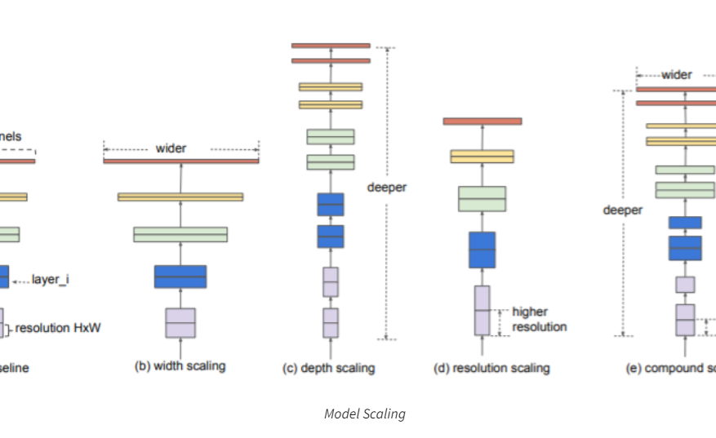
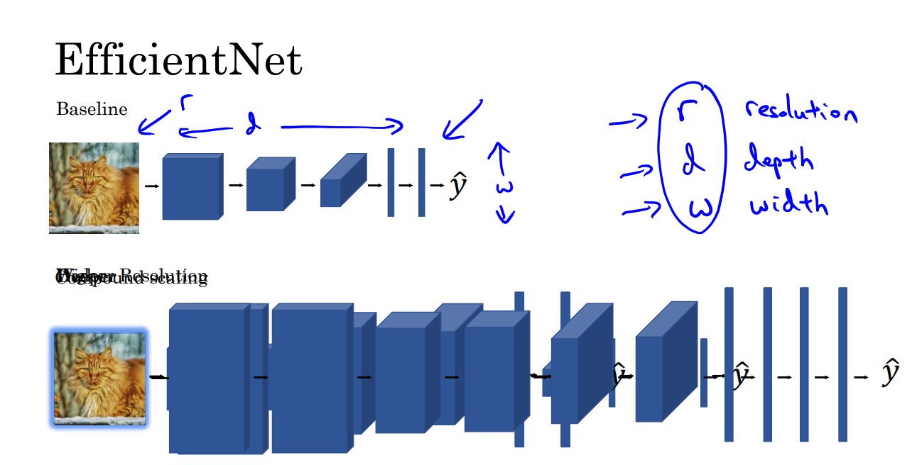
Efficient Net Model
Fig.4 Scaling of models
Fig.5 EfficientNet architecture ( Image has been referred from Reference 4)

Slide 8
Plans
The plan includes model training, validation, and real-world testing. Milestones include achieving over 90% accuracy and reducing detection time to under 0.5 seconds.
EfficientNet for high accuracy with fewer parameters.
YOLO for real-time detection.
2. Model Training:
Use annotated datasets to train the models.
Optimize hyperparameters (learning rate, batch size, epochs).
3. Model Evaluation:
Evaluate models on validation set.
Metrics: Accuracy, Loss, mAP.
Model Selection:

Slide 9
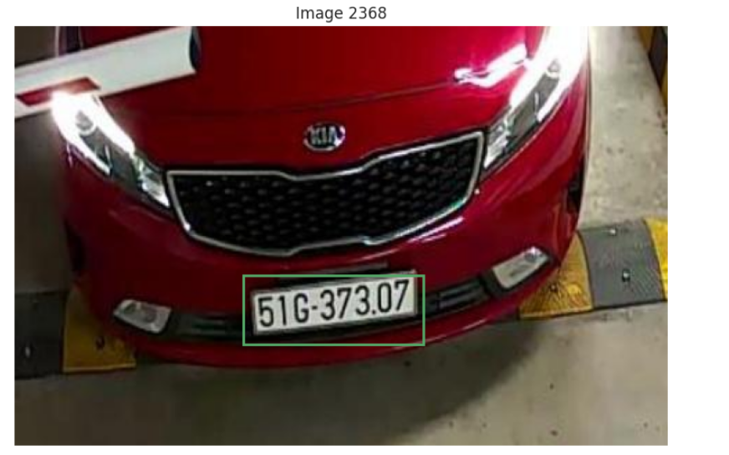
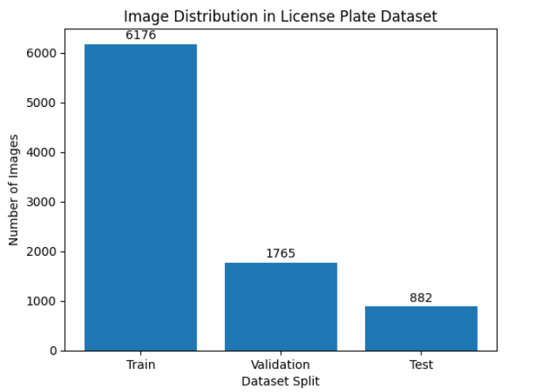
Exploratory Data Analysis (EDA)
- Utilized key tools like TensorFlow and PyTorch for data handling.
- Analysis Of Image Properties And Model Performance Metrics.
- Visualized data distributions and analysed plate variations
- Display Random Images From The Dataset With Annotated Bounding Boxes.
- Check The Distribution Of Bounding Box Sizes And Positions.
Ensure Balanced Representation Of Different Lighting Conditions, Angles, And Plate Types.
Fig.6 Accurate license plate detection
Fig.7 Dataset Split Distribution

Slide 10
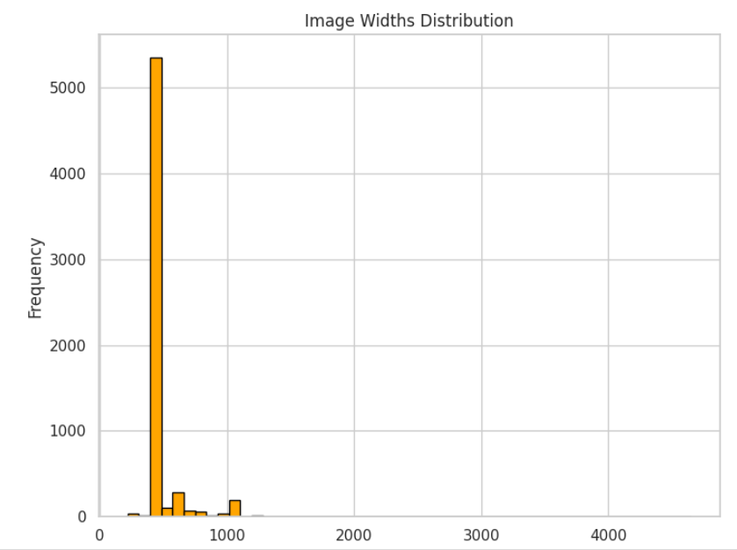
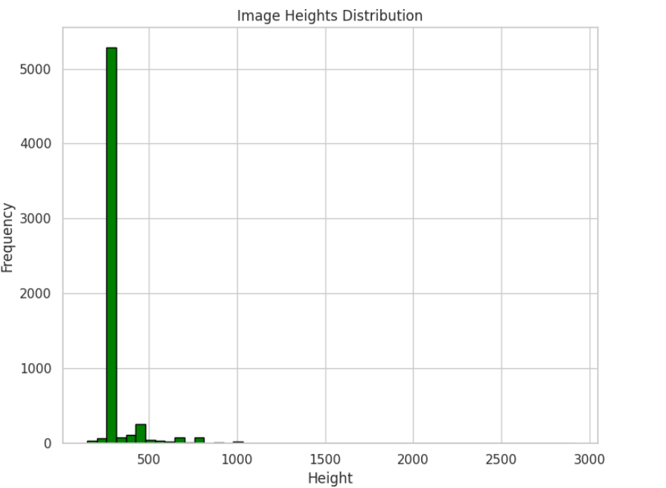
Exploratory Data Analysis (EDA)
Fig.8 Image Widths Distribution Graph.
Fig.9 Image Height Distribution Graph.
Notes:
Image width Distribution:
The graph shows a high concentration of images with widths around 500 pixels. There's a rapid decline in image frequency as the width increases beyond 500 pixels.
Image Height Distribution: The majority of images in this dataset have a relatively small height, clustering around the 200–300-pixel range.

Slide 11
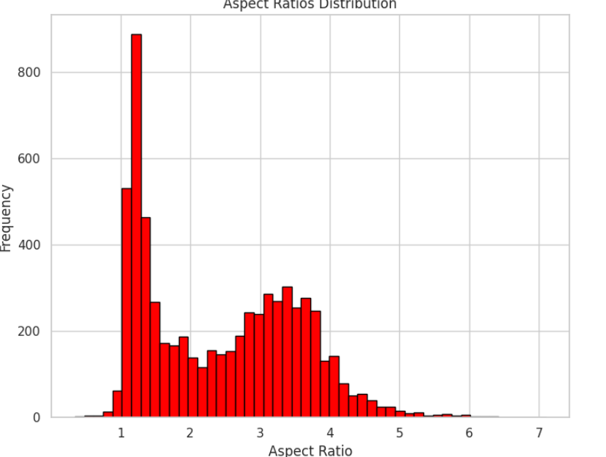
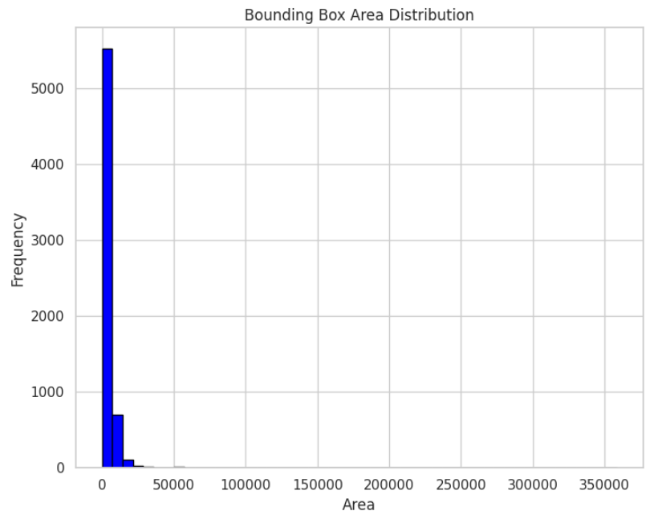
Exploratory Data Analysis (EDA)
Fig.10 Distribution of aspect ratios
Fig.11 Distribution of bounding box areas in a dataset.
Notes:
Aspect Ratio:
This graph represents the distribution of aspect ratios within a dataset.
The x-axis shows the aspect ratio values, ranging from approximately 0 to 7. An aspect ratio of 1 indicates a square image, while values greater than 1 represent wider images, and values less than 1 represent taller images.
The y-axis represents the frequency or count of images that fall within each aspect ratio range.
The graph shows that the dataset contains a wide range of aspect ratios, with a concentration around the value of 1.5 to 2, suggesting that many images in the dataset are slightly wider than they are tall.
Bounding Box Distribution:
The x-axis represents the area of the bounding boxes, measured in pixels. The y-axis represents the frequency or count of bounding boxes with a particular area.
The graph indicates that most bounding boxes in the dataset are relatively small, with a peak around 0 to 50,000 pixels. There are fewer bounding boxes with larger areas, and very few with extremely large areas. This suggests that the dataset contains a majority of small objects.

Slide 12
Comparison Between Algorithms
YOLO | Efficient Net
Single stage object detection | Two stage object detection
CSPDarknet | Compound scaling method
Faster | Slow
Require less training data | Require more training data
Low Computational cost | High Computational cost
Real time object detection | High accuracy object detection
Fig.12 Comparison between Yolo and Efficient net

Slide 13
Result
The Implemented Models Show Promising Results With High Accuracy In Plate Detection. Comparative Analysis Indicates Significant Improvements Over Traditional Methods, Particularly In Handling Obscured And Poorly Lit Plates.
Mean Average Precision (mAP) is a key metric for evaluating object detection models. It offers a comprehensive assessment of how accurately a model identifies and locates objects in an image.
MODEL | LOSS | ACCURACY | mAP
Efficient Net | 8.3631 | 0.9263 | 0.233
NASNET | 15.225 | 0.7913 | 0.19
YOLO | 1.0693 | 0.9427 | 0.95

Slide 14
Conclusion
Both Efficient Net And YOLO Show Potential For Number Plate Detection.
Yolo offers high accuracy with fewer parameters.
YOLO provides real-time detection capabilities.
Future work could explore further optimization and real-world application testing.

Slide 15
Reference
Reference 1
Author: Stanford University. Title: Copyright Notice - CS230 Deep Learning [on Stanford University cs230.stanford.edu]. Year: 2024 https://www.cs.utexas.edu/~yukez/cs391r_fall2021/slides/pre_09-02_Shivang.pdf
Reference 2
Adrian Rosebrock. YOLO object detection with OpenCV. PyImageSearch, 2018. [Online]. https://www.datacamp.com/blog/yolo-object-detection-explained
Reference 3
A. Aggarwal, "YOLO Explained. What is YOLO?," Analytics Vidhya, Dec. 27, 2020. [Online]. https://medium.com/analytics-vidhya/yolo-explained-5b6f4564f31
Reference 4
M. Tan and Q. V. Le, "EfficientNet: Rethinking Model Scaling for Convolutional Neural Networks," arXiv:1905.11946, 2019. [Online]https://arxiv.org/pdf/1905.11946
Literature review References……

Slide 16
Thank-You!

