Slide 1
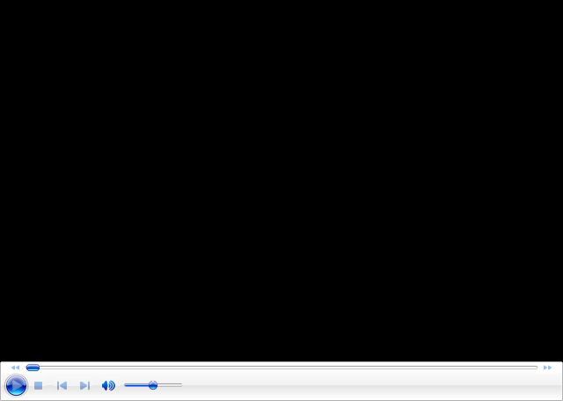
Evaluation only.
Created with Aspose.Slides for Java 16.4.0.0.
Copyright 2004-2016 Aspose Pty Ltd.
Evaluation only.
Created with Aspose.Slides for Java 16.4.0.0.
Copyright 2004-2016 Aspose Pty Ltd.

