Slide 1
MediChain
LIVE CLUSTER
a1
b1
Secure & performance-optimized distributed healthcare records system
a2
a3
b2
b3
shard-a
shard-b
Raft consensus
Sharding
AES-256-GCM
Hash-chained audit
11 OS processes, one command
2 × 3 shards × Raft replicas
Distributed Systems and Applications · Software Testing
0 writes lost under chaos
N. Sankkarshana
Ganesan P.V
Hemanth S
CH.EN.U4CCE23023
CH.EN.U4CCE23008
CH.EN.U4CCE23013
B.Tech Computer & Communication Engineering · Amrita Vishwa Vidyapeetham, Chennai
Notes:
Introduce the team and the project. MediChain is a working implementation of the distributed healthcare records architecture from our proposal. Eleven real processes start with one command; patient data lives in two shards of three Raft replicas each. The headline result: under a chaos test that kills leaders, not a single acknowledged write was lost.

Slide 2





A single database can't keep health records safe
Single point of failure
Can't scale out
Weak access control
Editable history
One crashed server halts record access for every hospital.
One machine caps concurrent access from thousands of clinics.
Role-only rules ignore patient consent and emergencies.
Logs can be changed later, so access can't be proven.
PROJECT GOAL
A records system that stays available when servers fail, never loses or duplicates an acknowledged write, and lets patients control who reads their data.
Notes:
The existing centralized model routes every hospital through one server and one database. That makes it a single point of failure, a bottleneck, and one big target, and its logs can be edited. Our goal is availability under failure, no lost or duplicated writes, and patient-controlled access.

Slide 3
From one central server to a fault-tolerant cluster
Concern | Centralized system | MediChain
Server failure | Total downtime | Raft elects a new leader in about 1–2 s; writes continue
Durability | Lost if the disk fails before backup | Stored on a majority of replicas before it is acknowledged
Scaling | Vertical only, capped by one machine | Horizontal: patients sharded by consistent hashing
Network partition | Undefined behaviour | Minority side refuses writes; no split-brain
Access control | Role only | Role + patient consent + time-limited emergency override
Data at rest | Plaintext identifiers | AES-256-GCM field-level encryption
Auditing | Editable logs | SHA-256 hash-chained ledger; edits are detected
Notes:
Each weakness of the centralized model is replaced by a specific distributed mechanism: Raft for failover and durability, consistent hashing for scale, majority quorums for partitions, consent-based access control, field encryption and a hash-chained audit log.

Slide 4
Architecture: every request passes the gateway
Clinician portal
Patient portal
Operations console
API gateway
JWT check · RBAC + consent · rate limits · cache · circuit breakers · routing by patient-ID hash
Auth service
Shard A · Raft group
Shard B · Raft group
Event bus
bcrypt · lockout · RS256 tokens
a1
a2
a3
b1
b2
b3
topics · offsets · consumer groups
commits at 2 of 3
commits at 2 of 3
Supervisor (control plane)
starts all 11 processes; kills and restarts them on demand
Audit service
Notifications
SHA-256 hash-chained ledger
SSE push to browsers
Notes:
Every box is a separate operating-system process talking HTTP, so a crash is real. Clients only talk to the gateway, which authenticates, checks policy, and routes by hashing the patient ID to the home shard. Each shard is a 3-replica Raft group that commits when 2 of 3 store a write. Security events go to the event bus, which feeds the audit ledger and the live notifications. The supervisor is our mini Kubernetes: it starts and kills processes for the demo.

Slide 5
Raft keeps every shard consistent through failures
Leader election
Write path
timeout + PreVote
majority votes
1
Gateway sends the command to the shard leader
Follower
Candidate
Leader
2
Leader appends it to its write-ahead log and replicates it
Sees a higher term, or loses its quorum → steps down to follower
Randomized timeouts
PreVote
3
A majority stores it → the leader commits
Election restriction
Check-quorum
4
Every replica applies it in the same order
Lease reads
Write-ahead log
Implemented from the Ongaro & Ousterhout paper: 524 lines, 16 dedicated tests
Leader crash → new leader in ~1–2 s, 0 writes lost
Notes:
Raft: replicas start as followers. If a follower stops hearing heartbeats it first runs PreVote, so a node coming back from a partition cannot disrupt a healthy cluster. A candidate needs a majority of votes, and only a candidate with an up-to-date log can win, so committed data is never lost. Writes go to the leader, are logged durably, replicated, and committed once a majority has them. Check-quorum makes an isolated leader step down, and lease reads give linearizable reads.

Slide 6
Consistent hashing spreads patients evenly across shards
Key-space share
~20%
~80%
150 virtual nodes per shard
of keys move when a 5th shard joins (consistent hashing)
would move with plain hash mod N
Consistency model
Operation | Consistency | Served by
Read a record or consents | Linearizable | Shard leader (lease read)
Patient directory | Eventual | Any follower (read replica)
All writes | Linearizable | Leader + majority
Notes:
Patient IDs are hashed onto a ring with 150 virtual nodes per shard, so each shard owns about half the key space. All keys of one patient land on the same shard. Adding a shard moves only about one fifth of keys, versus about eighty percent with hash mod N; that was measured in test TC-HASH-10. Reads that drive access decisions are linearizable; the directory uses eventually consistent follower reads.

Slide 7





The gateway hides failovers from clients
Leader tracking
CP
Followers reply 'not leader' with a hint; the client follows it immediately.
Retry with backoff + jitter
per shard, in CAP terms
Other replicas are tried until a new leader exists: a slower request, not an error.
Without a majority a shard refuses writes instead of diverging: no split-brain.
Circuit breaker per replica
After 2 failures a dead replica is skipped for 2.5 s, then probed once.
If a whole shard is down, the other keeps serving, and cross-shard queries return partial results flagged 'degraded'.
Failure detector
Every replica is polled each second; node-down and leader events are published.
Outbox for events
Audit events are buffered if the bus is down, so clinical requests never fail.
Notes:
Raft handles consensus inside a shard; the gateway makes failover invisible to users. It tracks the leader, follows redirects, retries other replicas with exponential backoff and jitter, and skips dead replicas with circuit breakers. A heartbeat failure detector updates the topology. Each shard is CP: without a majority it refuses writes. The whole system degrades gracefully when one shard is down.

Slide 8








Every access is authorized, encrypted and audited
Authentication
Signed tokens
RBAC + ABAC
Least privilege
bcrypt hashes; lockout after 5 failed attempts
RS256 JWTs verified locally by every service
Role plus patient consent, in a 28-rule decision table
Admins run the cluster but can't read patient data
Break-glass
AES-256-GCM
Hash-chained audit
Zero trust
Emergency access: reason required, 30 min, patient alerted live
Phone, ABHA ID and notes encrypted before replication
A SHA-256 chain exposes any edited or deleted entry
Service tokens between services; rate limits; CSP
Notes:
Security is layered. Passwords are bcrypt-hashed with lockout. Tokens are RS256, so only the auth service can sign them. Authorization combines role and patient consent, tested with a 28-row decision table. Admins are deliberately denied clinical data. Break-glass lets an emergency doctor in for 30 minutes, with a reason, and the patient is alerted in real time. Sensitive fields are encrypted before they are replicated, and every access lands in a hash-chained ledger.

Slide 9
No external infrastructure: one command starts 11 processes
Proposal | Implemented as | Same core idea
Apache Kafka | Event bus service | Topics, offsets, consumer groups
Redis cache | Gateway LRU cache | Cache-aside, TTL, invalidation
Sharded PostgreSQL | Raft key-value shards | Hash sharding, majority replication
etcd / ZooKeeper | Own Raft implementation | The algorithm etcd itself uses
Keycloak (OIDC) | Auth service | RS256 tokens checked everywhere
Kubernetes | Supervisor process | Lifecycle, health, kill and restart
Prometheus + Grafana | /metrics + Ops console | Prometheus format, live dashboard
8,100
lines of JavaScript (Node.js 22)
11
OS processes started by npm start
0
external services needed
Notes:
Our proposal named production tools. To keep the project runnable on any laptop with one command, each one is implemented in miniature with the same semantics. That also makes every mechanism visible and testable. The whole system is about 8,100 lines of JavaScript including tests.

Slide 10
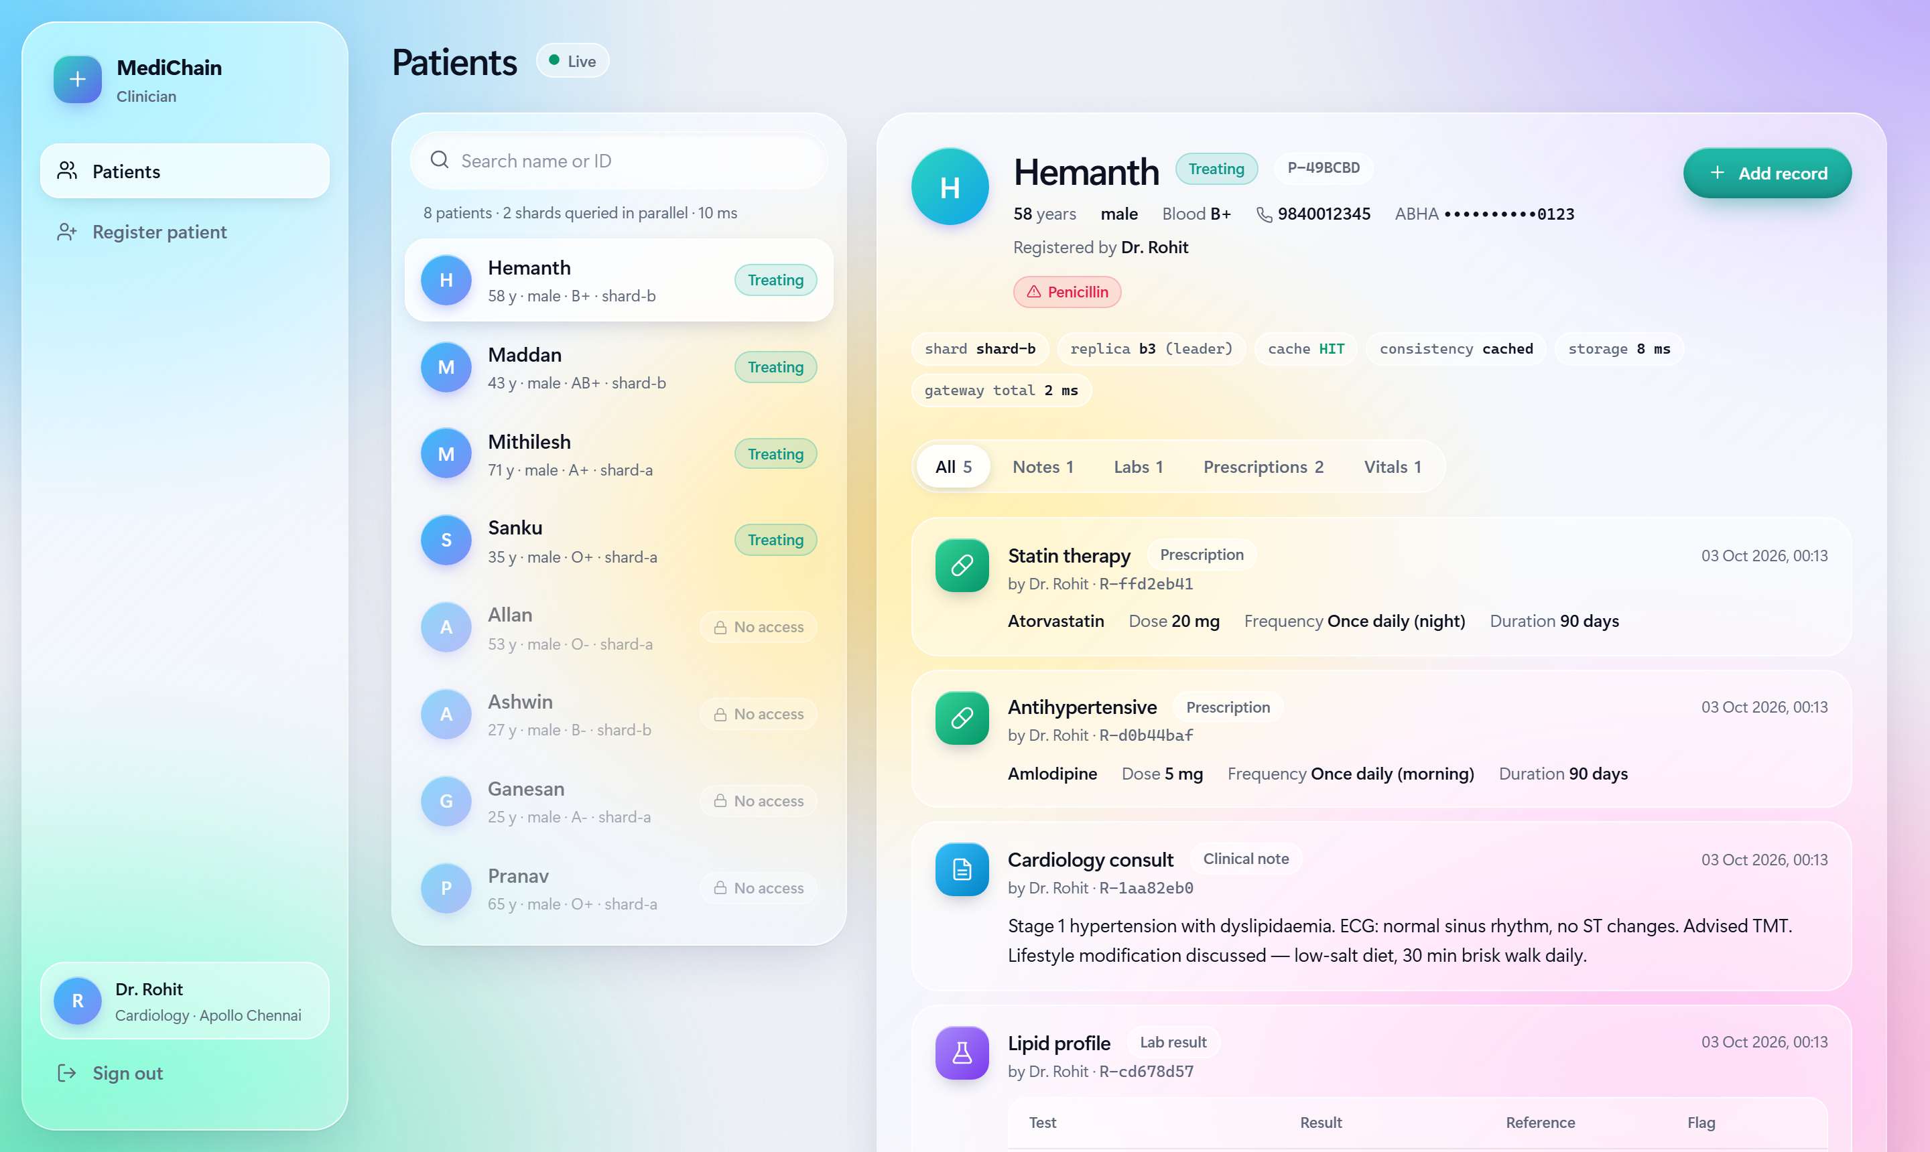



Clinician portal: every read shows its path through the cluster
Both shards in parallel
The directory is a scatter-gather query across every shard.
Request inspector
Shard, replica, cache and latency of every read.
Full clinical record
Notes, labs, prescriptions and vitals; free text is encrypted at rest.
Notes:
Dr. Rohit is the treating doctor. The patient list comes from both shards queried in parallel. Opening Hemanth shows the full record, and the inspector strip shows which shard and replica served it, whether it was a cache hit, the consistency level and latency. That makes the distributed system visible in the UI.

Slide 11
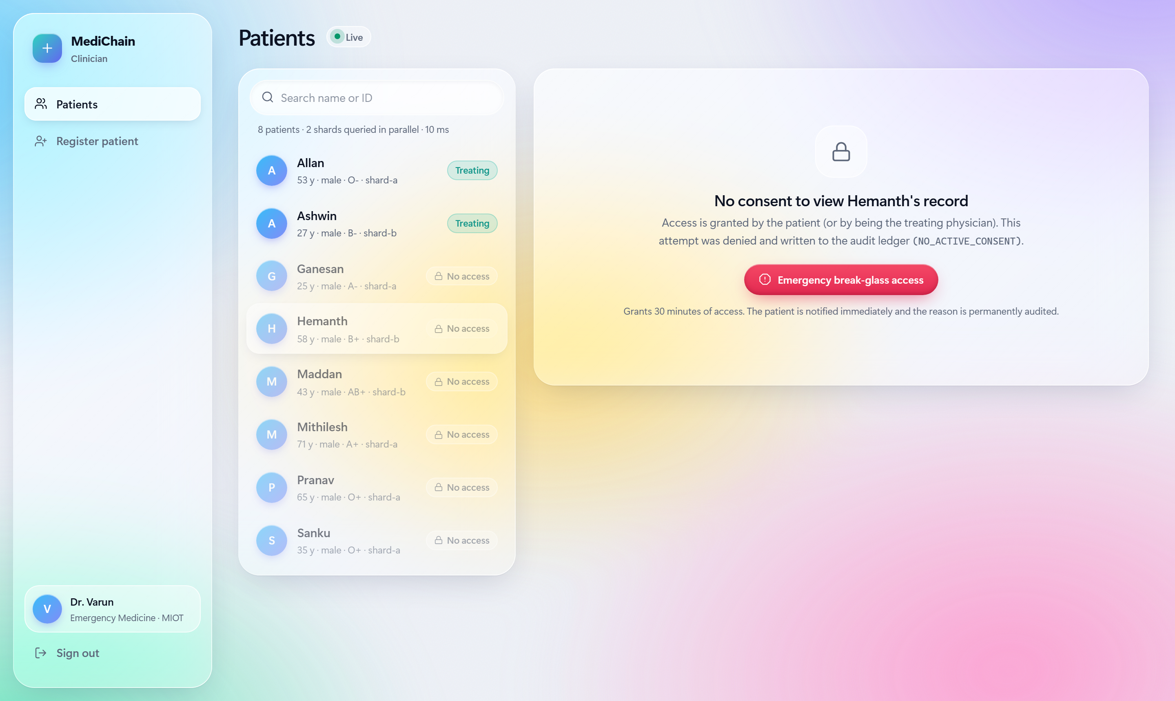
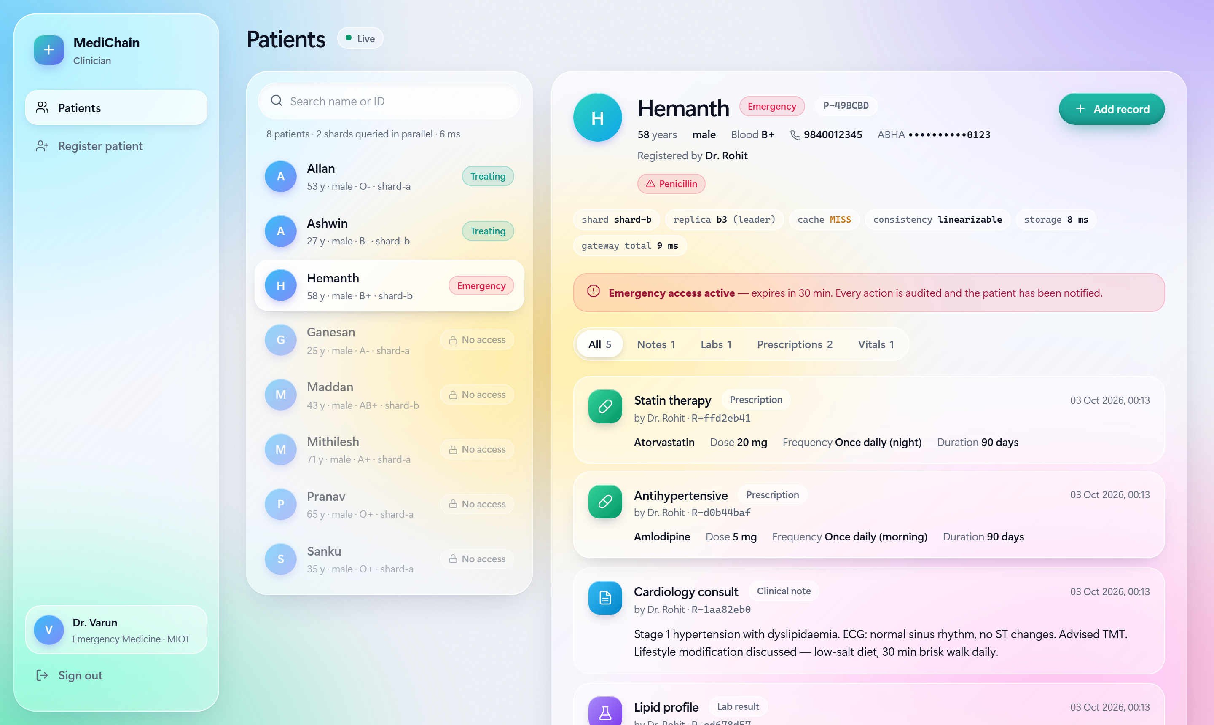
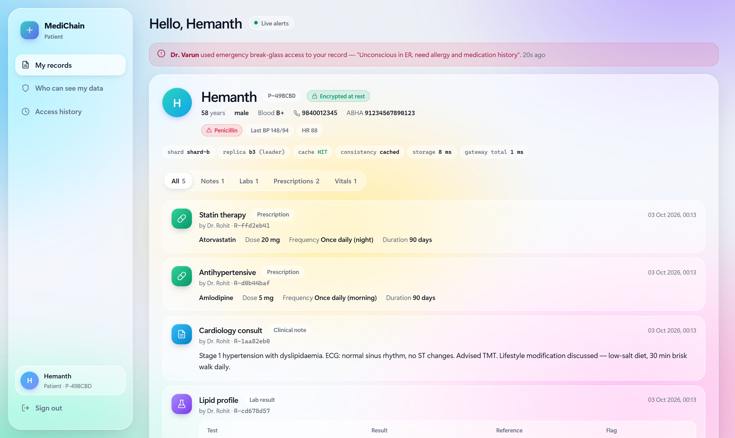
Break-glass: emergency access the patient sees in real time
1
Dr. Varun has no consent, so access is denied and audited
2
He gives a clinical reason and gets 30 minutes of access
3
Hemanth is alerted instantly and sees it in his history
Each step is sealed in the hash-chained ledger
ACCESS_DENIED
BREAK_GLASS
RECORD_READ
Grants expire automatically after 30 minutes.
Notes:
This is the consent model working end to end. Dr. Varun, the emergency doctor, has no consent, so he is denied, and the denial is audited. He uses break-glass with a clinical reason and gets 30 minutes of access. Hemanth sees a red alert immediately through server-sent events, and the whole trail is in the hash-chained ledger.

Slide 12
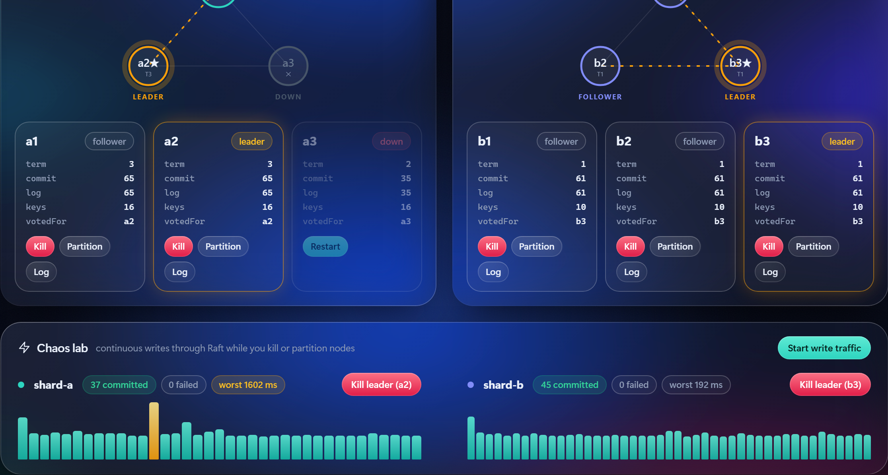
Chaos lab: killing a leader loses nothing
0 failed
37 writes committed during the kill
1.6 s
worst stall: one election timeout
term 3
new leader a2; a3 rejoins as follower
Ops console during a live run: node a3 was killed (SIGKILL); a2 won the election in term 3.
Notes:
Live demo moment. Start write traffic in the chaos lab, then kill the shard-a leader. The node goes grey; about one election timeout later another node becomes leader with a higher term. The chart shows one tall orange bar, the stall, but zero failed writes. Restarting the dead node replays its write-ahead log and it rejoins as a follower.

Slide 13
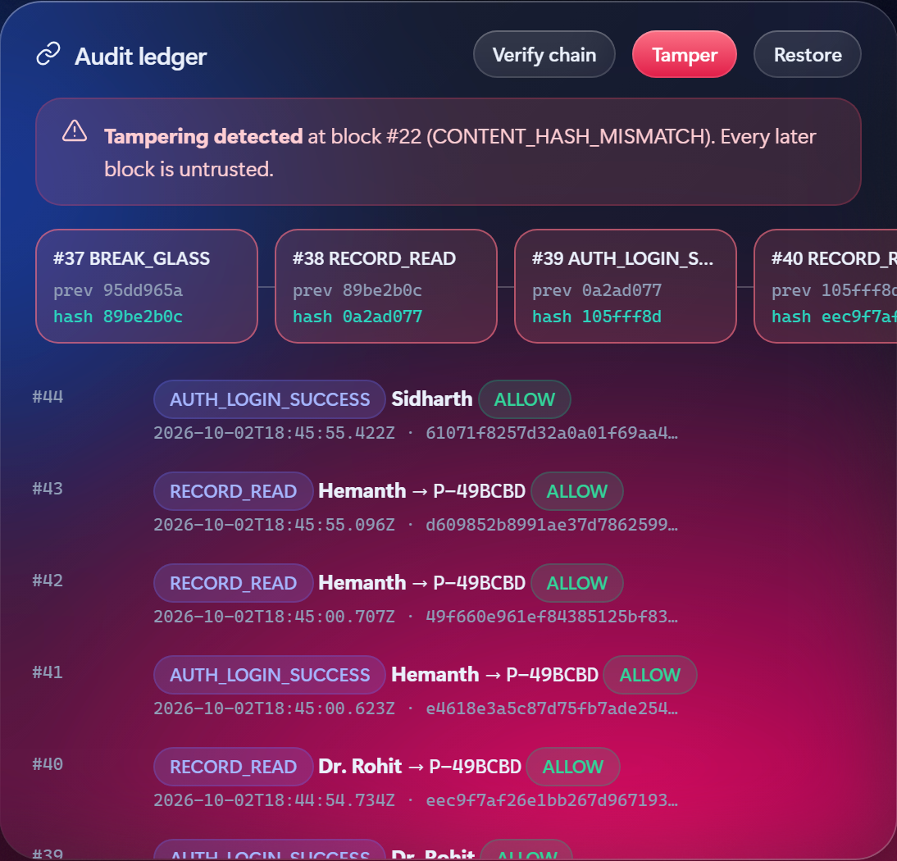
Tamper-evident audit: an edit is caught at the exact block
1
Each entry stores the previous entry's hash
Changing any entry breaks every link after it.
2
Tamper edits block #22
Simulates an insider rewriting who accessed a record.
3
Verify re-hashes the whole chain
It reports CONTENT_HASH_MISMATCH at block #22, and Restore makes it valid again.
hash(n) = SHA-256(index, time, data, hash(n−1))
Notes:
Every security event is appended to a hash chain: each entry includes the hash of the previous one, like a blockchain without mining. The Tamper button simulates an insider editing an entry. Verify re-hashes the chain and pinpoints the exact block. Patients see a Ledger verified badge on their access history.

Slide 14
281 automated tests across five levels
Automated tests by level
Tools
Vitest
unit, integration, chaos
fast-check
property-based tests
Supertest
HTTP API tests
Playwright
browser E2E, Page Objects
Stryker
mutation testing
autocannon
load and failover tests
Notes:
We followed IEEE 829: a test plan, a catalogue of 184 named test cases, and a traceability matrix where every requirement is covered at two or more levels. 197 unit tests, 69 integration, system and security tests, 3 chaos tests and 12 browser end-to-end tests against the real 11-process cluster. Every change had to pass three full runs in a row to catch flaky tests.

Slide 15



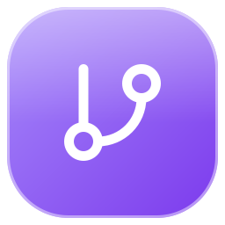




Test design techniques, applied where the risks are
Equivalence partitioning
Boundary values
Decision table
State transition
Phone, ABHA ID, blood group, record type
Age 0/130, heart rate 20/250, lockout N−1/N
28 rules: role × action × consent × expiry
Circuit breaker states; Raft roles
Property-based
Fault injection
Security testing
Mutation testing
Hash-ring invariants over random inputs
Crashes, partitions, 20% message loss
Forged tokens, IDOR, injection, XSS, brute force
486 injected bugs; survivors drove 15 new tests
Notes:
Each syllabus technique is applied to a real risk. Equivalence partitioning and boundary values for input validation, for example heart rate 19, 20, 250 and 251. A 28-row decision table for the access policy. State-transition tests for the circuit breaker and Raft. Property-based tests for consistent hashing. Fault injection for Raft. OWASP-style security tests. And mutation testing to measure the strength of the tests themselves.

Slide 16
Results: every exit criterion met
281/281
98.4%
96.5%
0 / 0
automated tests passing
line coverage (target 80%)
mutation score (target 85%)
writes lost / duplicated under chaos
89.0%
0
14
branch coverage (target 70%)
client errors during leader failover under load
defects found by testing, all fixed
Notes:
All 281 tests pass: 98.4 percent line coverage, 89 percent branch coverage, a 96.5 percent mutation score, and the chaos test lost and duplicated nothing. Load testing showed zero client errors even while a leader was killed. Testing found 14 defects, all fixed.

Slide 17
Mutation testing raised test strength from 84% to 96.5%
What the surviving mutants revealed
A property test that passed even when node removal did nothing
Clocks starting at 0 hid now − t vs now + t bugs
Untested exact boundaries: hash position, cache expiry
A real circuit-breaker flaw (DEF-08)
At 98% line coverage, coverage alone overstated test quality.
Notes:
Coverage shows code ran; mutation testing shows whether the tests notice a bug. Stryker injected 486 small bugs. The first run scored 84 percent despite 98 percent coverage. The survivors exposed a property test that verified nothing, clock assumptions, untested boundaries, and a real circuit-breaker design flaw. Fifteen targeted tests raised the score to 96.5 percent.

Slide 18
Chaos and load: no lost writes, no client errors
Jepsen-style chaos test
Load test · 20 connections · 6 s each
3 clients × 25 writes while a nemesis killed the leader 3 times and partitioned a follower.
Scenario | req/s | p50 ms | p99 ms | Errors
Read record (cache hit) | 319 | 59 | 282 | 0
Read across 2 shards | 251 | 78 | 263 | 0
Directory (both shards) | 114 | 169 | 344 | 0
Add note (majority commit) | 87 | 231 | 314 | 0
Add notes, leader killed | 66 | 291 | 1,041 | 0
75 / 75
acknowledged
0
lost
0
duplicated
4
Raft terms
0
client retries
1
identical state
A leader crash costs one election timeout of tail latency, and no failed requests.
Notes:
The chaos test is in the style of Jepsen: concurrent clients write while a nemesis kills and restarts leaders and partitions a follower. All 75 writes were acknowledged, none lost or duplicated, and the replicas ended byte-identical. The load test shows caching makes reads several times faster than majority-committed writes, and killing the leader mid-run only raises tail latency to about a second, with zero errors.

Slide 19
Testing found 14 defects, all fixed
ID | Found by | Defect | Severity
DEF-01 | Boundary value test | Tamil and other Indic-script names were rejected at registration | High
DEF-02 | First system start | Every service crashed on start-up (schema library limitation) | High
DEF-03 | Exploratory testing | "No access" shown after break-glass: stale follower read | Medium
DEF-04 | Idempotency test | A retried write reported a different record ID | Medium
DEF-08 | Mutation testing | Half-open circuit breaker relied on a stale failure count | Medium
DEF-13 | E2E test | Chaos-lab buttons rebuilt 5×/s, so clicks could be lost | Medium
10
product defects
3
defects in the tests themselves
1
tooling incompatibility
Notes:
The most serious defect: names written in Tamil were rejected because the validation pattern allowed letters but not the combining vowel signs Indic scripts use, so real patients could not register. Others include a stale read after break-glass, an idempotency reporting bug, and a circuit-breaker flaw found only by mutation testing. The full list of 14 is in the test report.

Slide 20


Conclusion
Available
Private
Proven
Future work
Raft snapshots and log compaction
Dynamic cluster membership
Several gateways, shared cache invalidation
MFA and an OIDC identity provider
Kubernetes multi-host deployment
FHIR / ABDM interoperability
A leader crash costs about one election timeout and loses zero writes.
Consent, field encryption and a verifiable ledger on every access.
281 tests, 96.5% mutation score and a Jepsen-style chaos test.
"In healthcare, the system must be as resilient as the people it serves."
From our proposal; MediChain shows it working under real failures.
Notes:
In summary: MediChain stays available when servers fail, keeps patient data private and every access verifiable, and the testing proves both. Next steps would be log compaction, dynamic membership, multiple gateways, MFA and deployment on Kubernetes.

Slide 21
Thank you
TRY IT LIVE
npm start
http://127.0.0.1:8080
Questions, and a live demo
dr.rohit
treating doctor
dr.varun
emergency, break-glass
hemanth
patient portal
admin
ops console, chaos lab
N. Sankkarshana · Ganesan P.V · Hemanth S
Notes:
Thank you. We can show it live: npm start brings up all 11 processes. Log in as dr.varun for the break-glass flow, hemanth to see the patient alert, and admin for the chaos lab where we kill a leader.

